Slide 1
Chapter 10: Reconstructing the Nation and the State
STUDY PRESENTATION
© 2022 Clairmont Press

Slide 2
Section 1: Political Reconstruction on the National Level
Section 2: Reconstruction in South Carolina
Section 3: The Economy During Reconstruction
Section 4: The Violent End of Reconstruction

Slide 3
Section 2: Reconstruction in South Carolina
Essential Question: How did Reconstruction affect the lives of South Carolinians?

Slide 4
Section 2: Reconstruction in South Carolina
What terms do I need to know?
propaganda
discrimination
amnesty

Slide 5
Introduction & South Carolina under Presidential Reconstruction, 1865-1867
Was difficult because South Carolina had largest number of freedmen in the South.
When the Confederacy collapsed, President Johnson temporarily appointed Benjamin F. Perry as governor of South Carolina, until a constitution could be written and elections held.
President Andrew Johnson

Slide 6
The Benjamin F. Perry Administration
Benjamin F. Perry
allowed former Confederate state officials to keep their old positions
allowed organization of white, volunteer militia companies
recommended that the state ratify the Thirteenth Amendment
called a constitutional convention
White people in South Carolina were determined to maintain their southern way of life; they did not want northerners to change their ways.

Slide 7
The James L. Orr Administration
James L. Orr
first governor elected under new constitution, not the General Assembly, and first governor elected directly by the state’s voters
presided over reopening of South Carolina College, and the opening of the new state penitentiary
United States Congress required new constitutional conventions to be held in South Carolina and other southern states, because:
The General Assembly ratified the Thirteenth Amendment, but went on to pass the Black Codes.
legislature refused to ratify the Fourteenth Amendment
white citizens showed resistance – formation of armed night patrols

Slide 8
South Carolina under Congressional (Radical) Reconstruction
1868 was a time of great turmoil in South Carolina.
Blacks were hopeful about having some control over their own destiny and were working toward political equality.
Whites were anxious about black and white equality, because it threatened their superiority and the previous structure of South Carolina.

Slide 9
The Constitution of 1868
South Carolina’s new constitutional convention was composed of 73 black delegates and 51 white delegates.
A democratic constitution was created in 1868.
Gave equal voting rights, political opportunities for all men, and men without property could hold political office
General Assembly representation based on population, rather than wealth
local people could elect own officials and officials could tax for local needs
statewide public education system implemented, available equally to all children
Most whites resented the equality outlined by the new constitution in South Carolina .

Slide 10
Republican Rule in South Carolina
The first general election in South Carolina was held in 1868.
Republican Party was dominant, over 80% Republican in General Assembly - with 75 out of 124 in the House black, and 10 out of 32 in the Senate black
Robert K. Scott elected governor
white Union officer, head of Freedmen’s Bureau in South Carolina; held favor with black voters
Francis L. Cardozo elected secretary of state
first black man to hold a statewide office in South Carolina, member of the constitutional convention of 1868, showed interest in establishing a public school system

Slide 11
Republican Rule in South Carolina -continued
General Assembly ratified the Fourteenth Amendment, and circuit courts were established across the state.
South Carolina met the new requirements of Congress.
Military supervision was suspended in South Carolina.
Problems faced by the mostly Republican government:
threatened opposition from white minority who controlled wealth
violence, threats, beatings, and overall intimidation by whites after blacks were given voting rights; whites determined to uphold their civilization
The 12 years of Reconstruction in South Carolina was similar in intensity to the Civil War.

Slide 12
The Peak of Black Participation
After 1868, blacks became increasingly involved in the political life of South Carolina.
served on various committees, offices of lieutenant governor, secretary of state, secretary of treasury, and attorney general
On a national level, The Fifteenth Amendment to the Constitution guaranteed the right of African Americans to vote.
The election of Jonathan J. Wright, a black attorney, as justice of the South Carolina Supreme Court shocked many Conservatives.
white scalawags and carpetbaggers also important in the Republican majority

Slide 13
Propaganda against Radical Reconstruction
Conservatives thought poorly of Republicans, which helped to unify white opinion against Reconstruction.
Propaganda was used against Republicans, who were often corrupt and not suited for political leadership.
propaganda – accusations spread deliberately to further a cause or damage an opposing cause
Many northerners believed the propaganda, causing them to lose enthusiasm for their biracial democracy.
Many believed that the propaganda was initiated by revengeful congressmen and was carried out by blacks, carpetbaggers, and scalawags; this contributed to future segregation and discrimination against blacks.

Slide 14
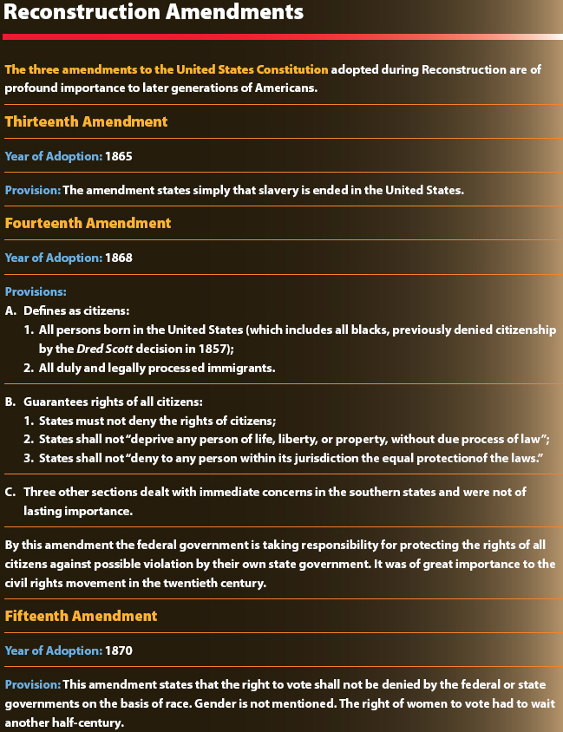

Slide 15
Black Leadership
Some black leaders were well-suited to be politicians, but others weren’t.
Robert Brown Elliot: distinguished legislator, (Congress for two terms) and powerful speechmaker
Joseph Hayne Rainey was the first black man elected to Congress. He voted for amnesty (pardon granted to a large group of individuals) for former Confederate officials.
Alonzo Jacob Ransier: first black lieutenant governor
Benjamin Franklin Randolph served in the state Senate and state Republican Party, and he was one of four Republican leaders assassinated in 1868.
Other black leaders include church leaders, newspaper editors, and political organizers.

Slide 16
Successes of Radical Reconstruction
Some black leaders, scalawags, and carpetbaggers, experienced success during Reconstruction in South Carolina; they provided an example of what biracial democracy might look like.
new statewide public school system
most not racially integrated, did not attract all school-age children immediately
Race relations became more open and integrated during Reconstruction in South Carolina, but integration did not sit well with many white people.
A small, professional black upper class developed: lawyers, ministers, doctors, nurses, teachers, even firemen and policemen in some areas.

Slide 17
Successes of Radical Reconstruction (continued)
Additional accomplishments of Radical Reconstruction:
Debtor’s home could not be taken to satisfy their debt.
People could not be put in jail for their debt.
Black people were allowed to serve on juries, and their testimony could be accepted in court.
Women, single or married, could own and control property.
A woman’s property could not be taken to satisfy her husband’s debt.
Divorce could be instituted by judges.
Temporary racial integration of the University of South Carolina

Slide 18
Religion and Race during Reconstruction
After emancipation, freedmen commonly established their own churches, exercising their freedom from white control.
Church became a social and political safe haven for black communities, and they were heavily attended (especially Baptist churches).
Many new churches adopted northern denominations (Methodists, Baptists, Presbyterians), rather than southern denominations.
The African Methodist Episcopal (AME) Church and the AME Zion Church were two national, solely black churches.
Both white and black denominations showed interest in education; several founded colleges and universities.
Return to Main Menu

