Slide 1
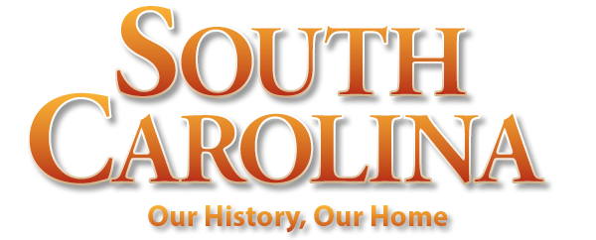
Chapter 11: Progress and Poverty
STUDY PRESENTATION
© 2022 Clairmont Press

Slide 2
Section 1: The National Industrial Boom
Section 2: South Carolina: Progress and Poverty
Section 3: Politics: Bourbons and Tillmanites

Slide 3
Section 2: South Carolina: Progress and Poverty
Essential Question: How did industry replace agriculture as most important to the state’s economy?

Slide 4
Section 2: South Carolina: Progress and Poverty
What terms do I need to know?
deflation
gold standard
textiles

Slide 5
Introduction
South Carolinians made their living on farms growing rice and cotton.
In the 19th century, people were able to choose between a life as a farmer or one as a factory worker.
‘Cotton Pickers,’ an oil portrait by William Aiken Walker

Slide 6
Agriculture – The Old Reliable
The destruction of the Civil War caused farmers to have difficulty producing the same amount of crops as before.
The crop-lien systems, falling price of cotton, loss of slave labor and the agricultural depression that lasted from 1873 to 1896 caused great hardship for farmers.
In the late 1800s, farmers lost millions of acres of land due to this hardship.
They turned to tobacco, which quickly became the foremost crop in the state.

Slide 7
Rise of Industry
It took a while for the South to become open enough to accept industry.
first new industry, phosphate mining (fertilizer), was short lived
other industries- pottery, lumber, turpentine, and cottonseed oil

Slide 8
The Textile Industry
The textile industry became the most important in the state.
People wanted textile mills in their communities to promote economic progress.
Their collected funds weren’t enough to result in huge progress, so many northern investors got involved.
By 1900, there were 115 textile mills in South Carolina.
A textile mill from 1920.

Slide 9
Life in the Mill Villages
Mills were created for their own communities. There were houses, churches, and activities for the people who worked and lived in the mill village.
An average man would work from 5AM to 6:30PM and would earn only about 5 dollars per week.
The only day people didn’t work was Sunday.
The entire family worked, even children.
Child working in a textile mill c. 1918.

Slide 10
Railroads
Towns wanted to be connected to a railroad.
By 1900, every county in the state was linked to the railroad system.
Many of the small railroads were combined to form three major railroad companies.
These companies created seven huge railroad systems that took up a large percentage of the 193,000 miles of track in the United States.

Slide 11
Resort Towns
Several towns wanted to run health resorts.
They needed a large hotel and a railroad that rain through the community.
The first health resort was built in Aiken.
Many Yankees came to the resort towns to escape the harsh winters of the northern states.
Camden and Summerville soon accompanied Aiken on the list of resort towns.

Slide 12
Natural Disasters and the Economy
In 1886, 83 people died in Charleston when the most powerful earthquake ever to hit the Southeast occurred.
One-fourth of the buildings in the city were destroyed.
Two hurricanes struck the South Carolina coast in the late 1800s.
The first one claimed 21 lives, and the other took nearly two thousand lives.
Return to Main Menu

