Slide 1
Chapter 12: The Progressive Era
STUDY PRESENTATION
© 2022 Clairmont Press

Slide 2
Section 1: Life at the Turn of the Century
Section 2: Politics in the Progressive Era
Section 3: America and South Carolina at War

Slide 3
Section 2: Politics in the Progressive Era
Essential Question: What beliefs and ideals affected politics in the progressive era?

Slide 4
Section 2: Politics in the Progressive Era
What terms do I need to know?
Progressive Era
direct primary
referendum
recall
trust
Federal Reserve System
women’s suffrage

Slide 5
The Progressive Response
Societal problems
Overcrowded, unsanitary, and unsafe living and working conditions
Child labor and lack of worker security
Corruption
Economic gap
Progressive beliefs
Planned progress
Education
Human problem solving
Democratic government as a change agent.

Slide 6
Progressivism in Action in the Cities
Led by middle class city dwellers
Reforms in education, health and safety
Creation of parks and transportation systems
Support for prohibition
Government of experts, not cronies
Commission city government
City Manager form of government

Slide 7
Progressivism at the State Level
States were a testing ground for new ideas.
Direct primary was adopted.
In SC led to primary being the only meaningful election due to the overwhelming Democratic majority.
States adopted secret ballot, referendum, and recall.
Recall was not adopted in SC.

Slide 8
Progressivism at the National Level
Theodore Roosevelt
Sherman Antitrust Act broke up railroad monopoly.
Interstate Commerce Commission set railroad rates.
Coal strike intervention
Regulations in food and drug industry (The Jungle by Sinclair)
William Howard Taft
Trust breaker
Roosevelt’s Bull Moose Party
Woodrow Wilson
Federal Reserve System
Federal Trade Commission
16th Amendment
Support for agriculture
Women’s suffrage – 19th Amendment

Slide 9
Politics in South Carolina: Progressive and Regressive
Governor Heyward
Improved education
Abolished child labor under 10
Lowered mill work week to 60 hours
Governor Ansel
Abolished Dispensary
Governor Blease
Blocked reforms in education and labor
Created tuberculosis sanatorium
Accepted SC Medical College as state supported

Slide 10
The Progressive Administrations of Richard I. Manning
Passed laws to help working-class
Labor board
Insurance compensation to laid-off workers
Minimum child labor age raised to 14
Improved State Hospital
Established State Tax Commission
Created State Highway Commission

Slide 11
The Progressives and Education
Doubled funding for education
Mandated compulsory school attendance
Created special schools
Required teacher certification and increased teacher salaries
Made uneven progress across state
Cooperated with Julius Rosenwald to build schools for rural black children

Slide 12
South Carolina and Women’s Suffrage
Virginia Durant Young
pioneer of movement
South Carolina Equal Rights Association
Susan Pringle Frost
Anita Pollitzer
Eulalie Chafee Salley
19th Amendment
Ratified nationally, but not in SC
SC women could vote, but not serve on juries

Slide 13
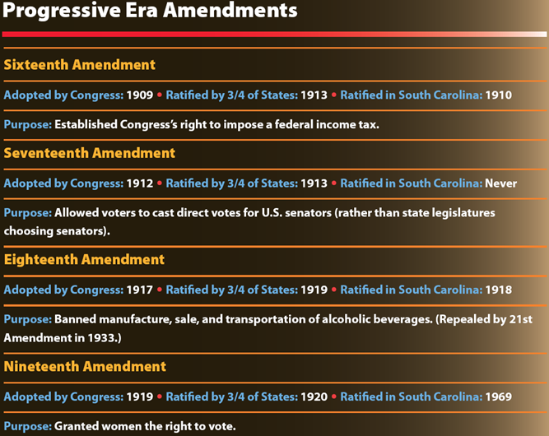
Return to Main Menu

