Slide 1
Chapter 13: The Transition Twenties and Depression Thirties
STUDY PRESENTATION
© 2022 Clairmont Press

Slide 2
Section 1: The Twenties: An Era of Transition
Section 2: The Economy: From Hard Times to Desperate Times
Section 3: The New Deal
Section 4: Politics of the Twenties and Thirties

Slide 3
Section 3: The New Deal
Essential Question: How did the New Deal change the lives of South Carolinians?

Slide 4
Section 3: The New Deal
What terms do I need to know?
New Deal
collective bargaining
Social Security Act

Slide 5
Introduction & Relief, Recovery, and Reform
Herbert Hoover
Not the cause of the Depression
Ineffective in improving conditions
Franklin Roosevelt
Elected by landslide in 1932
Dealt with crisis on the first day
Reducing fears
Giving hope
Franklin Roosevelt

Slide 6
The Banking Crisis
Roosevelt’s plan
Ordered a bank holiday
Closed banks
Send in federal inspectors
Reopened healthy banks
Gave assistance to others
Reformed banking system - federal laws, Federal Deposit Insurance Corporation

Slide 7
Emergency Relief
Forms of relief
Cash to needy families
Creation of agencies to create jobs
Purpose of relief
Get money into hands of people
Create a demand for goods
Prime the pump
Prevent starvation and suffering
Purpose of recovery and reform
Growth of private, profitable enterprise
Avoidance of another collapse

Slide 8
Relief and Jobs
Federal relief grants to South Carolina
Built and repaired bridges, sewer lines, schools, and courthouses
Hired teachers and funded school lunches
Problems with grants
Favoritism
Political connections
FDR’s Fireside Chats
Explained programs
Built confidence
Proved usefulness of radio

Slide 9
The CCC
Civilian Conservation Corps
Hired young men from needy families
Sent money home
Provided food, clothing, shelter, and educational opportunities
Worked on state parks
The CCC renovating a canal in Washington, D.C.

Slide 10
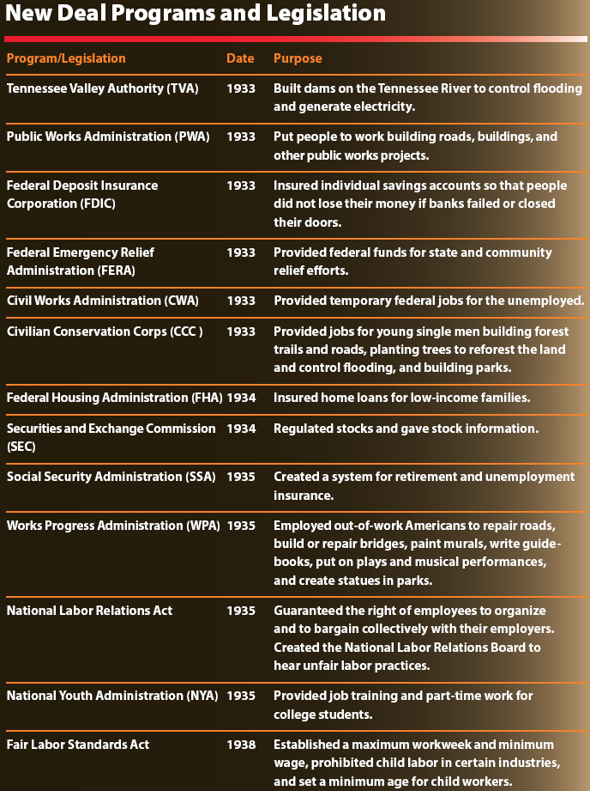

Slide 11
The PWA and WPA
Public Works Administration
Provided immediate employment
Built schools, libraries, and courthouses
Works Progress Administration
Built hospitals, highways, bridges, sewer systems, parks, and airports
Supported artists, writers, musicians, and teachers
Employed more people in the state than any other
Provided funding for historic Charleston theatre

Slide 12
Labor Troubles
A nationwide General Textile Strike was called by United Textile Workers.
Purpose was to force mill owners to honor new federal standards
Violence erupted between strikers and strikebreakers, the South Carolina National Guard, law officers, and factory owners at a mill in South Carolina.
The Union lost, and some disheartened workers refused to participate in collective bargaining.

Slide 13
The Santee Cooper Project
State owned utility company providing electricity to rural areas
Known as South Carolina Public Service Authority
Biggest New Deal project in state
Built Lakes Marion and Moultrie

Slide 14
Reforms
The role of the federal government increased in the economy and in individuals’ lives.
Agricultural legislation - support for crop prices, reduced crop acreage, increased crop prices
Labor legislation - right to join labor unions, Fair Labor Standards Act
Social Security Act - federal retirement system, payments for disabled persons and children of deceased workers, safety net
Housing reforms - insured loans, affordable mortgage rates

Slide 15
The Legacy of the New Deal
Positive
Survival of the individual
Minimal South Carolina bank failure
Building projects
Labor reforms
Renewal of confidence in government
Negative
No full economic recovery
WWII spending

