Slide 1
SMART SKILLS
Week 3 – Artifact 1
© 2021 Clairmont Press

Slide 2
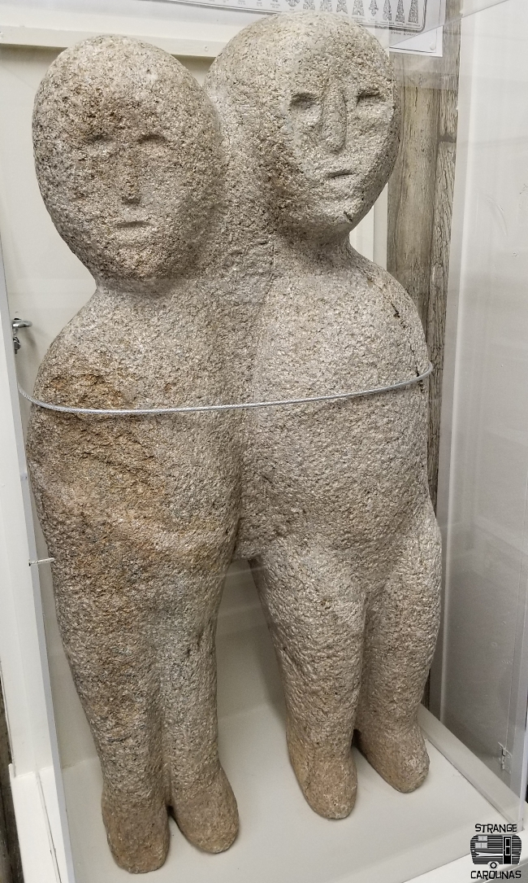
Monday
Cherokee Native American Effigy
This is an example of a Native American effigy. What is an effigy?

Slide 3
Tuesday
Cherokee Native American Effigy
What does the effigy represent?

Slide 4
Wednesday
Cherokee Native American Effigy
This effigy is called “the Moon-Eyed People”. Why might it be called that?

Slide 5
Thursday
Cherokee Native American Effigy
What is the relationship between art and advancing civilizations?

Slide 6
Friday
Cherokee Native American Effigy
What judgements would you make about the ancient Cherokee people based on observing this effigy?

Slide 7
Image Credits
Title Slide: South Carolina State House, by HaloMasterMind, Uploaded 30 August 2013, Wikimedia Commons
Slides 2-6: moon04.jpg. (2019). Strange Carolinas. photograph, Murphy. Retrieved October 7, 2021, from https://www.strangecarolinas.com/2019/10/the-moon-eyed-people-effigy-murphy-nc.html#A+.
End Slide: Hunting Island 1, Public Domain, Wikimedia Commons
Return to Main Menu

