Slide 1
SMART SKILLS
Week 13 – Artifact 3
© 2021 Clairmont Press

Slide 2
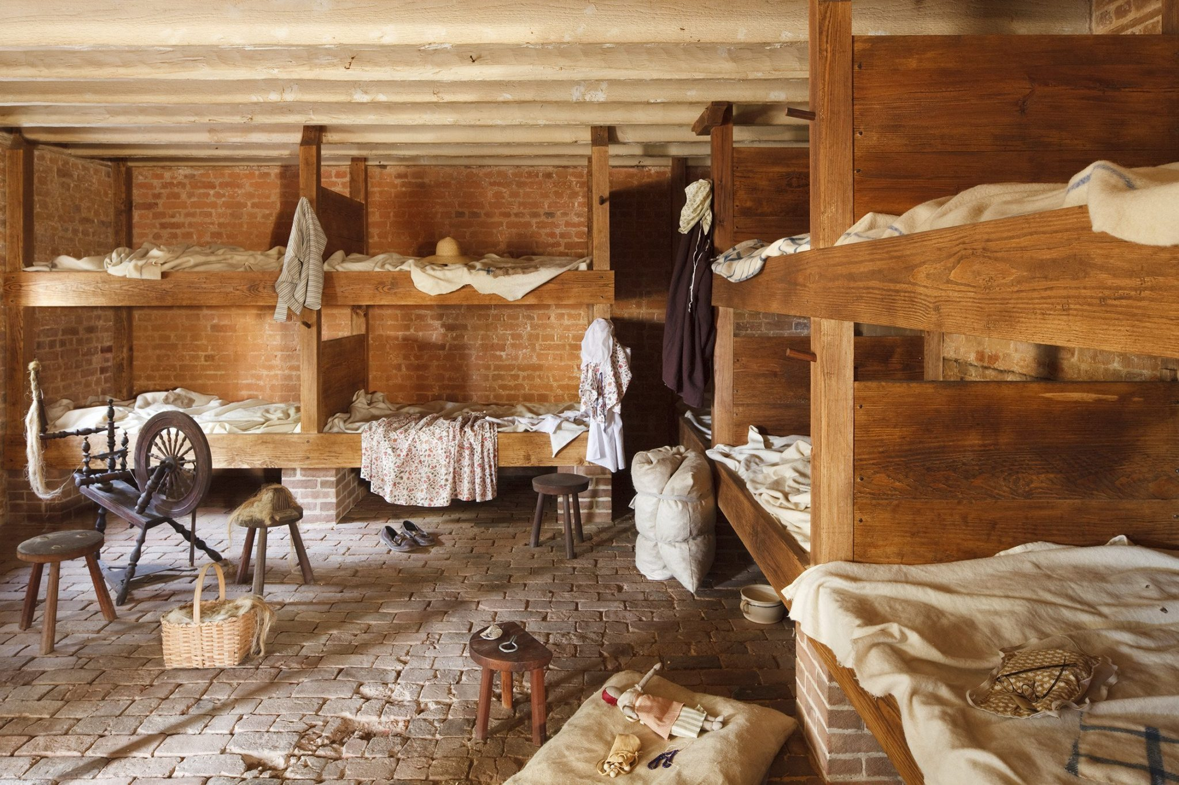
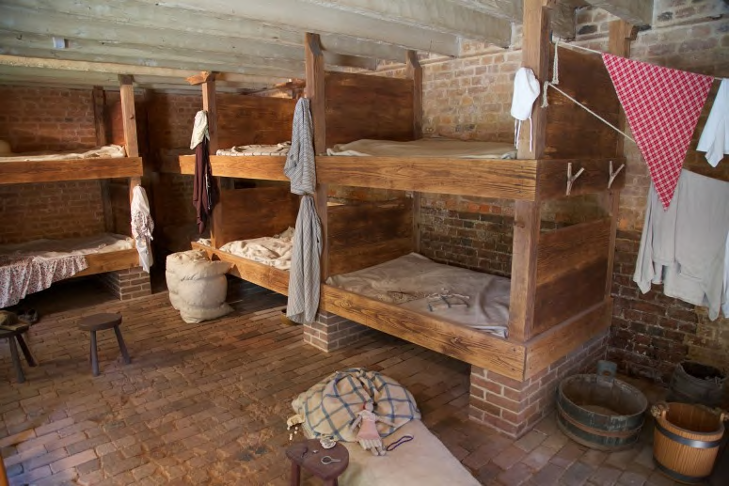
Monday
Slave Cabin Interior (recreated), Mount Vernon
Study the pictures. What do you observe?

Slide 3
Tuesday
Slave Cabin Interior (recreated), Mount Vernon
How is the cabin constructed? What materials are used?

Slide 4
Wednesday
Slave Cabin Interior (recreated), Mount Vernon
What events of daily life are evidenced in the cabin’s interior? Which artifacts are connected with those events?

Slide 5
Thursday
Slave Cabin Interior (recreated), Mount Vernon
If you could interview someone who works at this historic site, what 3 questions would you ask about the cabin or its interior?

Slide 6
Friday
Slave Cabin Interior (recreated), Mount Vernon
What is the value of recreated historic sites such as this one? Explain your thinking.

Slide 7
Image Credits
Title Slide: South Carolina State House, by HaloMasterMind, Uploaded 30 August 2013, Wikimedia Commons
Slides 2-6: large_mount-vernon-may-2013-shenk-001-web.jpg. (n.d.). https://www.mountvernon.org/library/digitalhistory/digital-encyclopedia/article/greenhouse-slave-quarters/. photograph. Retrieved October 7, 2021.
Slides 2-6: 9655Hpr_5a2d3fab3c89a6c-2048x1365.jpg. (n.d.). https://encyclopediavirginia.org/entries/slave-housing-in-virginia/. photograph. Retrieved October 7, 2021.
End Slide: Hunting Island 1, Public Domain, Wikimedia Commons
Return to Main Menu

