Slide 1
SMART SKILLS
Week 18 – Artifact 4
© 2021 Clairmont Press

Slide 2
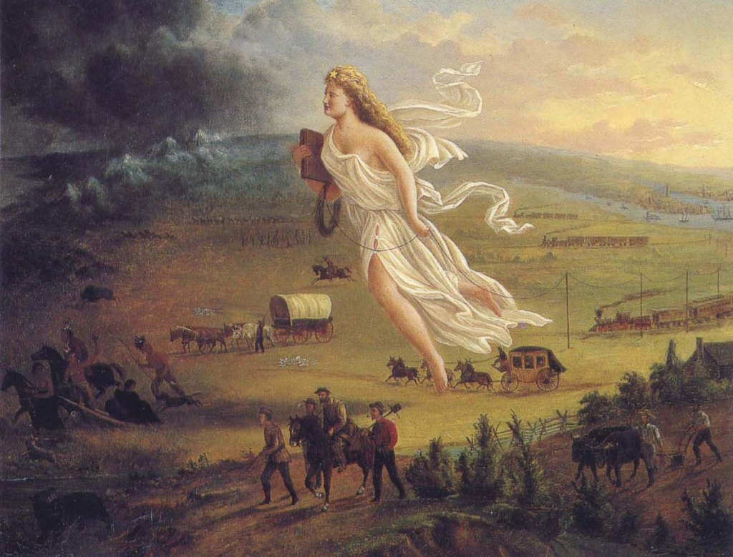
Monday
What is shown in picture? List as many parts of the image as you can in 5 minutes.

Slide 3
Tuesday
What forms of progress do you see demonstrated in the painting? Why is this significant?

Slide 4
Wednesday
What direction is everyone headed? How does this link to the idea of progress?

Slide 5
Thursday
What does the angel symbolize? Why do you think this is such a prominent part of the painting?

Slide 6
Friday
Write a caption for the painting that explains how it represents the idea of Manifest Destiny. Be sure to include explanations for the various parts of the painting.

Slide 7
Image Credits
Title Slide: South Carolina State House, by HaloMasterMind, Uploaded 30 August 2013, Wikimedia Commons
End Slide: Hunting Island 1, Public Domain, Wikimedia Commons
Return to Main Menu

