Slide 1
SMART SKILLS
Week 23 – Artifact 5
© 2021 Clairmont Press

Slide 2
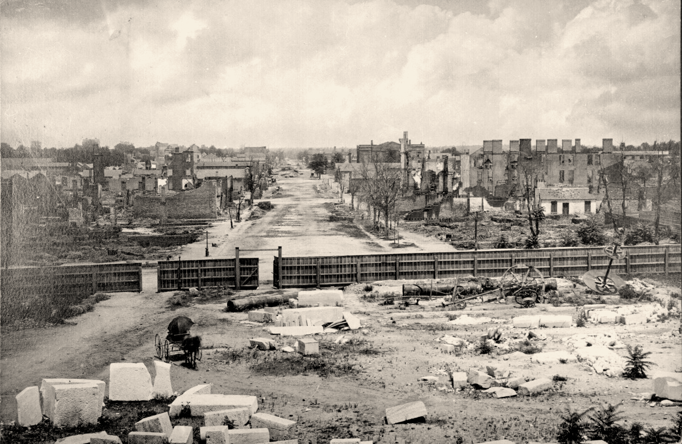
Monday
Ruins seen from the capitol, Columbia, South Carolina, 1865
Study the picture. What do you notice first? What stands out to you? When was the picture taken?

Slide 3
Tuesday
Ruins seen from the capitol, Columbia, South Carolina, 1865
What evidence do you see of an economically strong city prior to the Civil War? What evidence do you see of the fires that ravaged the city?

Slide 4
Wednesday
Ruins seen from the capitol, Columbia, South Carolina, 1865
Are there any parts of the city that seem untouched by the damage? Why might that be?

Slide 5
Thursday
Ruins seen from the capitol, Columbia, South Carolina, 1865
Columbia was an important political and supply center for the Confederate South. How might this have played into the fires breaking out after General Sherman took the city?

Slide 6
Friday
Ruins seen from the capitol, Columbia, South Carolina, 1865
Write a caption for the photograph.

Slide 7
Image Credits
Title Slide: South Carolina State House, by HaloMasterMind, Uploaded 30 August 2013, Wikimedia Commons
End Slide: Hunting Island 1, Public Domain, Wikimedia Commons
Return to Main Menu

