Slide 1
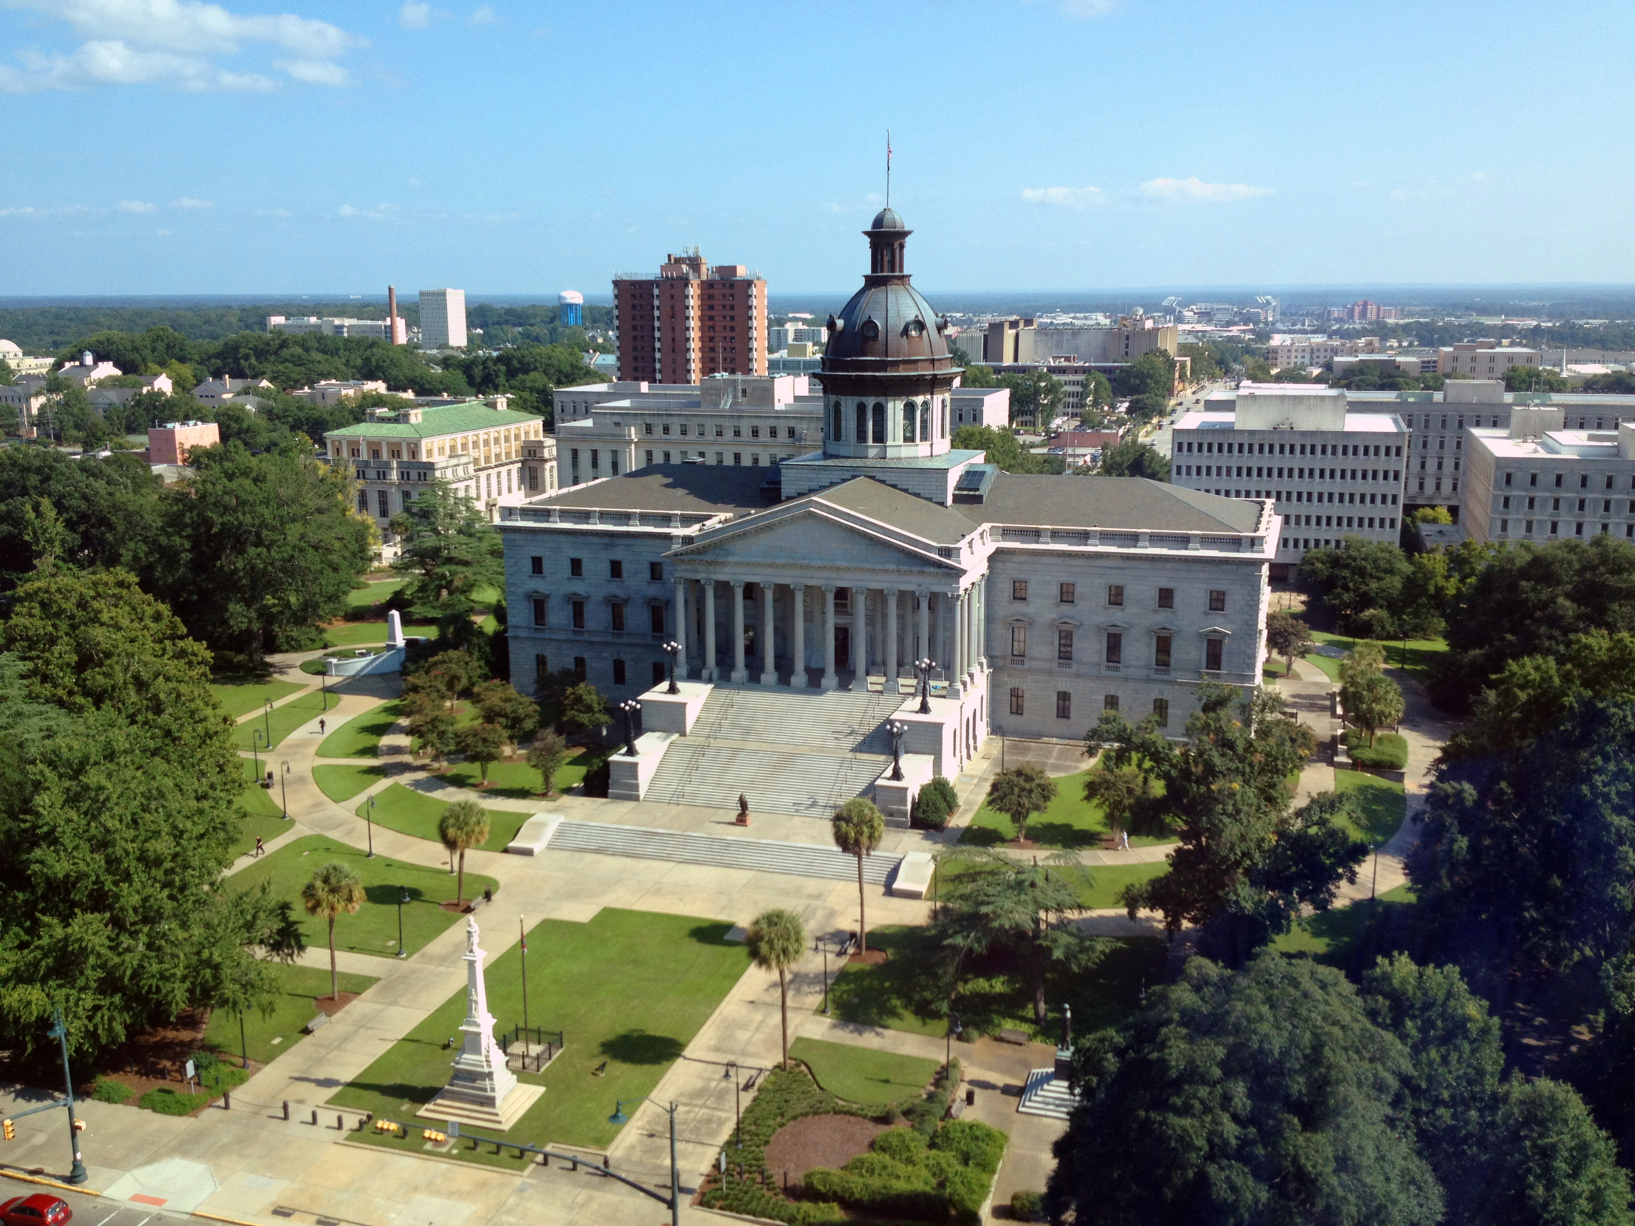
SMART SKILLS
Week 33 – Artifact 7
© 2021 Clairmont Press

Slide 2
Monday
Excerpt from Richard Nixon’s Address Accepting the Presidential Nomination at the Republican National Convention in Miami Beach, Florida August 8, 1968:
“For four years this Administration has had at its disposal the greatest military and economic advantage that one nation has ever had over another in any war in history. For four years, America's fighting men have set a record for courage and sacrifice unsurpassed in our history… Never has so much military and economic and diplomatic power been used so ineffectively.
And if after all of this time and all of this sacrifice and all of this support there is still no end in sight, then I say the time has come for the American people to turn to new leadership -- not tied to the mistakes and the policies of the past. That is what we offer to America.
And I pledge to you tonight that the first priority foreign policy objective of our next Administration will be to bring an honorable end to the war in Vietnam. We shall not stop there -- we need a policy to prevent more Vietnams.”
  Who delivered this speech? What was the event?

Slide 3
Tuesday
Excerpt from Richard Nixon’s Address Accepting the Presidential Nomination at the Republican National Convention in Miami Beach, Florida August 8, 1968:
“For four years this Administration has had at its disposal the greatest military and economic advantage that one nation has ever had over another in any war in history. For four years, America's fighting men have set a record for courage and sacrifice unsurpassed in our history… Never has so much military and economic and diplomatic power been used so ineffectively.
And if after all of this time and all of this sacrifice and all of this support there is still no end in sight, then I say the time has come for the American people to turn to new leadership -- not tied to the mistakes and the policies of the past. That is what we offer to America.
And I pledge to you tonight that the first priority foreign policy objective of our next Administration will be to bring an honorable end to the war in Vietnam. We shall not stop there -- we need a policy to prevent more Vietnams.”
  Which American conflict is being referenced in the speech? What is Nixon’s primary argument about the war?

Slide 4
Wednesday
Excerpt from Richard Nixon’s Address Accepting the Presidential Nomination at the Republican National Convention in Miami Beach, Florida August 8, 1968:
“For four years this Administration has had at its disposal the greatest military and economic advantage that one nation has ever had over another in any war in history. For four years, America's fighting men have set a record for courage and sacrifice unsurpassed in our history… Never has so much military and economic and diplomatic power been used so ineffectively.
And if after all of this time and all of this sacrifice and all of this support there is still no end in sight, then I say the time has come for the American people to turn to new leadership -- not tied to the mistakes and the policies of the past. That is what we offer to America.
And I pledge to you tonight that the first priority foreign policy objective of our next Administration will be to bring an honorable end to the war in Vietnam. We shall not stop there -- we need a policy to prevent more Vietnams.”
  What is the relationship between a presidential campaign speech and American foreign policy? How is that referenced here?

Slide 5
Thursday
Excerpt from Richard Nixon’s Address Accepting the Presidential Nomination at the Republican National Convention in Miami Beach, Florida August 8, 1968:
“For four years this Administration has had at its disposal the greatest military and economic advantage that one nation has ever had over another in any war in history. For four years, America's fighting men have set a record for courage and sacrifice unsurpassed in our history… Never has so much military and economic and diplomatic power been used so ineffectively.
And if after all of this time and all of this sacrifice and all of this support there is still no end in sight, then I say the time has come for the American people to turn to new leadership -- not tied to the mistakes and the policies of the past. That is what we offer to America.
And I pledge to you tonight that the first priority foreign policy objective of our next Administration will be to bring an honorable end to the war in Vietnam. We shall not stop there -- we need a policy to prevent more Vietnams.”
  What additional facts are needed to support that a change in administration would solve America’s problems in Vietnam?

Slide 6
Friday
Excerpt from Richard Nixon’s Address Accepting the Presidential Nomination at the Republican National Convention in Miami Beach, Florida August 8, 1968:
“For four years this Administration has had at its disposal the greatest military and economic advantage that one nation has ever had over another in any war in history. For four years, America's fighting men have set a record for courage and sacrifice unsurpassed in our history… Never has so much military and economic and diplomatic power been used so ineffectively.
And if after all of this time and all of this sacrifice and all of this support there is still no end in sight, then I say the time has come for the American people to turn to new leadership -- not tied to the mistakes and the policies of the past. That is what we offer to America.
And I pledge to you tonight that the first priority foreign policy objective of our next Administration will be to bring an honorable end to the war in Vietnam. We shall not stop there -- we need a policy to prevent more Vietnams.”
  Nixon states that we need to “prevent more Vietnams.” How would you evaluate America’s handling of foreign policy/conflict in the time since Vietnam?

Slide 7
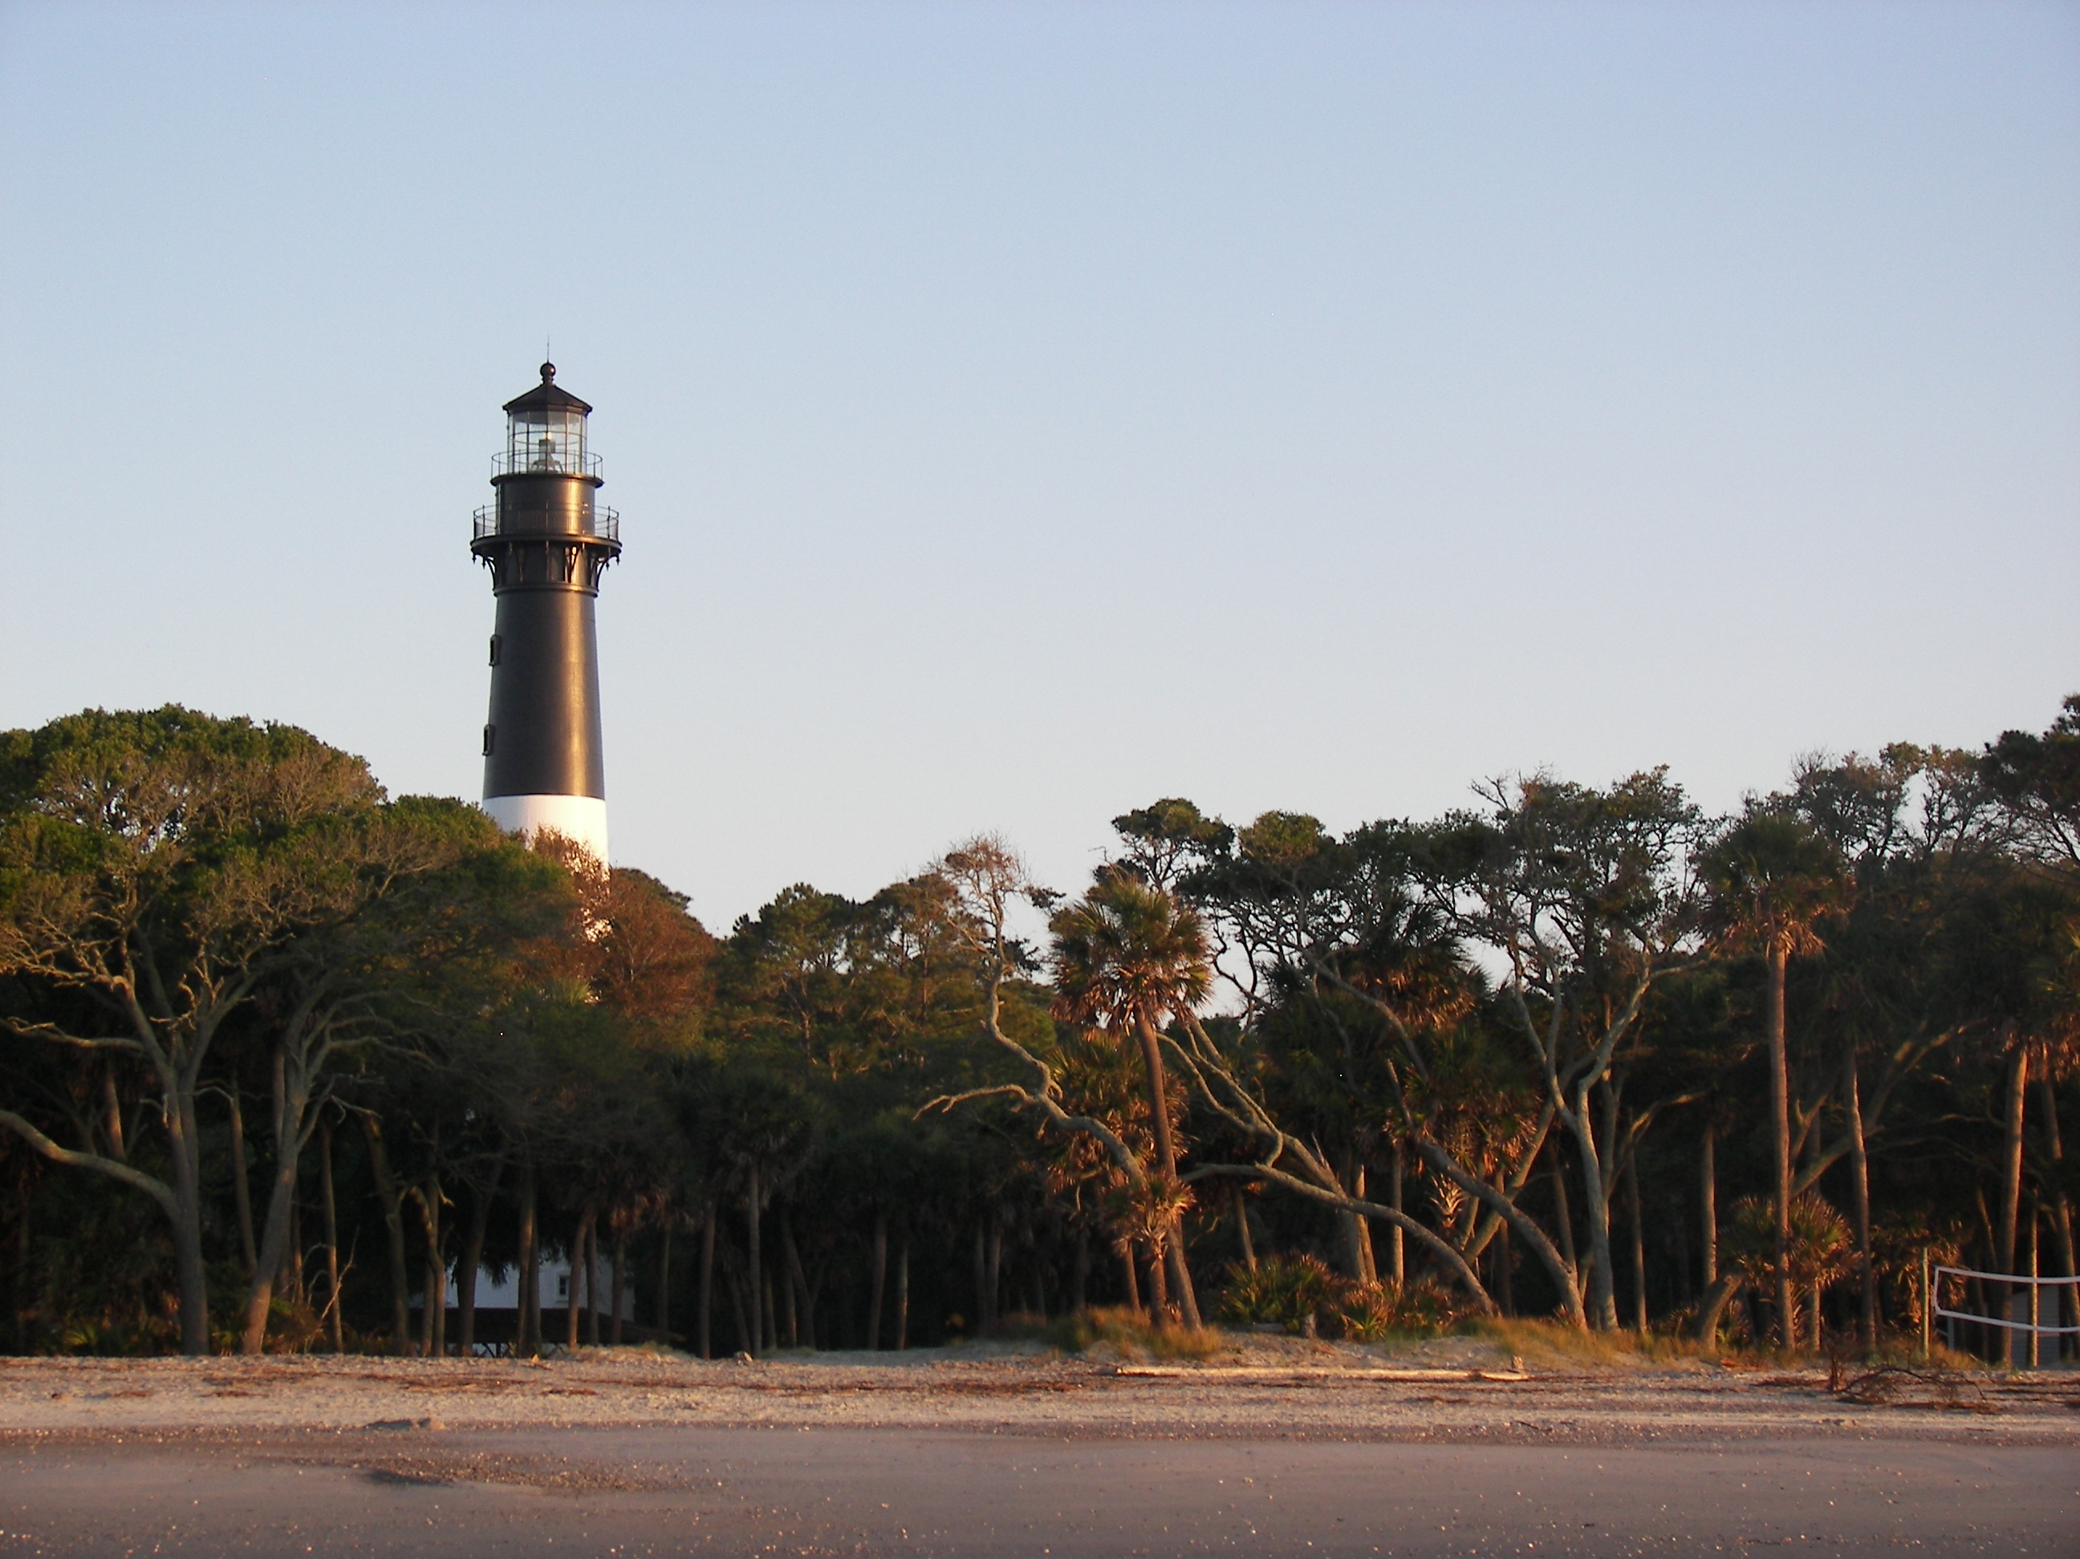
Image Credits
Title Slide: South Carolina State House, by HaloMasterMind, Uploaded 30 August 2013, Wikimedia Commons
End Slide: Hunting Island 1, Public Domain, Wikimedia Commons
Return to Main Menu

