Slide 1
SMART SKILLS
Week 2 – Charts & Graphs 1
© 2021 Clairmont Press

Slide 2
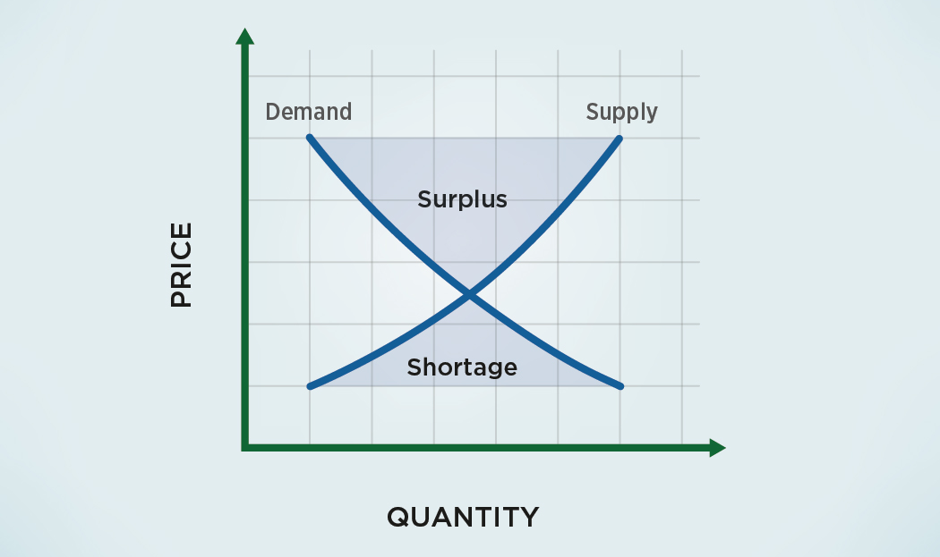
Monday
What does the graph show? What information is contained on the x-axis and y-axis?

Slide 3
Tuesday
If demand for a product increases, what typically happens to the supply of that product?

Slide 4
Wednesday
If the supply of a product is far greater than the demand, what happens to that product?

Slide 5
Thursday
Use the chart to explain why winter coats go on sale (price reduced) in the summer.

Slide 6
Friday
How does the graph relate to South Carolina’s broiler markets in modern day? Explain your answer.

Slide 7
Image Credits
Title Slide: South Carolina State House, by HaloMasterMind, Uploaded 30 August 2013, Wikimedia Commons
End Slide: Hunting Island 1, Public Domain, Wikimedia Commons
Return to Main Menu

