Slide 1
SMART SKILLS
Week 7 – Charts & Graphs 2
© 2021 Clairmont Press

Slide 2
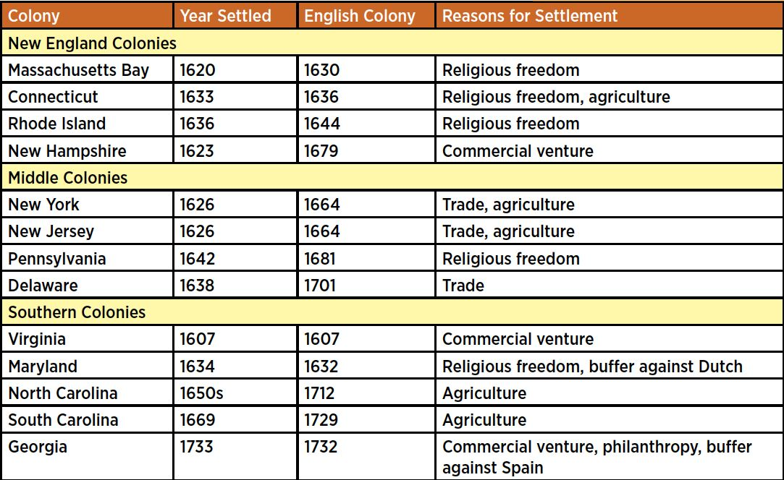
Monday
13 Original Colonies
What does the chart show? What information is contained in each column?

Slide 3
Tuesday
13 Original Colonies
How many colonial regions are there? What are they called? What are these titles based on?

Slide 4
Wednesday
13 Original Colonies
Based on the chart, which colony was settled first? Which was settled last? How long is the range of time between the first and last settlements?

Slide 5
Thursday
13 Original Colonies
What is the most common reason for settlement? How often does this occur?

Slide 6
Friday
13 Original Colonies
If you were a farmer moving to the colonies, who was seeking religious freedom, which colony would you be most likely to choose if you studied this chart? Why?

Slide 7
Image Credits
Title Slide: South Carolina State House, by HaloMasterMind, Uploaded 30 August 2013, Wikimedia Commons
End Slide: Hunting Island 1, Public Domain, Wikimedia Commons
Return to Main Menu

