Slide 1
SMART SKILLS
Week 12 – Charts & Graphs 3
© 2021 Clairmont Press

Slide 2
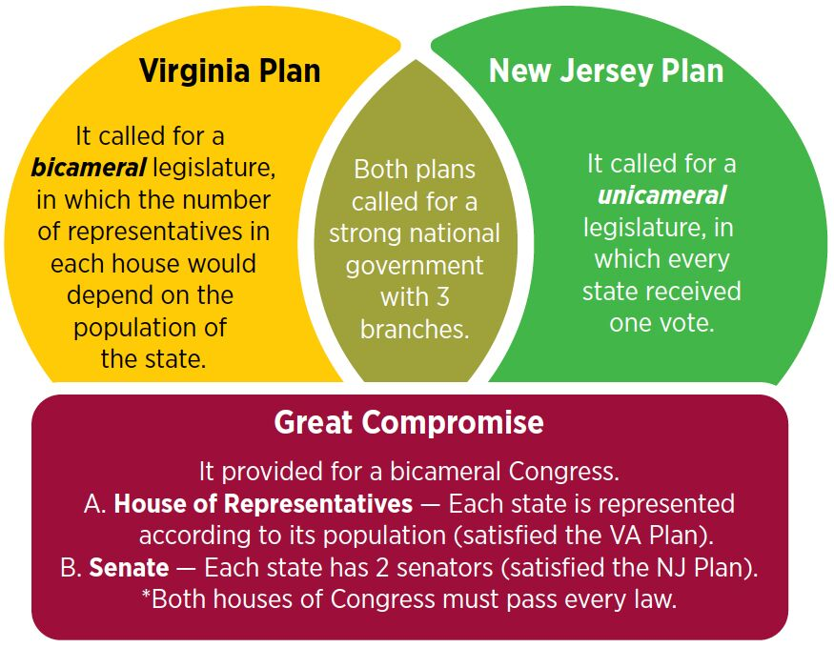
Monday
What does the chart show? What are the 3 main elements of the chart?

Slide 3
Tuesday
Which two Constitutional plans did the Great Compromise draw from? What did they have in common?

Slide 4
Wednesday
How were both the New Jersey plan and the Virginia plan included in the Great Compromise? Why was it important to include parts from both plans?

Slide 5
Thursday
Predict the outcome for the United States if the Convention had adopted only the New Jersey plan instead of making a compromise with the Virginia Plan.

Slide 6
Friday
Imagine you are a delegate at the Constitutional Convention. Write a short letter to the editor of a newspaper in either Virginia or New Jersey explaining why the Great Compromise was important. Explain how the state’s position is represented fairly in the Compromise.

Slide 7
Image Credits
Title Slide: South Carolina State House, by HaloMasterMind, Uploaded 30 August 2013, Wikimedia Commons
End Slide: Hunting Island 1, Public Domain, Wikimedia Commons
Return to Main Menu

