Slide 1
SMART SKILLS
Week 22 – Charts & Graphs 5
© 2021 Clairmont Press

Slide 2
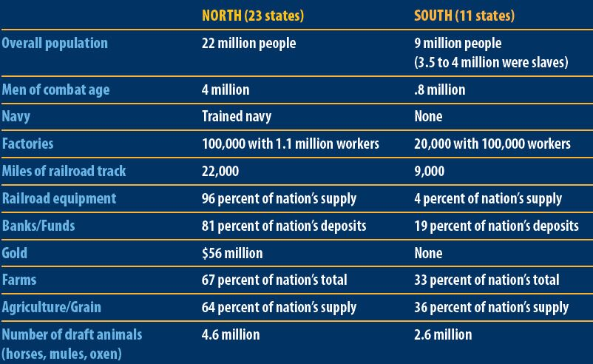
Monday
Resources of the North and South, 1860
What does the chart explore?

Slide 3
Tuesday
Resources of the North and South, 1860
In which areas does the South have no resources?

Slide 4
Wednesday
Resources of the North and South, 1860
What is significant about the South’s overall population number? (Hint: What percentage of the population were slaves?)

Slide 5
Thursday
Resources of the North and South, 1860
Why were these particular resources included on the chart? What is the author’s purpose in examining these comparisons?

Slide 6
Friday
Resources of the North and South, 1860
Draw a picture or graphic to illustrate the difference between the North and South in one of the areas listed. Be sure to include a caption for your drawing.

Slide 7
Image Credits
Title Slide: South Carolina State House, by HaloMasterMind, Uploaded 30 August 2013, Wikimedia Commons
End Slide: Hunting Island 1, Public Domain, Wikimedia Commons
Return to Main Menu

