Slide 1
SMART SKILLS
Week 27 – Charts & Graphs 6
© 2021 Clairmont Press

Slide 2
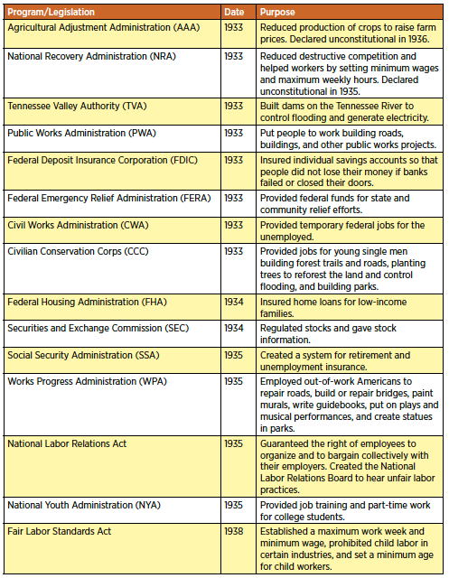
Monday
New Deal Programs
What does the chart show? What information is contained in each column?

Slide 3
Tuesday
New Deal Programs
Which programs listed put unemployed people to work on building projects?

Slide 4
Wednesday
New Deal Programs
What is the date range shown on the chart? How many pieces of legislation shown were passed after Roosevelt’s first term in office?

Slide 5
Thursday
New Deal Programs
How many of the programs shown were declared unconstitutional? Predict why these were unconstitutional.

Slide 6
Friday
New Deal Programs
Which of the programs listed has the most significant impact on the US economy today? Explain your answer.

Slide 7
Image Credits
Title Slide: South Carolina State House, by HaloMasterMind, Uploaded 30 August 2013, Wikimedia Commons
End Slide: Hunting Island 1, Public Domain, Wikimedia Commons
Return to Main Menu

