Slide 1
SMART SKILLS
Week 32 – Charts & Graphs 7
© 2021 Clairmont Press

Slide 2
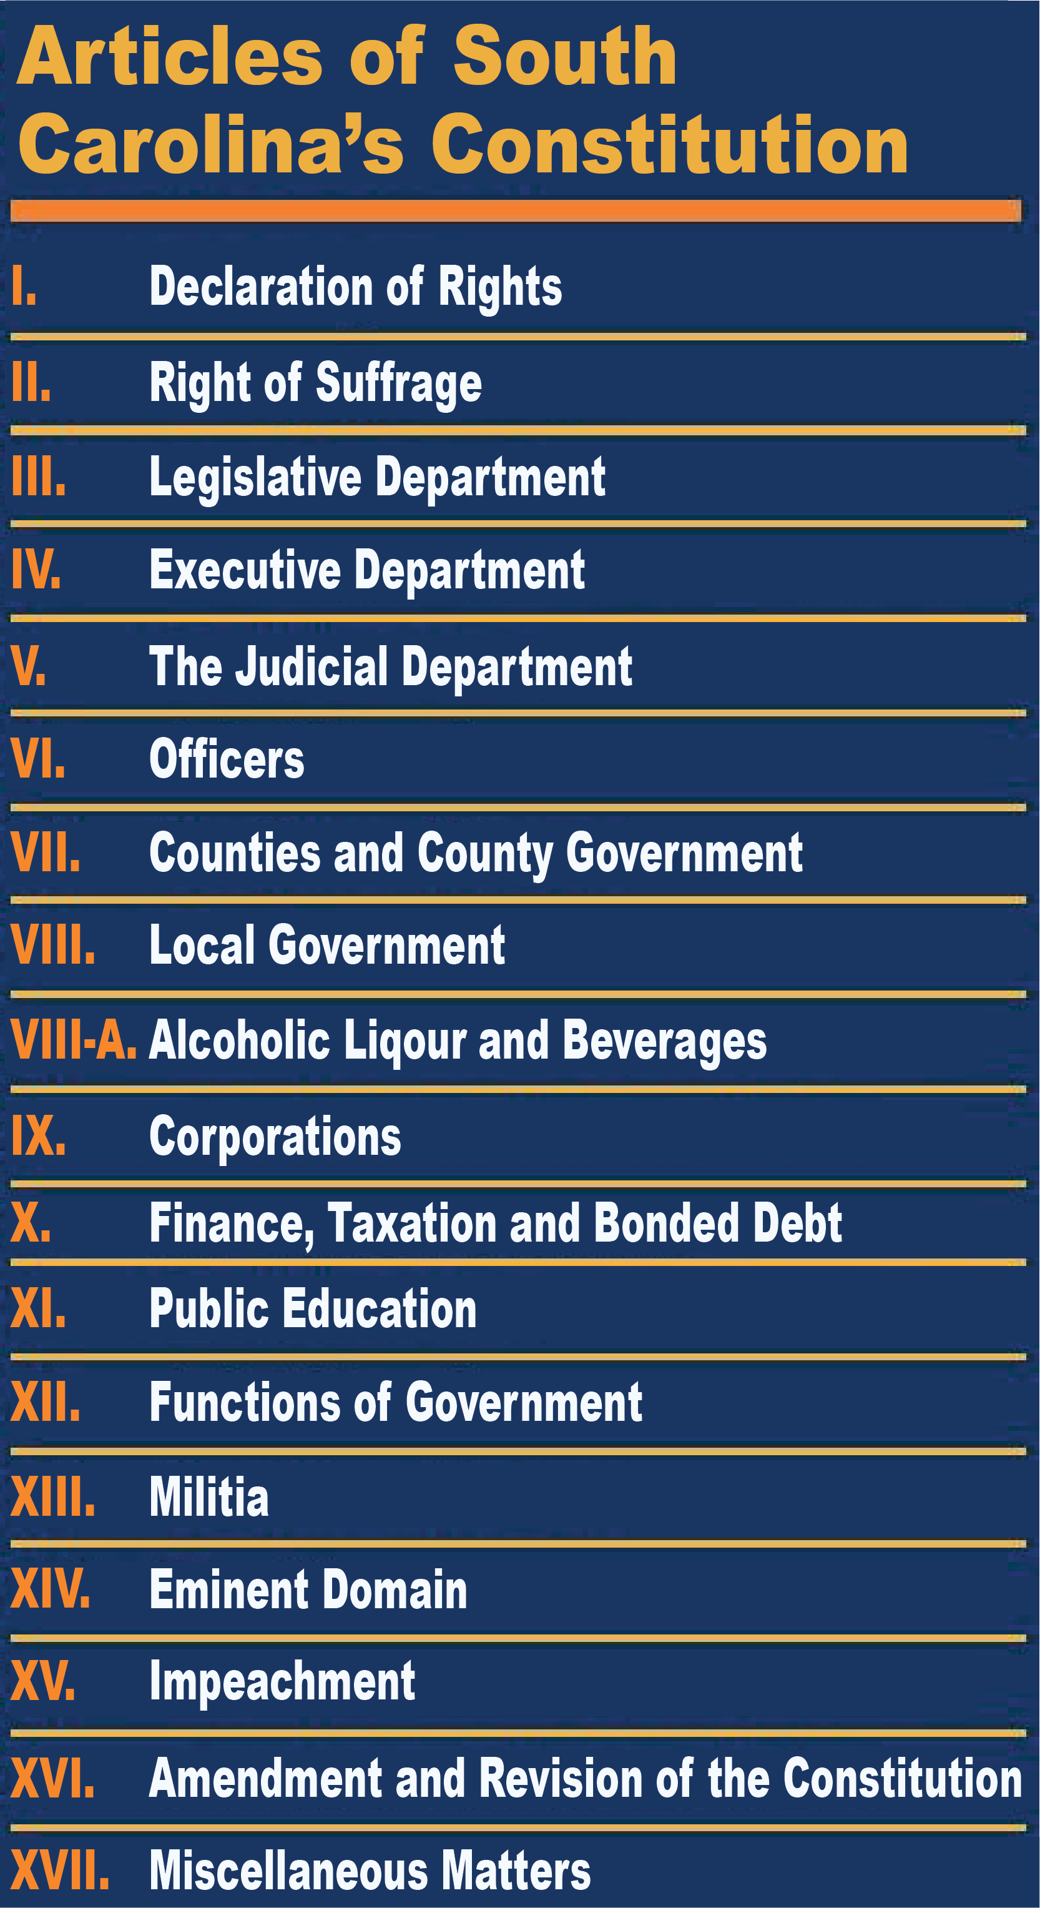
Monday
What is the topic for the chart? How many sections does it have?

Slide 3
Tuesday
How many branches of government are included in the articles? What are they?

Slide 4
Wednesday
Which article is dedicated to Education? Which is dedicated to Voting/Suffrage?

Slide 5
Thursday
Why is it significant that the Declaration of Rights is the first article?

Slide 6
Friday
If you were going to write a provision to add to the ‘Miscellaneous Matters’ article, what would it include? Why do you believe that provision is important?

Slide 7
Image Credits
Title Slide: South Carolina State House, by HaloMasterMind, Uploaded 30 August 2013, Wikimedia Commons
End Slide: Hunting Island 1, Public Domain, Wikimedia Commons
Return to Main Menu

