Slide 1
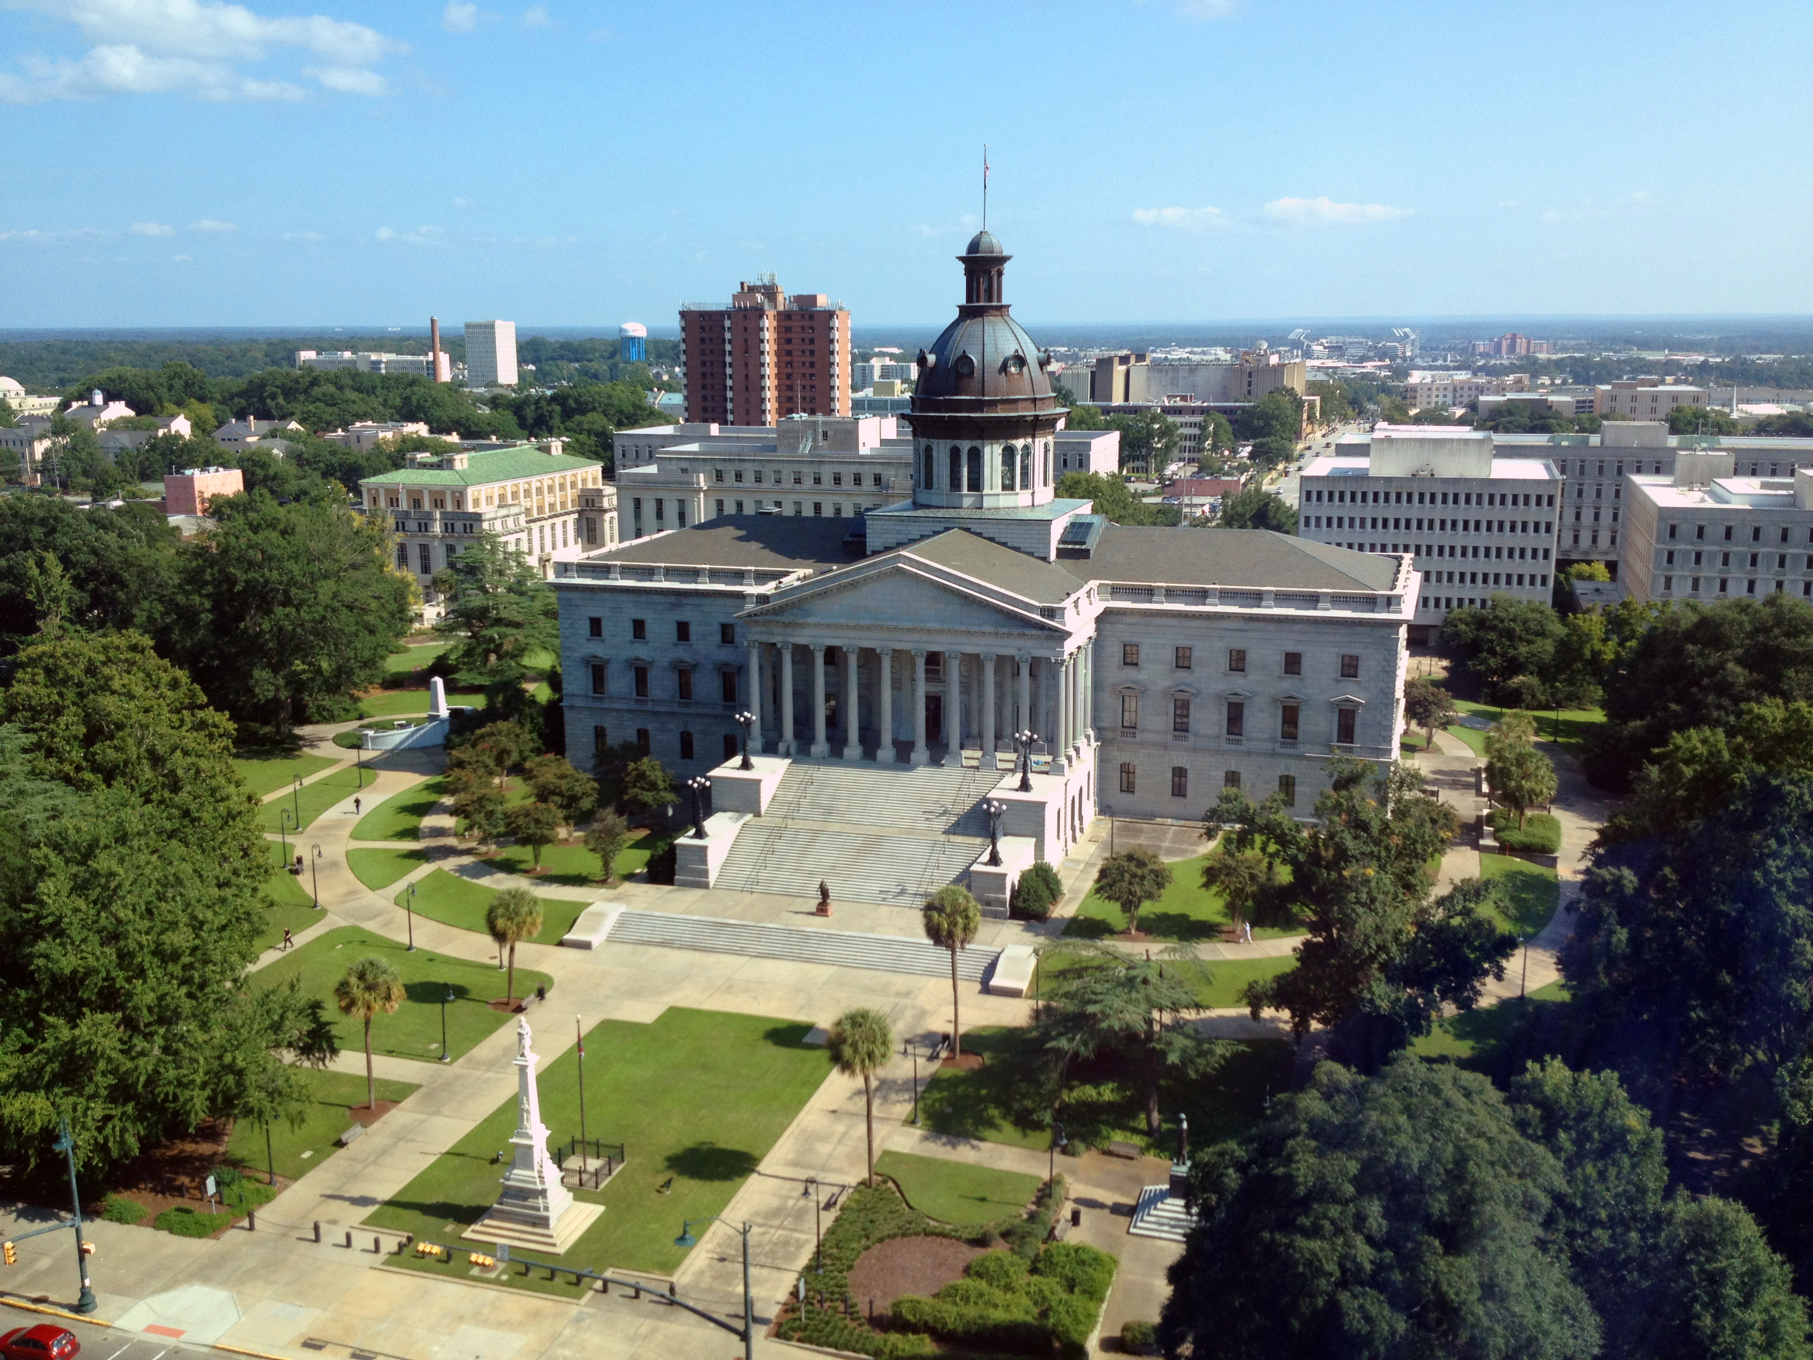
SMART SKILLS
Week 5 – Political Cartoon 1
© 2021 Clairmont Press

Slide 2
Monday
Click this to go to the Political Cartoon for this week.
Brant Parker and Johnny Hart. Wizard of Id Comics, April 27 2010.
Who is the author of the political cartoon?
What is the date of the political cartoon?
Who or what is the subject of the cartoon?
Notes:
Brant Parker and Johnny Hart
April 27, 2010
Two explorers in the age of exploration who have gathered funds from sources other than the king.

Slide 3
Tuesday
Click this to go to the Political Cartoon for this week.
Brant Parker and Johnny Hart. Wizard of Id Comics, April 27 2010.
Describe what you are viewing in the political cartoon.
How is the artist trying to convey his message?

Slide 4
Wednesday
Click this to go to the Political Cartoon for this week.
Brant Parker and Johnny Hart. Wizard of Id Comics, April 27 2010.
What is the cartoon meant to signify: humor, anger, sarcasm, or disgust?
What emotions does the cartoon stir in you?

Slide 5
Thursday
Click this to go to the Political Cartoon for this week.
Brant Parker and Johnny Hart. Wizard of Id Comics, April 27 2010.
Does the cartoonist choose a political side in this cartoon?
Do you feel like the cartoonist is making a fair statement? Explain.

Slide 6
Friday
Click this to go to the Political Cartoon for this week.
Brant Parker and Johnny Hart. Wizard of Id Comics, April 27 2010.
How can a cartoonist be an influential citizen in society?
Why is it important to analyze the political standpoint of the cartoon?

Slide 7
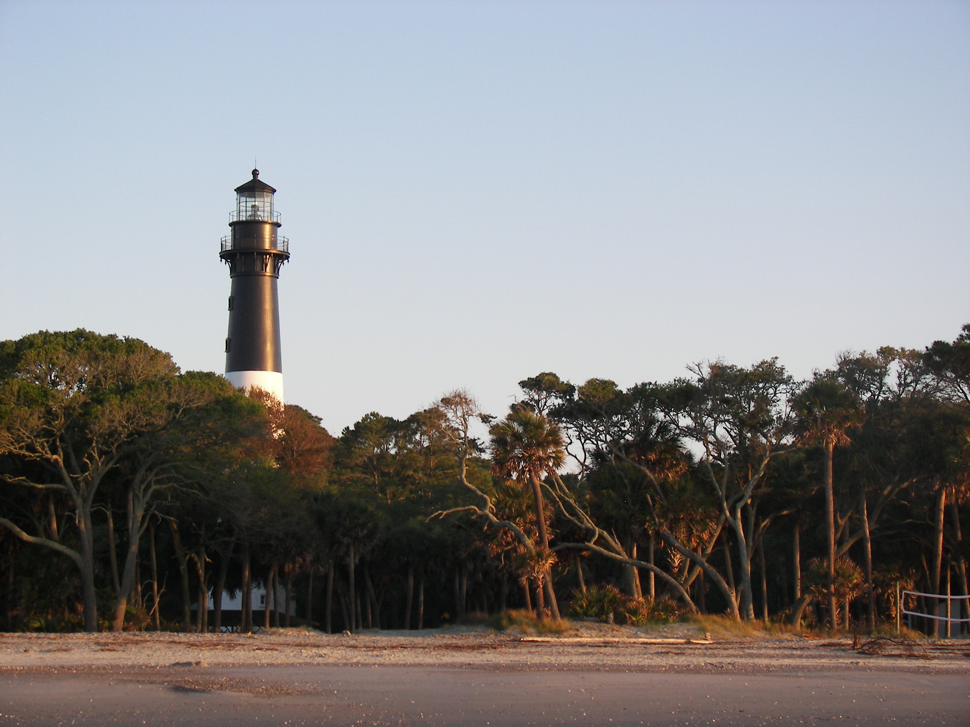
Image Credits
Title Slide: South Carolina State House, by HaloMasterMind, Uploaded 30 August 2013, Wikimedia Commons
End Slide: Hunting Island 1, Public Domain, Wikimedia Commons
Return to Main Menu

