Slide 1
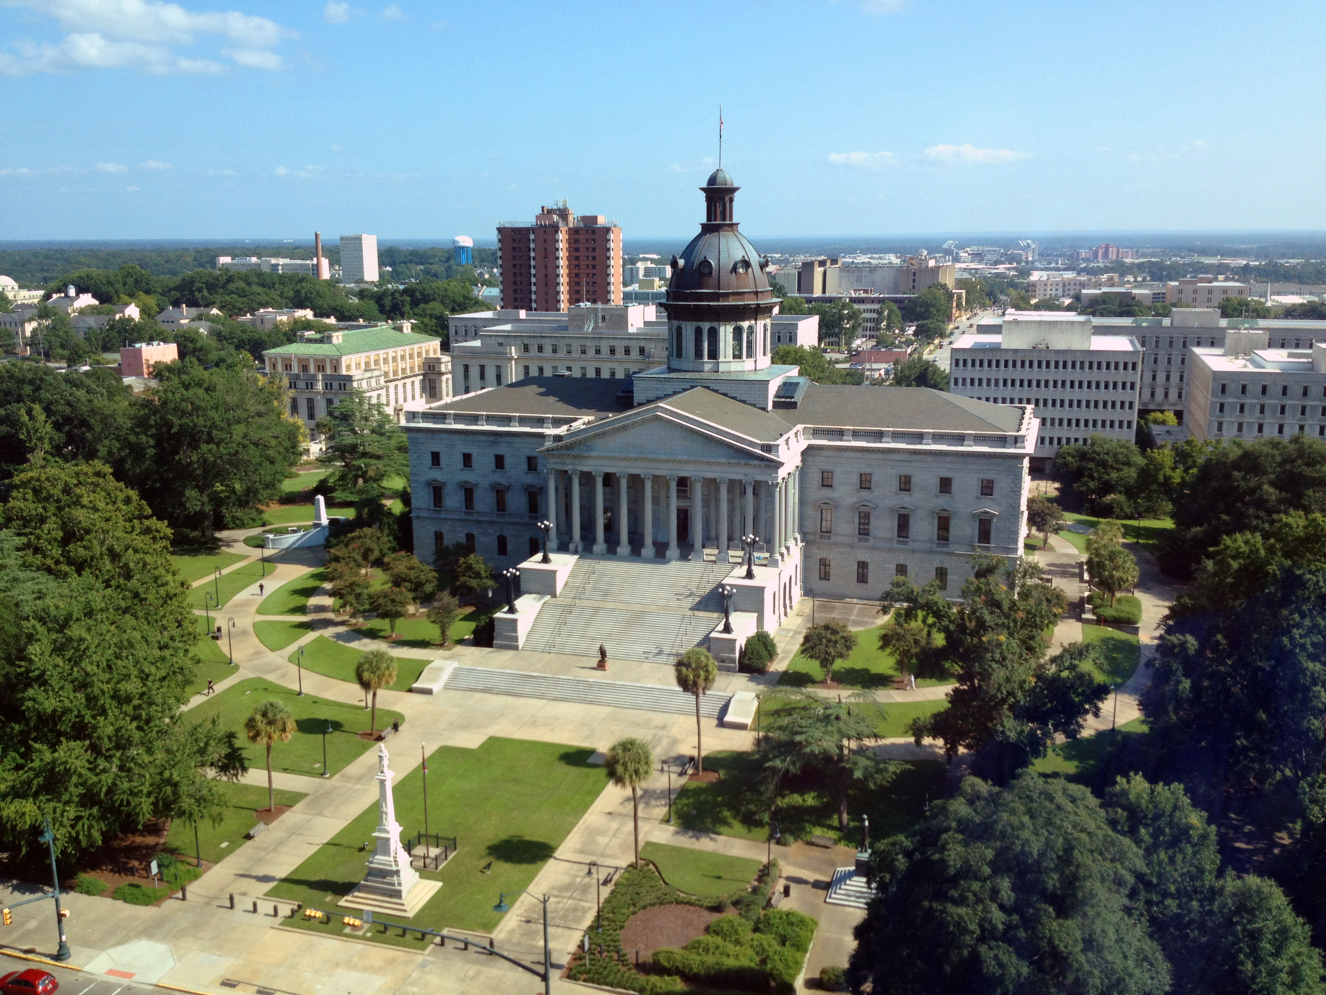
SMART SKILLS
Week 25 – Political Cartoon 5
© 2021 Clairmont Press

Slide 2
Monday
Click this to go to the Political Cartoon for this week.
New York American and Journal. “White Slavery: Northern Capital and Southern Child Labor,” 18 October 1902.
Who is the publisher of the political cartoon?
What is the date of the political cartoon?
Who or what is the subject of the cartoon?
Notes:
New York American and Journal
October 18, 1902
Capitalists are seeking to use cheap child labor for their businesses.

Slide 3
Tuesday
Click this to go to the Political Cartoon for this week.
New York American and Journal. “White Slavery: Northern Capital and Southern Child Labor,” 18 October 1902.
Describe what you are viewing in the political cartoon.
How is the artist trying to convey his message?

Slide 4
Wednesday
Click this to go to the Political Cartoon for this week.
New York American and Journal. “White Slavery: Northern Capital and Southern Child Labor,” 18 October 1902.
What is the cartoon meant to signify: humor, anger, sarcasm, or disgust?
What emotions does the cartoon stir in you?

Slide 5
Thursday
Click this to go to the Political Cartoon for this week.
New York American and Journal. “White Slavery: Northern Capital and Southern Child Labor,” 18 October 1902.
Does the cartoonist choose a political side in this cartoon?
Do you feel like the cartoonist is making a fair statement? Explain.

Slide 6
Friday
Click this to go to the Political Cartoon for this week.
New York American and Journal. “White Slavery: Northern Capital and Southern Child Labor,” 18 October 1902.
How can a cartoonist be an influential citizen in society?
Why is it important to analyze the political standpoint of the cartoon?

Slide 7
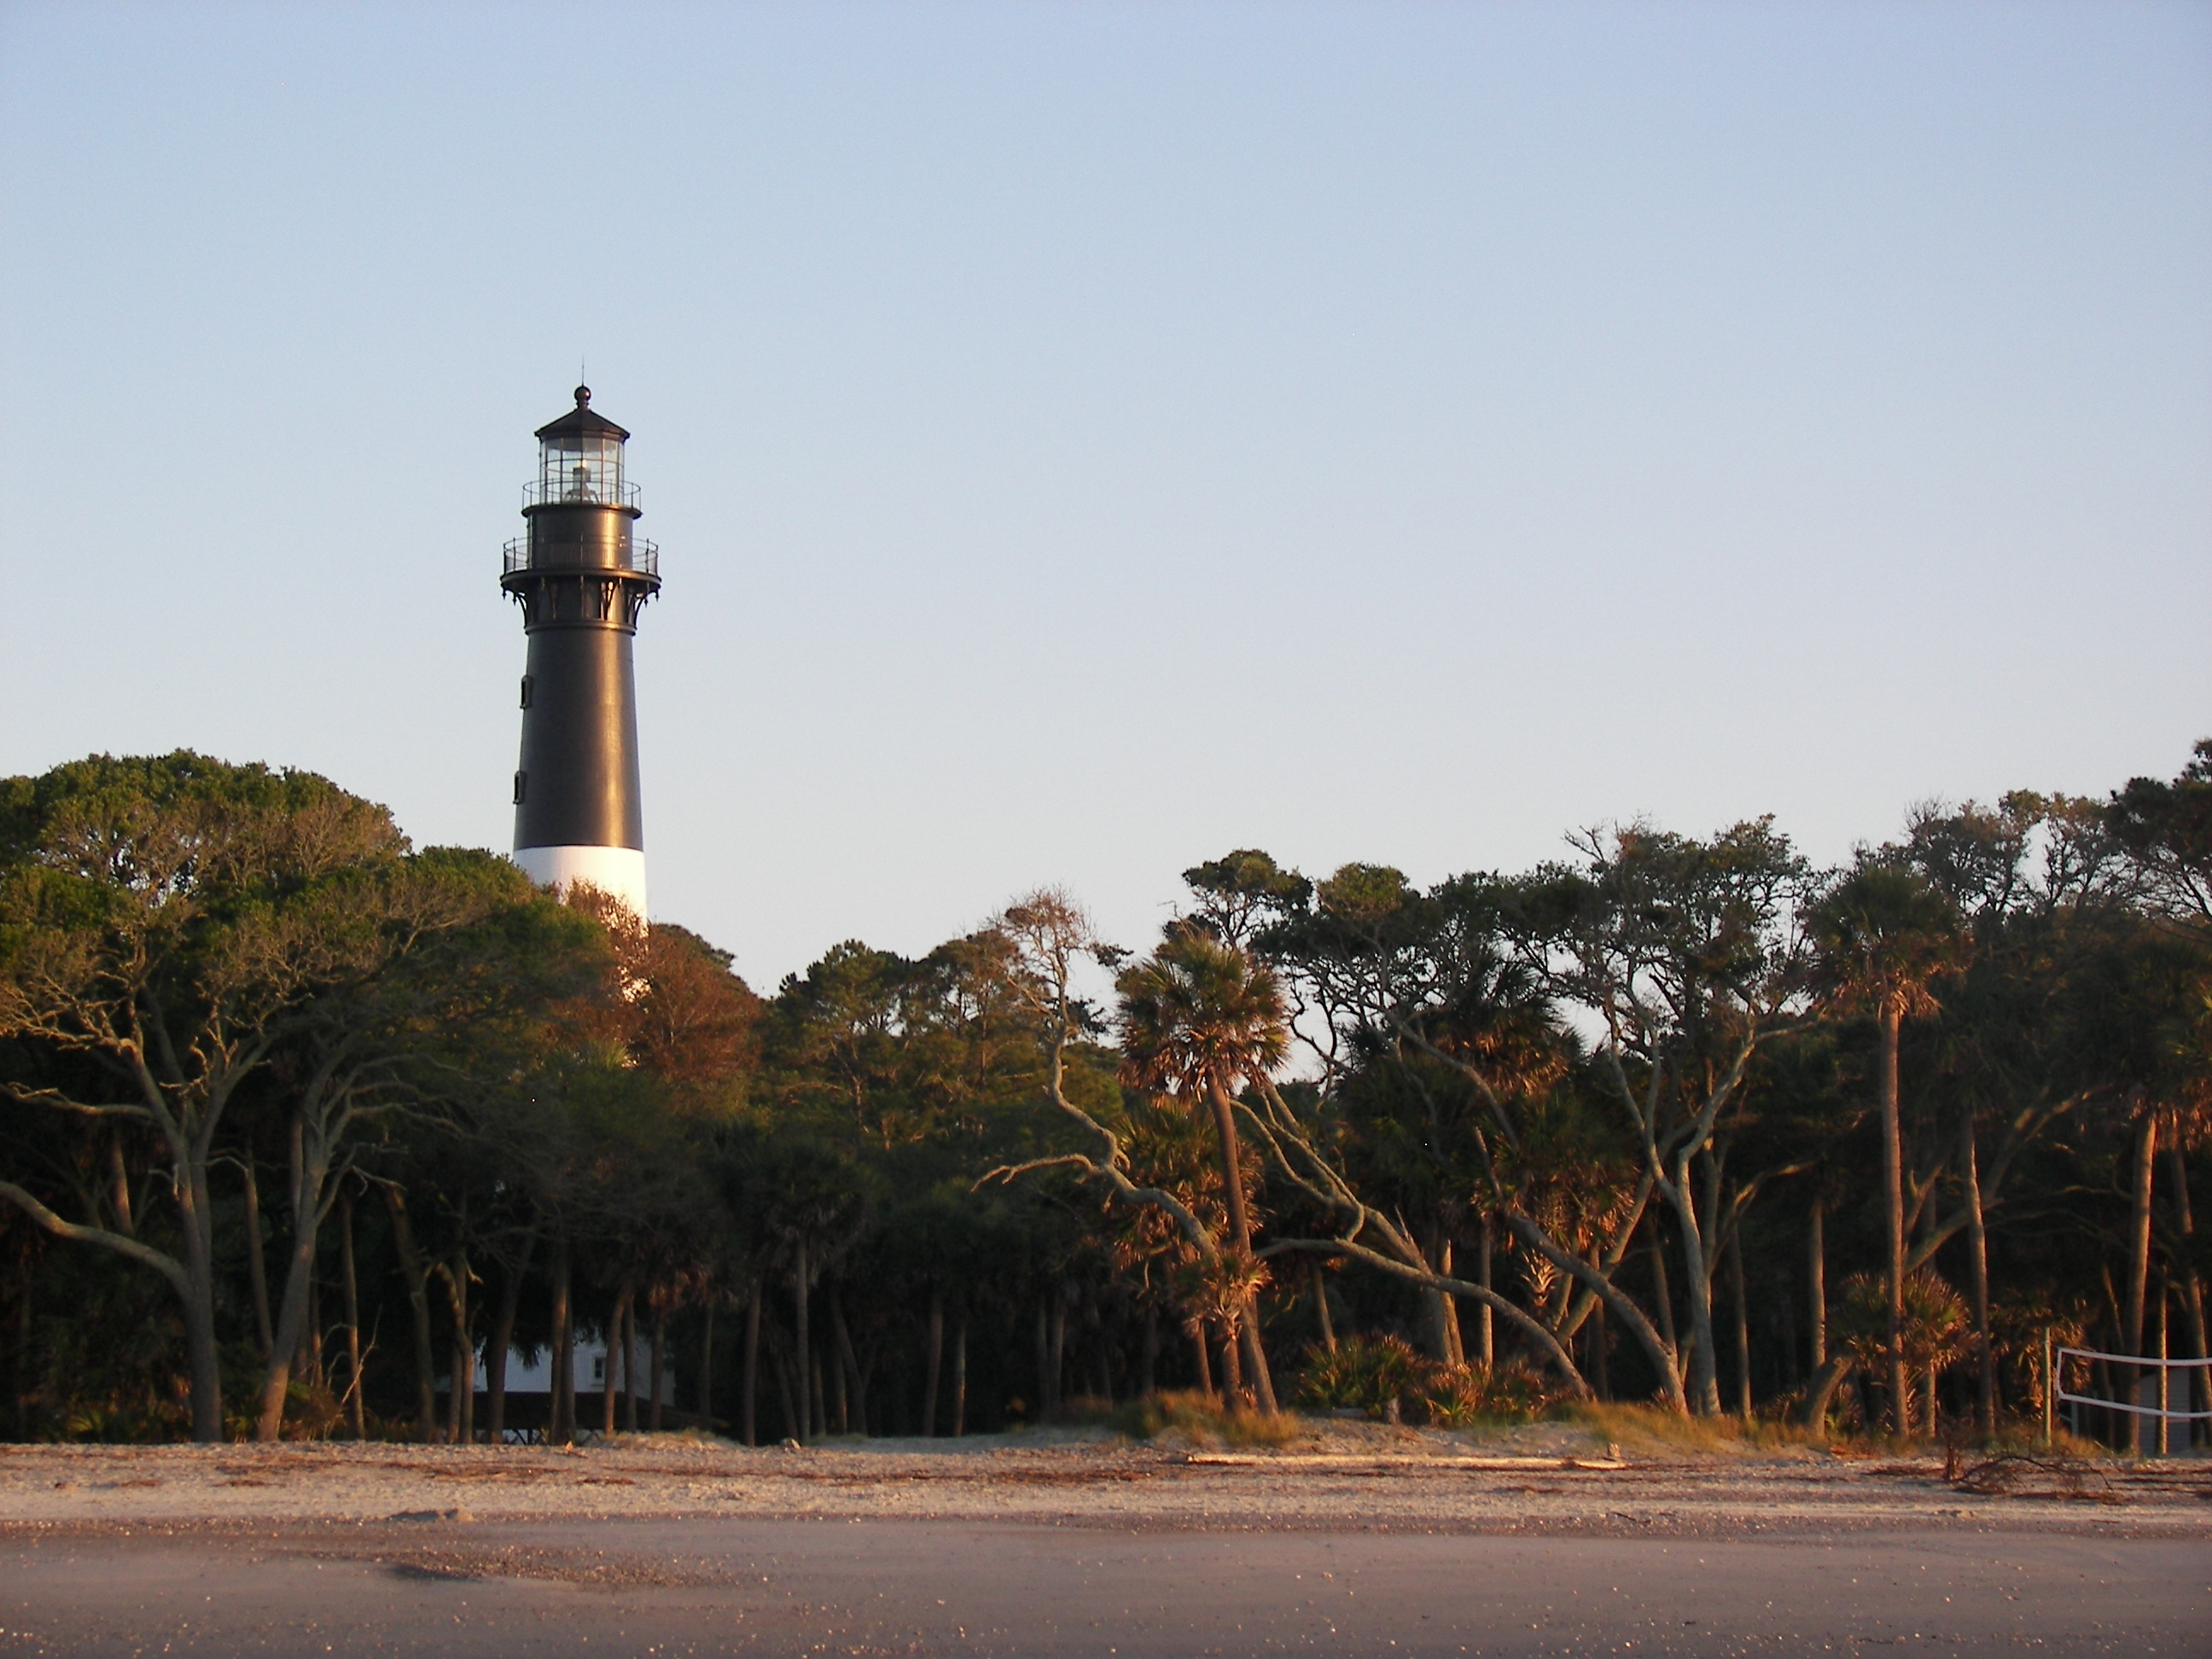
Image Credits
Title Slide: South Carolina State House, by HaloMasterMind, Uploaded 30 August 2013, Wikimedia Commons
End Slide: Hunting Island 1, Public Domain, Wikimedia Commons
Return to Main Menu

