Slide 1
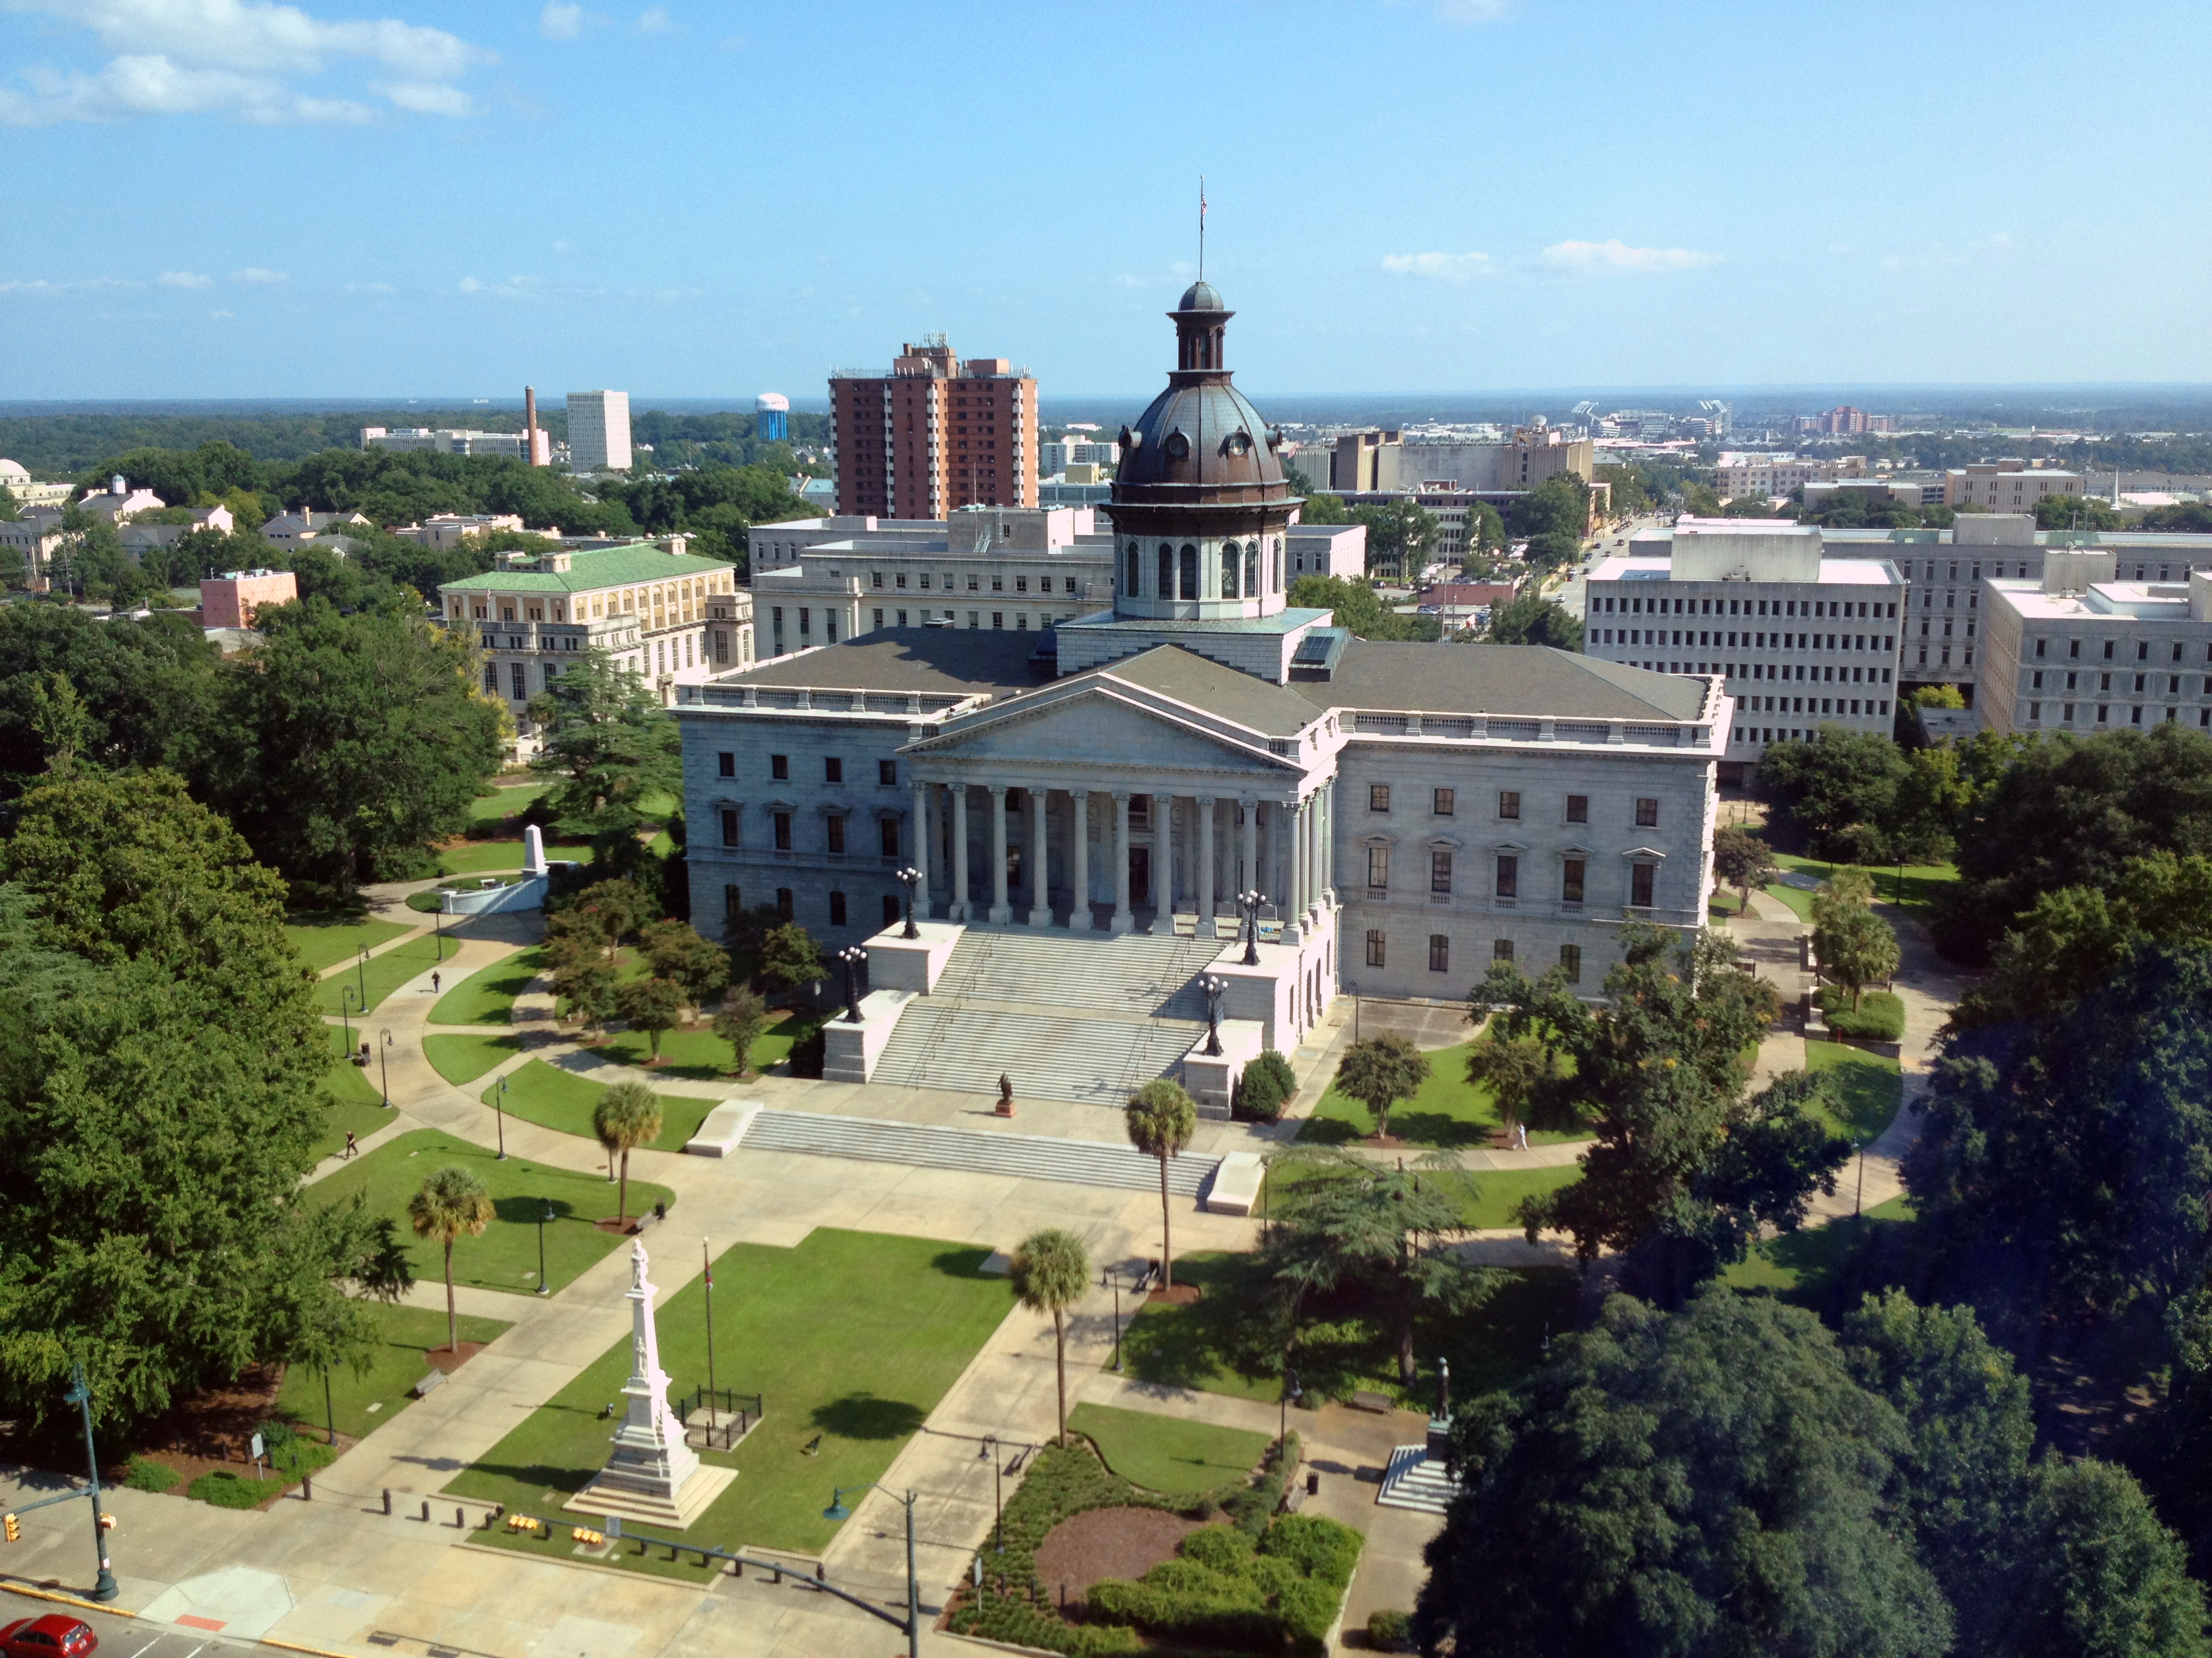
SMART SKILLS
Week 35 – Political Cartoon 7
© 2021 Clairmont Press

Slide 2
Monday
Click this to go to the Political Cartoon for this week.
Walt Handelsman. “2016 Election Accessories,” April 9 2016.
Who is the artist of the political cartoon?
What is the date of the political cartoon?
Who or what is the subject of the cartoon?
Notes:
Walt Handelsman
It shows what ”items” people used when listening to their favored candidates.

Slide 3
Tuesday
Click this to go to the Political Cartoon for this week.
Walt Handelsman. “2016 Election Accessories,” April 9 2016.
Describe what you are viewing in the political cartoon.
How is the artist trying to convey his message?

Slide 4
Wednesday
Click this to go to the Political Cartoon for this week.
Walt Handelsman. “2016 Election Accessories,” April 9 2016.
What is the cartoon meant to signify: humor, anger, sarcasm, or disgust?
What emotions does the cartoon stir in you?

Slide 5
Thursday
Click this to go to the Political Cartoon for this week.
Walt Handelsman. “2016 Election Accessories,” April 9 2016.
Does the cartoonist choose a political side in this cartoon?
Do you feel like the cartoonist is making a fair statement? Explain.

Slide 6
Friday
Click this to go to the Political Cartoon for this week.
Walt Handelsman. “2016 Election Accessories,” April 9 2016.
How can a cartoonist be an influential citizen in society?
Why is it important to analyze the political standpoint of the cartoon?

Slide 7

Image Credits
Title Slide: South Carolina State House, by HaloMasterMind, Uploaded 30 August 2013, Wikimedia Commons
End Slide: Hunting Island 1, Public Domain, Wikimedia Commons
Return to Main Menu

