Slide 1
SMART SKILLS
Week 6 – Map 2
© 2021 Clairmont Press

Slide 2
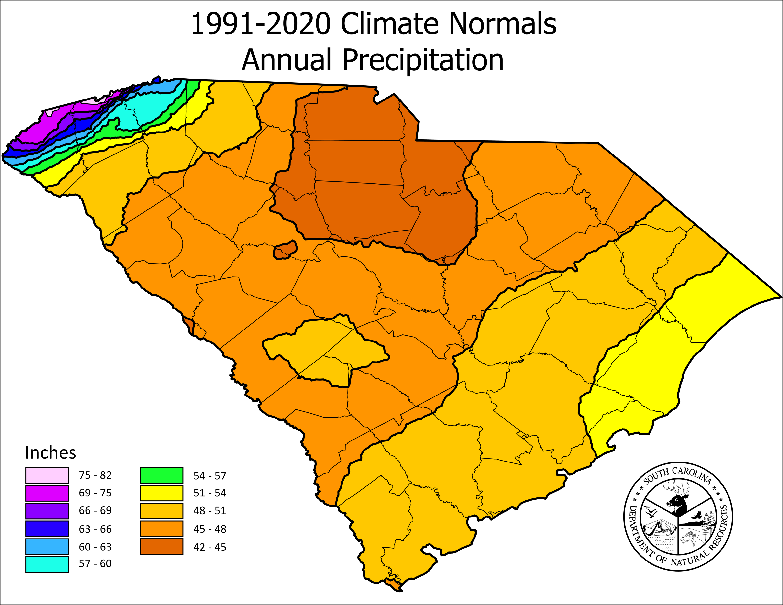
Monday
South Carolina Average
What does the map depict?

Slide 3
Tuesday
South Carolina Average
What is the range of average annual rainfall for the entire state of South Carolina?

Slide 4
Wednesday
South Carolina Average
What region of the state has the least rainfall? Which has the most?

Slide 5
Thursday
South Carolina Average
Why do you think the mapmaker chose these colors to represent the range of precipitation?

Slide 6
Friday
South Carolina Average
List 3 professions in South Carolina that may use a map like this in their work.

Slide 7
Image Credits
Title Slide: South Carolina State House, by HaloMasterMind, Uploaded 30 August 2013, Wikimedia Commons
Slides 2-6: “Annual_Precip.png.” https://www.dnr.sc.gov/water/climate/sco/ClimateData/cli_sc_climate.php. Accessed 26 Oct. 2021.
End Slide: Hunting Island 1, Public Domain, Wikimedia Commons
Return to Main Menu

