Slide 1
SMART SKILLS
Week 11 – Map 3
© 2021 Clairmont Press

Slide 2
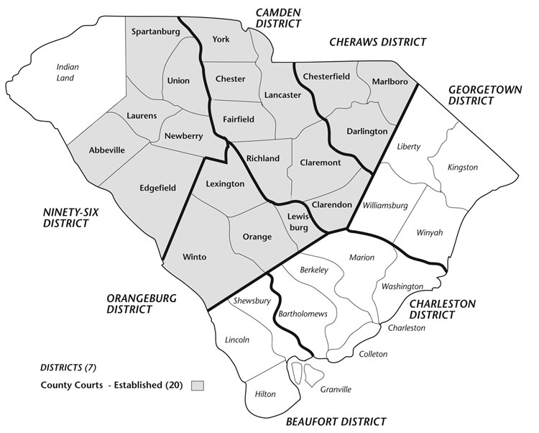
Monday
South Carolina Districts and Counties, 1785
What does the map depict?

Slide 3
Tuesday
South Carolina Districts and Counties, 1785
Which part of the state was controlled by Native peoples?

Slide 4
Wednesday
South Carolina Districts and Counties, 1785
How many English counties are there? How many English districts are there?
If able, list what county and district your school would be located in.

Slide 5
Thursday
South Carolina Districts and Counties, 1785
In which district is Charleston located? How many counties border the Atlantic Ocean?

Slide 6
Friday
South Carolina Districts and Counties, 1785
List 3 factors that could have contributed to South Carolina’s counties being located where they were in 1785.

Slide 7
Image Credits
Title Slide: South Carolina State House, by HaloMasterMind, Uploaded 30 August 2013, Wikimedia Commons
Slides 2-6: South Carolina counties in 1785. (n.d.). Retrieved November 4, 2021, from http://www.archivesindex.sc.gov/guide/CountyRecords/1785.htm.
End Slide: Hunting Island 1, Public Domain, Wikimedia Commons
Return to Main Menu

