Slide 1
SMART SKILLS
Week 16 – Map 4
© 2021 Clairmont Press

Slide 2
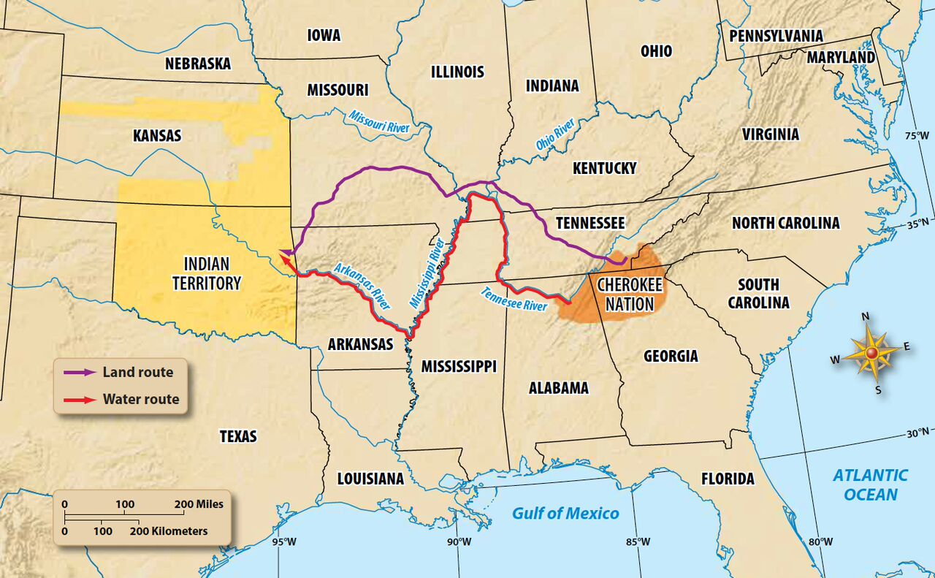
Monday
The Trail of Tears, 1838-39
What historic event is depicted on the map? When did it occur?

Slide 3
Tuesday
The Trail of Tears, 1838-39
Which group of Native Americans was sent on the Trail of Tears? From which states did they originate?

Slide 4
Wednesday
The Trail of Tears, 1838-39
Which modern-day states were a part of Indian Territory? Which direction was this from the Cherokee homeland?

Slide 5
Thursday
The Trail of Tears, 1838-39
How many routes were used to remove the Cherokee? How are they represented on the map?

Slide 6
Friday
The Trail of Tears, 1838-39
Using the scale on the map, approximately how far were the Cherokee moved from their homeland?

Slide 7
Image Credits
Title Slide: South Carolina State House, by HaloMasterMind, Uploaded 30 August 2013, Wikimedia Commons
End Slide: Hunting Island 1, Public Domain, Wikimedia Commons
Return to Main Menu

