Slide 1
SMART SKILLS
Week 21 – Map 5
© 2021 Clairmont Press

Slide 2
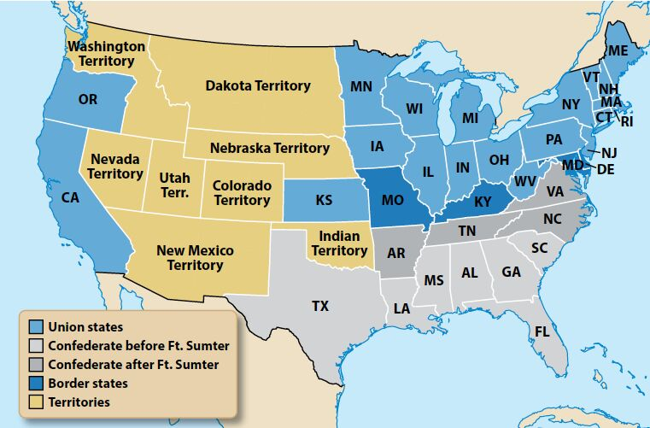
Monday
Secession, 1860-61
What does the map depict? When did this occur?

Slide 3
Tuesday
Secession, 1860-61
Which two states are a part of the Union but not located in the North?

Slide 4
Wednesday
Secession, 1860-61
What color is used to indicate a territory? How many are there? Which nation controlled this area?

Slide 5
Thursday
Secession, 1860-61
How many states are Confederate? Why do you think the mapmaker indicated a difference in “before” and “after” Ft. Sumter?

Slide 6
Friday
Secession, 1860-61
What states are border states? Why are border states significant?

Slide 7
Image Credits
Title Slide: South Carolina State House, by HaloMasterMind, Uploaded 30 August 2013, Wikimedia Commons
End Slide: Hunting Island 1, Public Domain, Wikimedia Commons
Return to Main Menu

