Slide 1
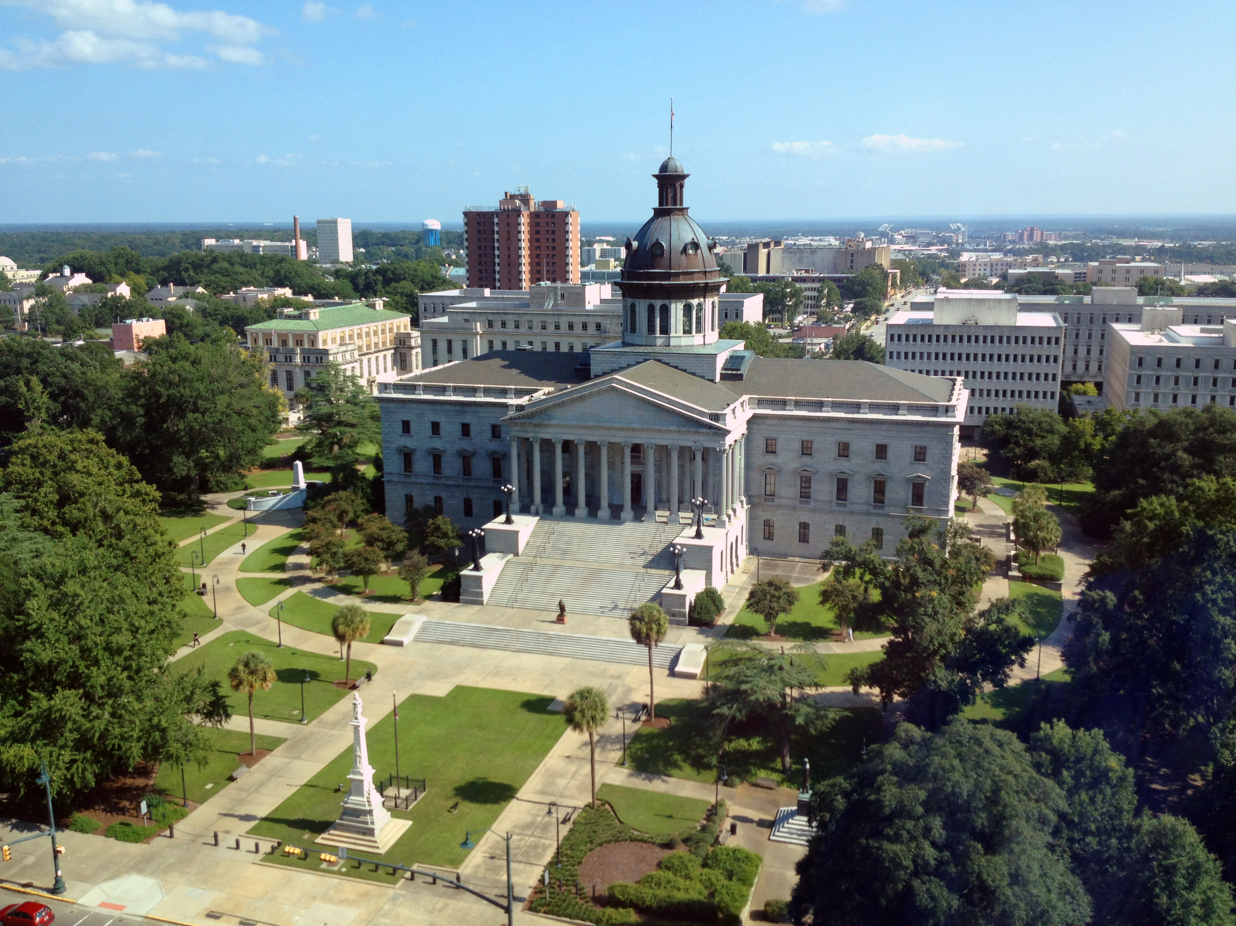
SMART SKILLS
Teacher’s Overview
© 2021 Clairmont Press

Slide 2
Overview
The goal of the Smart Skills presentations is to promote mastery of a skill and further support the standards.
The questions promote higher order thinking (interpreting, analyzing, formulating, determining, etc.).
By using these questions to begin a lesson, students will be guaranteed work in essential skills throughout the year. For example: 5 minutes a day, 5 days a week, for seven weeks each skill equals to 2 ½ class periods devoted to each skill per year.

Slide 3
How to Use the System
    Simply follow the weeks 1-35 as shown in the chart on slide 4. For week one, use presentation file Wk1_Map1 (Week 1, Map 1). Maps will be the focus again in weeks 6, 11, 16, 21, 26, and 31.
Each day of the week uses the same presentation. The slide days are marked and the answers are in the Notes section of the slide. Answers and discussion should take no more than five minutes.
As the week progresses, the questions become more rigorous and/or open-ended. By Friday, the students are challenged with higher level questions.
The chart on slide 4 shows the progression:
    Maps
    Charts and Graphs
    Analyzing Artifacts and Documents
    Timelines
    Political Cartoons

Slide 4
Map/ Globe Skills | Charts/ Graphs | Analyzing Artifacts | Timelines | Political Cartoons
Map 1 Week 1 | C/G 1 Week 2 | Artifact 1 Week 3 | Timeline 1 Week 4 | Cartoon 1 Week 5
Map 2 Week 6 | C/G 2 Week 7 | Artifact 2 Week 8 | Timeline 2 Week 9 | Cartoon 2 Week 10
Map 3 Week 11 | C/G 3 Week 12 | Artifact 3 Week 13 | Timeline 3 Week 14 | Cartoon 3 Week 15
Map 4 Week 16 | C/G 4 Week 17 | Artifact 4 Week 18 | Timeline 4 Week 19 | Cartoon 4 Week 20
Map 5 Week 21 | C/G 5 Week 22 | Artifact 5 Week 23 | Timeline 5 Week 24 | Cartoon 5 Week 25
Map 6 Week 26 | C/G 6 Week 27 | Artifact 6 Week 28 | Timeline 6 Week 29 | Cartoon 6 Week 30
Map 7 Week 31 | C/G 7 Week 32 | Artifact 7 Week 33 | Timeline 7 Week 34 | Cartoon 7 Week 35

Slide 5
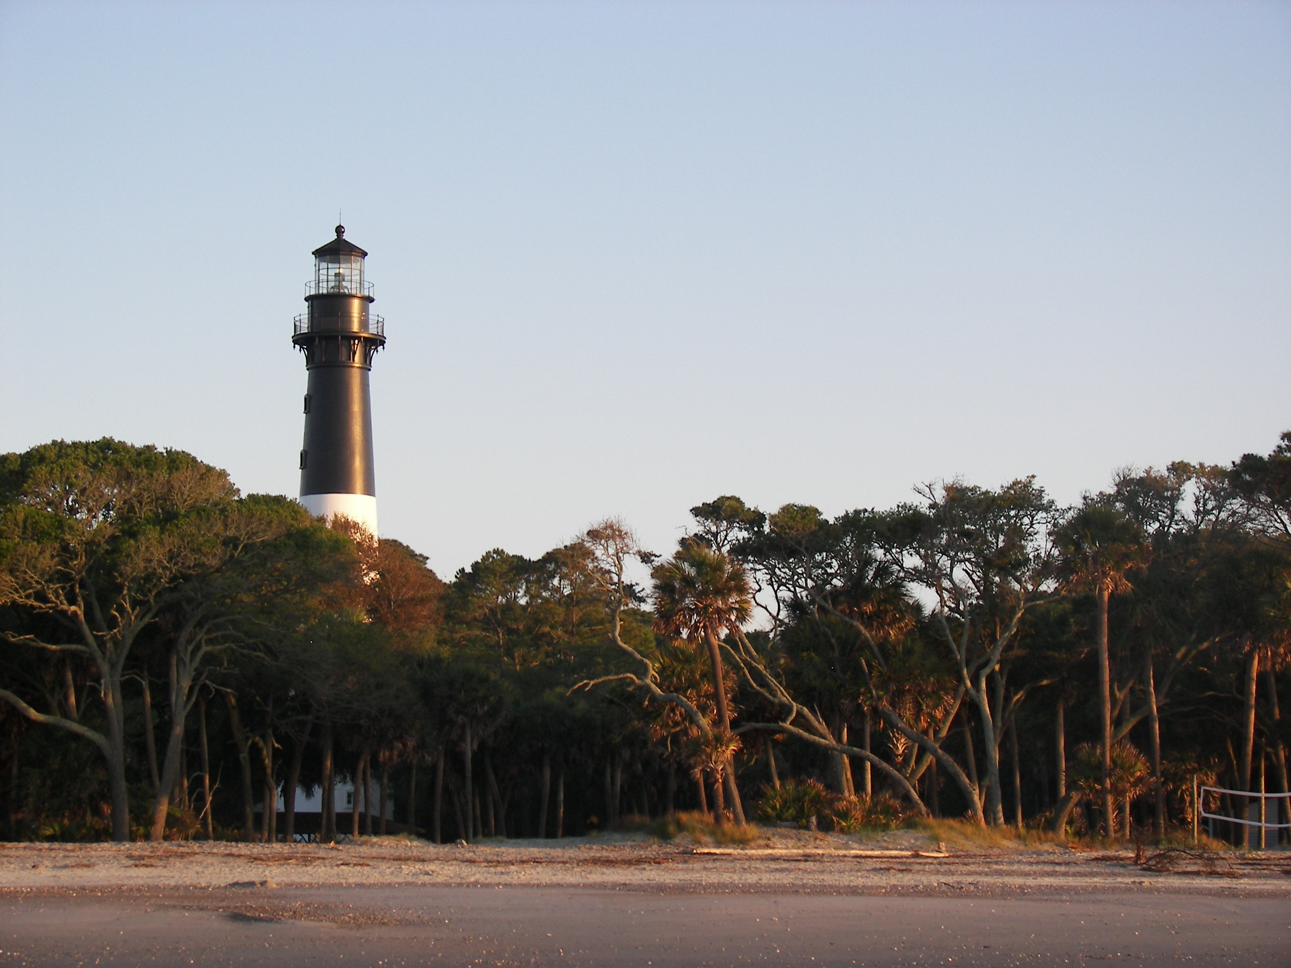
Image Credits
Title Slide: South Carolina State House, by HaloMasterMind, Uploaded 30 August 2013, Wikimedia Commons
End Slide: Hunting Island 1, Public Domain, Wikimedia Commons
Return to Main Menu

