Slide 1

SMART SKILLS
Week 14 – Timeline 3
© 2021 Clairmont Press

Slide 2
Monday
Early Republic
1800
1803
Louisiana Purchase
1805
1807
Congress bans import of slaves
1810
1815 – War of 1812 ends
1820 – Missouri Compromise
1812
War of 1812 begins
1825
1830 – Indian Removal Act
1835
1838
Cherokee Trail of Tears
  What does the timeline show?

Slide 3
Tuesday
Early Republic
1800
1803
Louisiana Purchase
1805
1807
Congress bans import of slaves
1810
1815 – War of 1812 ends
1820 – Missouri Compromise
1812
War of 1812 begins
1825
1830 – Indian Removal Act
1835
1838
Cherokee Trail of Tears
  When did the Louisiana Purchase occur?

Slide 4
Wednesday
Early Republic
1800
1803
Louisiana Purchase
1805
1807
Congress bans import of slaves
1810
1815 – War of 1812 ends
1820 – Missouri Compromise
1812
War of 1812 begins
1825
1830 – Indian Removal Act
1835
1838
Cherokee Trail of Tears
  Based on the timeline, how long was the War of 1812?

Slide 5
Thursday
Early Republic
1800
1803
Louisiana Purchase
1805
1807
Congress bans import of slaves
1810
1815 – War of 1812 ends
1820 – Missouri Compromise
1812
War of 1812 begins
1825
1830 – Indian Removal Act
1835
1838
Cherokee Trail of Tears
  List two events on the timeline that are connected. How are these events connected?

Slide 6
Friday
Early Republic
1800
1803
Louisiana Purchase
1805
1807
Congress bans import of slaves
1810
1815 – War of 1812 ends
1820 – Missouri Compromise
1812
War of 1812 begins
1825
1830 – Indian Removal Act
1835
1838
Cherokee Trail of Tears
  This timeline is titled “Early Republic.” Give the timeline a new name that would explain its information.

Slide 7
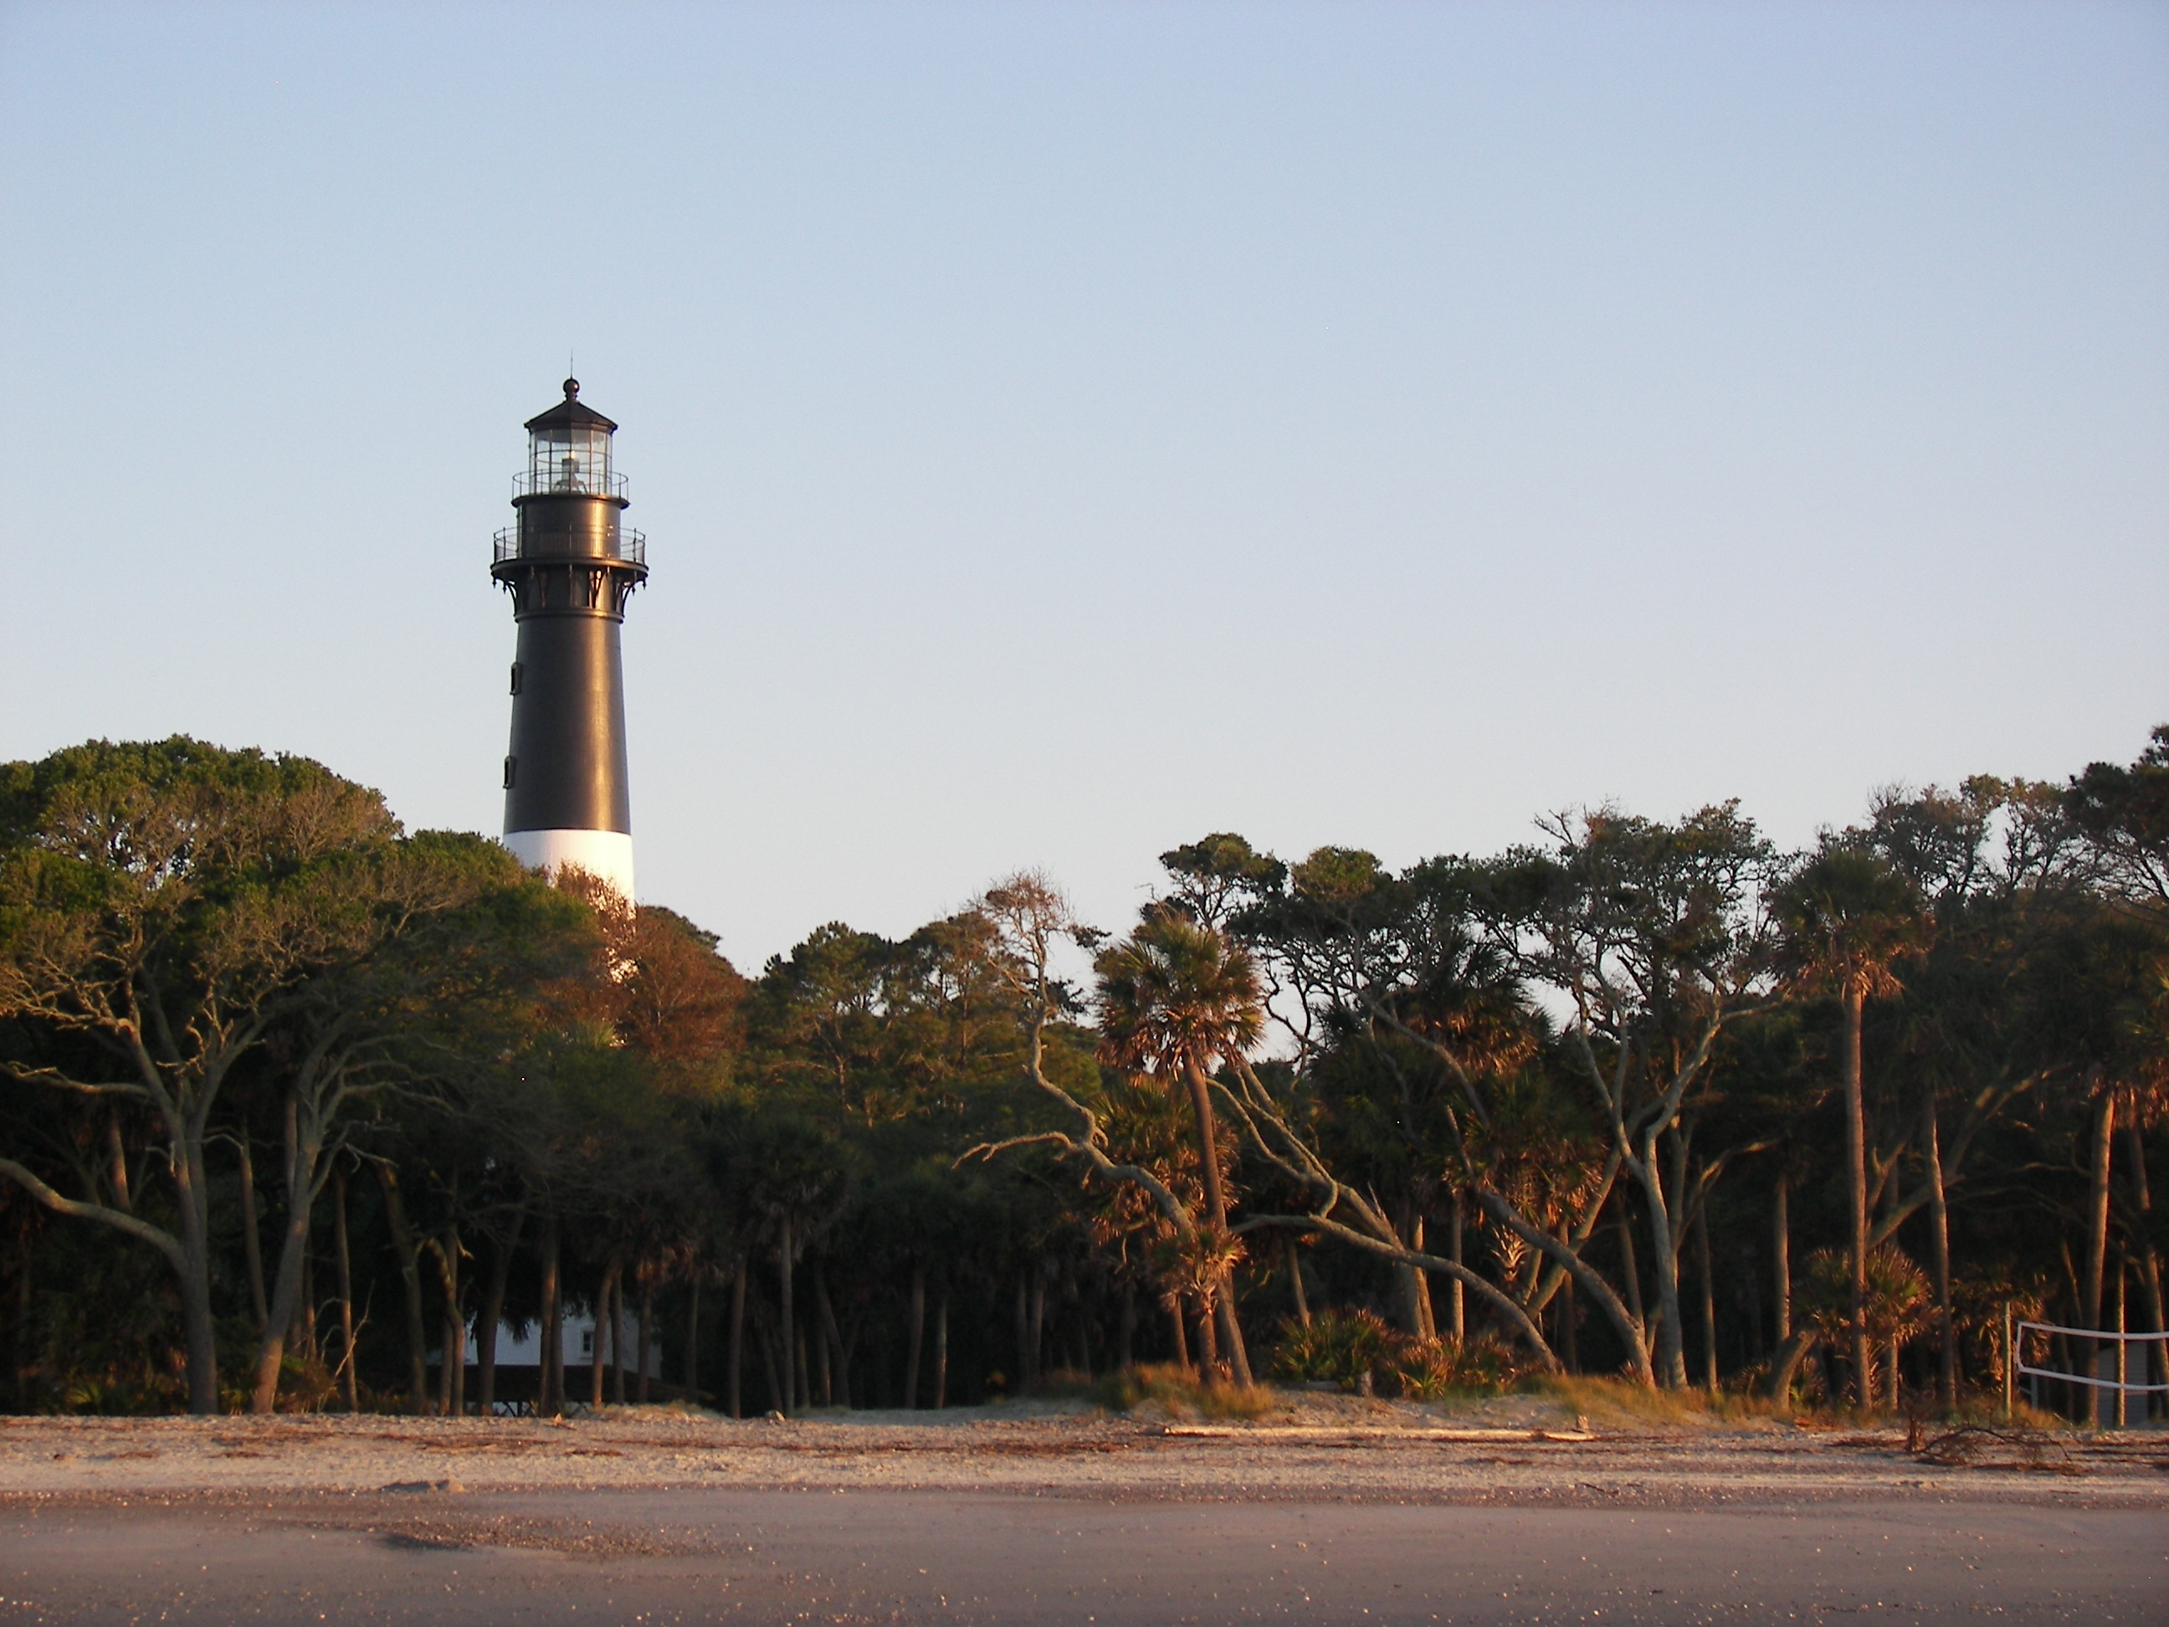
Image Credits
Title Slide: South Carolina State House, by HaloMasterMind, Uploaded 30 August 2013, Wikimedia Commons
End Slide: Hunting Island 1, Public Domain, Wikimedia Commons
Return to Main Menu

