Slide 1
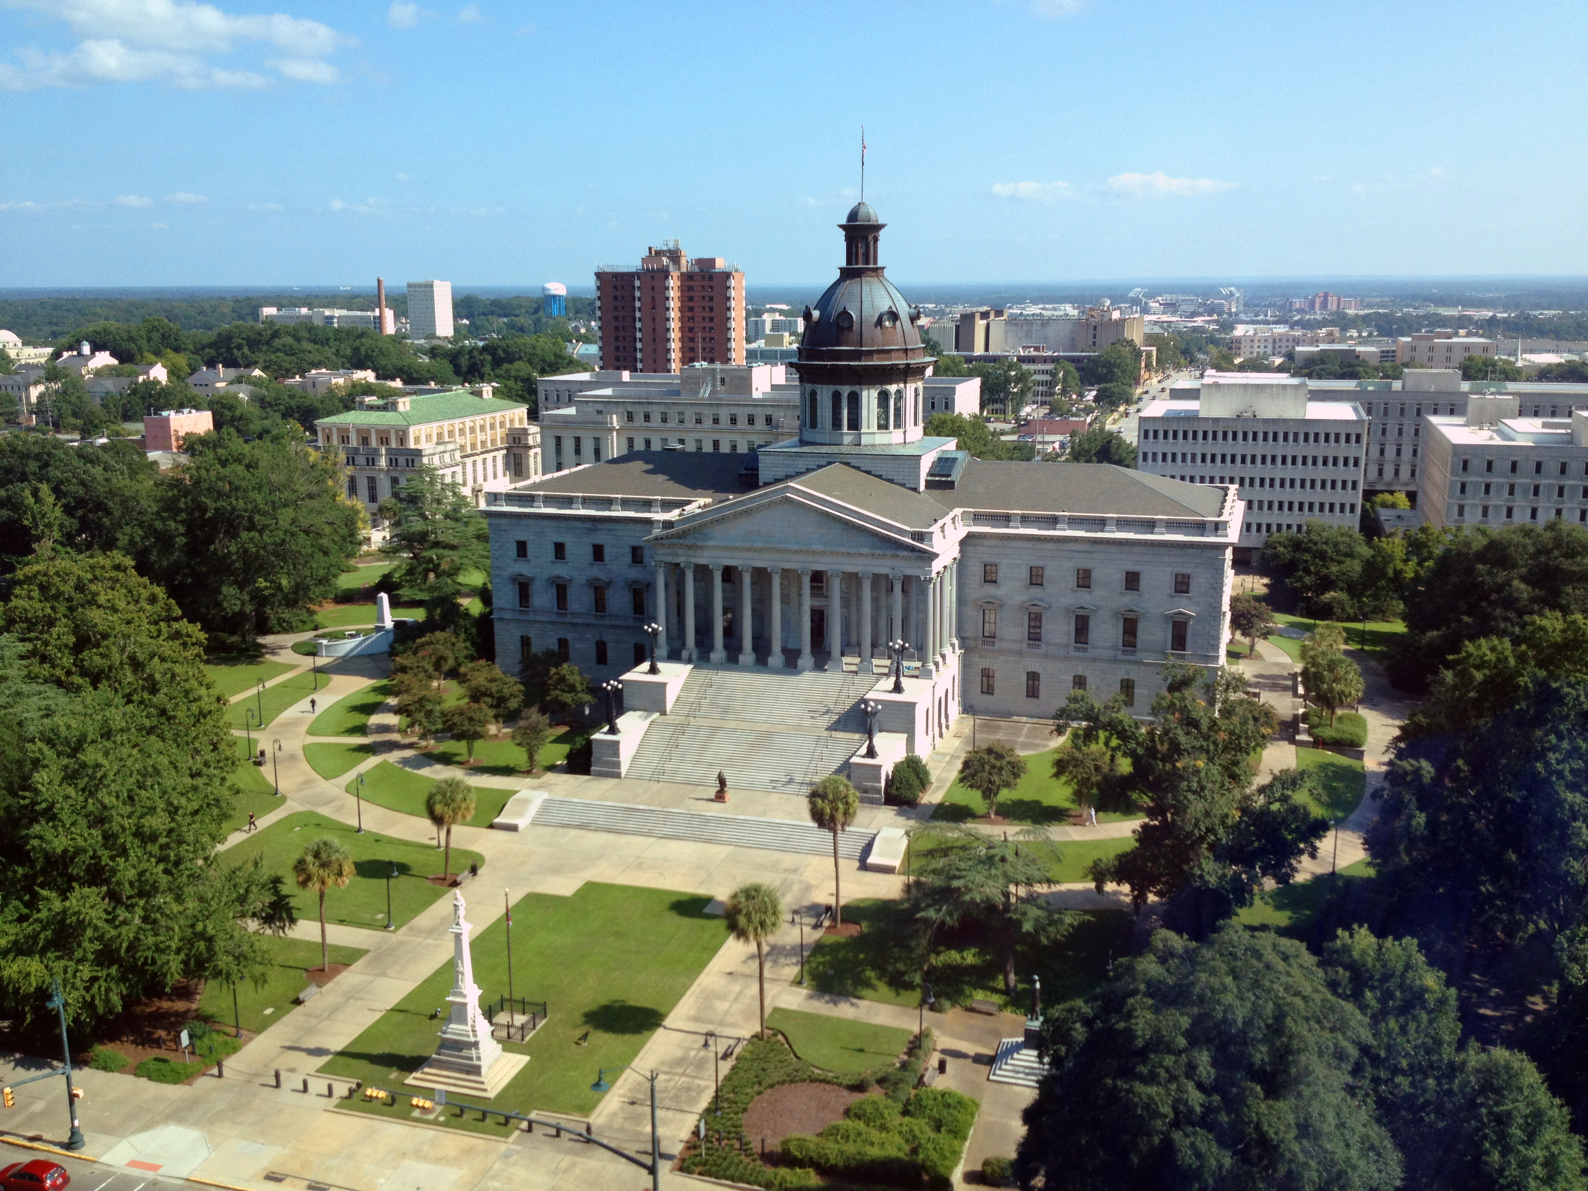
SMART SKILLS
Week 19 – Timeline 4
© 2021 Clairmont Press

Slide 2
Monday
1850
Compromise of 1850
1852
Uncle Tom’s Cabin published
1854
Kansas-Nebraska Act
1856
1857: Dred Scott Decision
1858
1860
1859:
John Brown’s Raid at Harper’s Ferry
Causes of the Civil War
  What does the timeline show? How long is the timespan shown?

Slide 3
Tuesday
1850
Compromise of 1850
1852
Uncle Tom’s Cabin published
1854
Kansas-Nebraska Act
1856
1857: Dred Scott Decision
1858
1860
1859:
John Brown’s Raid at Harper’s Ferry
Causes of the Civil War
  How many events of the 1850s are shown?

Slide 4
Wednesday
1850
Compromise of 1850
1852
Uncle Tom’s Cabin published
1854
Kansas-Nebraska Act
1856
1857: Dred Scott Decision
1858
1860
1859:
John Brown’s Raid at Harper’s Ferry
Causes of the Civil War
  How many events on the chart were events in government? List them.

Slide 5
Thursday
1850
Compromise of 1850
1852
Uncle Tom’s Cabin published
1854
Kansas-Nebraska Act
1856
1857: Dred Scott Decision
1858
1860
1859:
John Brown’s Raid at Harper’s Ferry
Causes of the Civil War
  What is the relationship between Uncle Tom’s Cabin and John Brown’s Raid?

Slide 6
Friday
1850
Compromise of 1850
1852
Uncle Tom’s Cabin published
1854
Kansas-Nebraska Act
1856
1857: Dred Scott Decision
1858
1860
1859:
John Brown’s Raid at Harper’s Ferry
Causes of the Civil War
  If you were to continue this timeline in to the next decade, list 3 events you could add.

Slide 7
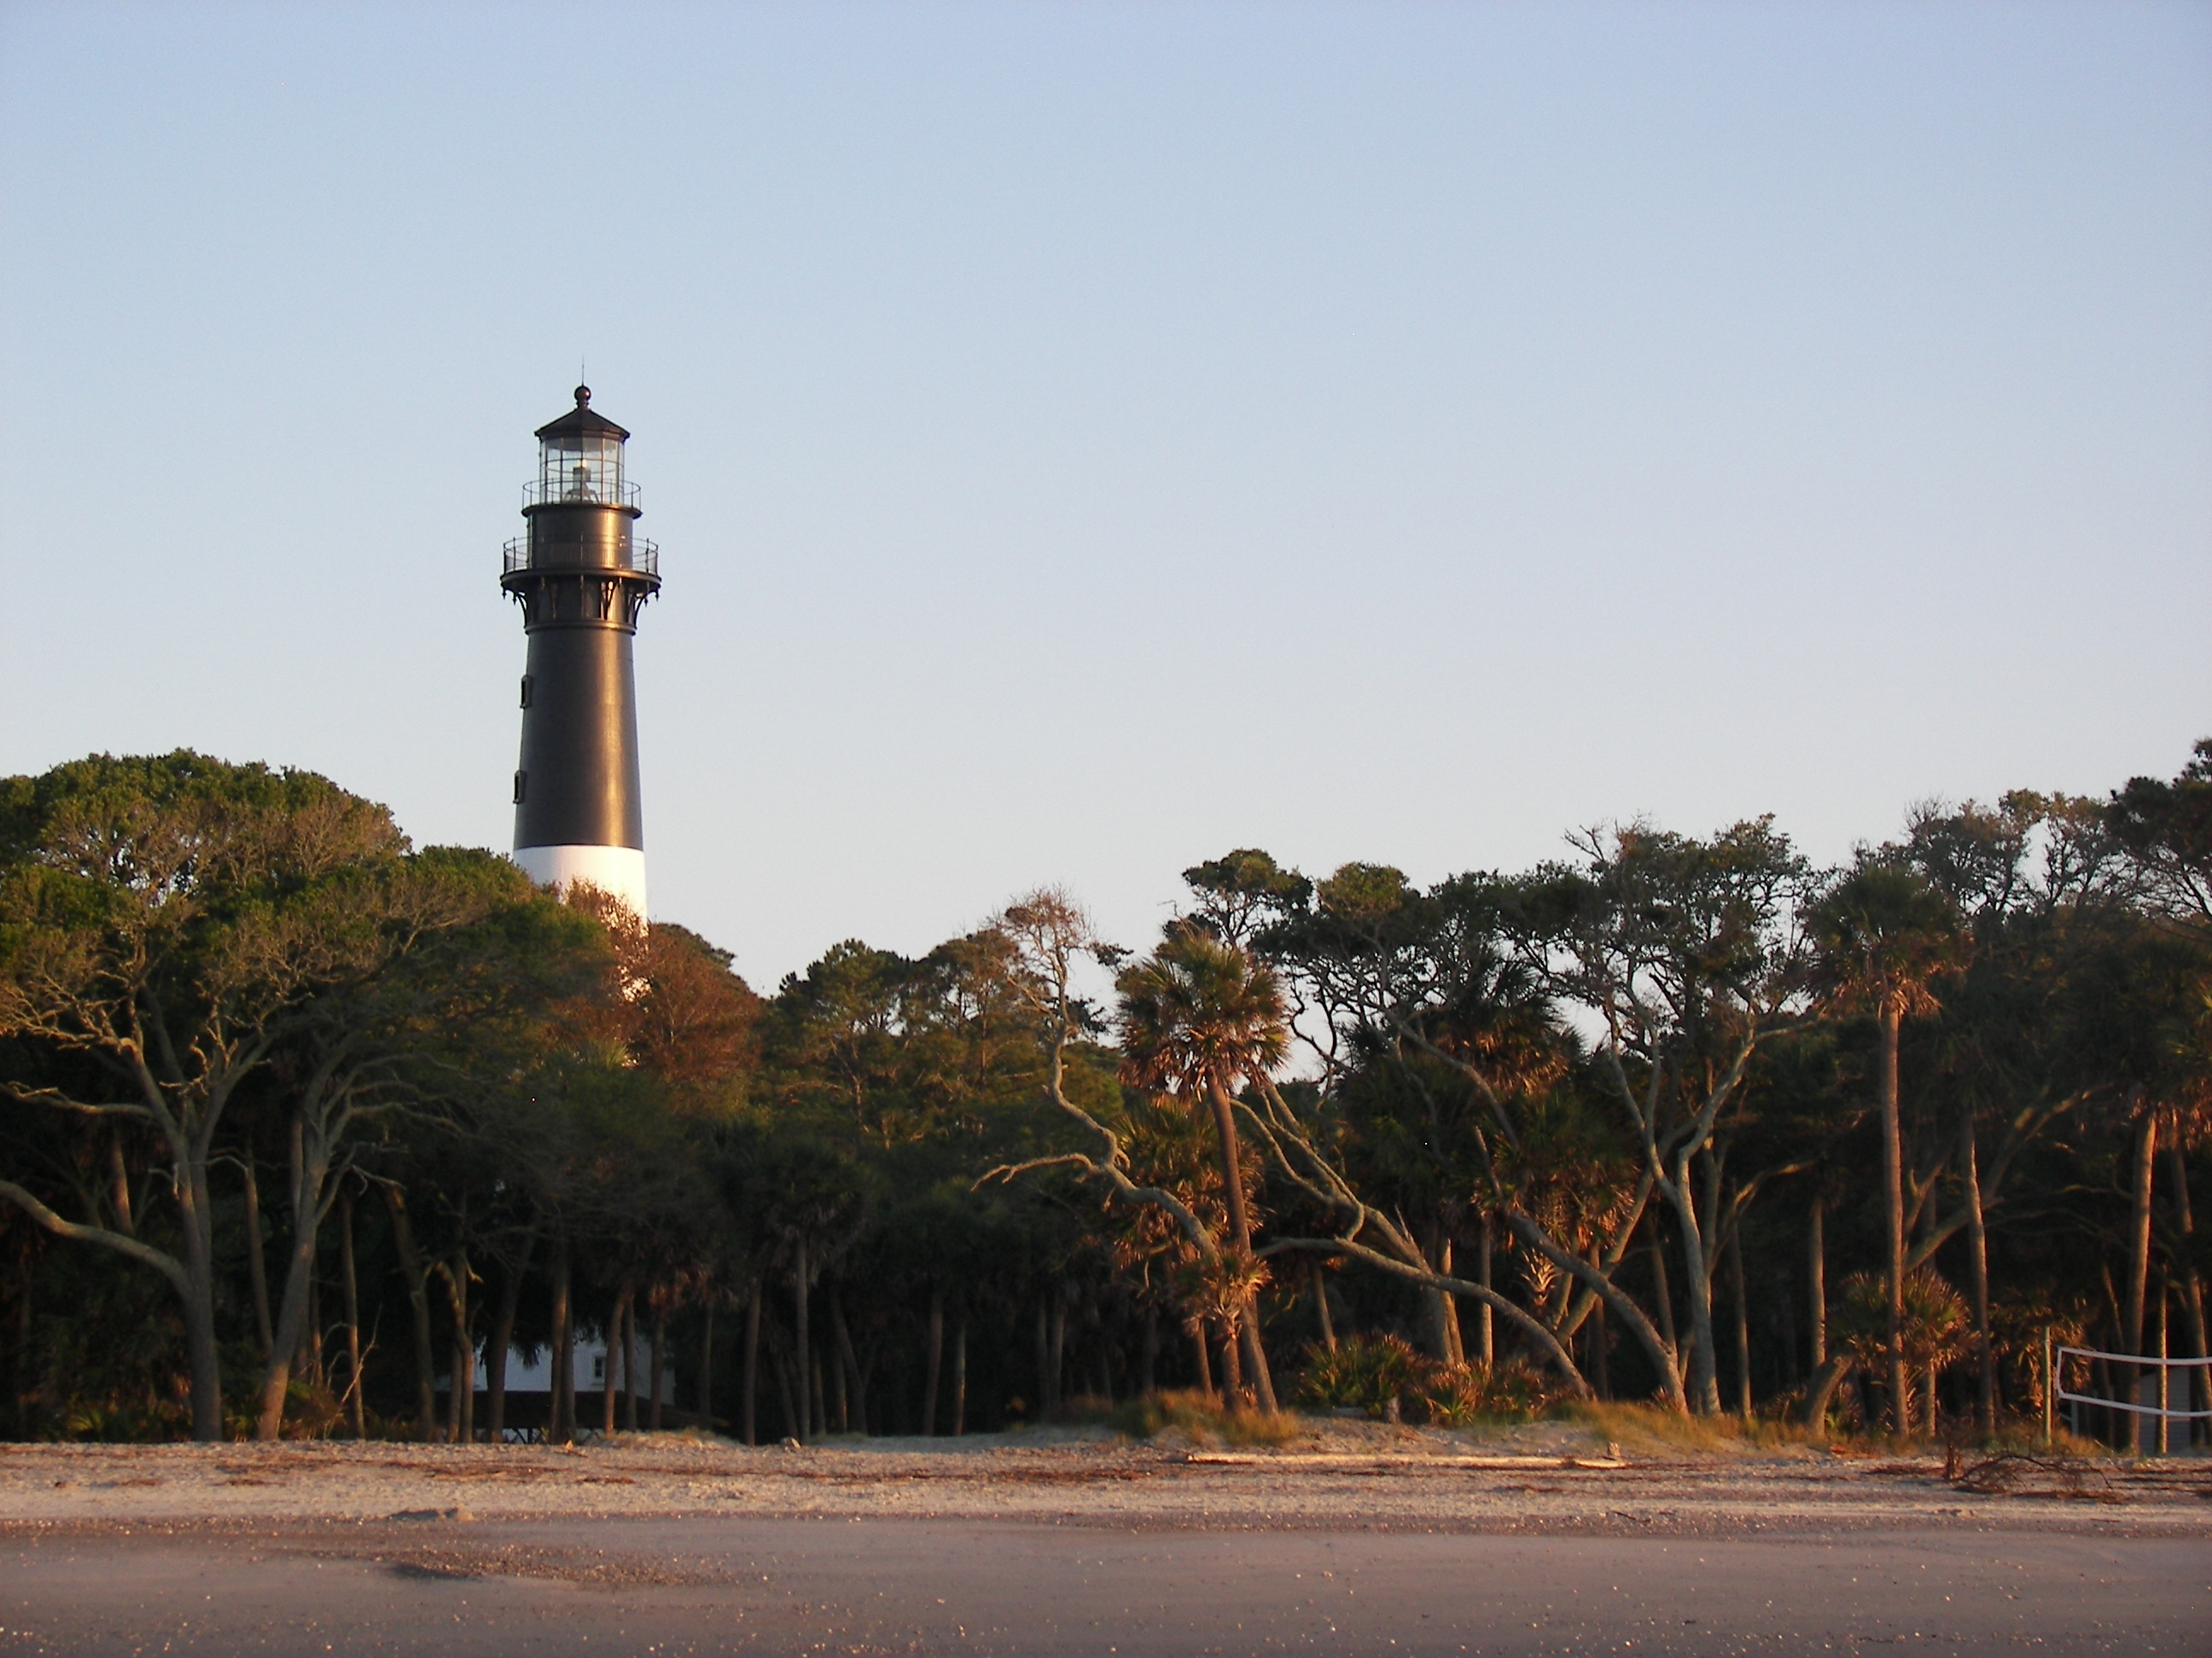
Image Credits
Title Slide: South Carolina State House, by HaloMasterMind, Uploaded 30 August 2013, Wikimedia Commons
End Slide: Hunting Island 1, Public Domain, Wikimedia Commons
Return to Main Menu

