Slide 1
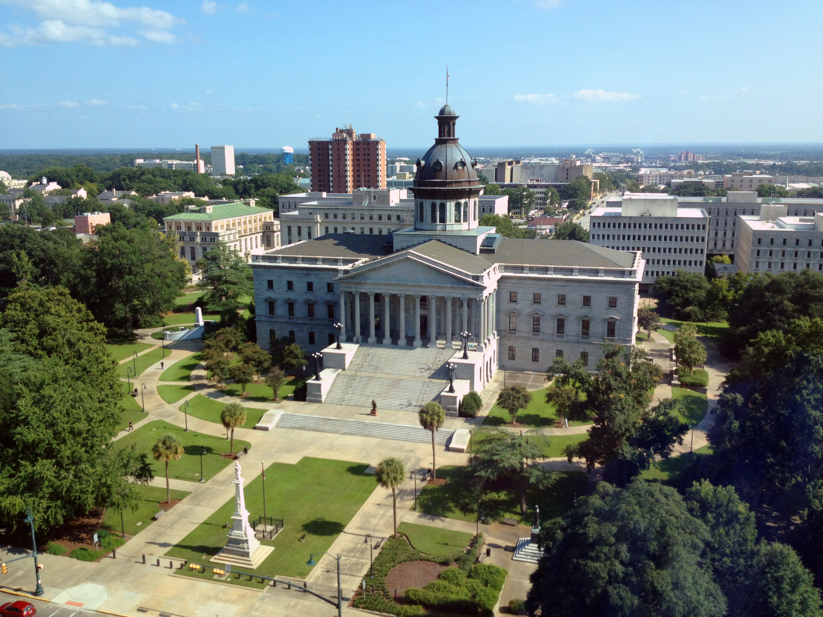
SMART SKILLS
Week 29 – Timeline 6
© 2021 Clairmont Press

Slide 2
Monday
1941
FDR gives “Day of Infamy” speech, US enters WWII
1942
US drops atomic bombs on Hiroshima and Nagasaki
1943
1944
1945
Japanese attack Pearl Harbor
Island Hopping campaign in Pacific begins
Japan surrenders, V-J Day
FDR dies, Truman becomes President
D-Day invasion
Doolittle’s Raid
Americans capture Guadalcanal
US liberates Guam
Battle of Iwo Jima
War in Europe ends
Battle of the Bulge begins
United States in
World War II
  What does the timeline show? What is the timespan included?

Slide 3
Tuesday
1941
FDR gives “Day of Infamy” speech, US enters WWII
1942
US drops atomic bombs on Hiroshima and Nagasaki
1943
1944
1945
Japanese attack Pearl Harbor
Island Hopping campaign in Pacific begins
Japan surrenders, V-J Day
FDR dies, Truman becomes President
D-Day invasion
Doolittle’s Raid
Americans capture Guadalcanal
US liberates Guam
Battle of Iwo Jima
War in Europe ends
Battle of the Bulge begins
United States in
World War II
  When did the US enter the War? When did our offensive attacks against Japan start?

Slide 4
Wednesday
1941
FDR gives “Day of Infamy” speech, US enters WWII
1942
US drops atomic bombs on Hiroshima and Nagasaki
1943
1944
1945
Japanese attack Pearl Harbor
Island Hopping campaign in Pacific begins
Japan surrenders, V-J Day
FDR dies, Truman becomes President
D-Day invasion
Doolittle’s Raid
Americans capture Guadalcanal
US liberates Guam
Battle of Iwo Jima
War in Europe ends
Battle of the Bulge begins
United States in
World War II
Categorize the events shown during 1945 based on whether they occurred in the US, Europe, or the Pacific.

Slide 5
Thursday
1941
FDR gives “Day of Infamy” speech, US enters WWII
1942
US drops atomic bombs on Hiroshima and Nagasaki
1943
1944
1945
Japanese attack Pearl Harbor
Island Hopping campaign in Pacific begins
Japan surrenders, V-J Day
FDR dies, Truman becomes President
D-Day invasion
Doolittle’s Raid
Americans capture Guadalcanal
US liberates Guam
Battle of Iwo Jima
War in Europe ends
Battle of the Bulge begins
United States in
World War II
  List two events that occurred during this time period that are not included on the timeline.

Slide 6
Friday
1941
FDR gives “Day of Infamy” speech, US enters WWII
1942
US drops atomic bombs on Hiroshima and Nagasaki
1943
1944
1945
Japanese attack Pearl Harbor
Island Hopping campaign in Pacific begins
Japan surrenders, V-J Day
FDR dies, Truman becomes President
D-Day invasion
Doolittle’s Raid
Americans capture Guadalcanal
US liberates Guam
Battle of Iwo Jima
War in Europe ends
Battle of the Bulge begins
United States in
World War II
  Would this timeline be more improved by showing additional events before or after the dates shown? Explain your thinking.

Slide 7
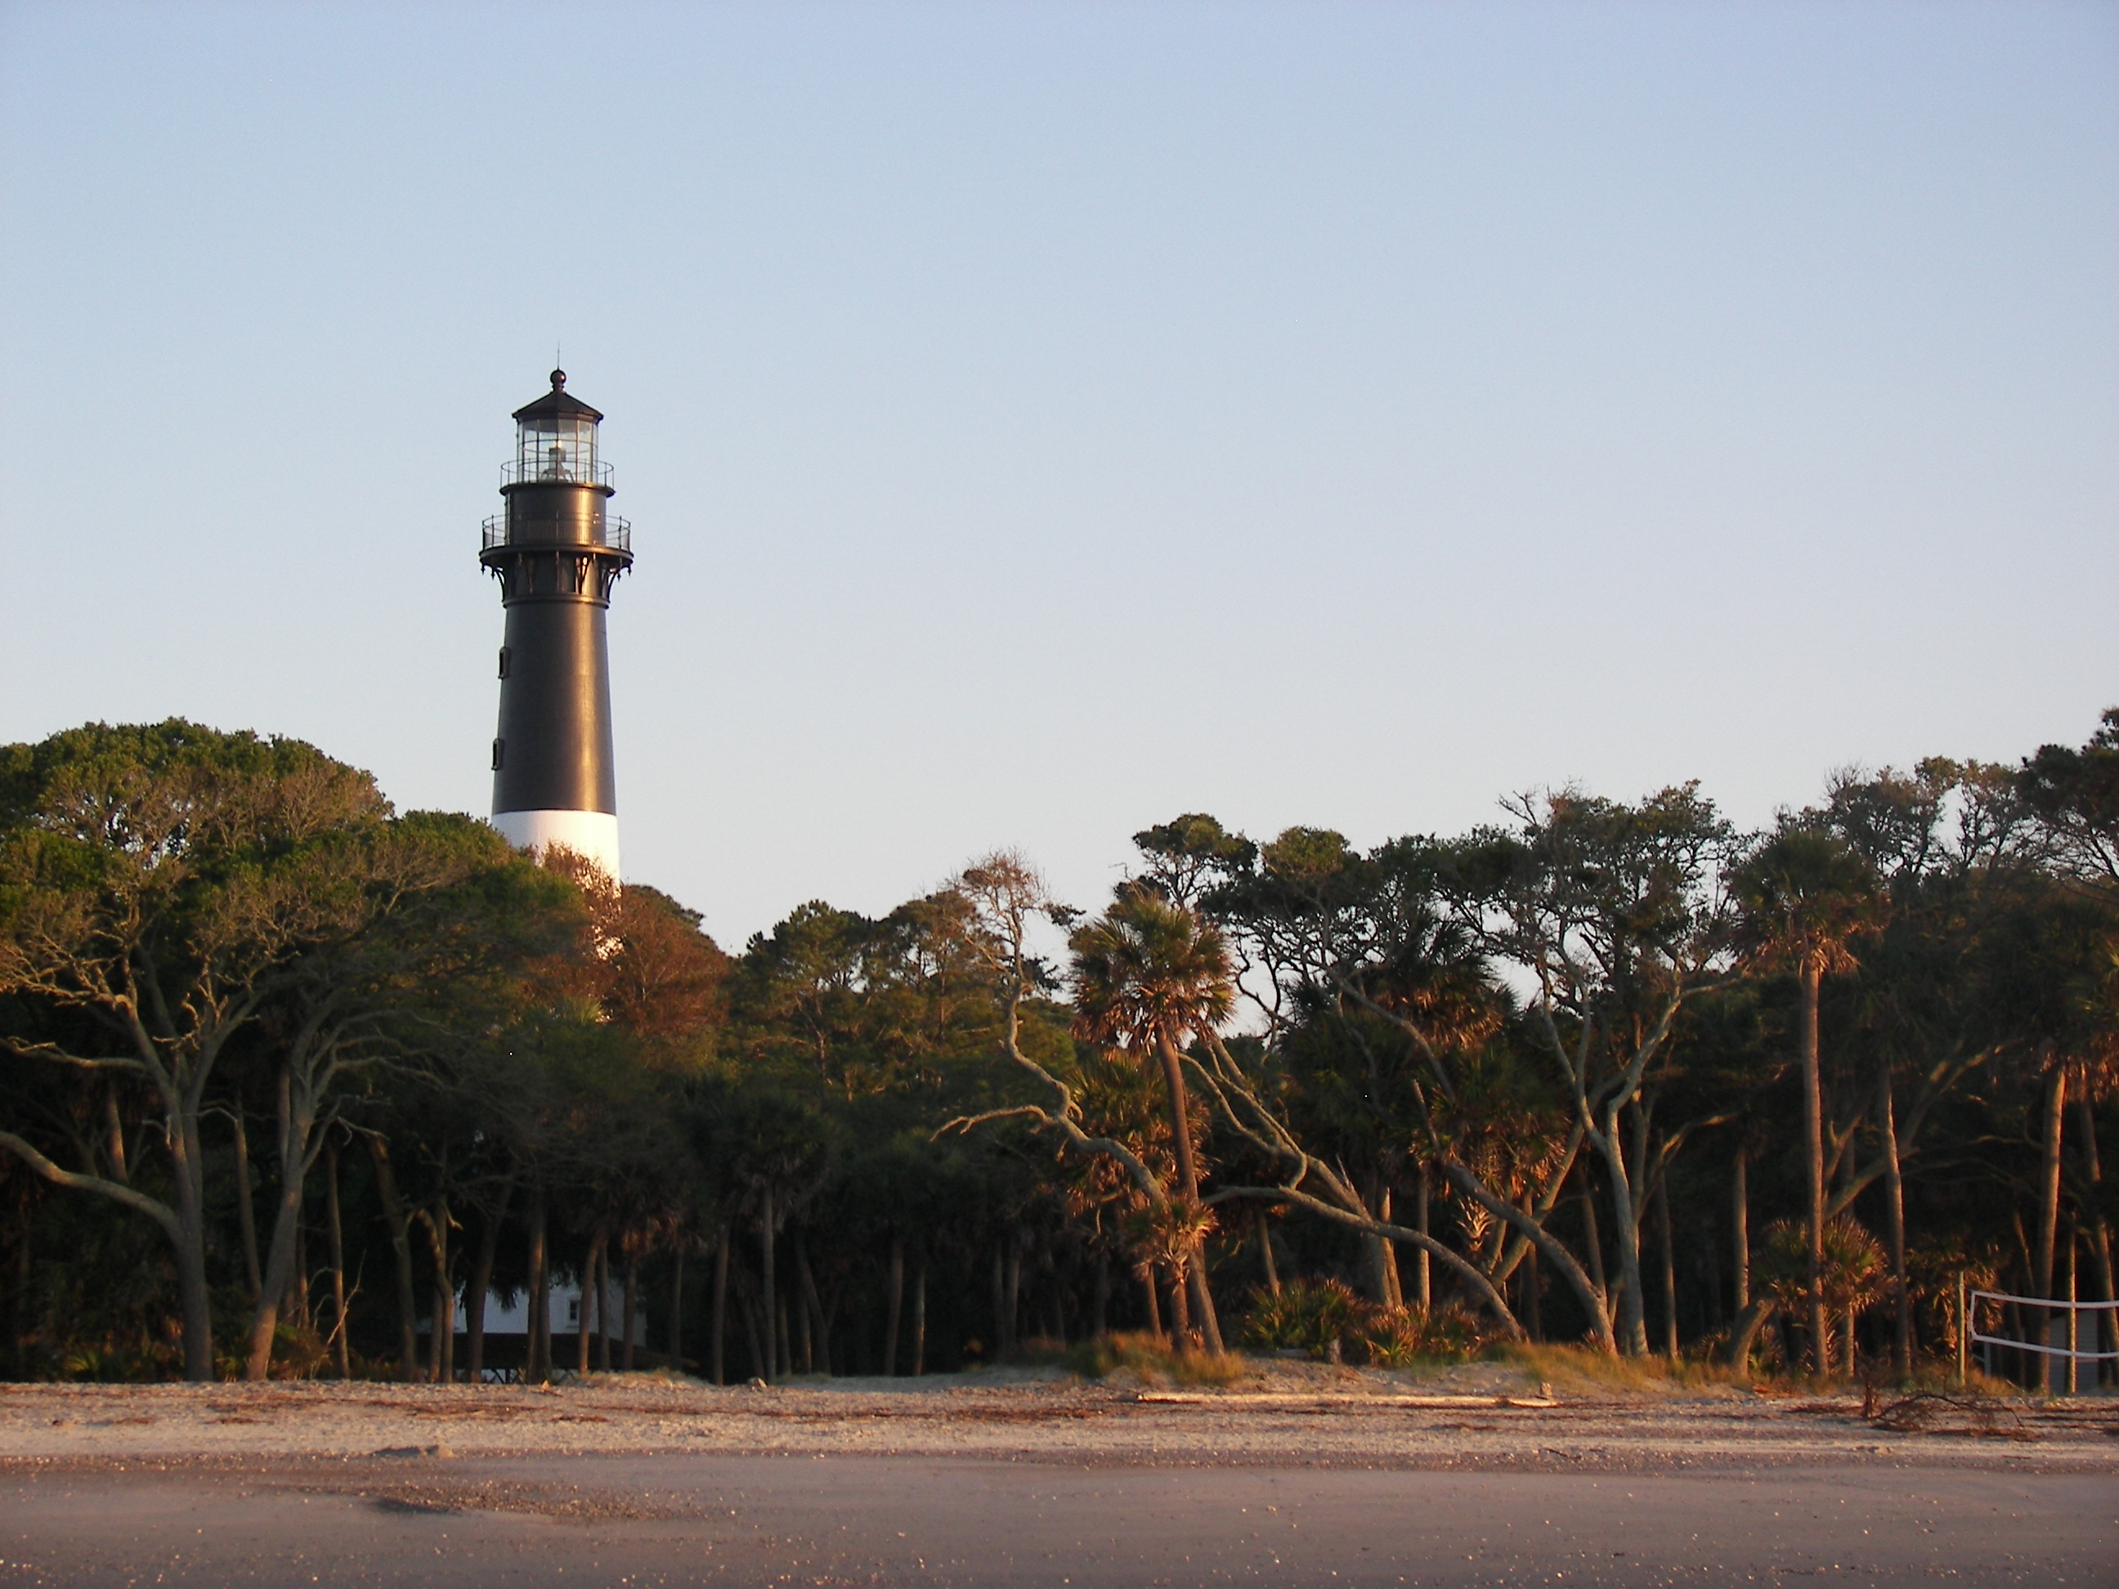
Image Credits
Title Slide: South Carolina State House, by HaloMasterMind, Uploaded 30 August 2013, Wikimedia Commons
End Slide: Hunting Island 1, Public Domain, Wikimedia Commons
Return to Main Menu

