Slide 1
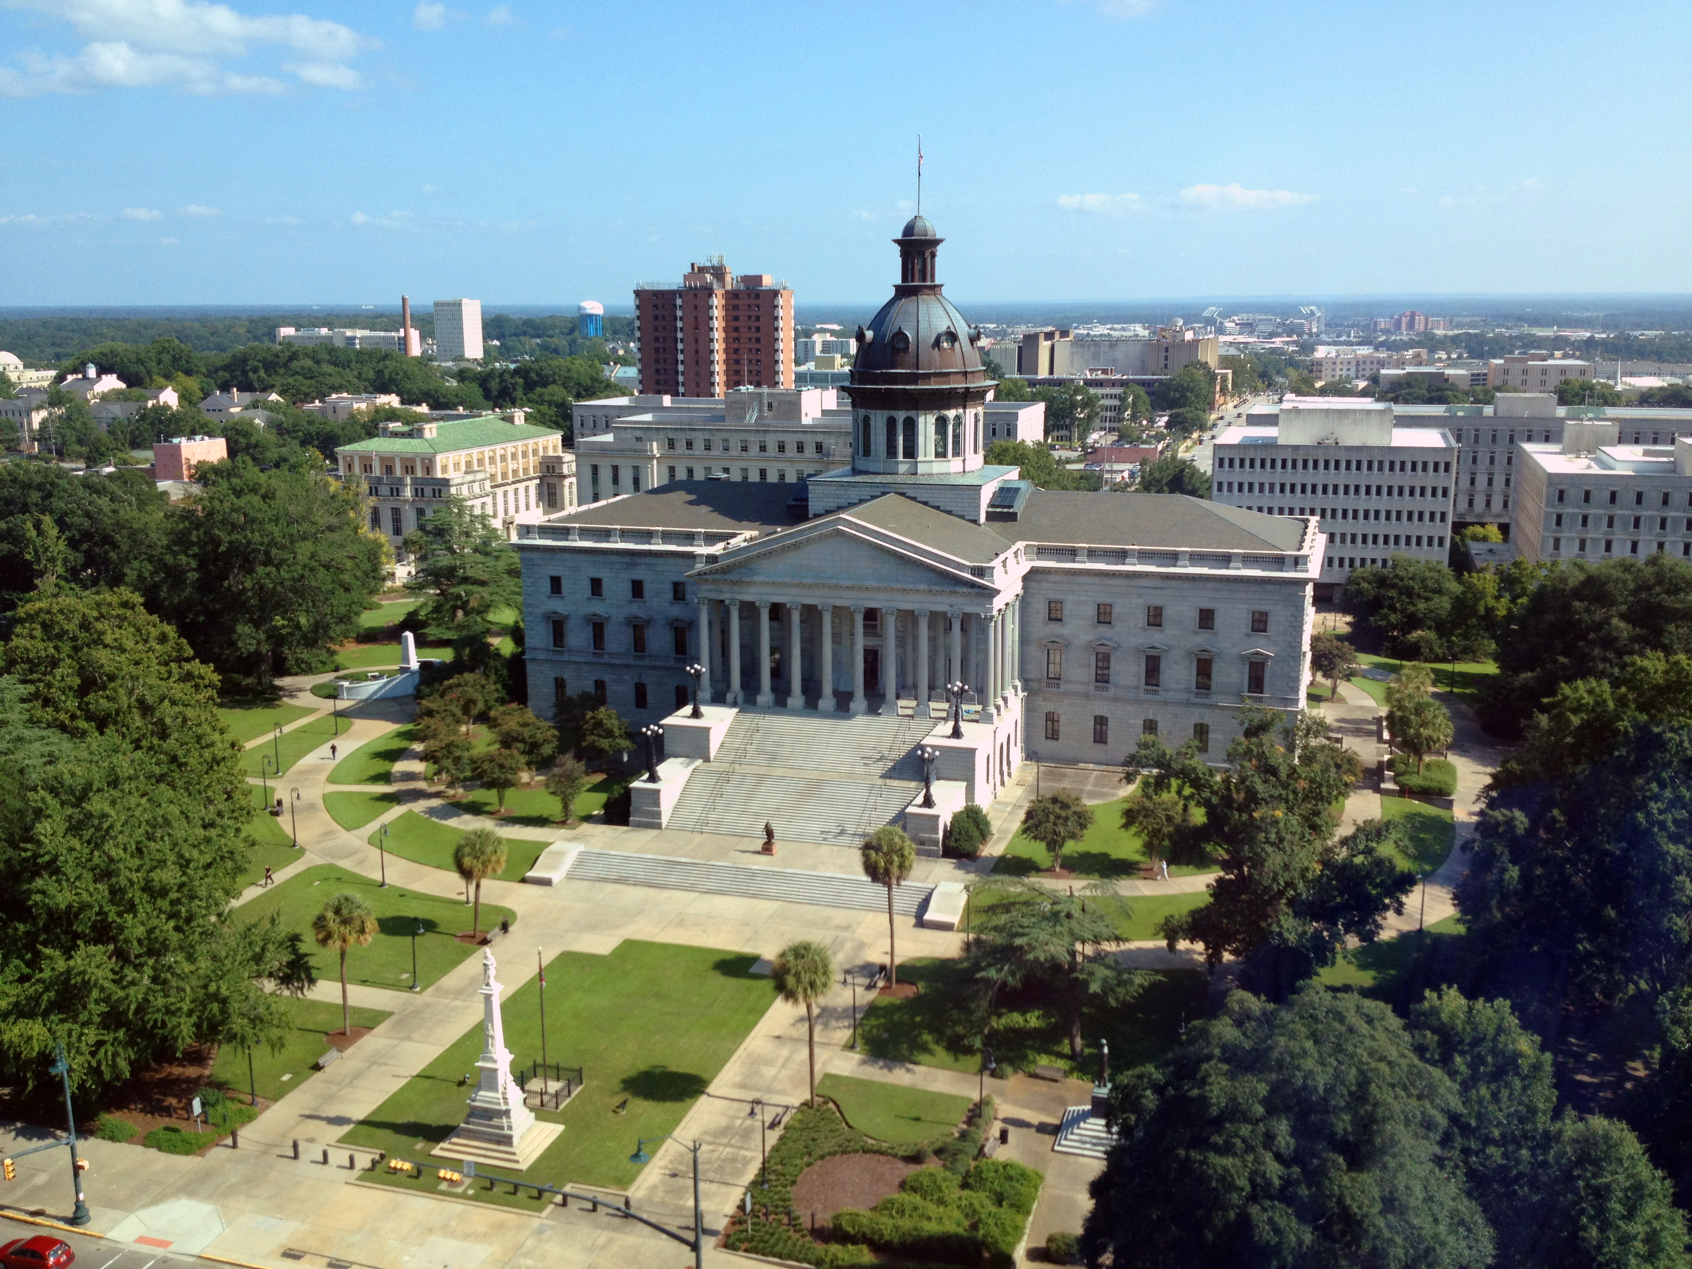
SMART SKILLS
Week 34 – Timeline 7
© 2021 Clairmont Press

Slide 2
Monday
Jan-Feb
Tet Offensive
April
Martin Luther King assassinated
Aug
Nov
Robert F. Kennedy assassinated
June
Rioting at the Democratic National Convention in Chicago
Richard Nixon elected President
1968
  What does the timeline show? What is the timespan of the events?

Slide 3
Tuesday
Jan-Feb
Tet Offensive
April
Martin Luther King assassinated
Aug
Nov
Robert F. Kennedy assassinated
June
Rioting at the Democratic National Convention in Chicago
Richard Nixon elected President
1968
  How many assassinations are included on the timeline? Who are they?

Slide 4
Wednesday
Jan-Feb
Tet Offensive
April
Martin Luther King assassinated
Aug
Nov
Robert F. Kennedy assassinated
June
Rioting at the Democratic National Convention in Chicago
Richard Nixon elected President
1968
  Name two connections between events on the timeline.

Slide 5
Thursday
Jan-Feb
Tet Offensive
April
Martin Luther King assassinated
Aug
Nov
Robert F. Kennedy assassinated
June
Rioting at the Democratic National Convention in Chicago
Richard Nixon elected President
1968
  What is missing from the timeline that could be added to improve your understanding of 1968?

Slide 6
Friday
Jan-Feb
Tet Offensive
April
Martin Luther King assassinated
Aug
Nov
Robert F. Kennedy assassinated
June
Rioting at the Democratic National Convention in Chicago
Richard Nixon elected President
1968
  What judgements would you make about 1968 based on the information presented in the timeline?

Slide 7
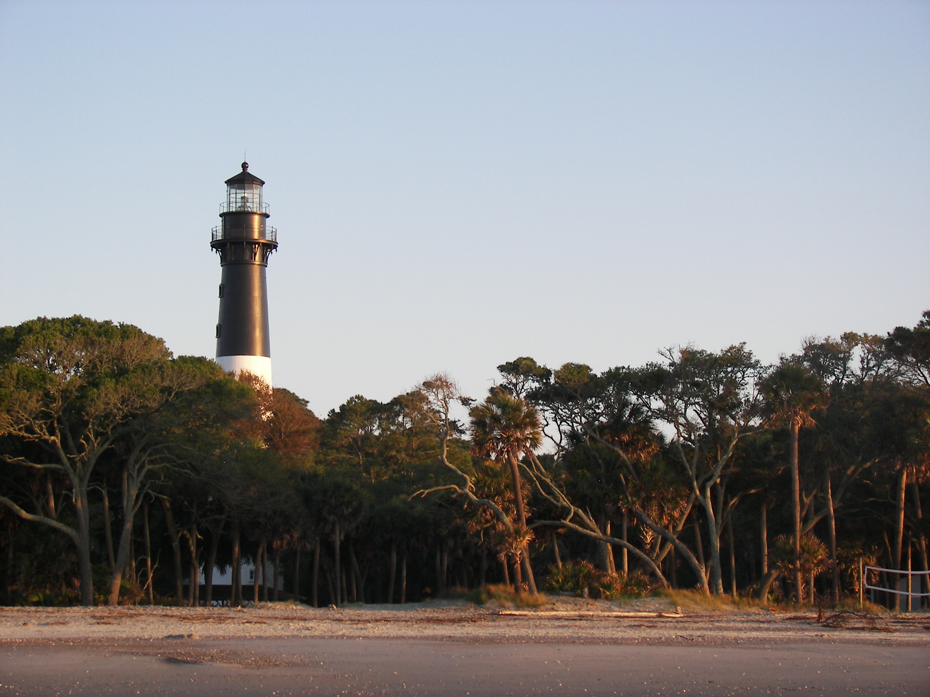
Image Credits
Title Slide: South Carolina State House, by HaloMasterMind, Uploaded 30 August 2013, Wikimedia Commons
End Slide: Hunting Island 1, Public Domain, Wikimedia Commons
Return to Main Menu

