Slide 1
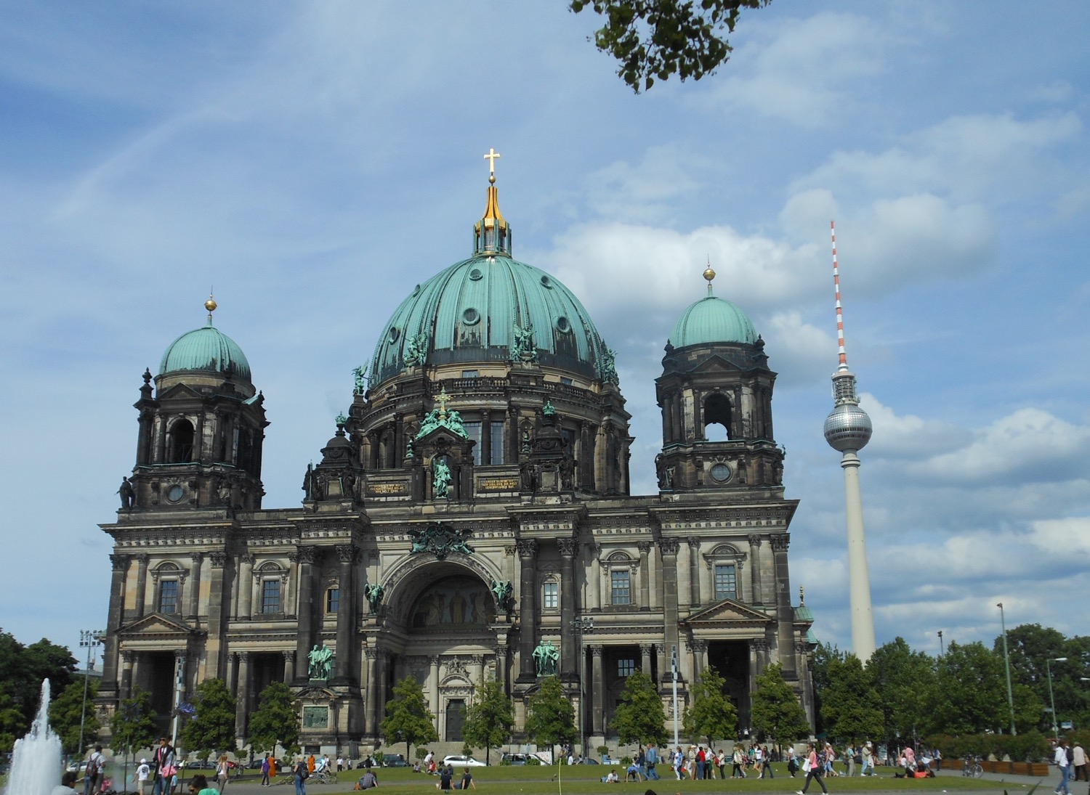
Chapter 6:
Federal Republic of Germany
STUDY PRESENTATION
© 2017 Clairmont Press

Slide 2
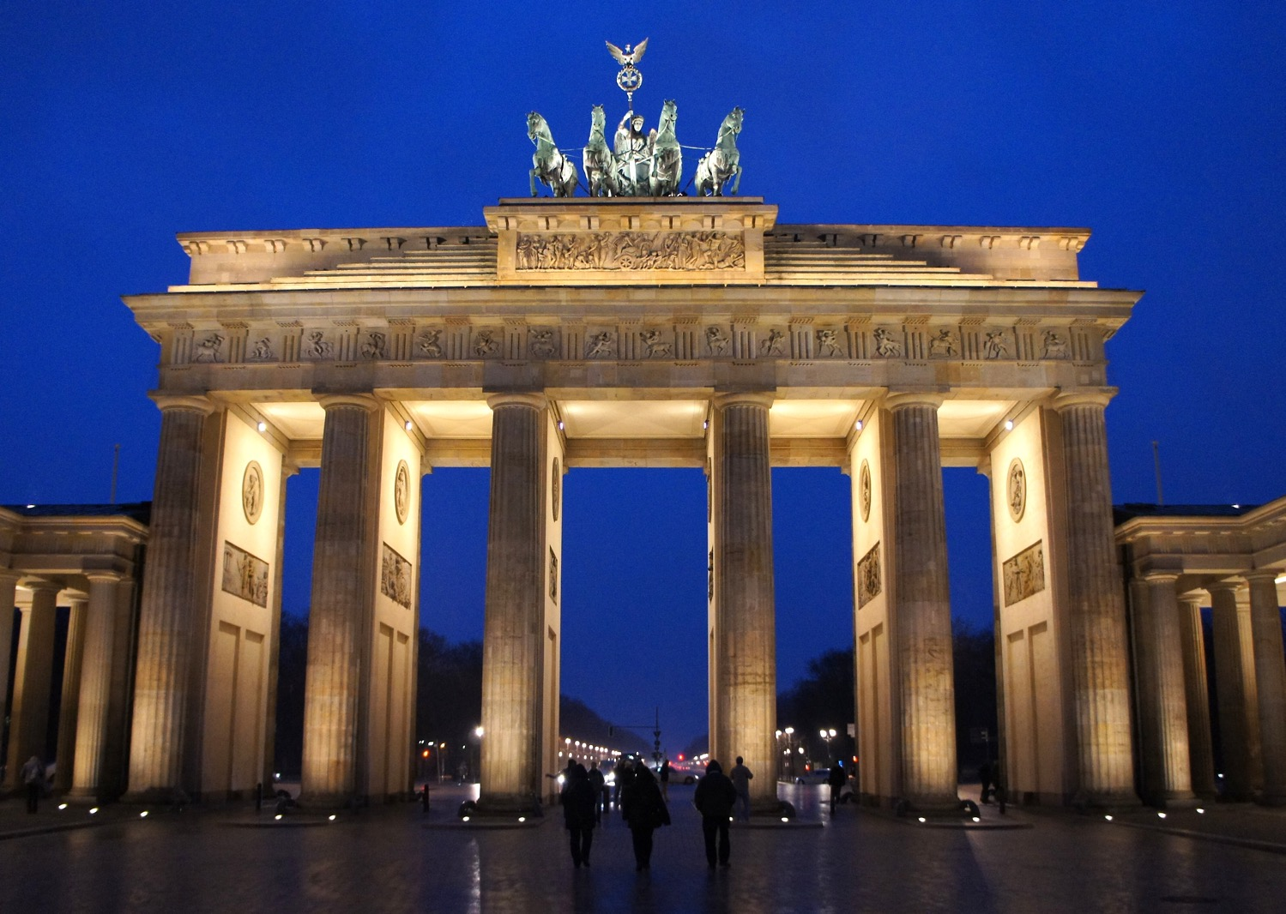
Section 1: The Geography of Germany
Section 2: A Brief History of Germany
Section 3: Government of Germany
Section 4: Economy of Germany
Section 5: US-German Relations

Slide 3
Section 1: The Geography of Germany
Essential Question:
How does Germany’s location affect its climate?

Slide 4
Section 1: Geography of Germany
What terms do I need to know?
autobahn
acid rain

Slide 5
Location and Size of Germany
Germany is located in the northern and central regions of Western Europe.
Germany shares a border with more countries than any other European country.
Germany’s location on the North and Baltic Seas allows it to have numerous sea ports, giving easy access to other countries and the Atlantic Ocean.
Germany is the 63rd largest nation in the world based on its land area.

Slide 6
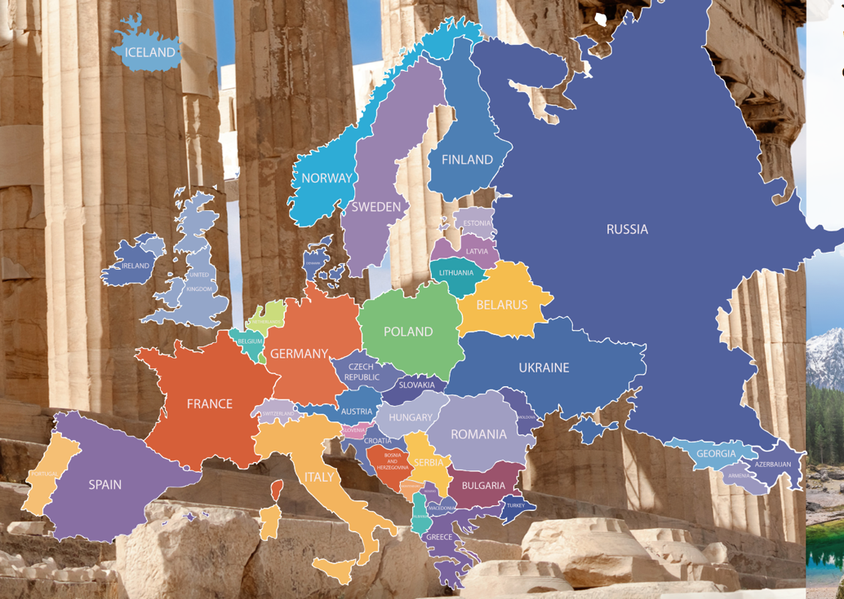
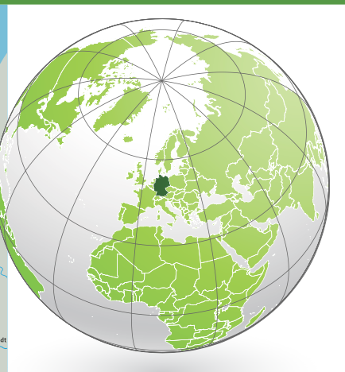
Location and Size of Germany

Slide 7
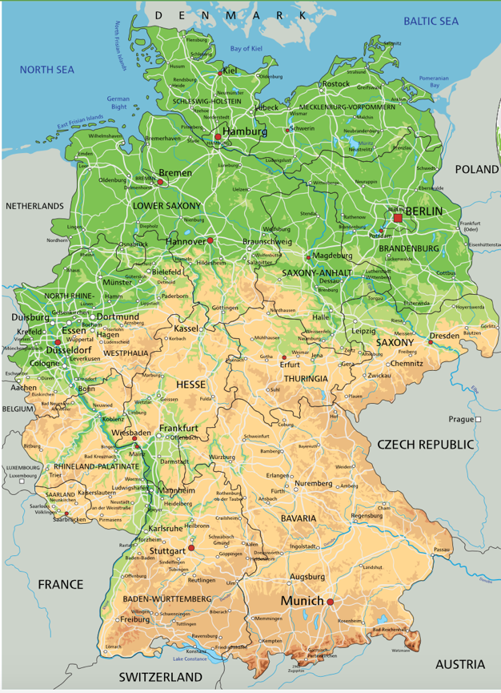
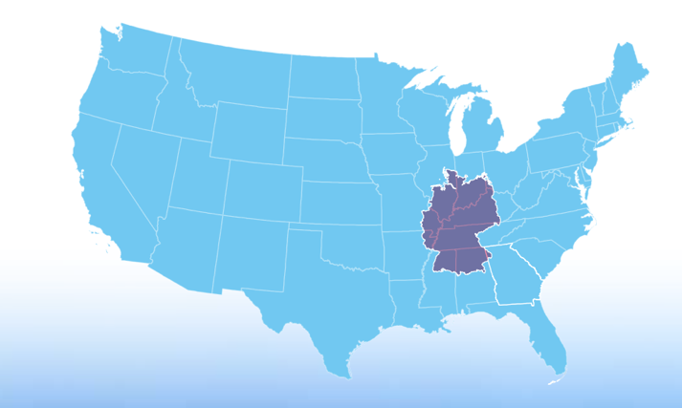
Location and Size of Germany

Slide 8
Climate of Germany
Most of Germany has a marine climate, as waters of the Gulf Stream bring warmth and moisture from the Gulf of Mexico across the Atlantic Ocean.
The warm waters keep the land warm in winter and cool in summer.
The climate of the Bavarian Alps changes based on altitude, with some areas of the mountains covered in snow all winter.
Eastern Germany is farther from the sea and therefore has longer, colder winters and hotter, drier summers.

Slide 9
Distribution of People in Germany
Germany is the most populated country in Europe with almost 81 million people.
Around 75% of Germans live in urban areas.
The most populated areas are in the northern and western parts of the country, along the Rhine River near Cologne and Frankfurt.
This area has the most manufacturing jobs and a large transportation system.
The former East German and Alps regions are the least populated areas.

Slide 10
Natural Resources of Germany
Germany’s natural resources include iron ore, coal, potash, uranium, nickel, natural gas, and copper.
Timber is an important renewable resource in Germany.
About 1/3 of Germany’s land is arable (able to be used for agriculture).
Germany’s natural resources have shaped the country’s development.
Coal helped build large industrial centers, which became large cities, mostly along the Rhine River.

Slide 11
Physical Features of Germany
Rivers and waterways are the lifelines of Europe, and Germany relies on the Rhine River for trade, travel, and transportation of goods.
The Rhine begins high in the Alps of Switzerland and flows through Germany to the North Sea.
The Main-Danube Canal connects Germany’s Rhine and Main Rivers to Europe’s second-longest river, the Danube.
Germany’s location in the center of Europe makes it an important crossroad for travel and trade, and the country’s excellent highway system (the autobahn) allows Germany to take full advantage of its location.

Slide 12
Environmental Issues of Germany
In recent decades, acid rain has damaged Germany’s ancient forests, rivers, and historic sites.
Acid rain has ruined nearly half of the Black Forest in western Germany.
Acid rain damages buildings and statues, and pollutes rivers, killing the wildlife.
Acid rain comes from smoke from factories and power plants. Germany depends on manufacturing industries.
Germany has begun to make changes to decrease the acid rain problem, like switching to hydroelectric power and solar powered technologies.
Germany has a number of nuclear power plants to produce its energy, but it plans to replace all nuclear plants with renewable energy in the future.
Return to Main Menu

Slide 13
Section 2: A Brief History of Germany
Essential Question:
How did the outcomes of World War I contribute to Hitler’s rise to power?

Slide 14
Section 2: A Brief History of Germany
What terms do I need to know?
reparations
Nazi Party
Holocaust
Cold War
Berlin Wall
Warsaw Pact

Slide 15
European Rivalries
The countries of Europe, especially Spain, France and Great Britain, were constant rivals for power and wealth into the 1800s.
France was the most powerful country on the European continent and wanted to prevent the unification of the several German-speaking kingdoms into a single country which could compete for France’s power.
France went to war in 1870 against Prussia and the German-speaking territories and lost, resulting in the unification of Germany under Emperor (Kaiser) Wilhelm I
Many countries began to establish colonies to help increase their power and wealth using raw materials from less-developed areas of the world, like Africa and parts of Asia.

Slide 16
World War I
The constant competition among European countries created huge amounts of tension.
Many countries signed agreements to protect each other in case of attack.
The June 1914 assassination of Austria-Hungary’s Archduke Franz Ferdinand by Serbians ignited the explosion into conflict.
Austria invaded Serbia with Germany’s support. Germany declared war on Russia and France and sent troops through Belgium to France, causing Great Britain to declare war on Germany in defense of Belgium.
More and more countries joined, including the US in 1917. Germany and the Central Powers surrendered in 1918.
After WWI, Germany had lost lands and people, and much of the country was destroyed.
Along with rebuilding, the Treaty of Versailles required Germany to pay reparations to the Allies, leaving Germany with almost nothing to rebuild with.
The German people blamed the government, and the Great Depression further worsened desperate conditions.

Slide 17
The Rise of the Nazi Party
Adolf Hitler and the Nazi Party claimed they could fix the problems in Germany, blaming the Treaty of Versailles and the Jews for controlling the banks and money.
Hitler became the leader of Germany in 1933 and quickly passed laws giving himself more power, eventually gaining total control of the government as a dictator.
Hitler rebuilt Germany’s military strength, opened factories, created jobs building highways, and improved the German economy.
While the economy improved, the German people lost many of their civil rights.
The Nazis continued to build up the military and made plans to go to war, sending troops into former German territories in 1936 and invading Austria and Czechoslovakia in 1938.
France and Great Britain declared war on Germany in 1939 when Germany invaded Poland, beginning World War II.
Hitler’s plan included systematically killing every Jew under German rule, now known as the Holocaust.

Slide 18
World War II
World War II was the bloodiest conflict in human history, with more than 60 million deaths as a result of the war.
Germany surrendered in 1945 after 6 years of war.
Germany had undergone intense bombing during the war, leaving much of the country destroyed.
Huge portions of cities were ruined, and highways, railroads, bridges, and water supplies were destroyed entirely.
More than 7 million German citizens had died during the war.
The British, French, American, and Soviet allies divided Germany and Berlin into 4 zones, each under the control of an Allied country.
The Allies goal was to rebuild Germany so that the events that followed World War I would not repeat themselves.

Slide 19
The Cold War
The Cold War was a period of distrust between the Soviet Union and its former allies, especially the United States.
The Soviet Union was a communist country with a powerful central government, very different from the democracy and capitalism of the United States.
After WWII, Soviet dictator Joseph Stalin created a “bloc” of Eastern European countries that were under Soviet control, creating a line between the Eastern Bloc countries and Western Europe known as the Iron Curtain.
The division of Germany contributed to the issues of the Cold War. In 1948, the Western Allies wanted to reunite Germany, but Stalin refused, declaring the Soviet section of the country East Germany, even dividing Berlin (which was in East Germany) into East and West.
Communist leaders build the Berlin Wall in 1961 to separate the communist part of the city from the free section.
To combat the threat of the Cold War turning into a nuclear war, Western Europe and the United States formed the North Atlantic Treaty Organization (NATO) in 1949, which the Eastern European countries counteracted by creating the Warsaw Pact the same year.

Slide 20
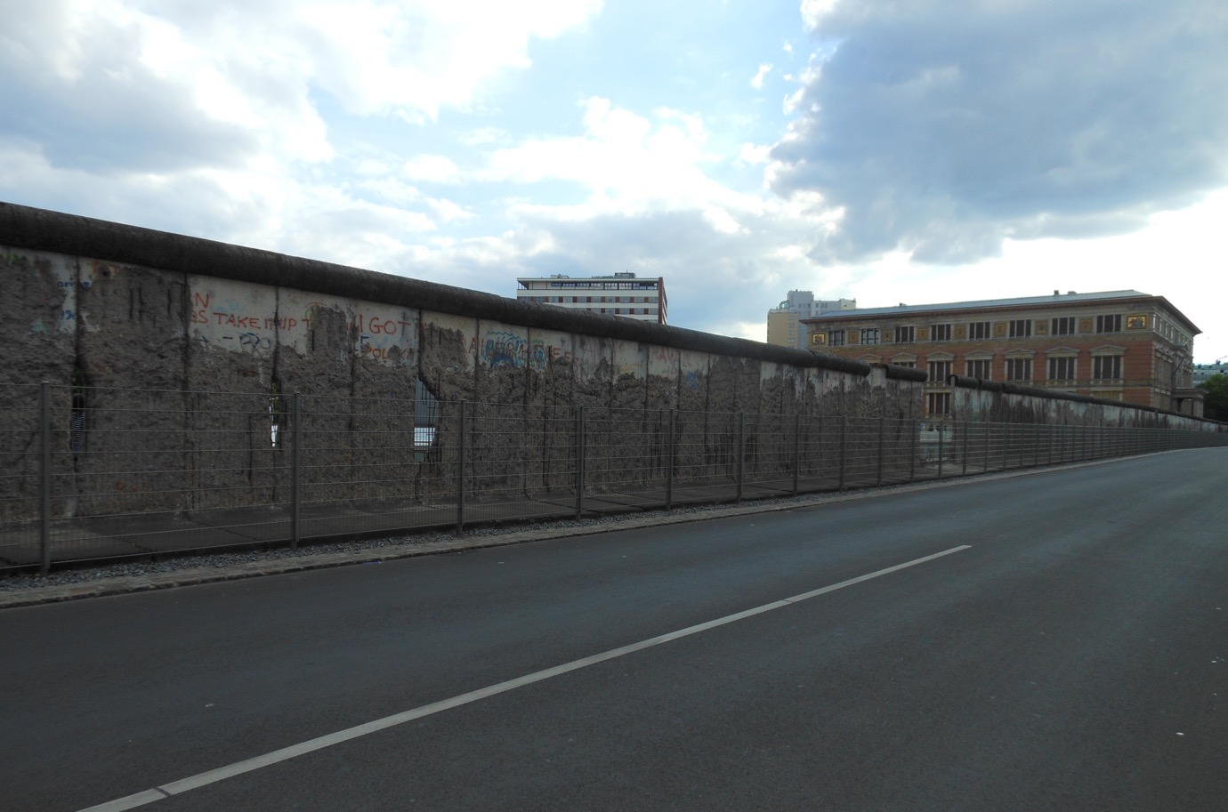
Berlin Wall

Slide 21
Reunification of Germany
The Soviet Union’s economy was unstable by 1985 after ever-increasing spending to put down revolts and keep up with the arms race.
Soviet leader Mikhail Gorbachev reduced government control of businesses and increased personal freedoms, which led to improved relations with the United States.
The people of the Eastern Bloc countries demanded freedom, and in 1989, the Berlin Wall was torn down and East and West Germany reunified in 1990, officially ending the Cold War.
By the end of 1991, the Soviet Union split into 12 independent republics, of which Russia is the largest.

Slide 22
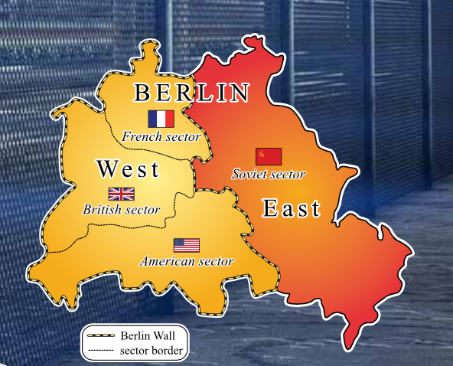
Reunification of Germany— Berlin
Return to Main Menu

Slide 23
Section 3: Government of Germany
Essential Question:
What type of government does Germany have today and how does it affect the rights of its citizens?

Slide 24
Section 3: Government of Germany
What terms do I need to know?
Länder
Bundestag
Bundesrat
president
chancellor
welfare state

Slide 25
Structure of Government
Germany has a federal government system with a constitution known as the Basic Law.
The states (Länder) share power with the national government.
Germany has a parliamentary system, and the German Parliament includes two houses: the Bundestag and the Bundesrat.
The lower house, the Bundestag, is the most powerful, containing 600 members elected by citizens. The Bundestag chooses the chancellor.
There are 69 members of the upper house, the Bundesrat, appointed by the states rather than individuals.
The president is the head of state and has limited powers. The chancellor is the head of government and takes care of the day-to-day business of government and is head of the military.

Slide 26
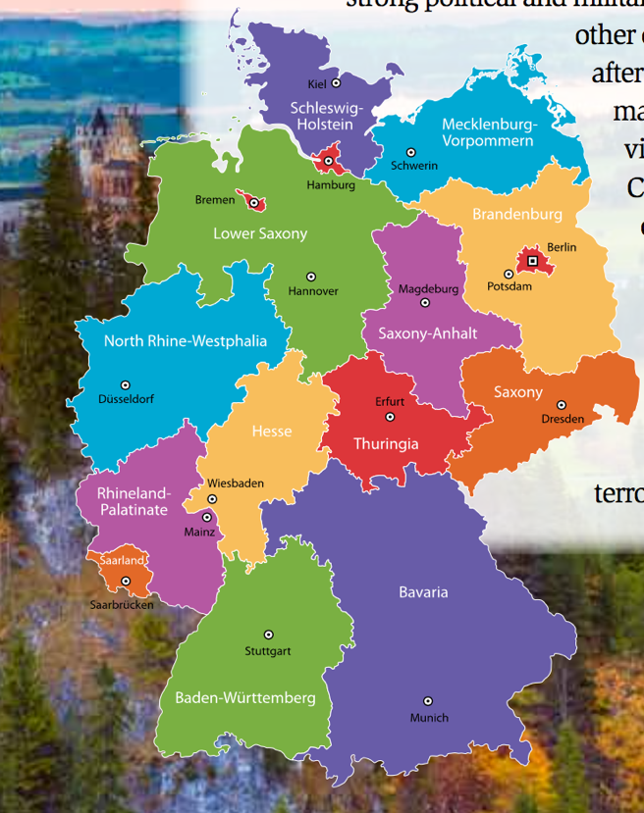
German States— Länder

Slide 27
Citizen Participation
German citizens have freedom of religion and expression, are equal before the law, and are free to vote from the age of 18.
Germany’s citizens have the same basic freedoms as citizens of the United States or the United Kingdom.
Germany’s constitution (the Basic Law) makes Germany a welfare state, meaning that the government guarantees certain benefits to those who are unemployed, poor, disabled, elderly, or sick.
German citizens also elect representatives to the European Parliament, the representative body of the European Union.
Return to Main Menu

Slide 28
Section 4: Economy of Germany
Essential question:
How does Germany’s type of economy impact its trading partnerships with other countries?

Slide 29
Section 4: Economy of Germany
What terms do I need to know?
deficit
surplus
euro

Slide 30
Economic System Today
Today Germany has a strong market economy that has remained strong even when other countries have experienced recessions.
Germany is ranked in the top 20 freest economies in the world.
Germany’s economy is 4th-largest in the world in terms of GDP and is the largest economy in Europe.
Government reforms in the 2000s to decrease unemployment and low growth rates resulted in a budget surplus by 2012.

Slide 31
Trade
Germany is a global power in the manufacturing of steel, iron, coal, machinery, tools, electronics, and automobiles.
More than 1/4 of the working population of Germany is employed in manufacturing.
Because Germany produces so many manufactured goods, they must import oil, gas, small machinery, food, and agricultural items that the people of Germany need.
As an example of specialization, only about 1% of Germans work in agriculture.

Slide 32
Standard of Living
Germany has a high standard of living, and most adults in Germany work outside of the home.
More than 95% of Germans work in manufacturing and service industries.
These jobs require secondary education or continuing education after high school to stay informed of new technologies.
Germans tend to save more and borrow less than Americans.
An average German saves about 10% of income and has little or no debt.

Slide 33
Currency
Since the end of World War I, Germany has experienced many changes and difficulties in its economy and currency.
By the time of the reunification of Germany, the German mark was a very strong, stable, and safe currency.
Germany continued to use the mark until the introduction of the euro in 1999.
Return to Main Menu

Slide 34
Section 5: US-German Relations
Essential question:
What common goals have allowed the United States and Germany to develop strong trade relations?

Slide 35
Section 5: US-German Relations
What terms do I need to know?
Transatlantic Economic Council (TEC)

Slide 36
Working Together for Security
Since the end of WWII, Germany has helped the United States in their common goal of preserving peace in Europe.
The United States’ policy toward Germany is to maintain a close relationship as friends, trading partners, and allies.
As allies in NATO, the US and Germany work together to maintain peace and freedom.
Germany was an important part of the UN forces in Afghanistan in the 2000s, and has remained a strong ally of the US in fighting global terrorism since the September 11, 2001 attacks.

Slide 37
Bilateral Economic Relations
The United States and Germany share a commitment to an open and expanding world economy.
In 2007 Germany pushed for the creation of the Transatlantic Economic Council (TEC) to increase cooperation between the US and the European Union in promoting economic growth.
The United States is one of Germany’s leading export markets.
The combined goods traded between the two countries show Germany as the United States’ 5th-largest trading partner.
Return to Main Menu

Slide 38
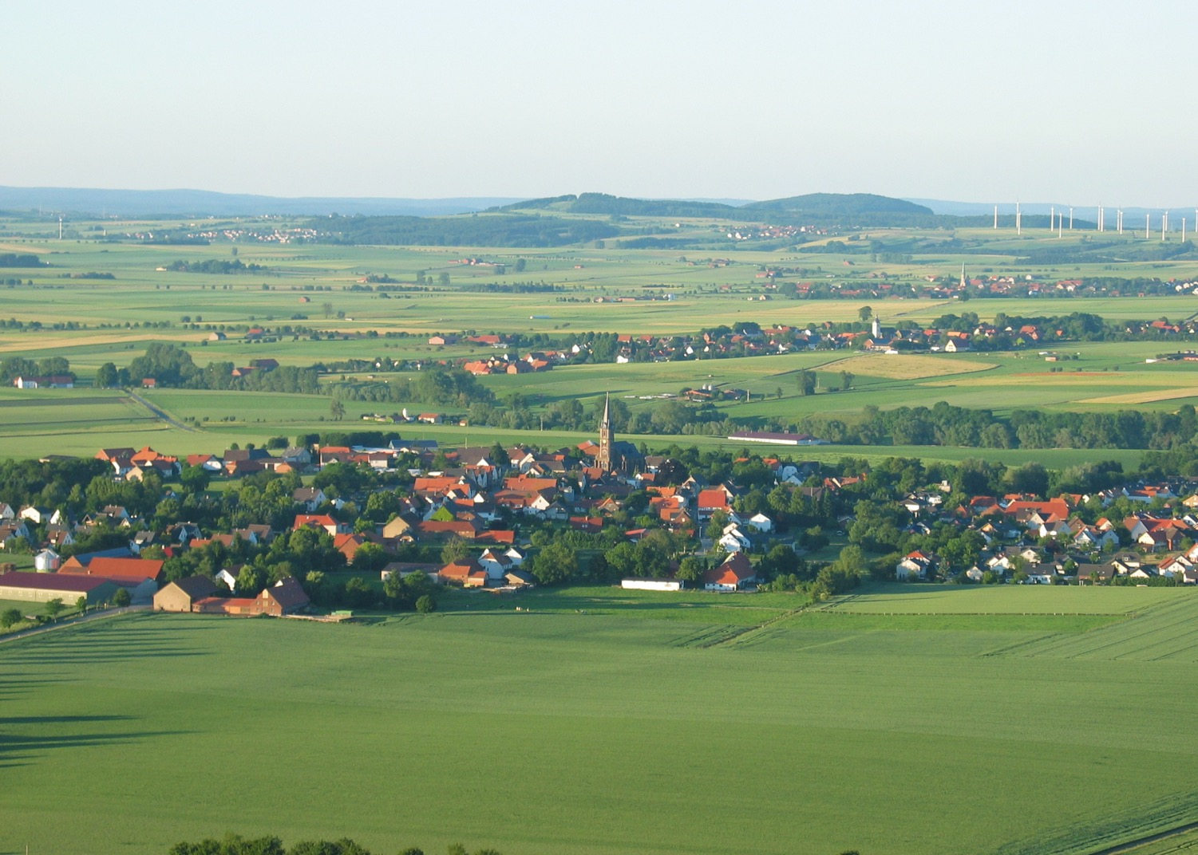
Image Credits: 1 Berliner Dome, 20 Berlin Wall; all others Wikimedia Commons. Maps ©2017 Clairmont Press.

