Slide 1
Smart Skills Practice
A Social Studies Skill Building Program
Overview and Week 1 SAMPLE
© 2017 Clairmont Press, Inc.

Slide 2
Overview
The focus is on obtaining a mastery of the skill and further support standards
Questions to promote thinking
Promotes higher order thinking.
Ex: interpret, analyze, translate, formulate, determine.
The math behind the system
5 minutes a day, 5 days a week, for seven weeks each skill.
Equal to 2 ½ entire class periods devoted to each skill.
Like doing a major project over one particular skill.

Slide 3
How the system works
You simply follow the weeks 1-35.
Each day of the week you will use that week’s presentation. The slide days are easily marked and the answers are listed at the end of the slide. It is easy for the teacher to access.
Each day is labeled and as the week progresses the D.O.K. level increases. By Friday, the students are asked Level III questions.
The chart on slide 2 shows the progression. There is a five week rotation: Maps, Charts and Graphs, Analyzing Artifacts and Photographs, Timelines, and Political Cartoons.
Each of the five skills has seven different examples. As the year progresses the difficulty of the skill increases.

Slide 4
Map/ Globe Skills | Charts/ Graphs | Analyzing Artifacts | Timelines | Political Cartoons
Map 1 Week 1 | C/ G 1 Week 2 | Artifact 1 Week 3 | Timeline 1 Week 4 | Cartoon 1 Week 5
Map 2 Week 6 | C/ G 2 Week 7 | Artifact 2 Week 8 | Timeline 2 Week 9 | Cartoon 2 Week 10
Map 3 Week 11 | C / G 3 Week 12 | Artifact 3 Week 13 | Timeline 3 Week 14 | Cartoon 3 Week 15
Map 4 Week 16 | C / G 4 Week 17 | Artifact 4 Week 18 | Timeline 4 Week 19 | Cartoon 4 Week 20
Map 5 Week 21 | C / G 5 Week 22 | Artifact 5 Week 23 | Timeline 5 Week 24 | Cartoon 5 Week 25
Map 6 Week 26 | C / G 6 Week 27 | Artifact 6 Week 28 | Timeline 6 Week 29 | Cartoon 6 Week 30
Map 7 Week 31 | C/ G 7 Week 32 | Artifact 7 Week 33 | Timeline 7 Week 34 | Cartoon 7 Week 35

Slide 5
Smart Skills Practice
A Social Studies Skill Building Program
Week 1 – Map 1
© 2017 Clairmont Press, Inc.

Slide 6
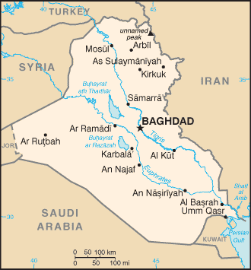
Monday
What is the country featured in the map?
What countries border the featured country?
Notes:
Iraq; Turkey, Syria, Jordan, Saudi Arabia, Kuwait, Iran

Slide 7
Tuesday
What are the major rivers located in Iraq?
Into what body of water do the rivers empty?
Notes:
Tigris and Euphrates; the Persian Gulf

Slide 8
Wednesday
What is the approximate distance from Baghdad to the Persian Gulf?
Notes:
About 300 miles.

Slide 9
Thursday
Why do you believe that Iraq strongly defends its Persian Gulf ports?
Notes:
Open answer (the Persian Gulf is its only direct access to the ocean, making it important for its Navy and shipping)

Slide 10
Friday
What are some key components that would improve this map?
Notes:
Sample answers: Name of the country, Compass Rose, star means capital, color

