Slide 1
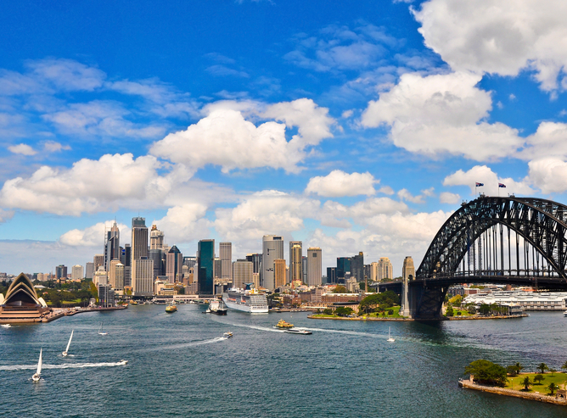
Chapter 11:
Commonwealth of Australia
STUDY PRESENTATION
© 2017 Clairmont Press

Slide 2
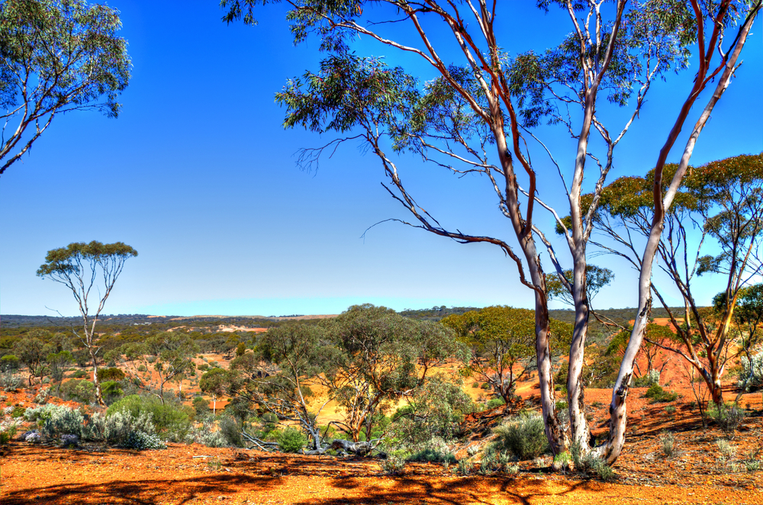
Section 1: Geography of Australia
Section 2: A Brief History of Australia
Section 3: Government of Australia
Section 4: Economy of Australia
Section 5: U.S.-Australia Relations

Slide 3
Section 1: Geography of Australia
Essential Question:
How does Australia’s size and climate affect the distribution of its people?

Slide 4
Section 1: Geography of Australia
What terms do I need to know?
outback
natural resource
monolith
Aborigines

Slide 5
Location and Size of Australia
Australia is both a continent and a country, with a land area nearly as large as the United States.
world’s 6th largest country
world’s smallest and flattest continent
driest continent other than Antarctica
surrounded by Pacific and Indian Oceans
Google Map

Slide 6
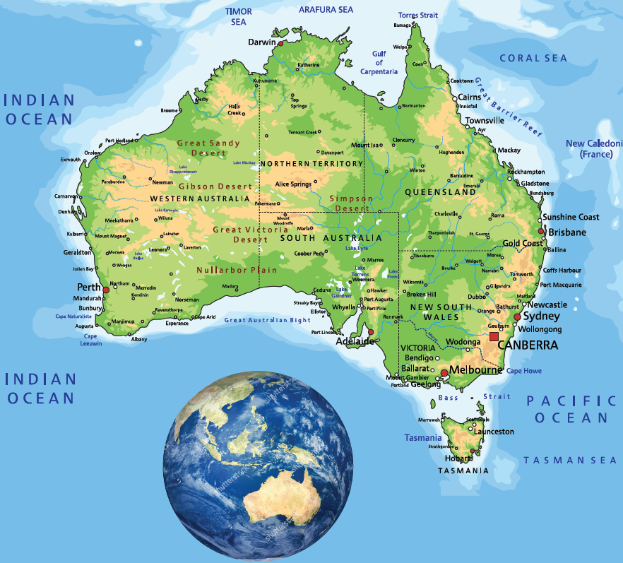
Location and Size of Australia

Slide 7
Climate of Australia
The climate varies across the continent.
The northern part of Australia is closest to the equator and has a tropical climate, it is warm to hot all year, and this area gets more rain than the rest of the country.
The largest part of Australia is desert, where little rain falls.
Only southeast and southwest corners have temperate climates.

Slide 8
Distribution of People in Australia
The coastal areas of Australia are the most highly populated, especially the eastern coast.
The most populated city is Sydney in New South Wales.
Nearly 80% of Australians live in urban areas, making Australia one of the most urbanized countries in the world.

Slide 9
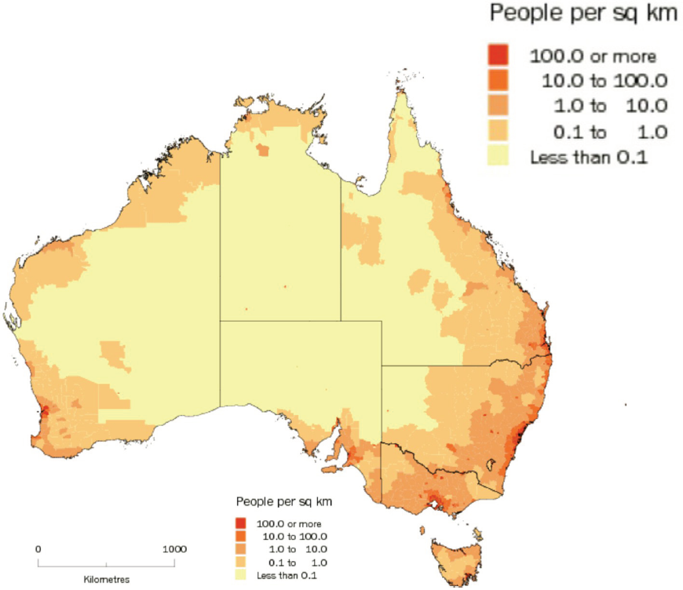
Distribution of People in Australia

Slide 10
Natural Resources of Australia
“Outback” refers to Australia’s dry interior, where there are few small settlements, usually around mines.
Australians use mining to take advantage of their natural resources.
Minerals are an important part of Australia’s trade.
Australia exports more coal and iron ore than any other nation.
Australia has arable land, and farmers produce more food than Australians can consume.

Slide 11
Physical Features of Australia
Across the middle of Australia are huge desert plains, with milder climates along the southeastern and southwestern coasts.
The largest part of Australia is the semiarid lands known as the outback.
Northern Australia’s tropical climate has a rain forest, mangrove swamps, grasslands, and even more desert.
Australia includes the island of Tasmania and several other islands in the Indian and Pacific Oceans.

Slide 12
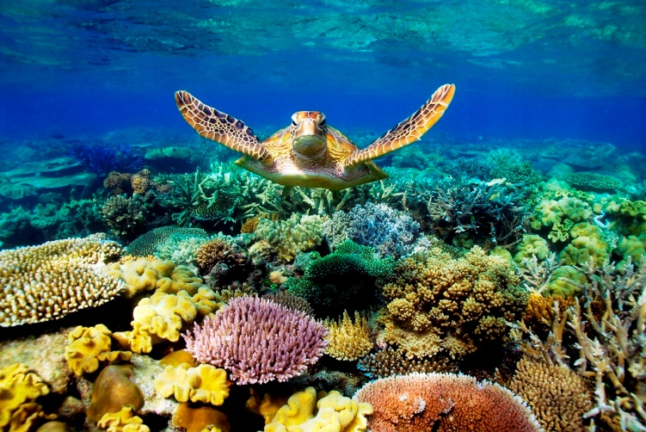
The Great Barrier Reef
The Great Barrier Reef is the world’s largest coral reef, and lies off the northeast coast of Queensland in the Coral Sea.
The reef contains the world’s largest collection of coral and is home to several rare species of animals.
Great Barrier Reef (Video: 4 min.)

Slide 13
The Coral Sea
The Coral Sea is part of the Pacific Ocean and an important source of coral for the Great Barrier Reef.
The Coral Sea lies off the northeast coast of Australia.
Coral Sea islands are scattered over thousands of miles of ocean.
Australia claimed the islands as a territory of Australia in 1969.
No one lives on the Coral Sea islands except a small group of weather specialists on the Willis Islets.
The Coral Sea (Video: 4 min)

Slide 14
The Great Dividing Range
The Great Dividing Range is a series of mountain ranges in eastern Australia.
It is over 2,100 miles long.
Australia’s tallest mountains are here.
Water from the mountains is used for drinking, irrigation, and hydroelectric power.
The mountains are crossed by highways and railroads.
The Great Dividing Range (Video: 2.5 min.)

Slide 15
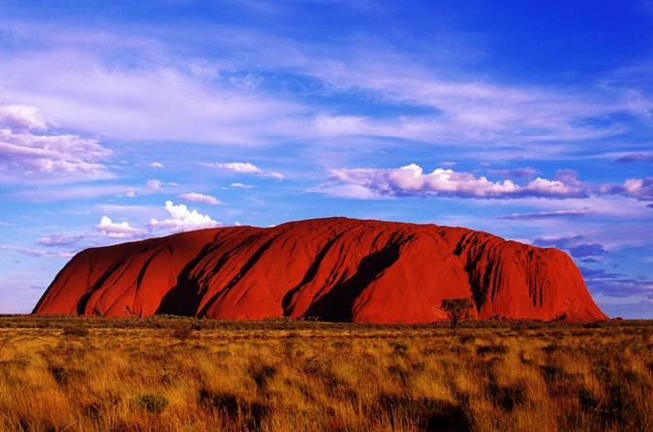
Uluru / Ayers Rock
At the center of the continent, a large red rock towers over the flatlands, a monolith called Uluru.
Uluru is the tip of a massive underground sandstone rock cemented together with sand and mud.
The Aborigines named the monolith Uluru. Europeans named it "Ayers Rock" after a government official in South Australia.
In 1950, Australia created Uluru-Kata Tjuta National Park.

Slide 16
The Great Victoria Desert
The Great Victoria Desert is located in the states of South Australia and Western Australia.
The desert only receives 8 to 10 inches of rain a year, and never receives snow.
It contains some grasslands, sandhills, and salt lakes.
The desert covers more than 160,000 square miles and is a protected wilderness area.
Very few people live in this area.
Return to Main Menu

Slide 17
Section 2: A Brief History of Australia
Essential Question:
Why did Europeans colonize Australia?

Slide 18
Section 2: A Brief History of Australia
What terms do I need to know?
nomadic
indigenous
Stolen Generations

Slide 19
The Aborigines
Aborigines are the native people of Australia.
Aborigines have occupied Australia for at least 40,000 years.
They were hunters and gatherers who ate animals, wild nuts, fruits, and berries.
They were nomadic, moving from place to place to find food.
Before the Europeans, there were between 250,000-500,000 Aborigines.

Slide 20
Colonization of Australia
The first Europeans arrived in 1606.
In 1770, British Captain James Cook claimed the east coast for Britain and named eastern Australia “New South Wales”.
British colonization began in 1788, using Australia as a prison colony.
Britain wanted to relieve overcrowding in its jails, have its navy stationed in the southern hemisphere, gain an economic base to expand trade, and wanted to prevent rivals, especially France, from colonizing Australia.

Slide 21
Prisoners as Colonists
Australia had no colonies from other European or Asian countries.
From 1788-1823, the colony of New South Wales was an official penal colony made up of convicts, marines, and the marines’ wives.
Many free immigrants moved to the region, establishing trading posts, farms, and businesses.
Britain saw opportunities for trade and a navy outpost.
By 1861 officials had created the boundaries that are still used today.
The Commonwealth of Australia was established on January 1, 1901.

Slide 22
Prisoners as Colonists
Notes:
The First Fleet of 11 ships left England in 1787 with more than 1480 men, women and children. Most were British, but there were African, American, and French convicts, too. After three months at sea, the First Fleet arrived in Australia in January, 1788.

Slide 23
European Impact on the Aborigines
European settlers took over sources of water, fisheries, and productive land from the Aborigines and turned Aborigine land into towns, farms, and mines.
Most damaging were the diseases that the Europeans brought to the Aborigines.
About half of the indigenous people died of smallpox and other disease brought by Europeans.
Guns gave the colonists a major advantage in fights with the indigenous people.
Introduction of cattle and sheep required fencing, clearing trees, and raising crops, changing the landscape and pushing the Aborigines off their lands.
As British settlement expanded, Aborigines turned to violence to protect their land.
The gold rush and increasing conflicts led to more deaths of Aborigines.

Slide 24
The Aborigines Today
Originally, there were about 600 different clan groups of Aborigines with distinct cultures and beliefs.
Indigenous communities keep their cultural heritage alive by passing down their knowledge, arts, rituals, and performances to new generations.
The government of Australia has had a poor record of treatment of Aborigine citizens.
The Stolen Generations refer to Aboriginal children removed by the Australian government and given to white families and church-run institutions for cultural reprogramming.
There is still inequality in the lives of Aborigines, but the government has been changing their position toward the native people.
Indigenous groups are increasingly well organized and successful.

Slide 25
Language in Australia
Australia’s language is a result of British colonization and expansion.
The language of the government officials and prisoners sent to Australia was English.
The British built new cities as fast as possible to keep the French out of Australia, spreading the English language to the western part of the continent.
When Australia gained independence from Great Britain, they regulated immigration to encourage more English-speakers to move to Australia and limit immigrants from Africa and Asia.

Slide 26
Religion in Australia
Europeans introduced Christianity to Australia in 1788.
Irish prisoners were mainly Roman Catholic, the rest were members of the Church of England (Anglicans) or Methodists.
In the 1800s, Europeans brought their traditional churches to Australia.
Today, most Australians are Christians, while Muslims, Buddhists, Jews, and Hindus make up less than 5% of the population.
Return to Main Menu

Slide 27
Section 3: Government of Australia
Essential Question:
What impact do the citizens of Australia have on the government of their country?

Slide 28
Section 3: Government of Australia
What terms do I need to know?
Commonwealth Parliament
constituency
territory
electorate

Slide 29
Type of Government
The legislative body, or Commonwealth Parliament, holds the power in Australia’s parliamentary democracy.
The people of Australia elect parliament’s members, and parliament chooses the prime minister to be the head of government.
The monarch (head of state) appoints a governor-general to represent the Crown in Australia.
Governor-general is chosen based on recommendation of the prime minister.

Slide 30
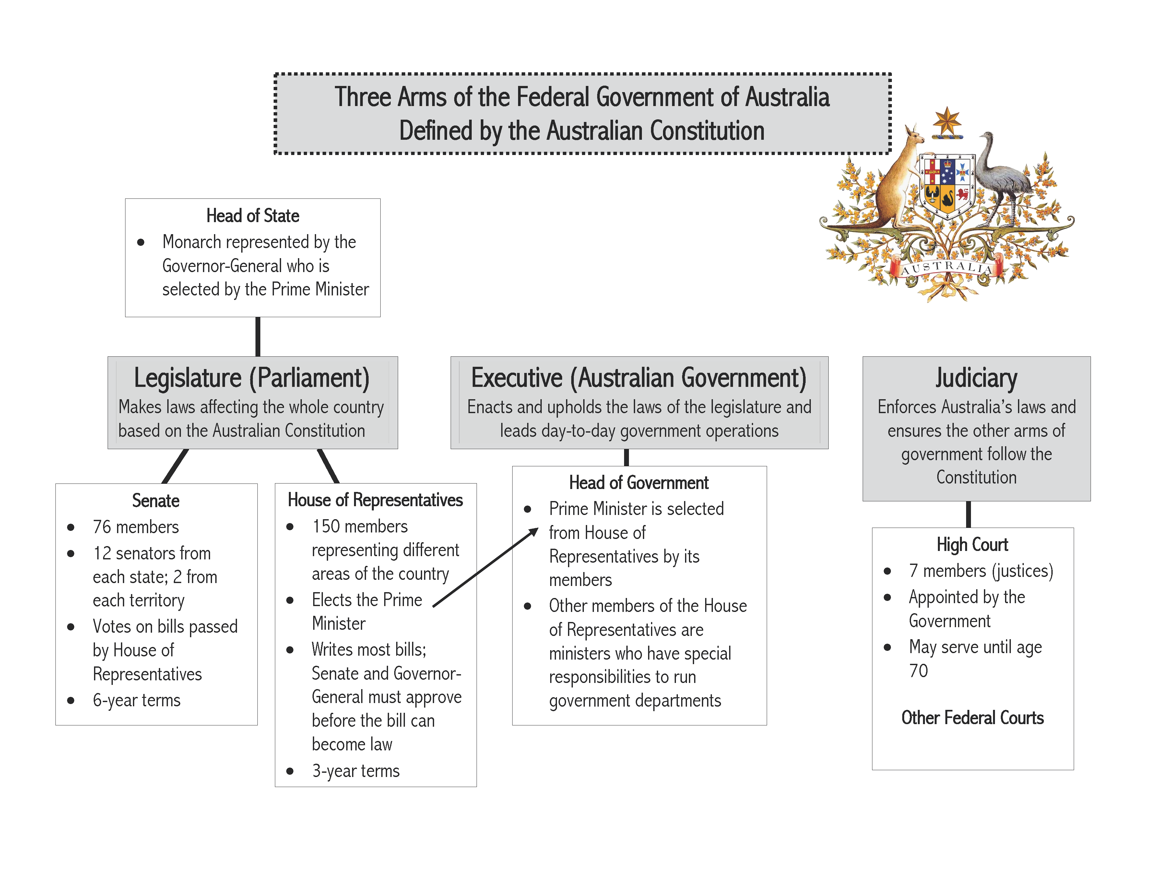

Slide 31
Form of Leadership
Australia’s 6 states were the 6 British colonies united to create the Commonwealth of Australia.
States approved a constitution which allowed the federal government to pass certain laws and allows states individual parliaments.
The English monarch is the head of state, but does not run the country; the monarch appoints a governor-general to act as representative of the monarchy in Australia and fulfill the duties of the head of state.
The prime minister is the head of government.
The prime minister is the leader of the political party with the most members in the Commonwealth Parliament.

Slide 32
Type of Legislature
An elected government runs the country.
The Commonwealth Parliament contains two houses: the House of Representatives and the Senate.
Australia is divided into areas called electorates; each electorate votes for a representative in parliament.
For the Senate, each state elects 12 senators, regardless of the size of the state.
After an election, the party with most seats in the House of Representatives becomes the government, and their leader becomes the prime minister.

Slide 33
Citizen Participation
Because Australia’s government is a democracy, voters choose the lawmakers.
In Australia, voting is compulsory.
Everyone who is eligible to vote is required to vote unless there is a good reason, like an illness.
Australians have many freedoms, including freedom of religion and of speech, freedom to choose their own jobs, freedom to travel, and right to vote.
Return to Main Menu

Slide 34
Section 4: Economy of Australia
Essential question:
What advantages does Australia gain from having a market economy?

Slide 35
Section 4: Economy of Australia
What terms do I need to know?
tariff
quota
embargo
currency
Gross Domestic Product (GDP)
literacy
entrepreneur

Slide 36
Economic Systems
All countries have to answer three basic questions in order to develop their economic systems:
What goods will they produce?
How will they be produced?
For whom will they be produced?
Based on the answers to these questions, a country develops a traditional, command, or market economy.

Slide 37
Traditional Economy
In a traditional economy, customs and habits are used to decide what goods will be produced, distributed, and consumed.
Jobs are often handed down from generation to generation, meaning there is very little change over time.
Farming, hunting and gathering, and cattle herding are often parts of a traditional economy.
This type of economy was found in the culture of the Aborigines in Australia.

Slide 38
Command Economy
In a command economy, government planning groups make the basic economic decisions.
Individuals and corporations do not usually own their businesses and farms; the government owns them.
Workers are told what to produce and how much to produce at a given time.
Government sets prices, wages, etc.
The expectation is that everyone in the country will have the goods they need when they need them.

Slide 39
Market Economy
In a market economy, decisions are made by changes in prices that occur between individual buyers and sellers in the marketplace.
Australia is a good example of a market economy.
Businesses operate without many rules from the government.
People are free to start businesses and can do so quickly.

Slide 40
Economic System in Australia Today
Australia has one of the freest economies in the world today.
Australia’s economy leans heavily toward a market system, as there is little involvement from the government in the economy.
Prices are set by the agreement of buyers and sellers, not the government.
Business owners and consumers in Australia can depend on good laws to protect them.

Slide 41
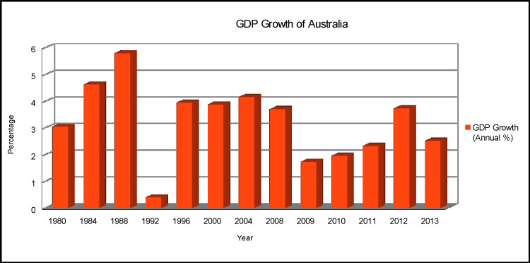
Australia GDP Growth
Notes:
Question: What patterns do you see? What seemed to have happened between 2008 and 2009? What has happened since then?

Slide 42
Trade and Tourism
China’s growth has a direct impact on the Australian economy, as Australia is a major supplier of natural resources to China.
Australia’s location makes it expensive for people to visit from other countries, and Australians do the majority of tourism within their own country.
Most international tourism comes from nearby New Zealand.
In the non-desert regions, Australians grow many grains, and Australia is developing its cotton industry, and has a large beef cattle industry.

Slide 43
Trade and Tourism
Notes:
Questions: What do you notice in this picture? Location is Sydney; large container ship; ship is loaded, etc. (Be sure to point out that the containers seen here could end up being carried down Georgia’s highways. How does Sydney’s location affect trade? It’s on the Pacific Ocean which gives its port access to markets around the world.

Slide 44
Specialization Encourages Trade
When workers have different skills and do different jobs, specialization occurs.
The factory runs best when each person learns his or her job well.
Work divided in this way is described as division of labor.
Economies of countries work in a similar way.
China needs coal and iron ore for its industries, and Australia has spent time and money to learn the best ways to mine those resources from the ground.
In return, goods produced in Chinese factories are brought into Australia to market.

Slide 45
Barriers to Trade
Countries limit trade by creating trade barriers/.
A tariff is a tax on imports.
A quota is a limit placed on the number of imports that may enter a country.
An embargo is a government order stopping trade with another country.
Australia has encouraged trade with other countries, so they have few trade barriers.
Australia has participated in embargoes such as refusing to sell weapons to countries at war to help stop the fighting.

Slide 46
Currency Exchange
Currency is the money people use to make trade easier, and most countries have their own forms of currency.
People trade their currency for the type of currency used in another country in order to purchase things there.
Usually the exchange of currency is made at a bank, which charges a fee for making the exchange.
Banknotes in Australia

Slide 47
Standard of Living
The Gross Domestic Product (GDP) of a country is the total value of all the final goods and services produced in that country in one year.
GDP per capita (per person) is a way to determine the quality of life for most people in a country.
Raising the GDP of the country can mean a higher standard of living for the people in the country.

Slide 48
Investment in Human Capital
To increase their GDP, countries must invest in human capital, which includes education, training, skills, and health care of workers in a business or country .
Australia has invested heavily in human capital.
Children are required to attend school paid for by taxpayers.
The workforce is very well trained and well educated.
Australia’s health care system is very good.
Australia’s standard of living is one of the highest in the world, and its GDP ranks with the richest countries in Western Europe.

Slide 49
How the Literacy Rate Affects the Standard of Living
Literacy is the ability to read and write; the literacy rate is the percentage of the population’s adults that can read and write.
Australia’s literacy rate is about 99%.
Though Australia’s literacy rate and standard of living are high, there are still issues of poverty.
The worst conditions of poverty are among the Aborigines.

Slide 50
Investment in Capital Goods
To increase GDP, countries must invest in capital goods—the factories, machines, technologies, buildings, and property need by businesses to operate.
New technology can produce more goods for a cheaper price.
If a company doesn’t keep its machinery up to date, other companies will be able to produce similar goods for a better price.
Australia’s businesses use advanced technology to make their companies work more efficiently.

Slide 51
The Role of Natural Resources
In Australia, arable land is an important natural resource.
Land also provides pasture for beef cattle, an important export.
Water is an important resource, but it is very limited in much of the country.
Minerals are a major export from Australia.

Slide 52
The Role of Entrepreneurship
People who have new, innovative ideas about goods or services are called entrepreneurs.
They risk their own resources to produce new or improved goods and services, and if people are willing to pay for them, they will earn a profit.
Australia is a world leader in entrepreneurs.
There are many opportunities for success in business, and the country has abundant raw materials, education, and wealth.
Laws protect entrepreneurs and their businesses, making it easy to start a business and limiting the restrictions on existing businesses.

Slide 53
Growth of Australia’s Economy
For the past 20 years, Australia’s economy has experienced continuous growth, low unemployment, low inflation, low public debt, and a strong financial system.
The service sector is the largest part of the Australian economy.
Australia was almost unaffected by the global financial crisis of 2008.
Australia has benefitted from an increase in trade in recent years.
The process of signing free trade treaties with many other countries has increased productivity, stimulated growth, and improved the economy.
Return to Main Menu

Slide 54
Section 5: U.S.-Australia Relations
Essential question:
How have Australia and the United States worked to increase global trade?

Slide 55
Section 5: U.S.-Australia Relations
What terms do I need to know?
autonomy
ANZUS security treaty

Slide 56
An Important Alliance
The United States and Australia established relations in 1940 after the United Kingdom’s recognition of Australia’s autonomy (right of self-government).
Australia is a vital ally to the U.S., and the two countries have a partnership based on shared democratic values and common interest, as well as cultural similarities.
The ANZUS security treaty serves as the foundation of defense and security cooperation between the two countries.
Australia and the U.S. have worked closely on counterterrorism issues worldwide.
The two countries also work together on global environmental issues like climate change.
The U.S.-Australian alliance is an anchor for peace and stability around the world.

Slide 57
Economic Relations
The U.S. exports machinery, vehicles, medical instruments, aircraft, and agricultural products to Australia.
To the U.S., Australia exports precious stones & metals, agricultural products, and medical instruments.
The United States is the largest foreign investor in Australia.
The two countries are committed to increasing global trade through the World Trade Organization and the Asia-Pacific Economic Cooperation forum.
Return to Main Menu

Slide 58
Image Credits: 1 Sydney Harbor, 2 Australian Outback, 12 Great Barrier Reef, 15 Ayers Rock/Uluru, 58 Great Barrier Reef (all Shutterstock license); all others Wikimedia Commons. Maps ©2017 Clairmont Press.

