Slide 1
Chapter 1:
The Social Sciences and Decision Making
STUDY PRESENTATION
© 2017 Clairmont Press

Slide 2
Section 1: What Is History?
Section 2: What Is Geography?
Section 3: What Is Political Science?
Section 4: What Is Economics?
Section 5: What Is Decision Making?

Slide 3
Section 1: What Is History?
Essential Question:
What are some reasons people study history?

Slide 4
Section 1: What Is History?
What terms do I need to know?
history
philosopher

Slide 5
What Is History?
History is the story of successes and failures from the past that shaped our world today.
By looking at our past, we can learn from our mistakes and make better decisions today.
Philosopher George Santayana wrote, “Those who cannot remember the past are condemned to repeat it.”
This textbook is meant to inform students about the history of many countries, including our own.
What effects did the actions of individuals or groups of the past have on the world that shaped it into what it is today?
Return to Main Menu

Slide 6
Section 2: What Is Geography?
Essential Question:
What are the five themes of geography?

Slide 7
Section 2: What Is Geography?
What terms do I need to know?
geography
environment
absolute location
latitude
longitude
relative location
human geography
physical geography

Slide 8
The Study of Geography
The study of geography is the study of the physical features on Earth and the human geography that examines how people adapt to their environment.
Geography has five themes:
Location describes where a place is on Earth in two different ways. Absolute location uses latitude, measuring lines on a map marking north or south, and longitude, measuring lines on a map marking east or west, to find an exact location. Relative location uses other locations to compare distance somewhere else, like saying that Atlanta, Georgia, is about 100 miles north of Macon, Georgia.

Slide 9
The Study of Geography (cont.)
Geography has five themes:
Places can be defined by either human geography or physical geography. Human geography includes languages, customs, and belief systems, all of which can vary based on place they are in. Physical geography includes landforms, climate, vegetation, and other natural characteristics, which can influence the human geography that develops in a place.
Human/environment interaction is important for how humans choose to survive in their environment. Some landscapes have hundreds of acres of forests, and others can have dry shifting sands. This theme covers the way humans adapt their environment to fit their needs.

Slide 10
The Study of Geography (cont.)
Geography has five themes:
Movement is when people, goods, or ideas travel from one location to another. In the past, movement was very slow because of the restrictions of communication and transportation. Today, movement is much faster, with planes, cars, and the Internet.
Regions are areas with distinctive human and/or physical characteristics. A region is a space that is united by some characteristic, with some regions existing in the Amazon rainforest where people still practice ancient traditions.

Slide 11
Solving the Longitude Problem
The skill of using latitude and longitude, while easily found today in GPSs, was a very difficult skill to master in the age of exploration.
Through navigational tools and maps, while also using the positions of the sun and stars, navigators on ships could determine latitude, but that’s only half of the problem.
For centuries, Europe worked to solve this problem.
In the early 1760’s, mechanic and clockmaker John Harrison created the chronometer, which was a precise instrument for calculating longitude.
This device would save ships time, along with possibly their lives, since many ships were known to get lost at sea.
Return to Main Menu

Slide 12
Section 3: What Is Political Science?
Essential Question:
What are the three parts to political science?

Slide 13
Section 3: What Is Political Science?
What terms do I need to know?
political science
civic life
personal life
politics
government

Slide 14
What Is Political Science?
Political science is the study of different types of governments and how they help their citizens.
There are three main parts to political science:
Civic life looks at how citizens’ decisions affect the local community and its decisions, like voting for a candidate in an election. On the other hand, personal life focuses on decisions people make about their own interests.
Politics is a process through which people with different opinions reach decisions that are agreed upon and enforced. Every social group, like family, school, and government, is engaged in politics.
Government is made up of people and institutions in a society with the authority to make laws and enforce them with the intention to protect citizens.
People will always have different views about politics, but it’s important to look past them and work together if we hope to improve.
Return to Main Menu

Slide 15
Section 4: What Is Economics?
Essential Question:
Why do people study economics?

Slide 16
Section 4: What Is Economics?
What terms do I need to know?
economics
scarcity
trade
specialization
domestic
globalization

Slide 17
What Is Economics?
Economics is the study of how decisions are made about how to distribute limited resources in order to satisfy our unlimited wants.
Scarcity is when there are not enough goods to satisfy a demand.
Trade, or the voluntary exchange of goods and services among people and countries, occurs as a result of scarcity and specialization (when a country focuses on the goods and services they can make best).
Learning about trade prepares you to understand domestic (one’s home country) and global economic issues.
Learning about trade and interdependence will also help you understand the problems of globalization, the development of an increasingly worldwide economy.
Return to Main Menu

Slide 18
Section 5: What Is Decision Making?
Essential question:
What are some important steps to take before making a decision?

Slide 19
Section 5: What Is Decision Making?
What terms do I need to know?
decision
issue
options
consequences
values

Slide 20
What Is Decision Making?
A decision is a determination reached after consideration of alternatives and choosing the most attractive option.
To make good decisions, you must first clearly identify an issue that needs to be solved.
Many times, an issue has two parts: a goal and an obstacle.
The next step is for the decision maker to list their options (choices), each of which has its own consequences (outcomes) that can be good or bad.
Decisions involve balancing choices against personal values, or what is important to you.
Your values will certainly affect the option you choose.
By combining all these factors, you are now ready to make your choice, hopefully choosing the option you believe is the best solution to the problem.
Return to Main Menu

Slide 21
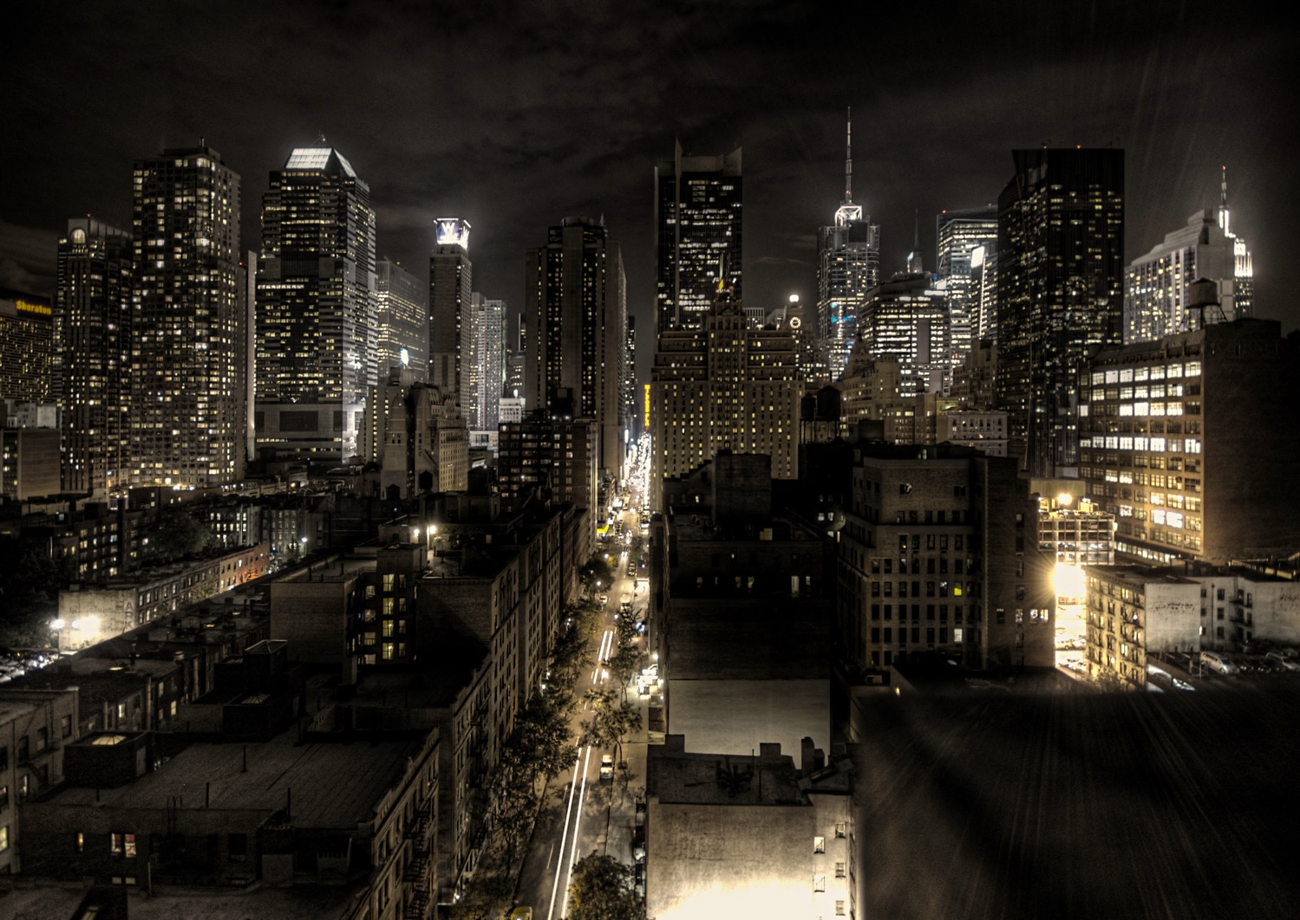
Image Credits: all Wikimedia Commons. Maps ©2017 Clairmont Press.

