Slide 1
Chapter 5:
United Kingdom of Great Britain and Northern Ireland
STUDY PRESENTATION
© 2017 Clairmont Press

Slide 2
Section 1: The Geography of the United Kingdom
Section 2: A Brief History of the United Kingdom
Section 3: Government of the United Kingdom
Section 4: Economy of the United Kingdom
Section 5: U.S.-United Kingdom Relations

Slide 3
Section 1: The Geography of the United Kingdom
Essential Question:
How could the United Kingdom’s geography and location affect its development?

Slide 4
Section 1: Geography of the United Kingdom
What terms do I need to know?
Gulf Stream
Great Smog of 1952
Industrial Revolution
acid rain

Slide 5
Location and Size of the United Kingdom
The United Kingdom is a country of islands off the northwest coast of mainland Europe.
The country consists of England, Northern Ireland, Scotland, and Wales.
Though it is a group of islands, it has close neighbors, such as France, Belgium, Denmark, and Germany.
Its many ports helped it once dominate world trade.
Now the country has 10 major ports.

Slide 6
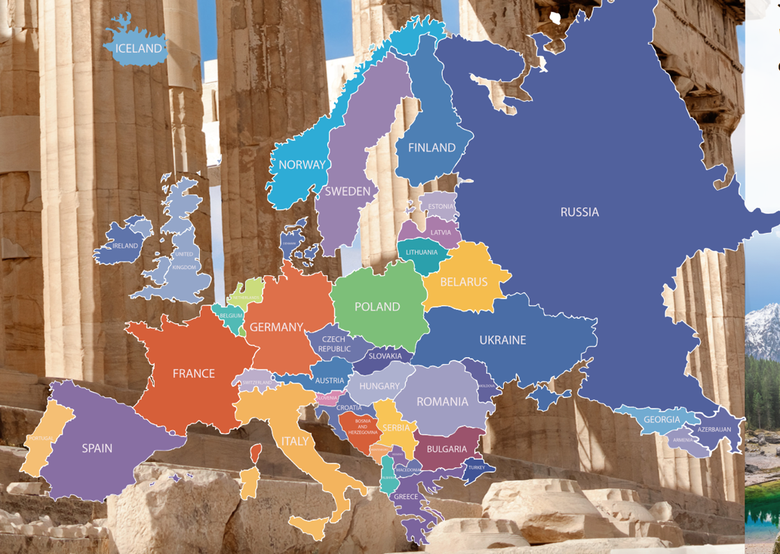
Location and Size of the United Kingdom

Slide 7
Location and Size of the United Kingdom

Slide 8
Climate of the United Kingdom
The United Kingdom has a mild climate with rainfall occurring throughout the year.
Almost no section goes without rain for longer than three weeks.
Warm waters and winds from the Gulf Stream affect the climate of the United Kingdom.
The Gulf Stream moves warm water along the coast of North America and across the Atlantic Ocean.
Because of the mild climate and arable land, much of the land is used for grazing and agriculture.
Despite this, less than 2% of the people earn their living as farmers.

Slide 9
Distribution of People in the United Kingdom
With an area of about 93,000 square miles and a population of 60 million, the UK has a population density of roughly 645 people per square mile.
Around 83% of UK citizens live in urban areas.
The most populated areas are in England, while the least populated are in Scotland.
The highest concentrations of people are in metropolitan areas like London, Birmingham, and Liverpool.
An increase in trade commodities, like ports, and industry growth has led to population growth in places like Liverpool.

Slide 10
Natural Resources of the United Kingdom
The United Kingdom’s natural resources include coal, petroleum, natural gas, and iron ore.
These are the backbone to the country’s main industries of auto production, steel manufacturing, and shipbuilding.
The recent shift to cleaner energies has led to a decrease in manufacturing.
Other resources include lead, zinc, gold, tin, limestone, salt, clay, chalk, gypsum, potash, sand, and slate.
Fishing is very profitable, with the fish used in domestic and foreign markets.
With the large amount of arable land, the country can produce roughly 60% of its own crops.

Slide 11
Environmental Issues of the United Kingdom
London has had a problem with air pollution for quite some time.
The word smog, or fog mixed with smoke, was first used to describe London’s air in 1905.
In the Great Smog of 1952, the smog was so dense that the people of London could not see directly in front of them for four days.
The Industrial Revolution marked a spike in air pollution, with coal acting as a cheap, available fuel source for many machines at the time.
Because of more recent transitions to cleaner energy, older fuel sources like coal are beginning to be replaced.
Air pollution that still exists blows east and causes acid rain for many countries in Western Europe.
Another concern is habitat loss for plants and animals caused by urbanization and a need for more farmland.
Return to Main Menu

Slide 12
Section 2: A Brief History of the United Kingdom
Essential Question:
How has the United Kingdom’s status changed as a result of World War II?

Slide 13
Section 2: A Brief History of the United Kingdom
What terms do I need to know?
Parliament of Great Britain
British Commonwealth of Nations
Brexit

Slide 14
The Age of Exploration and Colonization
The United Kingdom’s unified history began when King James VI of Scotland inherited the crown of the Kingdom of England in 1603.
In 1707, a single Parliament of Great Britain was established along with an official name change to the Kingdom of Great Britain.
In 1801, the addition of the Kingdom of Ireland caused the country to become the United Kingdom of Great Britain and Ireland.
The British Empire once covered the largest territory in history with control over Australia, most of North America, India, much of east Africa, and numerous islands of the world.
Even after the United States gained its independence, Britain still maintained control over Canada until the 20th century.
By the 1920s, almost a fourth of the world’s population was under British control.

Slide 15
The Effects of World War II
World War II saw the Soviet Union, Nationalist China, and the United States join the British as the Allied Powers.
The British Empire helped fight a successful war against Germany, Italy, and Japan.
To reduce the economic stress on itself from the war, Britain granted independence to much of its empire.
These new nations joined a group called the British Commonwealth of Nations.
The United Kingdom is now a leading member of the United Nations and the North Atlantic Treaty Organization.
With their current position, they now monitor many aspects of the worldwide community.

Slide 16
The London Blitz
During 1940, the German air force, or Luftwaffe, focused their efforts on bombing airfields and radar stations in England.
Their strategy changed in September of 1940, when Hitler gave the order to begin bombing London and other major cities, hoping it would force the British to pull out of the war.
It was called the Blitz, which was short for the German word Blitzkrieg, which means “lightning war”.
Hitler spared Oxford because he planned to make it the new capital after he conquered England.
Over 30,000 bombs were dropped on all cities targeted between September and November forcing citizens to take shelter or join the growing casualties.
The British did not give in but used various methods to protect their citizens and support those in the bombing zones
Hitler pulled the Luftwaffe out in May of the next year when he realized the Blitz was ineffective.

Slide 17
Changing Relationships
Independence movements in Northern Ireland, Scotland, and Wales have grown since the 1990s.
During the most recent vote for Scottish independence, the population voted to remain with the United Kingdom, but only by a slim margin.
In another recent vote, the people of the United Kingdom voted to leave the European Union, despite being a leading member.
This is commonly called Brexit, a combination of the words Britain and exit.
The vote shocked many in both the United Kingdom and the European Union, since it had a close victory of 52% versus 48%.
The process of the United Kingdom leaving the EU is expected to take several years to complete.

Slide 18
Section 3: Government of the United Kingdom
Essential Question:
What is the role of the United Kingdom’s monarchy?

Slide 19
Section 3: Government of the United Kingdom
What terms do I need to know?
prime minister
House of Lords
Life Peerages Act
House of Commons
constitutional monarchy
Scottish Parliament

Slide 20
Structure of Government
There are many parts of the United Kingdom’s government: the monarch, the prime minister, the Parliament of Great Britain, and an independent court system.
The prime minister enforces the laws and manages the country as head of government.
Parliament is composed of two parts:
The House of Lords: members were appointed by the monarch with the position inherited by the family until 1958, when the Life Peerages Act began introducing new members from different professions, included women, and had the prime minister appoint members.
The House of Commons: the 650 members are directly elected by voters for five-year-terms, have their power come from the budget, and tend to actually have more power than the House of Lords despite being considered the lower class.

Slide 21
Structure of Government (cont.)
The monarch is considered part of Parliament as head of state.
The United Kingdom is classified as a constitutional monarchy because the country is ruled by a monarch whose power is limited by a constitution.
In 1997, the Scottish people voted to restore their Scottish Parliament and its 129 elected members, which was dissolved in 1707.
With the restoration of this Parliament, the Scottish people have continued to gain political influence in the country.
The courts are separated into four courts: Courts of England and Wales, Courts of Northern Ireland, Courts of Scotland, and the Supreme Court of the United Kingdom.
Each court system has slight differences in law based on their traditions and customs.

Slide 22
Citizen Participation
Citizens of the United Kingdom elect members of the House of Commons.
The leader of the leading political party selects the prime minister to run the government.
The monarch acts as a figurehead, with mostly ceremonial duties and limits on what he or she can do.
Citizens of the United Kingdom have personal freedoms like those in the United States.
All citizens are treated equally, have the right to worship as they choose, have freedom of speech, right to a fair trial, right to own property, and the right to security.

Slide 23
Her Majesty the Queen
Elizabeth II has served longer than any monarch in British history, beginning in 1952.
She was not expected to become the monarch, but after her uncle abdicated the throne, her father took over and she became next in line.
During World War II, Elizabeth became a military truck driver and mechanic, which served to inspire other people, especially women.
After the war Elizabeth married Prince Philip of Greece and Denmark in 1947, leading to three sons and a daughter.
After becoming queen in 1952, she would go on to be an example of a hard-working, dedicated leader, working with nations around the world.
Return to Main Menu

Slide 24
Section 4: Economy of the United Kingdom
Essential question:
How does the United Kingdom’s type of economy impact its citizens?

Slide 25
Section 4: Economy of the United Kingdom
What terms do I need to know?
National Health Service (NHS)
British pound (£)

Slide 26
Economic System Today
The United Kingdom is considered one of the freest market economies in the world.
It is one of the few European countries that can boast about its economy in the trillions annually.
The legal system heavily enforces the rule of law and guarantees the rules of economic contracts.
The United Kingdom is a haven for entrepreneurs, with laws that allow any individual to create a business with relative ease.

Slide 27
Trade
The United Kingdom is a large producer of machine parts; railroad, ship, and aircraft equipment; motor vehicles and parts; electronics; and communications equipment.
These products are responsible for almost $470 billion of annual income.
The United Kingdom’s imports are mainly food and fuels.
Services like banking, insurance, and business services are key factors of British GDP growth.
After the 2008 recession, the government started several programs to help boost the economy and stabilize their markets.

Slide 28
Standard of Living
The United Kingdom has a good standard of living, with education, health status, and social activities all ranked higher than the average for European countries.
The National Health Service (NHS) is a program paid for by a national tax that provides most medical treatments a person could need.
The goal was to provide comprehensive and free health care for all British citizens.
While the GDP per capita of Great Britain is $42,000, which is lower than both Germany and the United States, more than 33 million people have jobs that provide for their families.

Slide 29
Currency
The British pound (£), the currency of the United Kingdom, is one of the most stable in the world.
Beginning in the time of the Romans, the pound has been around for roughly 1000 years.
The earliest minting occurred in the 8th century, with the first paper currency finally being printed in 1694.
Return to Main Menu

Slide 30
Section 5: US-United Kingdom Relations
Essential question:
What are some ways that the United States and the United Kingdom have worked together?

Slide 31
Section 5: US-United Kingdom Relations
What terms do I need to know?
embassy
British-American Business Council of Georgia

Slide 32
The Long Friendship
After the Revolutionary War and War of 1812, peace between the US and the United Kingdom was achieved and the two began the process of becoming partners in world affairs.
Today, the United Kingdom is one of the US’s closest allies.
This cooperation reflects the common language, ideals, and democratic practices of the two nations.
The two work together as part of many world associations, including the United Nations, UN Security Council, World Health Organization, and more.
This only makes sense, as the two countries have tackled many world issues, such as the Cold War, both world wars, the Korean conflict, and the Persian Gulf War.
The United Kingdom has an embassy in Washington, DC, with an ambassador to represent the United Kingdom in the states.

Slide 33
Bilateral Economic Relations
The United Kingdom is a major international trading power acting as one of the US’s largest trading markets for both exports and imports.
Groups like the British-American Business Council of Georgia promote trade between Georgia, the other states, and the United Kingdom.
Georgia exports quite a bit of machinery, and it imports other machinery and medical equipment.
The United Kingdom also acts as a large source of tourism for the United States, and vise versa.
Return to Main Menu

Slide 34
Image Credits: 34 By Michael Walsh, https://commons.wikimedia.org/w/index.php?curid=53682850, all others Wikimedia Commons. Maps ©2017 Clairmont Press.

