Slide 1
Chapter 13:
Mexico (Estados Unidos Mexicanos)
STUDY PRESENTATION
© 2017 Clairmont Press

Slide 2
Section 1: The Geography of Mexico
Section 2: A Brief History of Mexico
Section 3: The Government of Mexico
Section 4: The Economy of Mexico
Section 5: US-Mexico Relations

Slide 3
Section 1: Geography of Mexico
Essential Question:
What are some of the dangers of Mexico’s location on the Pacific Ring of Fire?

Slide 4
Location and Size of Mexico
Mexico is the third-largest country and has the second largest population in Latin America.
It is located in the northern and western hemispheres and is located directly south of the United States.
Mexico is located between the Pacific and the Gulf of Mexico and Caribbean Sea, giving it many opportunities to trade with all parts of the world.
Mexico also acts as a physical and cultural bridge, connecting North America and South America by a narrow strip of land called an isthmus.

Slide 5
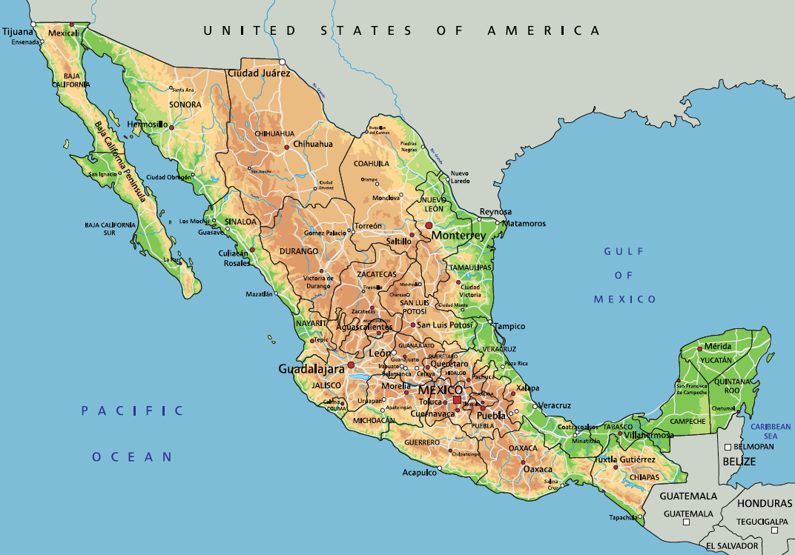
Location and Size of Mexico

Slide 6
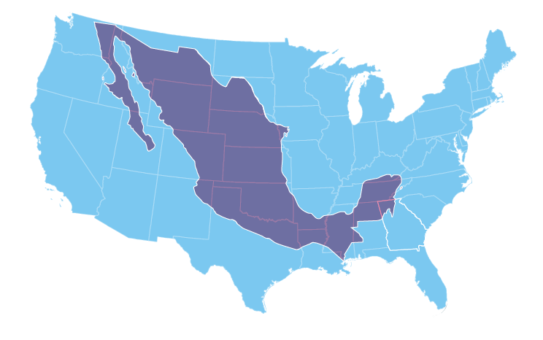
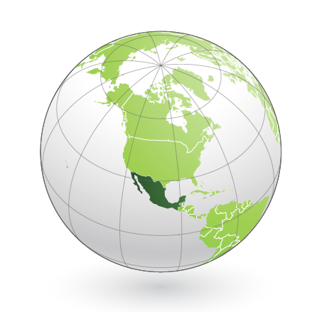
Location and Size of Mexico

Slide 7
Climate of Mexico
The Tropic of Cancer, which is an imaginary line of latitude, has typically hot summers and warm winters.
North of the line is considered subtropical, and south of it is considered tropical.
The Sierra Madre Mountains can have freezing temperatures at elevations above 14,000 feet.
There are also deserts in the north, plains, jungles, and plateaus (broad flat areas of high land).
Because of the harsh climate in the north, many live in an area called the Central Plateau.
The tropical rain forests, which are woodlands with high annual rainfall and very tall evergreen trees, draw many tourists.

Slide 8
Distribution of People in Mexico
The majority of the population lives in central Mexico between the states of Jalisco and Veracruz.
A fourth of the population, which is roughly 21 million people, lives in and around Mexico City.
The northern part of the country is sparsely populated, but there are large cities that exist along the US border.
The overall population density of the country is about 168 people per square mile.
Comparatively, the population density of Mexico City is about 4,000 people per square mile.

Slide 9
Natural Resources of Mexico
Oil is a major export of Mexico, being the 13th-largest oil exporter in the world.
The sales provide one-third, or about $19 billion, of the Mexican government’s budget.
Another major natural resource is silver, which is plentiful in the area and has been seen in history dating back to the early Mexican civilizations.
Mexican mines produce 15% of the silver sold in the world each year.
Mexico also has a number of other resources, including copper, gold, and natural gas.
Mexico also exports fruits, vegetables, coffee, cotton, and various types of timber.

Slide 10
Physical Features of Mexico
Mexico’s most dramatic physical features are dominated by its location on the Pacific Ring of Fire.
The Ring is a long chain of volcanoes that circles the Pacific Ocean, containing over 450 volcanoes that can erupt and can be a source of earthquakes.
Mexico is home to one of the most dangerous volcanoes, Popocatépetl, and also the dormant volcano of Citlaltépetl, the tallest mountain in Mexico at 18,000 feet.
In between the many mountain ranges within the country, there are deserts, plateaus, and grasslands, with the south having a wetter climate.

Slide 11
Environmental Issues of Mexico
Mexico City is known as one of the world’s worst areas of air pollution, with children being more likely to have breathing problems and develop lung disease when they grow up.
There are thousands of factories and over 10 million vehicles in Mexico City that send pollution into the air.
The older model cars lack modern emissions control technologies.
The geography of the city also affects the pollution problems.
The altitude makes the air thinner to begin with, and combined with the bowl-shape crater where the city is built, traps the pollution.
Smog, a combination of smoke and fog, forms on many days.
The government is working on many solutions for this, including limiting cars on the roads, encouraging public transportation, and closing factories on days with bad levels of pollution.

Slide 12
Día de los Muertos
The Day of the Dead is a popular holiday in Mexico that goes back 2,500 years to the traditions of the native people of Mexico.
It is a major commemoration of death and rebirth based on the belief that the spirits of people who have died can return to earth to visit with their families once a year.
Beginning on the night of October 31, families decorate the graves, followed by November 1, when infants and children are believed to visit their families, and November 2, when adults are believed to visit their families.
Marigolds and skulls are common symbols of the Day of the Dead, both of which are meant to honor the dead.
Return to Main Menu

Slide 13
Section 2: A Brief History of Mexico
Essential Question:
What was the role of Miguel Hidalgo in Mexico’s independence movement?

Slide 14
Section 2: A Brief History of Mexico
What terms do I need to know?
archaeologist
viceroy
Gadsden Purchase
drug cartel

Slide 15
Indigenous Empires Meet Europeans
Modern-day Mexico was once part of the Aztec and Maya Empires.
The Mayan pyramids and other ruins in the rain forests of the Yucatán peninsula attract tourists and archaeologists, or scientists who study ancient artifacts to learn about early people.
Aborigines tended to settle where modern day Australians currently live, where the climates were more moderate, and their low numbers allowed for plenty of room to live.
Both cultures were skilled at building with stone and constructing roads.
The Maya developed an accurate calendar and a writing system, but the Mayan population had declined by the time the Spanish arrived.

Slide 16
Indigenous Empires Meet Europeans (cont.)
The Aztecs were at their height when Hernán Cortés and his 600 soldiers arrived in Mexico from Spain.
Cortés and his men found the city of Tenochtitlán, with floating gardens, lakes, and beautiful pyramids.
The Spanish fought with the Aztecs, and within a few years, the Aztec leader Montezuma and other leaders were dead, with the population dramatically falling afterwards.
Spain sought out gold and silver in the land, and missionaries were sent to Mexico to convert the natives to Christianity.
Mexico, under Spain, was ruled by a viceroy, or a ruler chosen by the monarch of Spain, which meant there was little citizen participation in government.

Slide 17
The Rise and Fall of the Aztec Empire
The Aztec Empire was one of the most powerful empires in pre-Columbian Latin America.
After draining a marsh and building islands for agriculture, they began construction of Tenochtitlán.
It would eventually cover 80,000 square miles with approximately 6 million people.
They had advanced farming techniques, and every home had a bath in it, which was not yet common in Europe.
They had a very rigid social structure, which limited status change.
They believed in many gods, and one of their more famous religious practices was human sacrifice.
The sacrifices were usually captured warriors, with the most valuable being warriors that showed bravery in combat.
The Aztecs fell in 1521 when Cortés arrived with better weapons and armor, seeking to take their riches for himself and Spain.

Slide 18
Independence from Spain
In the 18th century, Spain was wealthy and powerful, as were its rivals, Great Britain and France.
In 1808, France invaded Spain and removed the king, and Emperor Napoleon made himself ruler of Spain.
Many in Mexico were not sure they supported the new French government, others did not like the old Spanish government, and some called for independence.
Miguel Hidalgo, a priest of the Roman Catholic Church, and his group were the first to call for Mexican independence.
His group of rebels won early victories, but they were eventually overtaken by the Spanish army.
Despite his death, Hidalgo became a symbol of Mexican independence.
In 1821, Mexican independence came when General Santa Anna, who fought for the Spanish, switched sides and helped Mexico gain independence.
He would eventually be elected president for a time.

Slide 19
Problems with Mexico’s Northern Neighbor
Early Mexico had trouble developing a stable government and had problems along its border with the United States to the north.
Texas, a part of Mexico, had a revolution in 1835.
Santa Anna led the attack to suppress the revolution, leading to the famous Battle for the Alamo.
Santa Anna won the battle, but he’d later lose Texas to the Texan army.
Texas, after a short independence, joined the United States of America.
The Mexican-American War was fought between 1846 and 1848 over boundary lines between the countries, eventually deciding on the Rio Grande River.
The United States, in an effort to create a trans-continental railroad, bought Mexican land in a deal known as the Gadsden Purchase in 1853, which established Mexico’s existing boundaries.

Slide 20
Problems from Europe
Benito Juárez was elected president in 1861, becoming popular for his fairness, honesty, and democratic principles.
Juárez stopped making loan payments to European countries when he was trying to focus on Mexico’s finances, so France invaded as a response and made Austrian Archduke Maximilian emperor in 1864.
Americans’ attention was focused on the United States Civil War, so Mexico was left to deal with the French themselves.
They eventually drove the French out, executed Maximilian, and returned Juárez as president.
From 1876 to 1911, the country was run by dictator General Porfirio Díaz, who kept power by granting the elite favors.
The 1911 Mexican Revolution overthrew him, and the Constitution of 1917 worked to better distribute land, wealth, and opportunities for the poor.

Slide 21
Mexico Today
Mexico is an industrial country with a democratically elected leadership.
Its government is divided into branches, similar to the United States.
Mexico works to create modern industry and improve the lives of its people.
Poverty remains high, however, and violence from drug cartels (criminal drug-trafficking organizations) is an ongoing problem.
Return to Main Menu

Slide 22
Section 3: Government of Mexico
Essential Question:
How does corruption interfere with government and business?

Slide 23
Section 3: Government of Mexico
What terms do I need to know?
federal government
National Congress
monopolist

Slide 24
Structure of Government
Mexico’s government is divided into the legislative, executive, and judicial branches.
It is classified as a federal government, meaning power is divided between national government and state and local governments.
Mexico is also a presidential democracy, meaning the citizens freely elect the president, who can serve for one 6-year term.
The president appoints his advisors as secretaries of state and attorney general of the Republic.
Citizens also elect members of legislature, called the National Congress.
The court system is managed by the central government and is not totally independent of the president.
Mexico has 32 states and its capital, Mexico City.

Slide 25
Citizen Participation
Citizens have the right to vote for representatives for them in the larger government.
They may also choose their own job, must pay taxes, and have the opportunity to go to college.
More Mexicans are becoming entrepreneurs, as businesses in Mexico are becoming more competitive in the global market.
However, there is a large amount of corruption in both the government and business sectors.
This includes governmental monopolists, who seek to control the enterprise, and organized crime members.
Return to Main Menu

Slide 26
Section 4: Economy of Mexico
Essential Question:
What have been some improvements in Mexicans’ standard of living?

Slide 27
Section 4: Economy of Mexico
What terms do I need to know?
market economy
life expectancy
Mexican peso

Slide 28
Economic System Today
Mexico has a market economy, which means individuals and corporations own most of the businesses and farms in Mexico.
The Mexican government does own and operate the energy companies, however.
The government does provide some laws to make sure businesses run smoothly and fairly, but it does not set prices on goods or services, and it does not own businesses or farms.
There are many manufacturing centers, which provide jobs for about 80% of the population in Mexico.

Slide 29
Trade
Since the North American Free Trade Agreement (NAFTA) was signed in 1994, manufacturing has increased.
Mexico has free trade agreements with 46 other countries, making 90% of its trade under these agreements.
The long term goal of the government is to grow the economy, which is why they are pushing investment and demand for Mexican exports.
Mexico’s economy is very sensitive to oil prices, so they have been investing in new technologies and resources to reduce the impact of oil price changes.

Slide 30
Standard of Living
The standard of living in Mexico has improved in the 21st Century.
Access to good education, housing, healthcare, and jobs remains low but has gone up.
There is a large gap between the rich and the poor.
Only 34% of adults completed high school, and employment is about 60%.
Life expectancy, the average lifespan of an individual, is about 75 years in Mexico.
In 2013, the GDP per capita was about $16,000, much lower than the United States’ $53,000.

Slide 31
Currency
Mexico uses the peso ($ or Mex$) for its currency.
The Mexican peso is one of the oldest traded currencies in the world, originating from Spain during the 16th century.
It has gone through many versions, including coin and paper bills, but it still remains one of the top traded currencies in the world.

Slide 32
The Zapatista Movement
The Zapatistas are a group of Mexicans, named after Emiliano Zapata, who support improved rights and living conditions for Mexico’s indigenous people.
The day after NAFTA came into effect, Zapatistas took over several towns in southern Mexico by force because they feared this agreement would allow cheaper farms to undercut Mexican farmers.
The army was sent in, and fighting lasted for weeks before a cease-fire was issued.
However, Zapatistas still push for better quality of life for the indigenous peoples, voicing concerns and desires to the government.
Return to Main Menu

Slide 33
Section 5: US-Mexico Relations
Essential question:
What are some ways the United States and Mexico cooperate to solve border issues?

Slide 34
Problems at the Border
The border region, meaning the states along the US-Mexico international border, represent a combined population of nearly 100 million people and the world’s 4th largest economy.
Collaboration between the countries includes state and local problem-solving, transportation planning, and cooperation on resource, environmental, and health issues.
There are serious environmental problems here caused by rapid population growth, urbanization, and industrialization.
Many agreements work to preserve the environment near the border, like migratory birds and wildlife, forests, marine resources, and the atmosphere.

Slide 35
US Security Cooperation with Mexico
The Mérida Initiative is a partnership between the United States and Mexico to address violence and crime while strengthening the rule of law and respect for human rights.
It has four goals:
Disrupt operations of organized crime, help Mexico’s government keep the rule of law, improve border control to stop the flow of contraband, and build strong communities.
The United States has helped to train and equip Mexico’s police force with the necessary skills and tools to complete this initiative.

Slide 36
Bilateral Economic Relations
US trade relations with Mexico are strong and vital, with a large part of trade in the state of Georgia.
Nearly 20 million US tourists traveled to Mexico in 2013, and over 14 million Mexican tourists traveled to the United States in 2013 and spent roughly $10.5 billion.
Both countries are top importers and exporters for one another, exchanging things like crude oil, machinery, plastics, and vehicle parts.
Both countries, as well as Canada, benefit from NAFTA.
Mexico has more free trade agreements than any other country in the world.
Return to Main Menu

Slide 37
Image Credits: all others Wikimedia Commons. Maps ©2017 Clairmont Press.

