Slide 1
Chapter 14:
Republic of Cuba (Repúblic de Cuba)
STUDY PRESENTATION
© 2017 Clairmont Press

Slide 2
Section 1: The Geography of Cuba
Section 2: A Brief History of Cuba
Section 3: The Government of Cuba
Section 4: The Economy of Cuba
Section 5: US-Cuba Relations

Slide 3
Section 1: Geography of Cuba
Essential Question:
What are some natural resources found in Cuba?

Slide 4
Section 1: Geography of Cuba
What terms do I need to know?
islet
blackout

Slide 5
Location and Size of Cuba
The Republic of Cuba is the largest nation in the Caribbean, about the size of Tennessee but smaller than Georgia.
It is bounded by the Gulf of Mexico to the northwest, Atlantic Ocean to the northeast, and Caribbean Sea to the south.
Cuba consists of one large island and about 1,600 islets (small islands).

Slide 6
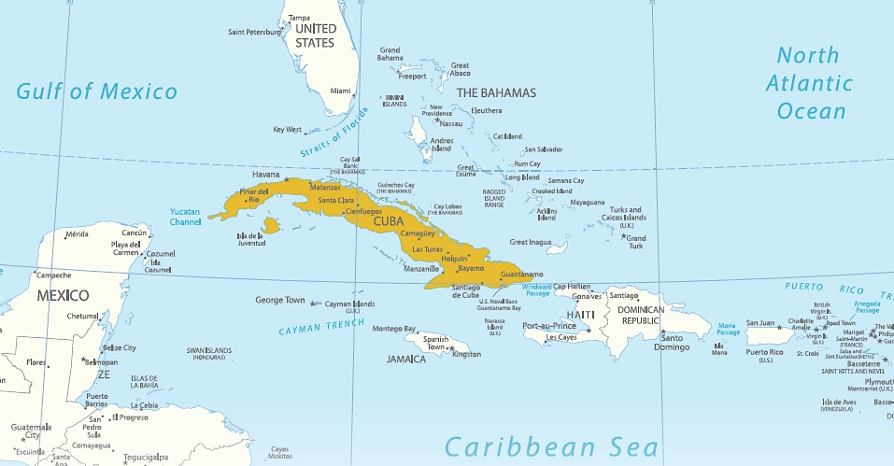
Location and Size of Cuba

Slide 7
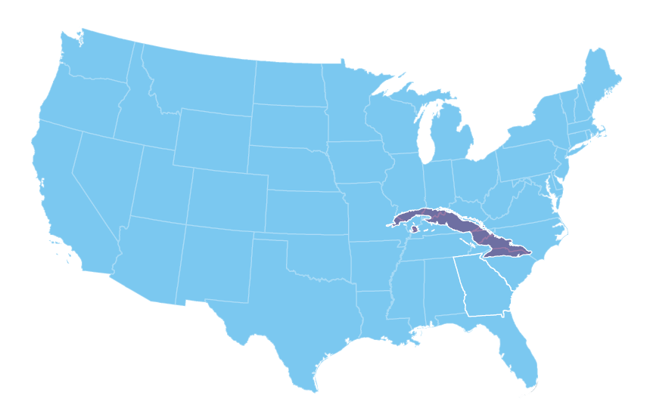
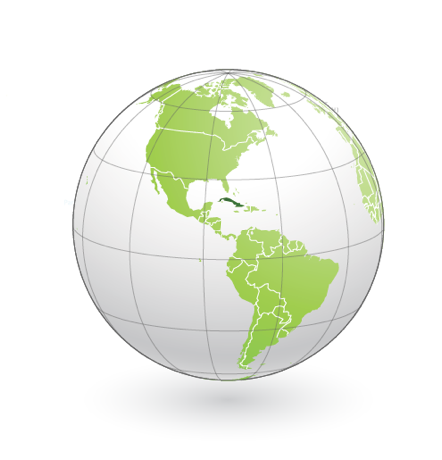
Location and Size of Cuba

Slide 8
Physical Geography of Cuba
Two-thirds of Cuba is flat with rolling plains, which has been used for farming for centuries.
There are also hills and mountains with the highest mountain, Turquino Peak, reaching about 6,500 feet above sea level.
Cuba has over 3,500 miles of beautiful coastline that attracts tourists from around the world.
Many of the largest cities in Cuba are along the coast, and 77% of Cubans live in urban areas.
Cuba’s location on ocean trading routes has been an important influence on its history and current economy.

Slide 9
Climate of Cuba
Cuba lies just south of the Tropic of Cancer, giving the country a tropical climate and making Cuba warm to hot all year long.
Temperatures are moderated by winds throughout the year.
There’s a rainy season from May to October and a dry season from November to April.
Cuba’s location and climate make it the target for hurricanes, which begin off the coast of Africa and travel across the Atlantic Ocean, passing over the Caribbean.
Hurricanes in the past have caused tremendous damage to the country.

Slide 10
Natural Resources of Cuba
About 28% of Cuba’s land is arable, meaning it can grow crops not only for its people but also to sell to other countries.
For centuries, sugarcane plantations have been a major source of income for Cuba.
Coffee, fish, fruit, and tobacco are also major exports of Cuba.
Cuba also has timber and mineral resources that include cobalt, nickel, iron ore, chromium, copper, salt, silica, and petroleum.
Nickel, which accounts for 21% of Cuba’s exports, is considered the country’s second most valuable natural resource after sugarcane.
Cuba has a beautiful landscape and wonderful beaches, attracting tourists from all over the world.
When the Soviet Union collapsed in 1991, Cuba faced difficult times since it could not supply all its energy needs.
Today, Venezuela sells oil to Cuba at a reduced cost, the government occasionally orders businesses and factories to close, and the government also orders blackouts, or times when all electricity to a region is cut off.

Slide 11
Gardens of the Queen
Fifty miles offshore to the south lies the Jardines de la Reina, or Gardens of the Queen, which is a reef and marine wilderness national park.
The waters are rich with healthy wildlife, like coral, sea turtles, stingrays, sharks, and more, making the area desirable for divers, marine biologists, and tourists.
The reefs of the Garden of the Queen have been protected from many threats that reefs around the world deal with, like coral bleaching.
Farmers use less chemicals in their farming, so there is less runoff into the water.
Increased tourism is risking damage to the reef, so in the past there have been restrictions on how many tourists can go to the reef.
Return to Main Menu

Slide 12
Section 2: A Brief History of Cuba
Essential Question:
What was Fidel Castro’s role in the history of Cuba?

Slide 13
Section 2: A Brief History of Cuba
What terms do I need to know?
Spanish-American War
embargo
Cuban Missile Crisis

Slide 14
Colonial Times and Independence
Cuba’s islands were among those explored by Christopher Columbus in 1492.
In 1511, Spanish settlers and African slaves made the first European settlement, with experimentation leading to the growth of cash crops like tobacco and sugarcane and increased use of African slaves as laborers.
It is believed over half a million people were brought from Africa as slaves to Cuba until 1886.
The Ten Years’ War (1868-1878) was a bloody revolution attempt by Cubans to gain freedom from Spain, but it ended with Spain sending in more troops to maintain control.
The USS Maine was blown up in the Havana harbor in 1898, which led to the Spanish-American War.
After the conflict, the United States assisted Cuba in becoming an independent country in 1902.

Slide 15
The Cuban Revolution
Cuba had political problems for the first half of the 20th century, and American businesses were trading with Cuba at the same time.
In 1952, former president Fulgencio Batista made himself dictator.
There were many who were unhappy with his rule, there was much poverty, and education and healthcare in the country were not good.
In 1959, Fidel Castro led a group of rebels against Batista, and many Cubans joined his cause.
Castro asked for help from the United States with the promise that he would make Cuba a democracy.
However, once he defeated Batista’s government in 1959, he made himself dictator, made the country communist, and claimed all American-owned property in Cuba for the country.

Slide 16
The Cuban Revolution (cont.)
Many changes occurred under Castro’s rule.
Castro had Batista supporters arrested and executed or sent to prison for decades.
Cubans could no longer protest the government, and they lost religious freedom.
The government shut down newspapers, radio, and television, and the government became the only source of news.
Because of these harsh events, the United States put an embargo on Cuban goods.
The Soviet Union became friends with Cuba, buying their sugarcane and supplying them with weapons and other goods.
The Soviets also educated young Cubans and trained their military.
Cubans did experience improved schools and hospitals, and women and blacks became better educated and employed.

Slide 17
Strained Relations with the United States
Castro’s government and the US government did not get along well during the remainder of the 20th century.
The United States kept pressure on their communist neighbor, preventing travel between the countries and trying to prevent other countries from trading with the Cubans.
At the same time, Cuba tried to spread communism into Latin America, providing training, money, and weapons for revolutionary cells.
Return to Main Menu

Slide 18
Strained Relations with the United States (cont.)
The Cuban Missile Crisis of 1962 was an event when the Soviets were allowed to build a missile-launching complex in Cuba, in range of the United States.
President John F. Kennedy demanded the removal of the missiles, and there was a tense period before the Soviets decided to remove the missiles.
Relations did not improve over the next fifty years.
The embargo was still in place, and many Cubans escaped the island in the 1980’s and 90’s, but they were being “allowed” to escape.
In 2008, Fidel Castro turned power over to his brother, and in 2014, Raúl Castro and President Barack Obama announced the restoration of diplomatic relations between the countries.

Slide 19
Cuba: A Rolling Car Museum?
The streets of Havana are full of old, operating cars, dating back to the 1950’s.
When Fidel came to power in 1959, he put an embargo on foreign-made cars.
This meant car owners had to get creative to keep their American and European cars from breaking down, such as scavenging from other cars or building their own homemade parts.
These old cars are still on the roads today, so some call the roads of Cuba a ‘rolling car museum’.
The government has recently started allowing imports on cars again, and American car companies are anticipating a market for seat belts, working speedometers, and air conditioning.
Return to Main Menu

Slide 20
Section 3: Government of Cuba
Essential Question:
What roles do citizens have in choosing their leaders in Cuba?

Slide 21
Section 3: Government of Cuba
What terms do I need to know?
unitary government
National Assembly of People’s Power

Slide 22
Structure of Government
Cuba has a unitary government, which means power is organized from a strong central government that controls each of the smaller units in the country.
The country is a communist dictatorship.
Citizens may vote for members of the National Assembly of People’s Power, but only for candidates approved by the Communist Party.
The Communist Party controls all aspects of government.
The leader carries the title of president of the Council of State, is elected by representatives of the populous, and has limits on the amount of terms he can serve.
The legislative body, the National Assembly of People’s Power, has 612 representatives who serve 5-year terms.
Despite this, the Council of State still makes many of the decisions for the country.

Slide 23
Citizen Participation
Cuba calls itself a democracy because people vote in elections, but it is not actually possible for a person to be elected to office without the approval of the Communist Party of Cuba.
Cuban citizens have little power in their government despite the ability to vote.
Men and women age 16 and up can vote if they choose.
Return to Main Menu

Slide 24
Section 4: Economy of Cuba
Essential Question:
What is the standard of living of Cuba’s people?

Slide 25
Section 4: Economy of Cuba
What terms do I need to know?
Cuban convertible peso (CUC)
Cuban peso (CUP)
mestizo
emigration

Slide 26
Economic System Today
Cuba has a command economy in which government planning groups make basic economic decisions, such as what to produce, the price of those items, and the wages of workers.
Workers are given a quota to meet when producing something with the expectation that when all quotas are met, everyone in the country will have what they need.
Some benefits of this are that there is wage and price control, with basic needs at very affordable prices.
Roughly 90% of the Cuban people work for the government, with a population of entrepreneurs recently on the rise.

Slide 27
Trade
Cuba trades with other countries for many of the things it does not have, like oil and natural gas.
However, because it cannot sell enough sugarcane to pay for its fuel needs, the government has to have temporary closing of factories and power blackouts to save power.
Since 2011, the Cuban political leaders have approved plans for implementing economic changes and reforms.
The United States and Cuba have done little trade in the past fifty years, due to the embargo that remained in place until 2015, when both countries met to ease some of the restrictions.
Cuba has trade relations with Canada, Venezuela, and China, but the dramatic difference between exports and imports contributes to the Cuban national debt.

Slide 28
Currency
Cuba has two currencies: the Cuban convertible peso (CUC) and the Cuban peso (CUP).
Americans must trade US dollars for the CUCs at a 1:1 rate with the addition of a fee.
Additionally, one CUC exchanges for roughly 25 Cuban pesos.

Slide 29
Standard of Living
Over 11 million people live in Cuba, with 64% being of European decent, 27% being mestizo, or mixed European and indigenous heritage, and 9% having African heritage.
The population mainly lives in large cities and towns with a heavy population around the capital city of Havana.
The urban population is around 77%.
All citizens have the right to free healthcare and health protection run by the government, with regular checkups encouraged.
Like healthcare, education is also run by the government, and the literacy rate is over 99% of the population.
Many Cubans still wish to leave the communist country, so illegal emigration (leaving one country for another) is a continuous problem.
Despite reforms, the average citizen’s standard of living remains lower than before the collapse of the Soviet Union, and the reduction in supplied Venezuelan oil in 2013 has also been hard.
Return to Main Menu

Slide 30
Section 5: US-Cuba Relations
Essential question:
What is the current relationship between the United States and Cuba?

Slide 31
Section 5: US-Cuba Relations
What terms do I need to know?
normalization
embassy

Slide 32
Improving Diplomatic Relations
During the Cold War, the United States issued an embargo on Cuba in 1960 and then broke diplomatic relations in 1961.
On December 17, 2014, President Obama announced the beginning of a normalization process between the countries.
However, the US Congress must pass laws lifting the embargo and allowing trade
US policy in Cuba is focused on supporting US values like freedom of speech and assembly and the ability to access information.
Through the opening of embassies (official residences and offices of ambassadors), the United States can now be more active in Cuban society.

Slide 33
Bilateral Economic Relations
New rules in 2015 allow more economic activity between Cuba and the United States.
Travel rules have eased, US businesses are able to export certain goods, and American credit and debit cards can now be used in Cuba.
Despite economic sanctions, the United States has been Cuba’s major supplier of food, agricultural products, and humanitarian goods, with expectations for a rise in the demand for these.
Cuba and the United States belong to many of the same international organizations, including the United Nations and the World Trade Organization.
Cuba was excluded in the Organization of American States in 1962, but this decision was lifted in 2009 and Cuba is in discussions to be admitted.
Return to Main Menu

Slide 34
Image Credits: 1 by Cheng keun li, https://commons.wikimedia.org/wiki/File:Morro_Castle,_Havana.jpg, 2 by Nigel Pacquette, https://commons.wikimedia.org/wiki/File:El_Capitolio_Havana_Cuba.jpg, all others Wikimedia Commons. Maps ©2017 Clairmont Press.

