Slide 1
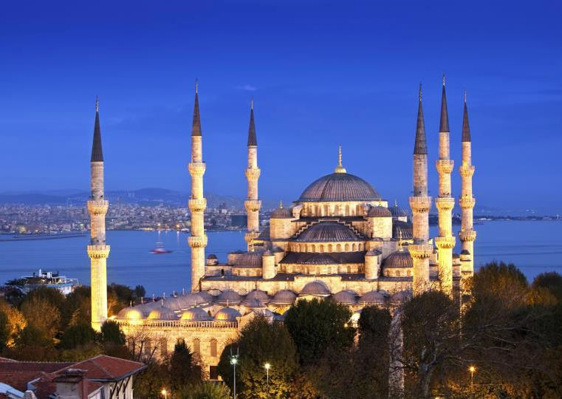
Chapter 7:
The Republic of Turkey
STUDY PRESENTATION
© 2020 Clairmont Press

Slide 2
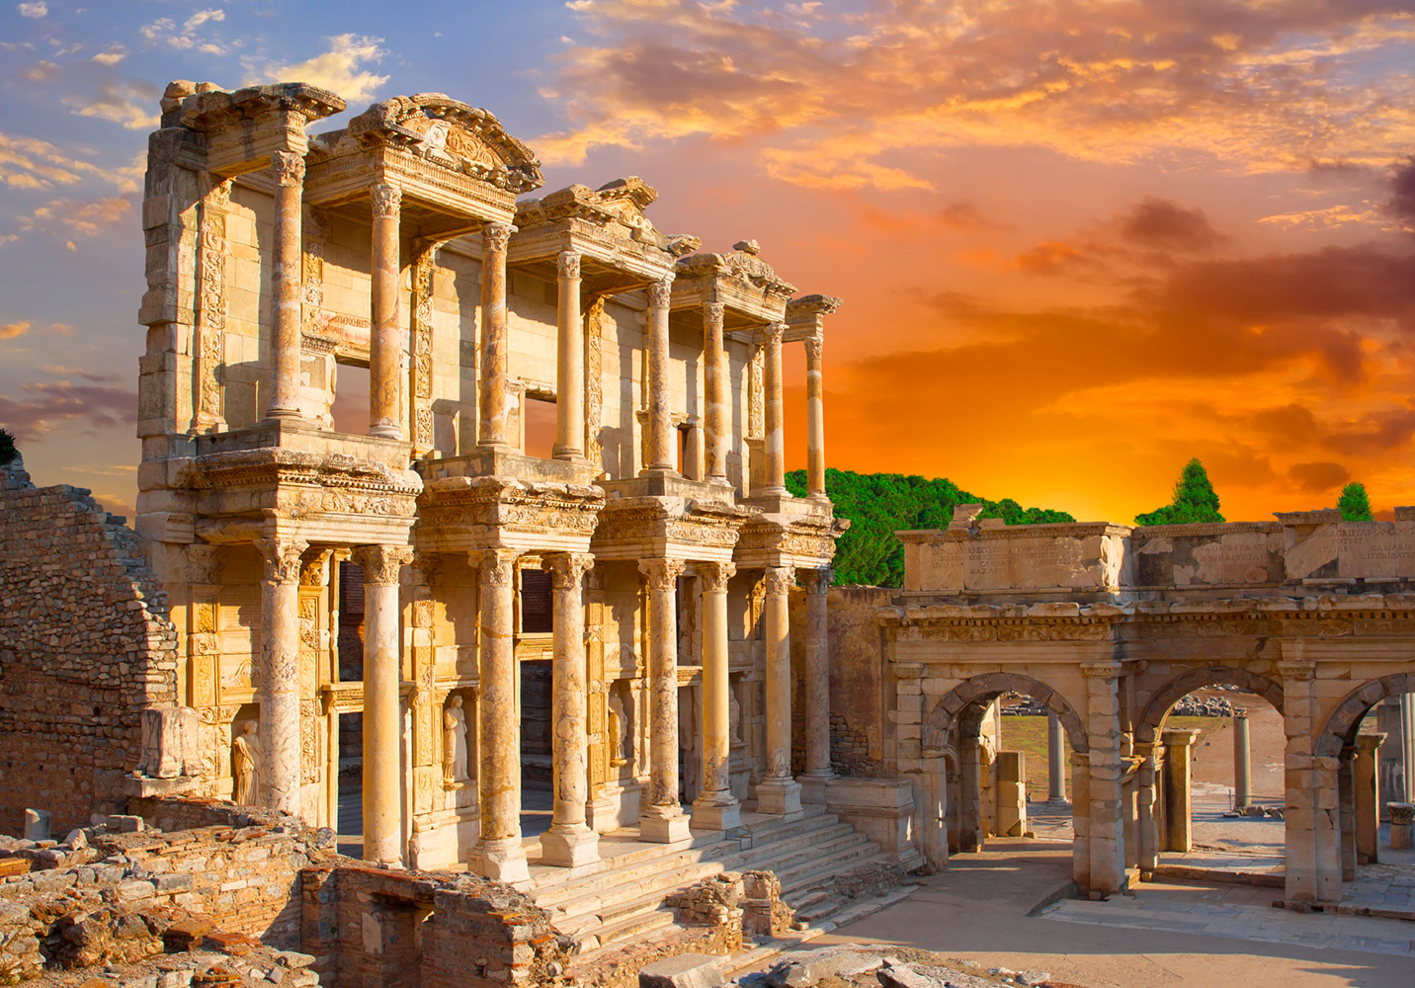
Section 1: Geography of Turkey
Section 2: A Brief History of Turkey
Section 3: Government of Turkey
Section 4: Economy of Turkey
Section 5: U.S.-Turkey Relations

Slide 3
Section 1: Geography of Turkey
Essential Question:
What impact does Turkey’s geography and its span over two continents have on the country’s economic system?
Notes:
Replace Slide

Slide 4
Section 1: Geography of Turkey
What terms do I need to know?
Fertile Crescent
reservoir
Notes:
Replace Slide

Slide 5
Location and Size of Turkey
Turkey is located in the Middle East and is part of Southwest Asia.
The part west of the Bosporus Strait is in Europe, but the majority of Turkey is in Southwest Asia.
Most of Turkey is located on the peninsula Asia Minor which connects Europe and Asia.
It’s bordered by the Black Sea, the Aegean Sea, and the Mediterranean Sea.
Over 4,400 miles of coastline made Turkey the center of trade routes for centuries.

Slide 6
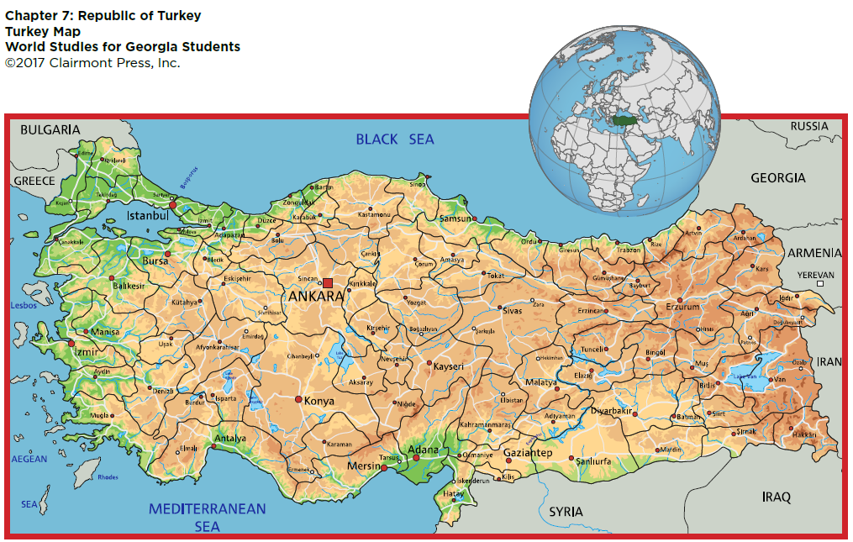
Location and Size of Turkey

Slide 7
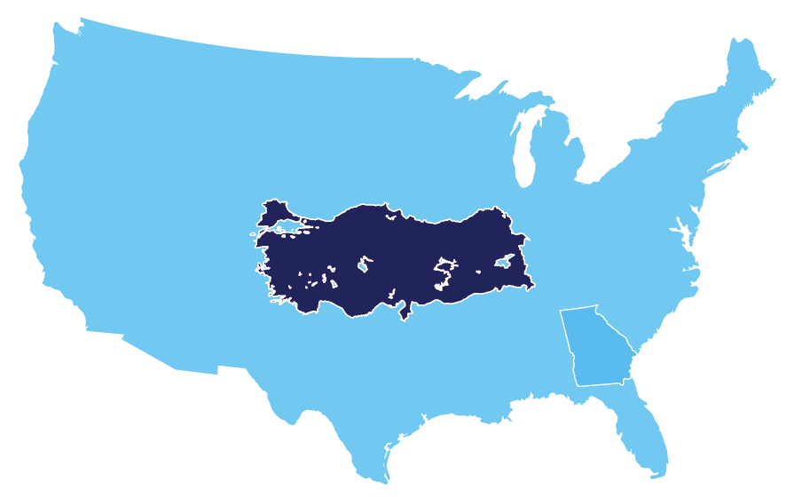
Location and Size of Turkey

Slide 8
Physical Geography of Turkey
The part of Turkey in Europe is covered in hills, but the majority of Turkey in Asia is covered in high mountains, except the narrow coastal plain.
Agriculture is difficult in the mountainous region due to terrain and climate.
The coastal plain has very fertile land.
The Tigris and Euphrates are two major rivers.
Dams create water reservoirs, control floods, and create hydroelectricity.
The land between the Tigris and Euphrates is known as Mesopotamia, or the Fertile Crescent.
The Bosporus Strait and Dardanelles Strait form part of the border between Asia and Europe.
Notes:
Replace Slide

Slide 9
Climate of Turkey
The climate of Turkey’s coastal areas is temperate with hot, dry summers and cool, rainy winters.
Because of plateaus and mountains in the interior of Turkey, the climate is harsher, with severe winters and very hot, very dry summers.
Areas with milder climates tend to have more agricultural activity.
Notes:
Replace Slide

Slide 10
Natural Resources of Turkey
Most of Turkey’s natural resources are minerals like coal, iron ore, copper, and many others.
Turkey ranks 10th in the world for its variety of minerals and 28th for mining.
Turkey has large amounts of natural stone like marble and is first in the world for marble exports.
Turkey has small oil reserves, but they are not enough to meet the country’s needs.
Notes:
Replace Slide

Slide 11
Environmental Issues of Turkey
Air pollution is common in urban areas.
Deforestation also occurs in Turkey.
The most significant environmental issues involve water pollution from the dumping of chemicals and detergents into waterways.
Notes:
Replace Slide

Slide 12
People in Turkey
Turkey’s population is over 80 million.
Any citizen of Turkey is considered a “Turk,” regardless of race or religion.
About 75% of the population is Turkish; the rest is made up of Kurds and other ethnic groups.
Turkish is the official language.
Over 99% of the population practices Sunni Islam.
Unlike other countries in Southwest Asia, religion and government are separate in Turkey.
Urban areas have high population densities, as do coastal areas, while interior mountainous areas have lower populations.
Return to Main Menu

Slide 13
Section 2: A Brief History of Turkey
Essential Question:
How did World War I help create modern-day Turkey?

Slide 14
Section 2: A Brief History of Turkey
What terms do I need to know?
Ottoman Empire
Mudros Armistice
Lausanne Peace Treaty
coup

Slide 15
The Ottoman Empire
Nomadic Turks arrived as raiders to the area of modern Turkey from the east in the 11th century.
The Ottomans, a group of Turks, grew in power until they had established the Ottoman Empire by 1299.
In 1453 the Ottomans took Constantinople and renamed it Istanbul and ruled until 1923.
The Ottoman Empire began to decline in the 16th century with the spread of nationalism and the empire’s reluctance to modernize.

Slide 16
World War I and the Ottoman Empire
During World War I, the Ottoman Empire allied with Germany and the Austro-Hungarian Empire.
The Ottomans were no match for the modernized and industrialized British and French armies.
The Ottoman Empire ended in 1918 when they were defeated and signed the Mudros Armistice, dividing their lands between Britain, France, Russia, and Greece.
A nationalist movement began, and after the Turkish National Liberation War (1919-1923), Turkey gained its freedom from European nations.
The Lausanne Peace Treaty was signed in 1923, creating an independent Turkish country.
Notes:
Replace Slide

Slide 17
Turkish Independence
The Republic of Turkey began on October 29, 1923.
Mustafa Kemal was elected the first president and given the last name “Atatürk,” meaning “Father of the Turks”.
His reforms separated government and religion, created new education systems, changed the alphabet, and gave women equal rights with men.
Turkey joined the United Nations in 1945 and the North Atlantic Treaty Organization (NATO) in 1952.
Turkey’s democracy has been relatively stable except for military coups, or a sudden overthrow of a government.
Notes:
Replace Slide

Slide 18
Present-Day Turkey
There has been an increase in violence and government instability recently.
Several car bombings and gun attacks in 2015
A terrorist attack on the airport in 2016
An attempted coup in 2016 failed to overthrow the government when citizens stopped the military forces.
The Turkish government blamed an Islamic terrorist group for the attempted coup.
Turkey has been involved in the ongoing conflicts in Southwest Asia, and supported the U.S. in Afghanistan in 2001.
Turkey has also been involved in the Syrian Civil War and is fighting against the ISIS (or ISIL) terrorist group in Syria.
Return to Main Menu
Notes:
Replace Slide

Slide 19
Section 3: Government of Turkey
Essential Question:
How do the people of Turkey participate in their country’s government?

Slide 20
Section 3: Government of Turkey
What terms do I need to know?
parliamentary democracy
presidential republic
secular
Grand National Assembly
Constitutional Court

Slide 21
Type and Branches of Government
Turkey was a parliamentary democracy from 1923 to 2017, when it became a presidential republic.
The national government is made up of three sections: executive, legislative, and judicial.
Turkey has a secular government.
The people of Turkey do not have complete freedom of speech.
The Legislative branch has one house called the Grand National Assembly. It has 550 seats and members are elected directly by the people.
The judicial branch is led by the Constitutional Court, the Court of Cassation, and the Council of State.
Return to Main Menu
Notes:
Replace Slide

Slide 22
Section 4: Economy of Turkey
Essential question:
What factors have caused Turkey’s economy to struggle in recent years?

Slide 23
Section 4: Economy of Turkey
What terms do I need to know?
lira
subsidy

Slide 24
Turkey’s Economic System
Turkey leans toward a market economy, but the government controls several aspects of the economy.
Turkey has attempted reforms to reduce government control in several areas of the economy.
Turkey’s economy is still struggling after a severe economic crisis in 2001.
The government created several helpful reforms, and Turkey did not suffer the same economic downturn as most countries in 2008.
Growth has slowed in recent years as demand for Turkish goods has decreased in Europe.
Notes:
Replace Slide

Slide 25
Trade
Turkey has always been a crossroads for trade routes.
Today, it is the 29th largest exporter of goods and services in the world.
Main exports: clothing, food, textiles, metals, and transport equipment
Turkey’s current currency is the lira.
The Turkish government uses subsidies (grants of money) to help the Turkish people.

Slide 26
Natural Resources
One of Turkey’s most important natural resources is arable land.
Almost half of Turkey’s land is used for agriculture.
Turkey’s mineral wealth is ranked 10th in the world.
Turkey creates large amounts of hydroelectricity from its rivers.
Turkey’s large deposits of natural stone are in high demand in the global economy.

Slide 27
Human Capital
Through educational reforms, the literacy rate in Turkey is about 95%.
In universities, engineering programs are some of the most popular degrees.
However, compared to other countries, Turkey doesn’t invest very much in education.
Notes:
Replace Slide

Slide 28
Capital Goods
Turkey’s industrial section is expanding and increasing output.
Top industries include automobiles, electronics, mining, steel, and lumber.
All of Turkey’s industries require investment in capital goods for the economy to continue to grow.

Slide 29
Entrepreneurship
Becoming an entrepreneur in Turkey can be difficult, but recent reforms have attempted to reduce the amount of time required to start a business.
Many universities in Turkey now have a focus on entrepreneurship and innovation and development.
Return to Main Menu
Notes:
Replace Slide

Slide 30
Section 5: U.S.-Turkey Relations
Essential question:
How does the relationship between the U.S. and Turkey provide assistance to Turkey?
Notes:
Replace Slide
Note: This is the first slide with “U.S.” instead of “US”.

Slide 31
Section 5: U.S.-Turkey Relations
What term do I need to know?
Truman Doctrine
Notes:
Replace Slide

Slide 32
A Long Relationship
The U.S. created ties with the Ottoman Empire in 1831.
After the Republic of Turkey was created, the U.S. reestablished ties in 1927.
They signed the Economic and Technical Cooperation Agreement.
This agreement activated the Truman Doctrine, which aimed at supporting free people and preventing the spread of communism.
Turkey’s location in Southwest Asia has made it an important ally for the U.S. in fighting terrorism.
Notes:
Replace Slide

Slide 33
U.S. Assistance to Turkey
The U.S. has provided assistance to Turkey in security, cooperation with neighboring countries, and democracy.
The U.S. wants to help increase border security to reduce terrorist attacks within Turkey.
The U.S. also provides support to the Turkish government, to help continue to improve their democracy, and the freedoms of their citizens.
Notes:
Replace Slide

Slide 34
Bilateral Economic Relations
Trade between the U.S. and Turkey has increased significantly in recent years, and will likely continue to expand.
Turkey imports aircraft, iron, steel, agricultural goods, oil, cotton yarn fabrics, and machinery from the U.S.
Turkish exports to the U.S. include vehicles, machinery, iron, steel, agricultural goods, travertine, and marble.
In 2014, Turkey was the 16th largest international trading partner with the state of Georgia.
Notes:
Replace Slide

Slide 35
Turkey’s Membership in International Organizations
Turkey is an active and essential member of NATO.
Turkey is also seeking full membership into the European Union, as well as improving relationships with neighboring countries in Southwest Asia, Central Asia, and Africa.
Turkey is a member of the United Nations, the World Trade Organization, the International Monetary Fund, the World Bank, and the Organization of Islamic Cooperation.
Return to Main Menu
Notes:
Replace Slide

Slide 36
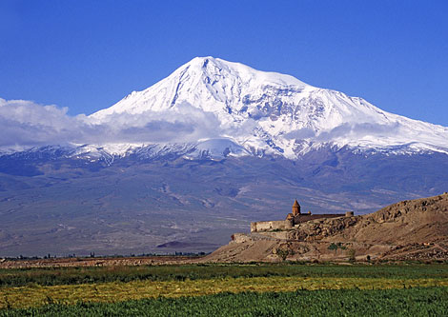
Image Credits: 1 Blue Mosque, Istanbul Turkey; 2 Ephesus; 9-11 Atatürk Dam; 41 Mount Ararat (Wikimedia commons); All maps ©2017 Clairmont Press.
Return to Main Menu

