Slide 1
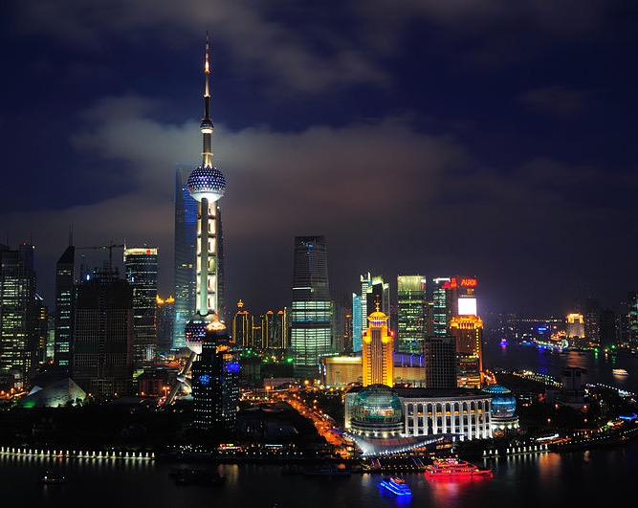
Chapter 13:
People’s Republic of China
STUDY PRESENTATION
© 2020 Clairmont Press

Slide 2
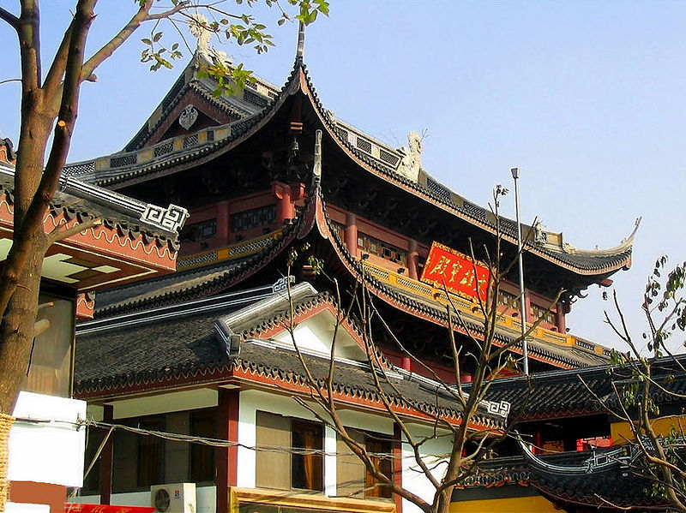
Section 1: The Geography of China
Section 2: A Brief History of China
Section 3: The Government of China
Section 4: The Economy of China
Section 5: US-China Relations

Slide 3
Section 1: The Geography of China
Essential Question:
How does China’s geography impact the country’s population distribution?

Slide 4
Section 1: The Geography of China
What terms do I need to know?
monsoon season
Three Gorges Dam
acid rain
Han
Mandarin

Slide 5
Location and Size of China
China’s large size causes it to stand out on a map, as it covers most of Eastern Asia.
Additionally, China is located in both the eastern and northern hemispheres.
Various bodies of water and fourteen countries surround China on all sides.
It is one of the largest countries in the world in both area and population.

Slide 6
Physical Features of China
Two large deserts in the middle of China, the Gobi and the Taklamakan, are harsh and dry areas. The deserts reach extreme hot and cold temperatures, and few people live in these regions.
Most Chinese people live where there are milder climates, in the southeastern and eastern parts of China, near river valleys and the most fertile farmland.
The Hueng He, or Yellow River, and the Chang Jiang, or Yangtze River, are China’s main rivers.
The Hueng He carries loess (silt) with it, giving both the river and the sea a yellowish color.
The Chang Jiang is China’s longest river as is one of the country’s main transportation routes.
The tallest mountains in the world, the Himalayan Mountains, border China to the south and are a barrier to India.

Slide 7
Climate of China
The climate of China is diverse and can vary dramatically between one location and another.
Wind currents from the Arctic north and the Pacific east influence the climate throughout the year.
In the summer, parts of eastern China sometimes experience devastating heavy rain during the monsoon season, which is a season when prevailing winds bring heavy rains.
As a general rule, China’s climate is cooler in the north and becomes warmer and more tropical the further south and east you get.

Slide 8
Natural Resources of China
Many natural resources are available in China, but the most prized is arable land, or land suited for agriculture.
Because of its rivers, China also has the potential to generate a lot of hydroelectric power.
The Three Gorges Dam is located on the Yangtze River, and it produces the most hydroelectric power in the world.
Other natural resources in China include petroleum, natural gas, coal, mercury, iron ore, tin, and manganese.

Slide 9
Impact of Location on Where People Live in China
The most populated area in China is in the northeast, along the Yellow River.
Beijing, the capital of China, is located in this region as well.
Farming is common in this region, but it is set apart as China’s industrial center.
Rapid industrialization in China has caused many Chinese to leave their rural homes in order to find work in overcrowded cities.

Slide 10
Environmental Issues in China
Air pollution has become a major concern for China as it becomes increasingly more industrialized.
Burning coal, which releases soot, ash, and chemicals into the atmosphere, and automobile exhaust are two common air pollution contributors.
Air pollution contributes to an acid rain problem in China, which occurs when chemicals in the air like sulfur dioxide and nitrogen oxides react with the moisture in the atmosphere and fall to the ground as rain containing sulfuric acid and nitric acid.
Water pollution is another environmental concern for China, since sewage are dumped into the river, along with chemicals from agricultural runoff and industrial wastes.
Pumping stations along the river treat water to make it safe for drinking, irrigation, and industrial uses.

Slide 11
Environmental Issues in China
Flooding is another major environmental issue China faces.
Damage caused by flooding of the Huang He has caused millions of dollars’ worth of damage and killed millions of people, leading people to nickname it “China’s Sorrow.”
In an attempt to prevent floods, China’s government has tried to build overflow channels and taller dikes. The Huang He has not had a major flood since 1945.

Slide 12
People of China
China has the largest population of the world, but its growth rate is slow.
Until 2015, the Chinese government had a “one-child” policy, which limited couples to one child.
90 percent of China’s population is descendant of the Han ethnic group.
The other 10 percent of the population is made up of 56 different ethnic groups including the Zhuang, Hui, Machu, and Uighur.
Many languages are spoken in China, but Mandarin is the official language.
Over 50 percent of China’s population does not practice an official religion.
Return to Main Menu

Slide 13
Section 2: A Brief History of China
Essential Question:
What major movements and figures have contributed to China’s political history?

Slide 14
Section 2: A Brief History of China
What terms do I need to know?
Qing Dynasty
Nationalist Party
Chinese Communist Party
Long March
Red Army
Great Leap Forward
Cultural Revolution
Red Guards

Slide 15
Early History of China
As one of the earliest civilizations in the world, China has a number of great accomplishments such as the invention of gunpowder, silk, tea production, the compass, and papermaking.
For most of its history, China was an absolute monarchy, but when unrest grew in the early 1900s, a new government without a monarch was formed: the Republic of China.
The Qing Dynasty, an absolute monarchy, had ruled China since the 1600s.
The new government wanted to end foreign control in China’s affairs. The leading political party was called the Kuomintang, or the Nationalist Party, led by a man named Sun Yixian.

Slide 16
Communist Revolution
In 1921, Mao Zedong and a group of other Chinese men met in Shanghai to form the first Chinese Communist Party (CCP).
When Mao Zedong faced opposition, a civil war began between Mao and his communist followers and the Nationalist government of Chiang Kai-shek.
In 1933, Mao and his followers, fled into the mountains to avoid capture by the Nationalist government. This journey is known as the Long March.
After a short-lived truce, a second civil war between the groups raged. Mao’s communists, the Red Army, removed the Nationalist government from power.

Slide 17
Mao and His Programs
Mao Zedong created a program called the Great Leap Forward that would help resolve China’s agricultural and industrial problems.
The program consisted of several components, like the organization of farms into large collectives, but it failed in the end.
After the failure of the Great Leap Forward, Mao saw his ideal of a classless society drifting away, so he organized the Cultural Revolution in 1966.
It encouraged war on anything in Chinese society that looked like it was encouraging class differences.
Many high school students were organized into an army known as the Red Guards.
When Mao died, a more moderate leader came into power. Deng Xiaoping allowed farmers and businesses more freedoms, and he introduced more western ideas.

Slide 18
Tiananmen Square
When communist governments were under attack in a number of places around the world, China experienced a period of student protests that resulted in a massive demonstration in Beijing’s Tiananmen Square in 1989.
The students protested what they felt was corruption in the Chinese government.
They called for a shift toward democracy in the government.
Deng Xiaoping ordered soldiers to end the protest, and they did so violently, destroying the pro-democracy movement.

Slide 19
One-Child Policy
The population of China was growing so rapidly in the 1970s that Deng Xiaoping felt something must be done to slow to population growth.
By 1980, Chinese families were only allowed to have one child.
Some exceptions were made to the policy, like with minorities.
Urban families were more likely to obey the policy than rural families.
Economic rewards and punishments were given according to those who obeyed or disobeyed.
Baby boys were preferred during this period over baby girls.
The one-child policy is no longer enforced.
Return to Main Menu

Slide 20
Section 3: The Government of China
Essential Question:
How does China’s current political system function?

Slide 21
Section 3: The Government of China
What terms do I need to know?
communist
Political Bureau of the Communist Party
premier
president
head of government
head of state
National People’s Congress
Supreme People’s Court

Slide 22
Type of Government
The People’s Republic of China is a communist country, led by a one-party dictatorship, in which a single party controls state-owned means of production with the aim of establishing a society where all are classless.
Mao Zedong brought communism to China, with the assistance of Political Bureau of the Communist Party.
The men made decisions about how the Chinese government should be carried out, as well as how life should be organized in China.

Slide 23
Branches of Government
Like many governments, China’s government is separated into three branches.
The executive branch is made up of the president, premier, and cabinet.
The premier is the head of government and is nominated by the president and approved by the National People’s Congress.
The head of state is the president, who is chosen by the National People’s Congress for a five-year term with a term limit of two terms.
The head of government oversees daily executive and legislative activities of the country.
The head of state is an individual who represents the government in a symbolic fashion but does not oversee the daily activities of the country.
The National People’s Congress is the legislative branch, and it also controls the judicial branch. The Supreme People’s Court is the highest court in China.

Slide 24
Challenges Facing the Government
When communists took over the government in China, farmers and industries were controlled by the government.
For farmers, there was often great suffering in the years following the revolution, and starvation was widespread during some of the early years as officials tried to organize farming.
Historically, China has isolated itself from the rest of the world, but there are signs that China is gradually opening itself up.
China continues to face many economic challenges, like air pollution, increasing the standard of living for its people and reducing corruption of government leaders.

Slide 25
China’s Great Firewall
The Chinese Communist Party was not pleased about the arrival of the Internet in 1994.
The Internet was perceived as a threat to the Chinese Communist Party’s control of China, and so the government began to strictly monitor and censor the Internet.
The phrase “Great Firewall” often references the massive Internet surveillance and content-control system in China.
Various social media sites are blocked, as well as other selective information, like information about the Tiananmen Square protests and environmental problems leading up to the 2008 Olympics.
Return to Main Menu

Slide 26
Section 4: The Economy of China
Essential question:
What economic changes were made after China became communist?

Slide 27
Section 4: The Economy of China
What terms do I need to know?
command economy
market economy
yuan
Four Modernizations
Special Economic Zones

Slide 28
Type of Economy
The People’s Republic of China is a command economy, meaning that the government controls nearly all the major parts of the economy, such as what is produced, what goods cost, and what workers are paid.
China’s command economy is slowly beginning to change, however, as many Chinese people today are entrepreneurs and have small businesses of their own, but though the Chinese government still has final authority in most matters.
There are more examples of a market economy recently in China, meaning that economic decisions are made less by the government, and more by individuals.

Slide 29
Trade in China
Trade is a foundational part of China’s economy, and China is the largest exporter of goods in the world.
Its top export markets are the United States, Japan, and South Korea.
Additionally, China is one of the top importing countries in the world.
In order to trade, China must exchange their form of currency, the yuan, for other countries’ currencies.

Slide 30
Natural Resources in China
Mineral resources in China include iron ore, tin, tungsten, aluminum, lead, zinc, and other minerals.
Uranium is a rare mineral found in China, and it can be sold at high prices when the demand is right.
Mineral resources in China include iron ore, tin, tungsten, aluminum, lead, zinc, and other minerals.
Energy resources in China include coal, petroleum, natural gas, and hydroelectric power.
Arable land is a final important resource in China.

Slide 31
Human Capital in China
China puts a lot of emphasis on human capital to maintain their strong economy.
A program called the Four Modernizations created by the Chinese government was an effort to improve all aspects of Chinese production including farming, military defense, heavy and light industry, and scientific and technical research and production.
Four Special Economic Zones were established in provinces along the eastern coast of China to act as trade centers for global trade for new consumer goods.

Slide 32
Capital Goods in China
Because China’s government has control over spending and planning in agriculture and industry, China has been able to make changes more quickly than a country where power is more widely shared among regions, communities, and individuals.
As a result of China’s Four Modernizations, more modern equipment and technology was brought into nearly every area of Chinese production, including agriculture, industry and the military.

Slide 33
Entrepreneurship in China
As a result of its strict economic past, entrepreneurship is a relativity new concept in China.
The Chinese government recognizes that for the country to continue to make economic strides, entrepreneur freedom, leadership, and success is important.
The Chinese government is still sorting out what the relationship with entrepreneurs will look like as the global marketplace becomes more competitive.

Slide 34
Section 5: US-China Relations
Essential question:
What makes the relationship between the United States and China both important and complicated?

Slide 35
Section 5: US-China Relations
What terms do I need to know?
human rights
cyber security

Slide 36
A Complex Relationship
The United States wants to build a positive, cooperative, and comprehensive relationship with China.
The United States hopes to increase cooperation by focusing on areas of disagreement, such as human rights, copyright, and cyber security policies.
The annual US-China Strategic and Economic Dialogue (S&ED) provides an opportunity for China and the United States to discuss topics that are important to their economies.
It is meant to bring deeper understanding to both parties, and allows an opportunity to discuss differences, build trust, and increase cooperation with one another.

Slide 37
US Assistance to China
The United States provides assistance to China in four main areas:
Supporting environmental protection and climate science
Expanding human rights
Helping Tibetan communities
Addressing the threat of pandemic diseases

Slide 38
Bilateral Economic Relations
The economic relationship between the United States and China has two main goals.
The first goal of this relationship is to integrate China into the global economic and trading system.
The second goal of this relationship is to expand US exporters’ and investors’ access to the Chinese market.
Both the United States and China have announced ways to strengthen cooperation, promote open trade and investment, enhance global cooperation, and altogether be in good standing with one another.

Slide 39
China’s Membership in International Organizations
The People’s Republic of China assumed the China seat at the United Nations in 1971, and the country is a permanent member of the UN Security Council.
China has become increasingly more active in multilateral organizations, especially the United Nations.
The United States and China continue to work together to address threats to global security, like North Korea and Iran’s nuclear programs.
Return to Main Menu

Slide 40
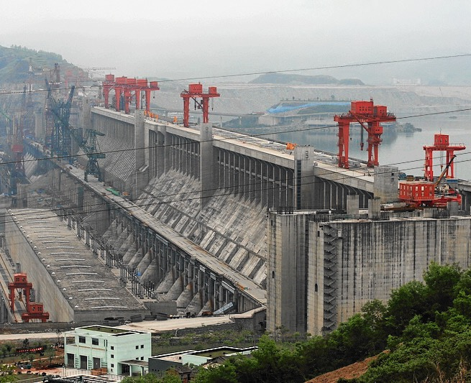
Image Credits: Wikimedia Commons.

