Slide 1
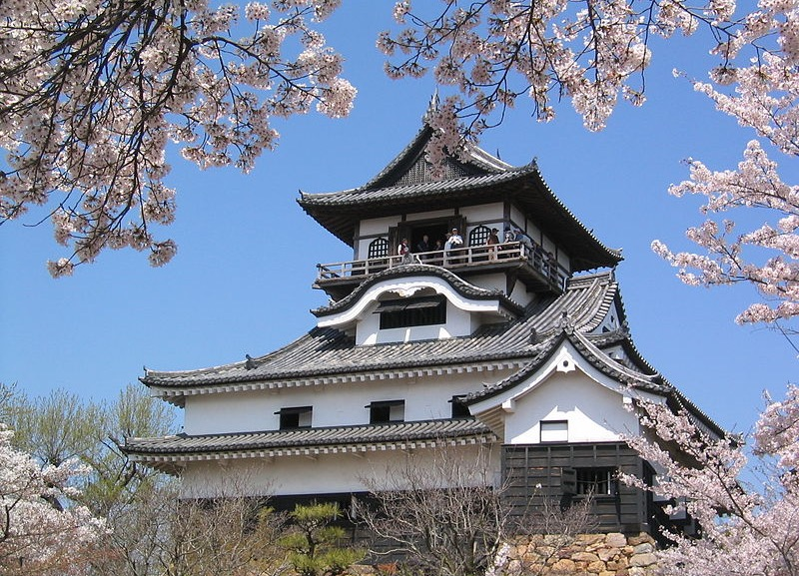
Chapter 15:
Japan
STUDY PRESENTATION
© 2020 Clairmont Press

Slide 2
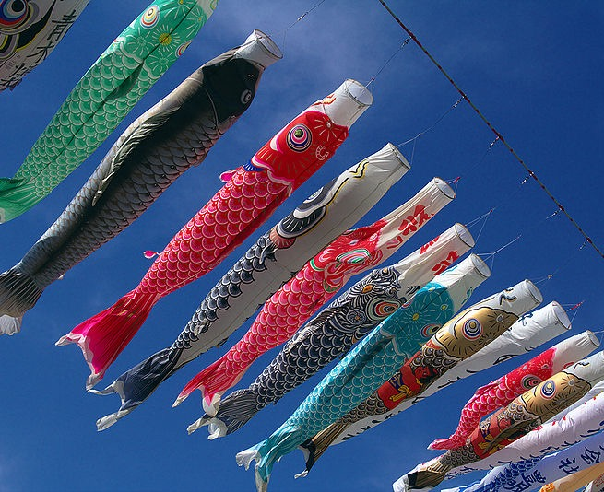
Section 1: The Geography of Japan
Section 2: A Brief History of Japan
Section 3: The Government of Japan
Section 4: The Economy of Japan
Section 5: US-Japan Relations

Slide 3
Section 1: The Geography of Japan
Essential Question:
How has the physical geography of Japan affected its development and people?

Slide 4
Section 1: The Geography of Japan
What terms do I need to know?
archipelago
terrace
Ring of Fire
tsunami
typhoon
homogenous

Slide 5
Location and Size of Japan
Japan is located to the east of Asia, in both the northern and eastern hemispheres.
Japan is an archipelago, or series of islands, and so it does not share a border with any other countries.
Japan has four large islands: Honshu, Shikoku, Hokkaido, and Kyushu, as well as thousands of smaller islands.
Only 430 of those smaller islands are inhabited.

Slide 6
Physical Features of Japan
Almost 80 percent of the land in Japan is covered by mountains, which leaves a small percentage of the land suitable for farming.
To reconcile this problem, Japanese have created farmland by building terraces on the mountains, constructing irrigation channels, and using different fertilizers and farming techniques.
Terraces are flat areas of land carved into the sides of hills and mountains by farmers so they can grow crops.
Japan imports food, fuel, and petroleum products to support its population.
Japan is located on the Ring of Fire, which is an area around the Pacific Ocean where there are frequent volcanic eruptions due to plate tectonic movements.
Volcanic eruptions often cause earthquakes.

Slide 7
Fukushima Earthquake and Nuclear Disaster
A 9.0 magnitude hit Japan on March 11, 2011, which is the worst earthquake recorded in Japan’s history.
Significant damage was caused by the earthquake itself, in addition to a tsunami over 40 feet high.
Over 20,000 people died as a result of the earthquake and tsunami.
After the earthquake, a nuclear power plant called Fukushima Daiichi in the northern part of Japan experienced a tragic accident.
The government has spent over $1.5 billion trying to clean and contain the area around the power plant.
Japan has stopped using nuclear power as a result of the accident.

Slide 8
Climate of Japan
Most of Japan experiences a temperate climate zone, usually without hot or cold temperature extremes.
Japan’s climate is affected by ocean currents, and locations are affected by their altitude as well.
The Japan Current from the south brings warm water to the southern and eastern coasts of Japan, while the Oyashio Current from the north cools the northern coast.
Japan receives about 40 inches of rain per year. High amounts of rain can be expected when monsoon rains and even tropical hurricanes called typhoons hit the islands.

Slide 9
Natural Resources of Japan
Japan only has a few natural resources, and they are a few deposits of minerals.
Because Japan is an island, however, one of the country’s main exports is fish, and fish are a common Japanese food.
To meet the needs of its population, Japan imports food, oil, natural gas, coal, and other resources.
Japan is the world’s largest importer of coal and natural gas and the second-largest importer of oil.

Slide 10
Environmental Issues of Japan
Many of Japan’s most pressing environmental concerns come as a result of burning coal and oil for power.
A direct result of air pollution, acid rain, is a significant concern for Japan, since it damages buildings and can pollute lakes and reservoirs.
Japan is considering better methods to solve its air pollution problems, especially since it no longer uses nuclear power plants.
Today, the government is investigating solar, wind, and other forms of clean and renewable energy sources.
The government is exploring ways to make the existing nuclear power plants safer.

Slide 11
Impact of Location
For hundreds of years, the population of Japan has been concentrated on its coasts.
93 percent of Japanese people live in urban areas, compared to 82 percent in the United States.
The population density in Japan is much higher than the United States as well.
Per square mile in Japan, there are approximately 868 people, compared to 84 people on average in the United States.
In Tokyo, the world’s largest city, the population density is around 11,500 people per square mile!

Slide 12
People of Japan
The population of Japan is very homogenous, which means similar.
98 percent of the population of Japan is Japanese, with small numbers of Koreans, Chinese, and other nationalities.
Almost 80 percent of Japanese practice Shinto, and 68 percent of the population practices Buddhism.
The population of Japan is shrinking, and this is a concern for the Japanese government.
Return to Main Menu

Slide 13
Section 2: A Brief History of Japan
Essential Question:
What is the role of Douglas MacArthur in Japanese history?

Slide 14
Section 2: A Brief History of Japan
What terms do I need to know?
shogunate
indigenous
MacArthur Constitution
war reparations

Slide 15
Early History of Japan
Thousands of years ago, clans in Japan fought one another for power.
About 660 BC, a member of the Yamato clan, Jimmu, united the clans and became the first emperor.
The age of the samurai was around the year AD 1000.
Samurai were hired to protect the lords in a way similar to the way medieval knights in Europe protected their lords.
By the 1200s there were powerful samurai called shoguns ruling Japan. There was an emperor in place, but the shogun had the ultimate power.
After decades of civil warfare, the Tokugawa shogunate, a military-led monarchy, provided a period of stability and isolation from foreign influence in Japan.
This period of time gave Japan a chance to focus on its indigenous, or native, culture.

Slide 16
Japan Reconnects with the World
In 1853, United States Navy member Commodore Matthew Perry forced Japan to enter into trade with the United States.
He demanded a treaty permitting trade and the opening of Japanese ports to United States merchant ships.
After signing the treaty, Japan began to modernize and industrialize, and became a regional power by the late nineteenth and twentieth centuries.
Japan attacked US forces in 1941 at Pearl Harbor, Hawaii, triggering America’s entry into World War II.
In 1945, the Japanese showed no significant sign of surrender.
The United States dropped two atomic bombs on Japan, which lead to Japan’s surrender and a peace treaty soon thereafter.

Slide 17
Rebuilding Japan after World War II
After World War II and Japan’s surrender, the country was in poor shape and needed to rebuild.
Industries and farms were destroyed, the government was in shambles, the people were demoralized, and the emperor had been exposed as an “ordinary person,” instead of the invincible figure many thought he was.
American commander General Douglas MacArthur was given the task of helping Japan to rebuild.
MacArthur wrote a constitution for the country, still referred to as the MacArthur Constitution, that created a two-house parliament called the Diet.
The Japanese signed all peace treaties ending the war and pledged to pay war reparations, or damages, to the countries they had harmed during World War II.

Slide 18
Atomic Bombings of Hiroshima and Nagasaki
Before the Unites States participated in World War II, funding for atomic weapons development had already started.
The atomic weapons development effort was referred to as the Manhattan Project.
As the war became deadlier, United States President Harry S. Truman wanted a way to stop the loss of American lives.
When the Japanese refused peaceful surrender, the use of atomic bombs was implemented.
Today, both Hiroshima and Nagasaki have rebuilt, but there were a number of consequences following the Japan bombings.
Return to Main Menu

Slide 19
Section 3: The Government of Japan
Essential Question:
How does the Japanese government function today?

Slide 20
Section 3: The Government of Japan
What terms do I need to know?
constitutional monarchy
Bill of Rights
prefecture
autonomous

Slide 21
Type of Government
Before World War II, Japan was a an absolute monarchy, under the control of an emperor named Hirohito who was thought to be a god.
After Japan’s defeat following World War II, the country transitioned to a constitutional monarchy.
A constitutional monarchy is a government in which there is a king, queen, or emperor, who is limited to the power granted to him or her by the constitution or laws of the nation.
In 1947, Japan adopted its first constitution, which created a two-house parliament. This parliament is called the Diet, and the government is led by a prime minister and a cabinet of advisors.
The Bill of Rights included in the constitution outlines the basic freedoms of the Japanese.
The constitution also addresses the role of the emperor, without political power.

Slide 22
Branches of Government
The Japanese government consists of three branches.
The executive branch includes the prime minister as head of government, the emperor as head of state, and the cabinet.
The legislative branch is the bicameral Diet made up of the House of Councilors and the House of Representatives.
The judicial branch has the highest court in Japan, the Supreme Court.
Japan is divided into prefectures which have limited autonomous, or self-governing power, with most decisions made by the national government.

Slide 23
Challenges Facing the Government of Japan
A declining population is Japan’s most pressing conflict.
Japan is projected to lose at least 50 percent of its population by the end of the century.
Should this trend continue, the Japanese will not have enough working population to take care of its elderly.
The country continues to seek out solutions for this problem, such as the use of robots in the workforce, and the use of migrant workers.
The Japanese government has also experienced issues regarding its territory, since other countries have challenged claims to some islands, and North Korea has threatened the country with its ongoing missile testing.
Return to Main Menu

Slide 24
Section 4: The Economy of Japan
Essential question:
How has Japan’s investment in human capital impacted its economy?

Slide 25
Section 4: The Economy of Japan
What terms do I need to know?
work ethic
Ministry of International Trade and Industry (MITI)
tariff
subsidy
yen
robotics

Slide 26
Type of Economy
Japan has one of the most technologically advanced economies in the world, second to China and the Unites States.
The Japanese government has a close relationship with its major industries.
Traditionally, Japanese people have a strong work ethic, or the belief that doing work is a valuable pursuit.
Because a restriction has been put on Japan’s military development, more funds are used to develop areas like industry and technology.
The Ministry of International Trade and Industry (MITI) helps companies decide what products will sell best on the global market.
The government also protects Japanese industries by setting tariffs, taxes placed on imports that make them more expensive than the Japanese products, on imported goods that might compete with products made in Japan.

Slide 27
Trade in Japan
Japan must rely on imports to have enough fuel to power its industries.
Although the country lacks natural resources, Japan is also a major exporter of goods such as cars, electronics, iron and steel products, power plant machinery, and car parts.
While Japan imports food to fulfill the needs of its people, it also uses subsidies to protect its farmers.
A subsidy is when the government pays a business or industry to make up the difference between the sales price for a good and the cost to produce it.
Japan’s currency is called the Japanese yen, so when Japan trades with other countries, they must exchange their yen for the currency of that country.

Slide 28
Natural Resources in Japan
Japan has very little farmland due to the nature of its geography, and it has few natural resources.
The fishing industry is a valuable resource for the country, since its location is ideal for that practice as a group of sea-bordered islands.
To benefit agriculture workers, the government often buys up farm goods to keep the prices high enough for farmers to make a profit.
The government does not let foreign countries sell certain farm products in Japan if those products will compete with Japanese farm goods.
For example, the United States produces a higher quality of rice cheaper than Japanese farmers, but the Japanese government imposes both quotas and tariffs to protect the Japanese rice farmers.

Slide 29
Human Capital in Japan
Japan has rapidly industrialized since World War II and has become one of the most powerful industrial nations in the world.
The population of Japan is considered one of the country’s most precious resources.
The literacy rate in Japan is nearly 99 percent, and Japan’s investment in human capital through education is among the highest in the world.
Japanese work ethic, in combination with benefits provided by Japanese businesses, make for a powerful workforce.

Slide 30
Capital Goods in Japan
Nearly all of Japan’s Gross Domestic Product comes from industry and services, since the country has few natural resources.
Technology and up-to-date training in the uses of that technology are essential for the Japanese economy to continue to grow.
Employees are encouraged to make suggestions for how a business might be run more efficiently.
Japanese industry leads most countries in the world in the use of robotics - assembling goods using mechanical techniques like robots.

Slide 31
Entrepreneurship in Japan
Japan is a land of entrepreneurs, and many successful entrepreneurs at that.
The need for business development in Japan, the prevelance of good education, and the Japanese work ethic provide an ideal place for someone who has a good idea and the energy to see if it can work.
Return to Main Menu

Slide 32
Section 5: US-Japan Relations
Essential question:
How the relationship between Japan and the United States changed since World War II?

Slide 33
Section 5: US-Japan Relations
What terms do I need to know?
Trans-Pacific Partnership (TTP)

Slide 34
A Close Ally to the United States
Japan is one of the world’s most successful democracies and largest economies.
Although they were enemies in World War II, the United States and Japan now have a relationship based on mutual friendship and respect for one another.
Japan provides bases and financial and material support to US military forces.
The alliance between the United States and Japan has been strengthened through revised defense guidelines.
The Defense Policy Review Initiative (DPRI) redefines roles, missions, and capabilities of alliance forces and outlines key realignment and transformation initiatives.
Both countries cooperate on range of global issues, like development assistance, combating communicable diseases, and protecting the environment and natural resources.
Japan and the United States partner in the areas of science and technology as well.

Slide 35
Bilateral Economic Relations
The goal of United States’ economic policy toward Japan is focused on increased access to Japan’s markets and two-way investment.
Additional goals include increasing economic growth, promoting economic restructuring, improving the climate for US investors, and raising the standard of living in both countries.
The United States-Japan bilateral economic relationship is strong, mature, and increasingly interdependent.
The United States and Japan cooperate in a number of international economic forums.
Japan formally began participating in the ongoing Trans-Pacific Partnership (TPP) negotiations in July 2013, joining eleven other Asia-Pacific countries, including the United States, that are aiming to conclude a comprehensive, high-standard free trade agreement.

Slide 36
Science and Technology Cooperation
The relationship between the United States and Japan concerning science and technology covers a range of diverse issues specific to the two countries and the world in general.
Under the rules of the US-Japan Science and Technology Agreement, both countries have collaborated for over twenty-five years on scientific research in areas such as new energy technologies, emergency management, supercomputing, and critical materials.

Slide 37
Japan’s Membership in International Organizations
The United States and Japan belong to a number of the same international organizations, which is helpful for their partnership.
Their joint memberships include the United Nations, G-7, G-20, Organization for Economic Cooperation and Development, Asia-Pacific Economic Cooperation forum, ASEAN Regional Forum, International Monetary Fund, World Bank, and World Trade Organization.
Additionally, Japan a Partner for Cooperation with the Organization for Security and Cooperation in Europe and an observer to the Organization of American States.
Return to Main Menu

Slide 38
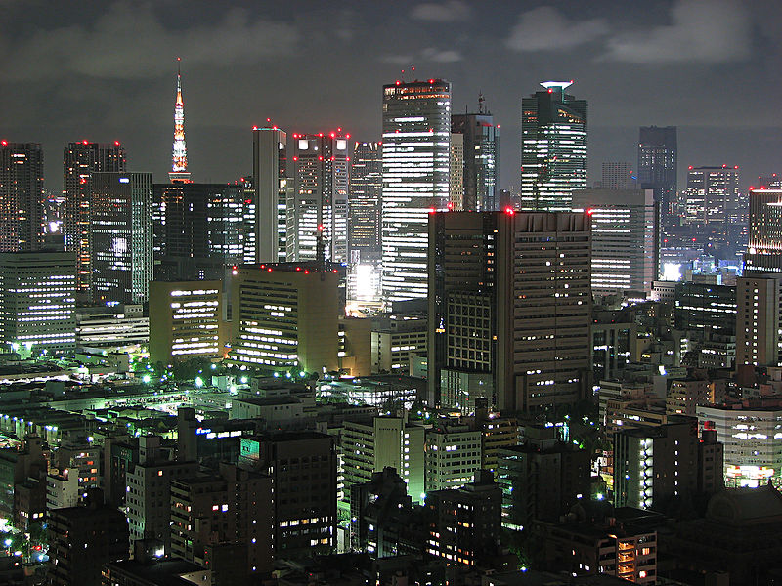
Image Credits: Wikimedia Commons.

