Slide 1
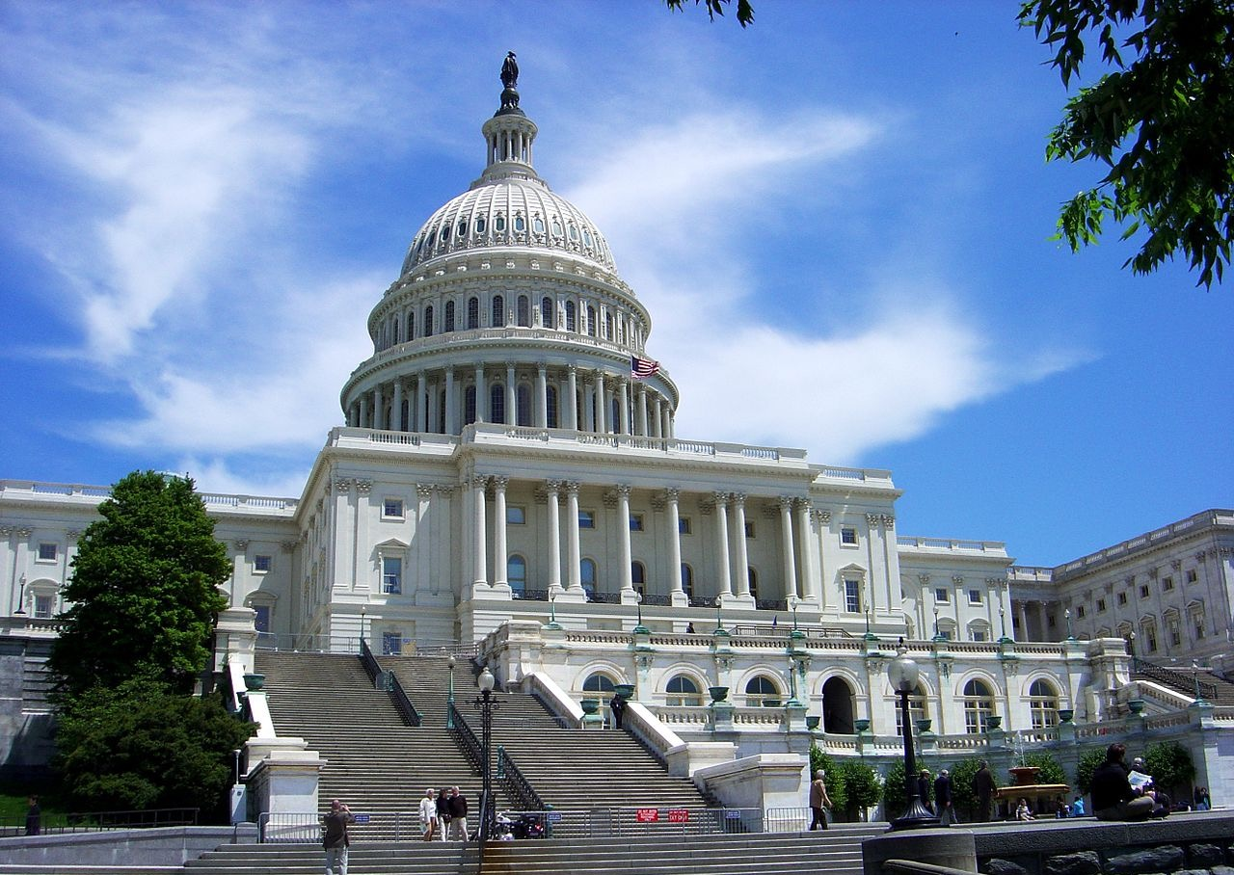
Chapter 2:
Government and Civics
STUDY PRESENTATION
© 2020 Clairmont Press

Slide 2
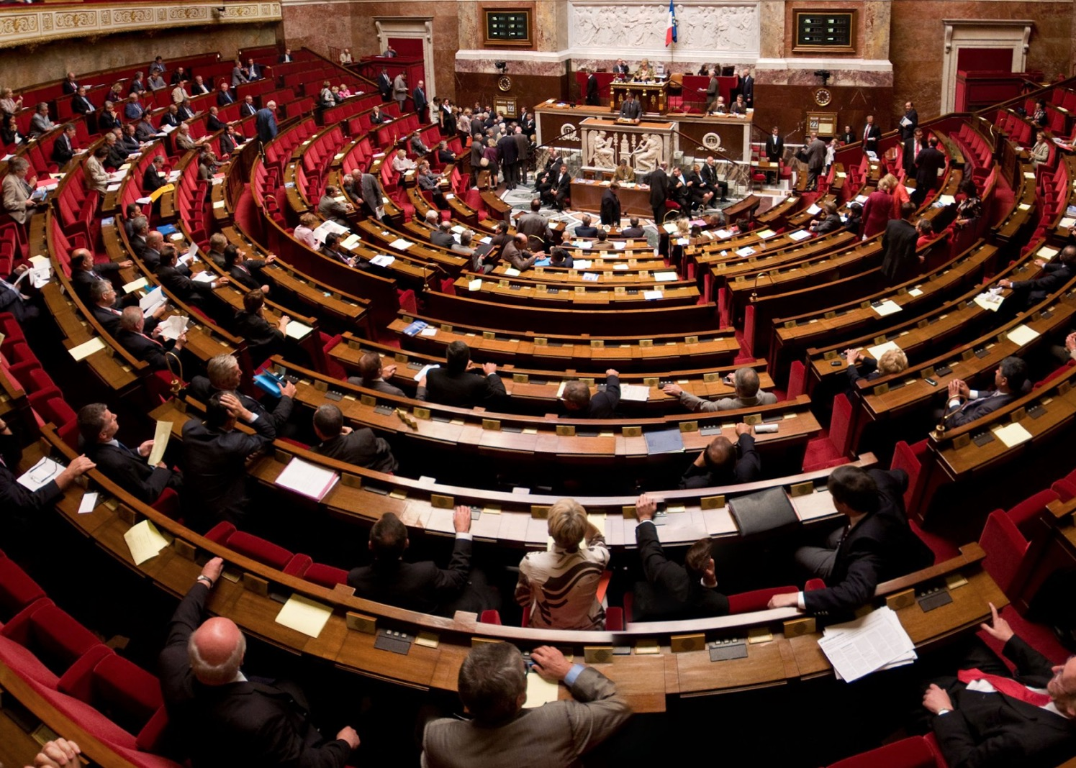
Section 1: What Is Government?
Section 2: Distribution of Power in Government
Section 3: Citizen Participation in Government
Section 4: Two Types of Democracies

Slide 3
Section 1: What Is Government?
Essential Question:
What is the purpose of government?

Slide 4
Section 1: What Is Government?
What terms do I need to know?
government
sovereignty
legislative branch
executive branch
judicial branch

Slide 5
Forms of Government
Government is the system by which a country is organized, from the earliest of tribes to the most powerful nations today.
People create governments to keep civil order and to protect the people, but there are many different responses to the question of what rules should be made. This has led to the creation of many types of governments.
The idea of government began when people discovered that protection was easier if they stayed together and elected a leader.
The idea of sovereignty, or right of a group to be free from outside interference, has led governments to build defenses against possible attackers.

Slide 6
Branches of Government
Government functions are usually separated into three branches: legislative, executive, and judicial.
The legislative branch is typically made up of elected members and is supposed to make laws for the country, with either one or two groupings of members.
The executive branch’s job is to enforce laws passed by the legislative branch and deal with foreign nations.
The judicial branch is in charge of the courts in a country that settles disputes among citizens and between citizens and the government.
Its main purpose is to interpret laws of a country and apply them to court cases.
Return to Main Menu

Slide 7
Section 2: Distribution of Power in Government
Essential Question:
What are some ways governments distribute power?

Slide 8
Section 2: Distribution of Power in Government
What terms do I need to know?
unitary government
confederation government
federal government

Slide 9
The Distribution of Power
People must decide how to set up their government, and countries must decide how to organize and distribute power.
Power can be held completely by the central government, or it can be spread among the lower levels of government.
Governments can be unitary, confederation, or federal.

Slide 10
Levels of Government
In a unitary government, the central government holds nearly all the power, giving the central government near-absolute power over how things function in the country.
Examples include the United Kingdom and Cuba.
In a confederation government, local governments hold all the power, with little power given to the central government.
Examples include the United Nations and OPEC.
In a federal government, power is shared among the different levels of government, with each having little overlapping control of each other and having their own duties.
An example of this is the United States.
Return to Main Menu

Slide 11
Section 3: Citizen Participation in Government
Essential Question:
What does “citizen participation” mean?

Slide 12
Section 3: Citizen Participation in Government
What terms do I need to know?
autocracy
dictatorship
absolute monarchy
head of government
oligarchy
democracy

Slide 13
The Power of the Citizens
There are three types of citizen participation: autocracy, oligarchy, and democracy.
The most important distinction between these is who or how many people rule or control the government.
The citizens living under these different types can usually recognize the differences in their lives compared to others around the world.

Slide 14
Types of Citizen Participation
In an autocracy, the ruler has absolute power to do whatever they wish, including making and enforcing whatever laws they desire.
Citizens living in an autocracy have very few rights, do not get to pick their leader, or get to vote on the laws that are made.
Two types of autocracies: dictatorships, which one person, supported by the military, rules the country, and absolute monarchies, where the sovereign gained their power through inheritance from the previous sovereign.
Both dictators and sovereigns serve as the head of government, the person in charge of running the country day-to-day.

Slide 15
Types of Citizen Participation (cont.)
In an oligarchy, a political party or other small group makes all the major decisions, with citizens having little choice but to go with the decisions of the group.
While citizens do have more power since there are more people in control, a citizen’s right to choose their leader is limited.
In a democracy, citizens have the power to choose their leaders.
Citizens have the most power because they have the ability to vote for those who make laws.
Direct democracies allow citizens to vote on all decisions. While citizens in republics elect representatives to vote for their interests.
In a republic, a head of government may be elected to manage the government day-to-day.

Slide 16
The United Nations
World War I was often called “the war to end all wars”.
To ensure another war like this did not happen, a global organization, that would work to solve problems, was discussed.
President Woodrow Wilson led the creation of the League of Nations in Switzerland, but it lost support from the United States Senate and could not prevent World War II.
During World War II, representatives from 26 nations fighting the Axis powers met in Washington, DC, and signed a Declaration of the United Nations. They pledged their resources to defeat the Axis Powers and agreed not to make separate peace.
After the war ended, the United Nations came into existence in New York City, after 51 nations agreed to its new charter.
The new charter called for: an Economic and Social council, an International Court of Justice, a Trusteeship Council to oversee colonial territories, and a Secretariat under a Secretary-General.

Slide 17
The United Nations (cont.)
The General Assembly and the Security Council are the two most visible parts of the United Nations.
The General Assembly, which includes all 193 member nations, conducts discussions on international issues, making up the policy-making body of the organization.
The Security Council has 15 members, 5 of which are permanent members.
Permanent members: the United States, the United Kingdom, the Russian Federation, France, and China.
The other members are selected by the General Assembly and serve two-year rotating terms.
The Security Council is in charge of maintaining peace and security as well as deciding when and where a United Nations peacekeeping force should be sent.
Some of the many issues the United Nations have tackled include: human rights, humanitarian needs, justice and international law, international peace and security, drug control, counterterrorism, climate change, advancement for women, aging, hunger, poverty, and refugees.
Return to Main Menu

Slide 18
Section 4: Two Types of Democracies
Essential Question:
Why would a government choose one type of democracy over the other?

Slide 19
Section 4: Two Types of Democracy
What terms do I need to know?
parliamentary democracy
head of state
constitutional monarchy
presidential democracy

Slide 20
Forms of Democracy
Like we stated before, a democratic government is one in which citizens vote on laws and make decisions in the government.
However, there are two major forms of democratic governments: parliamentary and presidential.
Each are designed to represent and protect the people of their country.

Slide 21
Parliamentary Democracy
In a parliamentary democracy, the citizens vote for representatives from a few political parties to form a parliament.
Parliament’s purpose is to make and carry out the laws of the country.
The party with the majority of members after voting gets to pick the head of government, who holds power for however long their term allows.
There is typically also a position called head of state, which is usually a leader who has very little power.
Australia’s constitutional monarchy has a sovereign as head of state, whose powers are limited by the constitution.

Slide 22
Presidential Democracy
In a presidential democracy, citizens elect the president as head of government.
The legislative and executive branches are separate and can stop the other branches’ powers if necessary.
The legislature cannot dismiss the president, and the president cannot dismiss the legislature.
Return to Main Menu

Slide 23
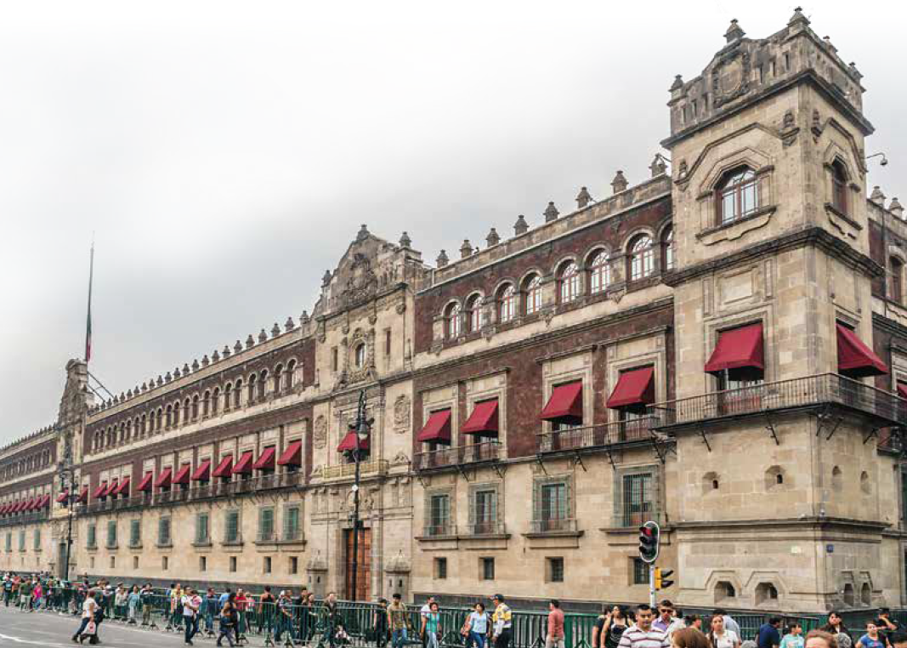
Image Credits: 1 by Kevin McCoy, https://commons.wikimedia.org/w/index.php?curid=106463, all others Wikimedia Commons. Maps ©2017 Clairmont Press.

