Slide 1
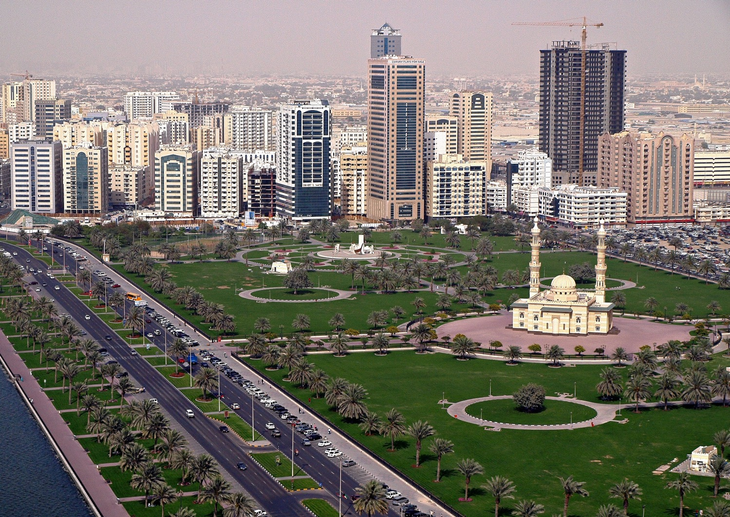
Chapter 4:
The Geography and History of Southwest Asia
STUDY PRESENTATION
© 2020 Clairmont Press

Slide 2
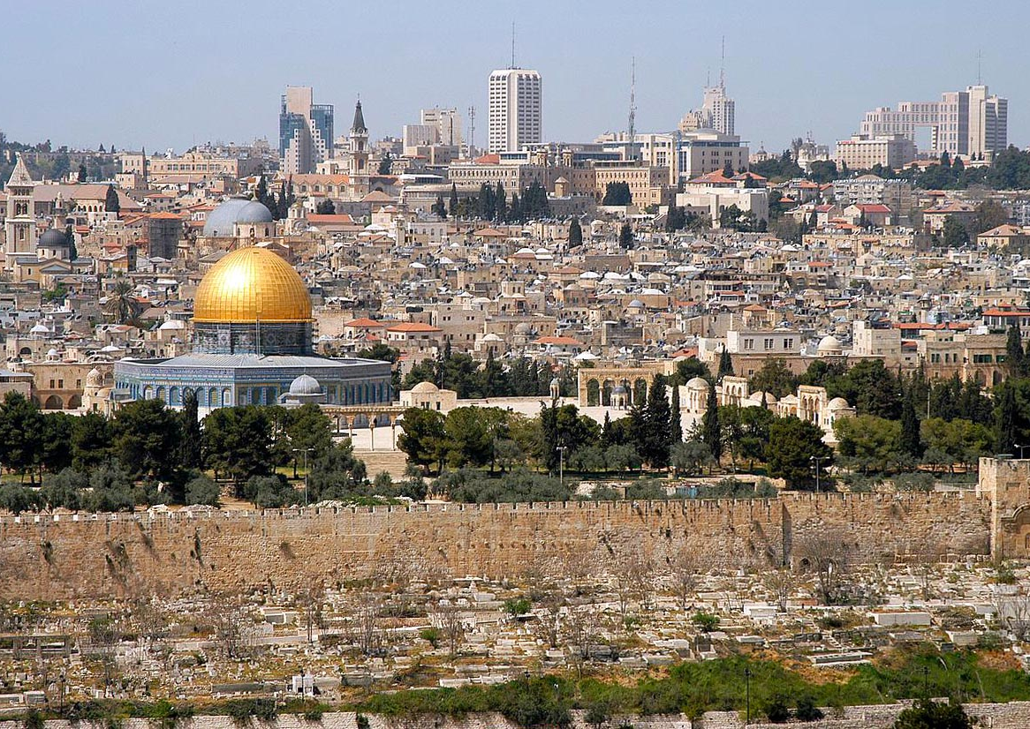
Section 1: The Geography of Southwest Asia
Section 2: The People of Southwest Asia
Section 3: OPEC and Oil in Southwest Asia
Section 4: A Brief History of Southwest Asia

Slide 3
Section 1: The Geography of Southwest Asia
Essential Question:
What is the importance of the Suez Canal?

Slide 4
Section 1: The Geography of Southwest Asia
What terms do I need to know?
oasis
Suez Canal
nomad
subsistence
agriculture
irrigation
reservoir
aquifer
fossil water
drip irrigation
desalination

Slide 5
Location of the Countries of Southwest Asia
Afghanistan is located at the far eastern edge of Southwest Asia, is landlocked, is very mountainous, and has many ethnic groups and tribes.
Iran is located to the west of Afghanistan, is mountainous, and has many long coastlines along the Persian Gulf, Caspian Sea, and Arabian Sea.
Iraq is located west of Iran, has a small amount of coastline along the Persian Gulf, and contains the two largest rivers in Southwest Asia: the Tigris and Euphrates Rivers.
Syria is northwest of Iraq, is mostly desert, has a coastline on the Mediterranean where its agricultural activity occurs, and has a capital located near a large oasis (a spring of fresh water found in a desert). Damascus, the capital city, is one of the oldest cities in the entire world.
Turkey is located north of Syria, borders Iraq, Syria, and Iran, and contains the source of the Tigris and Euphrates Rivers in its mountains.
Turkey builds dams along these rivers to help with irrigation, but it limits how much water those downstream have access to.

Slide 6
Location of the Countries of Southwest Asia (cont.)
The Mediterranean Sea coastline passes through Syria, Lebanon, and Israel.
The area of Israel was called Palestine until 1948, when the United Nations divided Palestine between Arabs and Jews and created Israel, the West Bank, and the Gaza Strip.
Next to Israel is Jordan, and past that is the Kingdom of Saudi Arabia, the largest country on the Arabian Peninsula.
It is mostly covered by desert, has coasts along the Persian Gulf and Red Sea, and is one of the largest oil-producing countries in the world.
The country of Kuwait is located north of the northeast corner of Saudi Arabia, has an important location on the Persian Gulf, and has a large amount of oil reserves which led to the Persian Gulf War in 1990-1991.

Slide 7
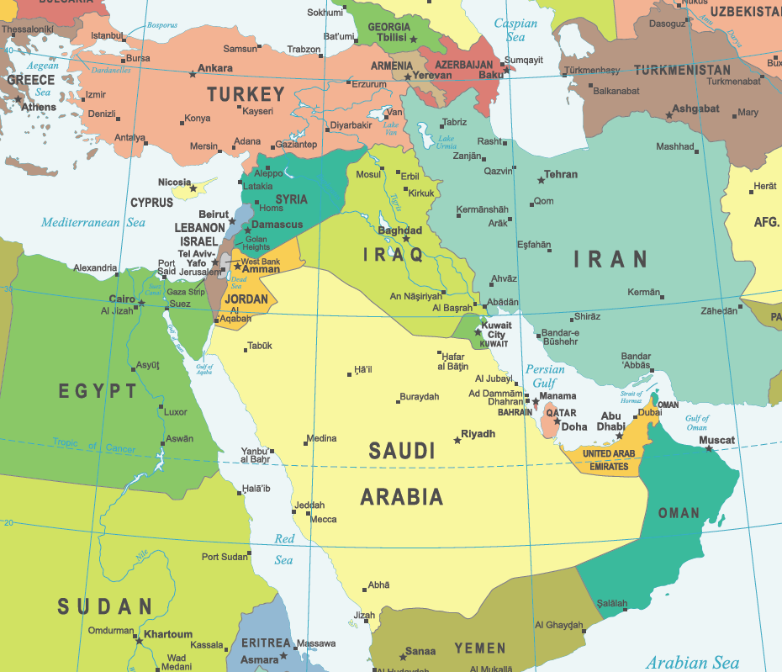
Location of the Countries of Southwest Asia

Slide 8
Major Bodies of Water in Southwest Asia
Because of the hot and dry climate of Southwest Asia and its many deserts, rivers are very important to the people of the region.
The three main rivers are the Tigris River, the Euphrates River, and the Jordan River.
They are both an important source of freshwater used for drinking and irrigation as well as a transportation highway for goods and people.
Many people live along these rivers, and large cities in the region are located along them, which has allowed them to become centers of industry.
These rivers also provide boundaries between nations.
The Tigris and Euphrates begin in Turkey and flow south though Syria and Iraq before joining and entering the Persian Gulf.
Countries containing these rivers have a hard time sharing them.

Slide 9
Major Bodies of Water in Southwest Asia (cont.)
The Jordan River, the smallest of the three rivers, begins in the form of tributaries in the mountains of Lebanon and Syria, flowing south through Israel before reaching the Sea of Galilee.
It officially begins as the Jordan River at the southern tip of the Sea of Galilee, where it flows south before ending at the Dead Sea, where the water is so salty that nothing can live in it.
It’s a main source of water for Israel, Jordan, parts of Syria, the West Bank, and the Gaza Strip. It also acts as a natural border between Israel, the West Bank, part of Syria, and Jordan.
The Persian Gulf is located in the center of Southwest Asia.
It is the center of oil production and transportation in the region, shipping oil into the Gulf, through the Strait of Hormuz, and into the Arabian Sea.
The Red Sea, located on the west coast of the Arabian Peninsula, is a very important trade and transportation route.
The Suez Canal, built in 1869, connects the Red Sea to the Mediterranean Sea.

Slide 10
Deserts in Southwest Asia
Despite having many large bodies of water around it, Southwest Asia is still very dry.
Mountain ranges block any potential rainfall coming from the coast, making much of the interior desert.
Areas in the interior, that have access to water, have grown and developed.
The largest all-sand desert in the world, called Rub al-Khali or “Empty Quarter”, is located on the Arabian Peninsula.
The Syrian Desert, located between Syria and Iraq, is also a large desert.

Slide 11
Deserts in Southwest Asia (cont.)
The deserts can act as a natural barrier against attack or invasion and the people of the region have had to adapt to their environment to survive.
For a long time, many were nomads, herding livestock from oasis to oasis. More recently, governments have limited their movements.
As nomadic life disappeared, many turned to farming.
Subsistence agriculture was a practice of growing just enough crops for a family’s survival.
Because of the climate, farmers depended on irrigation (watering crops to continue growth when there is insufficient rainfall).
In milder areas, larger farms can produce extra crops which can be sold at market.

Slide 12
Environmental Issues of Southwest Asia
Water is a very important, limited resource in Southwest Asia.
Because the Tigris and Euphrates Rivers pass through many different countries, water access has led to political conflicts.
Many countries have made reservoirs (lakes where water is stored) by damming the river so it can be used for irrigation and hydroelectric power.
However, each dam reduces the amount of water countries can get downstream.
Fresh water distribution is very uneven among the countries, with countries like Turkey and Iraq having access to plenty of water but Saudi Arabia having almost no water.
Because of this imbalance, many countries practice irrigation in various forms to farm and raise livestock.

Slide 13
Environmental Issues of Southwest Asia
Some regions use underground aquifers (layers of underground rock where water runoff from rains and streams is trapped), and others use wells that tap into fossil water (water that has been underground for centuries).
A problem with using these is that the water sources are not renewable, meaning they will run out.
Technologies, like drip irrigation (using computers to accurately give a plant exactly how much water it needs), have helped farmers become more efficient in their water use.
Desalination, the removal of salt and other chemicals from seawater, could help expand the region’s water sources, though it is expensive and requires complex technologies.
Water pollution has become a problem due to chemical fertilizers from farms. Also improper waste management, like sewage and garbage, gets into the rivers from the rapidly expanding cities and towns.
Return to Main Menu

Slide 14
Section 2: The People of Southwest Asia
Essential Question:
What is monotheism, and what are the three religions that originated in Southwest Asia?

Slide 15
Section 2: The People of Southwest Asia
What terms do I need to know?
ethnic group
religious group
monotheism
polytheism
Judaism
Torah
Exodus
Ten Commandments
synagogue
Yom Kippur
Rosh Hashanah
Christianity
disciple
New Testament
Messiah
crucifixion
resurrection
Bible
church
Islam
Ka’bah
Allah
Muslim
Quran
mosque
Ramadan
Eid al-Fitr
Eid al-Adha
al-Hijrah
Five Pillars
Sharia Law

Slide 16
Ethnic Groups in Southwest Asia
The people of Southwest Asia fall into many ethnic groups and religious groups that often overlap.
An ethnic group is a group of people who share cultural ideas and beliefs that have been a part of their community for generations, including history, language, religious beliefs, and more.
The three largest ethnic groups in Southwest Asia are: the Kurds, the Arabs, and the Persians.
Kurds: The Kurds live in the mountain region that spans Iran, Iraq, Syria, and Turkey. They speak Kurdish, and most are Sunni Muslims. They do not have their own country or homeland and are considered a minority group.

Slide 17
Ethnic Groups in Southwest Asia (cont.)
Arabs: Arabs are the largest ethnic group in the region. They primarily speak Arabic, and there is quite a diversity among Arabs regarding religious beliefs. Many are Sunni Muslims, but some are Shia Muslims or Christians.
Persians: Persians are an ethnic group originating from the Persian Empire. They mainly live in Iran, since the country of Persia changed its name to Iran after World War I. Persians speak Farsi, which shares the same alphabet with Arabic. Most Persians practice Shia Islam.

Slide 18
Religious Groups in Southwest Asia
A religious group shares a belief system in a god or gods, with a specific set of rituals and literature.
People from different ethnic groups can be part of the same religious groups.
The three largest religions in the world originated in Southwest Asia: Judaism, Christianity, and Islam.
Each have similarities, including monotheism (belief in one god), a sacred text, place of worship, and include the important figure Abraham.
Even though they have similarities, there has been much conflict between the three. Judaism only being practiced in Islam, Islam being practiced all over Southwest Asia, and Christianity being a minority religion in the region.

Slide 19
Religious Groups in Southwest Asia (cont.)
Judaism is the oldest of the three main religions in Southwest Asia, going back to a man named Abraham born in roughly 2000 BC in Mesopotamia, where most people were polytheistic (belief in more than one god).
According to the Torah (Jewish holy book), God made a covenant with Abraham, promising him a new nation if he would dedicate himself and the Hebrew people to monotheism. Abraham took the Hebrews to a land called Canaan, which is part of modern-day Israel.
Around 1300-1200 BC, the Hebrews were forced into slavery by the Egyptians. Moses would lead them out of slavery years later. This was called the Exodus.
On their journey back to Canaan, God revealed the Ten Commandments (divine rules of conduct) to the Hebrews.
Twelve tribes were formed, with the largest being Judah. Eventually, these united into the kingdom of Israel. However, they would lose control of their lands to the Roman Empire, who forced them out and scattered them.
Today, Jews are found worldwide, worship in synagogues, and celebrate the holidays Yom Kippur (Day of Atonement) and Rosh Hashanah (Jewish New Year).

Slide 20
Religious Groups in Southwest Asia (cont.)
Christianity is the second oldest religion originating in Southwest Asia, and began in the first century AD. Christianity is a religious movement that grew out of Judaism during Roman rule.
The founding figure is Jesus, a man born in Nazareth, who worked as a carpenter until he attracted attention as a teacher and preacher at roughly the age of thirty.
Even though he followed Jewish law and beliefs, Jesus taught more about personal relationships with God. His followers were called disciples and wrote much of what we know about Jesus’s life and teachings, forming the first four books of the New Testament.
Many Roman and Jewish leaders grew worried about the attention Jesus attracted, with many followers calling him the Messiah, or “savior of man”.
Jewish leaders claimed Jesus encouraged these ideas and thus was guilty of breaking Jewish law. Pontius Pilate, a Roman governor, saw Jesus as a threat to the Roman Empire.
Because of this, Jesus was sentenced to death by crucifixion, a common method by which a person was tied or nailed to a cross and left to die.

Slide 21
Religious Groups in Southwest Asia (cont.)
Christianity (cont.)
Jesus’s followers believed he rose from the dead after three days and walked among them before ascending to heaven. They called him the Greek word “Christos”, which was eventually shortened to “Christ”. Word spread of his resurrection, and this, along with his teachings, became the basis for Christianity.
Romans were angered at Christianity because followers refused to worship Roman gods and goddesses. Many early Christians were killed because of their disobedience, but the religion continued to grow.
People liked the new religion because it emphasized older teachings as well as the loving, forgiving God that Jesus described.
By AD 300, Christianity had spread to most parts of the Roman Empire, with Emperor Constantine adopting it in AD 313, making it a legal religion.
Today, Christianity is the largest religion in the world, with Christians found on all continents. While there are a few different types, many main beliefs and traditions are the same.
The Bible is their sacred text, they worship in a church or cathedral, and their important holidays are Christmas (celebrating Jesus’s birth), and Easter (celebrating Jesus’s resurrection).

Slide 22
Religious Groups in Southwest Asia (cont.)
Islam is the third religion to originate in Southwest Asia, beginning in the city of Mecca on the Arabian Peninsula in the AD 600s.
Mecca was a major trade route along the Red Sea, and at its center was the Ka’bah, a cube-shaped building that many believed Abraham and his son, Ishmael, built to honor God. By this time, though, it held many different statues of idols and gods.
Muhammad was born in Mecca in AD 570 and lived with his uncle, who trained him to be a merchant. He married an older woman and took over her caravan business, becoming a respected member of the Mecca community.
At the age of 40, he heard the voice of the angel Gabriel telling him to bring forth the word of Allah, the one God, to the people. After worrying and discussing with his wife, Muhammad decided the voice was real and began to tell others. Those who believed his message became known as Muslims, or “ones who submit” to the will of God.
Many in Mecca were worried that Muhammad’s message would hurt trade, so threats and violence targeted his followers. They escaped to Yathrib, later called Medina, in AD 622, in a move called the Hijrah.

Slide 23
Religious Groups in Southwest Asia (cont.)
Islam (cont.)
The people of Medina accepted Muhammad as both a political and religious leader, and converted to the new religion of Islam.
In AD 630, Muhammad returned to Mecca with an army, and the city surrendered to avoid war. Muhammad’s first act was to remove all of the idols from the Ka’bah. He then dedicated the buildings to Allah.
After Muhammad’s death, Islam spread through the Arabian Peninsula. The four Rightly Guided Caliphs, four of Muhammad’s friends, acted as rulers over armies that conquered weakened empires. Many welcomed Islam and converted.
After his death, Muhammad’s teachings were copied into the Quran, the Muslim holy book, along with some stories and characters from the Bible, so the Quran can be seen as Allah’s final word.

Slide 24
Religious Groups in Southwest Asia (cont.)
Islam (cont.)
Today, Islam is the fastest-growing religion in the world. Muslims worship in a mosque. There are two main branches, Shia and Sunni, and while they have differing interpretations of beliefs, there are many traditions and beliefs that they share. Muslims celebrate Ramadan (month of fasting), Eid al-Fitr (end of Ramadan), Eid al-Adha (festival of sacrifice at the end of the hajj), and al-Hijrah (Islamic New Year).
Mecca and the Ka’bah are still important to Muslims, and a visit to them is a part of the Five Pillars (or five basic obligations) of Islam.
Some Muslim countries, like Saudi Arabia and Iran, have laws based on the law of the Quran, called Sharia Law. Muslims view Jews and Christians as “People of the Book” since so much of the Torah and Bible are in the Quran. As such, they should be respected and are given certain exception to rules in countries with Sharia Law, provided they pay a special tax.
Return to Main Menu

Slide 25
Section 3: OPEC and Oil in Southwest Asia
Essential Question:
What is the purpose of OPEC?

Slide 26
Section 3: OPEC and Oil in Southwest Asia
What terms do I need to know?
petroleum
Organization of Petroleum Exporting Countries (OPEC)

Slide 27
The Importance of Oil
Some everyday products that come from oil, or petroleum, include: soap, shampoo, shower curtains, toothpaste, toothbrushes, deodorant, many articles of clothing, and much more.
Much of the world’s economy relies on oil, and Southwest Asia has large amounts of it.
This combination brings wealth into the region.
Oil and natural gas were first discovered there at the beginning of the 20th century.
Most oil operations in Southwest Asia are controlled by countries in Southwest Asia, giving them a lot of control over the global economy.

Slide 28
The Influence of OPEC
In 1960, several Southwest Asian countries with large oil supplies joined other oil-rich countries around the world to create the Organization of Petroleum Exporting Countries (OPEC).
The first five members were Kuwait, Iraq, Saudi Arabia, Iran, and Venezuela, with countries like Nigeria and Indonesia joining later.
The primary function of OPEC is to control the price of oil on the world market by controlling the supply.
When these countries produce less oil, prices increase, and vice versa.
OPEC members have worked over the past 50 years to influence world events, by controlling the oil supply, occasionally calling for an embargo to increase their influence with other countries.
In 1973, the Arab-Israeli War broke out, with Arab OPEC members supporting the Palestinian Arabs and the United States and European countries supporting the Israelis.
To convince these other countries to stop supporting Israel, OPEC put an embargo on trade with them, restricting oil, which caused gas shortages and a crisis in the United States until 1974, when the conflict ended and the embargo was lifted.

Slide 29
Oil-Rich versus Oil-Poor Countries
Many countries, like Saudi Arabia in Southwest Asia have benefitted from exporting oil, but other countries, like Israel, have not been as lucky.
Countries with oil reserves have experienced tremendous growth in national wealth and an improved standard of living. While those without oil reserves have had a much more difficult time trying to improve living conditions for their populations.
These differences have led to conflicts among nations.
Israel and Turkey are exceptions.
While they don’t have large oil reserves, their economies have had a lot of success and people have enjoyed an increased standard of living.
They have diversified their economies to create income from various exports, unlike oil-rich countries.
Return to Main Menu

Slide 30
Section 4: A Brief History of Southwest Asia
Essential Question:
What are some conflicts in the region that have involved US military forces?

Slide 31
Section 4: A Brief History of Southwest Asia
What terms do I need to know?
Ottoman Empire
San Remo Agreement
nationalism
Palestinian-Israeli Conflict
refugee
Sunni Muslims
Shia Muslims
assimilate
ISIS
Operation Desert Storm
al-Qaeda
Taliban
Operation Iraqi Freedom

Slide 32
European Partitioning of Southwest Asia
Much of Southwest Asia was controlled by the Ottoman Empire from the 1300s to the end of World War I.
The Ottomans made a fatal error by allying themselves with the Central Powers, who lost the war.
Not only did they lose the war, but they were weakened by an internal rebellion.
After the San Remo Agreement in 1920, the remains of the empire was partitioned, or divided, into smaller countries.
Even though people were happy being free from Ottoman rule, this did not bring peace.
European politicians paid little attention to religious or ethnic groups when drawing new boundaries, and there was also little consideration to the sense of nationalism.
As a result, there has been ongoing conflict, and many groups have tried to live together in these forced boundaries.

Slide 33
Palestinian-Israeli Conflict
In May 1948, the United Nations announced the new country of Israel as a Jewish homeland.
War began shortly between the Israeli Jews and Palestinian Arabs who lived in the area that is now Israel.
The neighboring countries of Jordan and Lebanon supported the Arabs’ claim to the land.
However, the Israelis won the war, gaining more land than they were promised from the United Nations.
Many Palestinian Arabs became refugees (people who left their homes as a result of war).
There have been other wars over the past sixty years.
Even though tensions still exist, both sides are looking to find a peaceful resolution.
Arab countries still support the Palestinians, and the United States still supports the Israelis.

Slide 34
Sunni and Shia Division
Another source of conflict is between Sunni Muslims and Shia Muslims.
There was a disagreement about who should be the leader after Muhammad’s death.
The disagreement was solved by placing power in the hands of the Four Rightly Guided Caliphs, but when the last of the men in the group died, the disagreement came up again.
One group thought that the leadership should go to whoever would be best at keeping the community together (Sunni Muslims), while the other group believed leadership should go to Muhammad’s heir (Shia Muslims).
These divisions still exist, though their basic religious beliefs are largely the same.
The Sunni Muslims make up the majority of Muslims at 85%, and the Shia have always been a minority, though they make up a large portion of countries like Iran, Lebanon, and Iraq.
This has led to tensions between countries in the region.

Slide 35
Kurdish Nationalism
Another problem from the national boundary creation is that the Kurds were left without a homeland.
They're different from other Arabs, speaking their own language, Kurdish, and have their own separate history, literature, music, and traditions.
The Kurds were upset they did not get a homeland after World War I, especially because there was a treaty that discussed the creation of Kurdistan for the Kurds but it was replaced with a different treaty.
Nationalist movements spread among the Kurds in each of their assigned countries.
In Turkey, the government worked to assimilate the Kurds into their culture by trying to force them to abandon their language and identity. The Kurds created the Kurdistan Worker’s Party, or PKK, to fight for Kurdish independence, leading to a few armed conflicts.
Despite finally allowing the Kurdish language to be taught in 2002, tensions still exist today, but both groups currently fight ISIS (the Islamic State of Iraq and Syria).

Slide 36
Kurdish Nationalism (cont.)
The Kurds experienced similar treatment in Iran, with the mainly-Sunni Kurds conflicting with the mainly-Shia Iranians.
The Kurds created a nationalistic political party, but their conflicts with the Iranian government were never as bad as Turkish conflicts.
Iraqi Kurds were not forced to give up their culture or language, but they have less rights than Arabs.
In the 1970’s, the Iraqi government began allowing Arab Iraqis to live in Kurdish areas, forcing the Kurds out.
When they resisted, the government led by Saddam Hussein, used chemical weapons to target Kurdish fighters, women, children, and the elderly, leaving thousands dead.
The United States eventually helped secure a northern part of Iraq, where they were safe from chemical weapons.
Now, the Iraqi Kurds control this area much like it’s their own country, even having their own parliament.
Regardless of the country, Kurds work to gain their own independent land.

Slide 37
US Presence and Interests in Southwest Asia
The United States has had major political and economic interests in Southwest Asia since the 1800s, when US merchants, missionaries, and tourists began to visit it.
Vast oil supplies were discovered, which the United States desperately needed.
Since the end of World War I, the United States helped with diplomacy between countries in the region and has been one of the biggest supporters of Israel since 1948.
As the 21st century began, the United States focused on trying to end terrorism and promote democracy in Southwest Asia, and has fought three major wars here since the 1990s.

Slide 38
Persian Gulf Conflict (1990-1991)
Sometimes referred to as Operation Desert Storm, the Persian Gulf Conflict began in 1990 when Iraq invaded Kuwait to try to gain control over the country’s large supply of oil.
Iraq’s leader, Saddam Hussein, said Kuwait was taking more oil than it needed, that it had crossed into Iraqi borders when drilling, and that Kuwait should rightfully belong to Iraq.
Since Kuwait was a member of the United Nations, like the United States, UN member nations were supposed to help other members if one nation was attacked without reason.
The UN issued an ultimatum to Iraq: leave Kuwait or face UN armed forces; Iraq refused.
The UN voted to send a military force to liberate Kuwait from the invasion force, and since this invasion was a threat to the US oil supply from Kuwait, the US supplied a large portion of the total troops.
Within six weeks of arriving in Kuwait, the UN forces drove the Iraqi army out of Kuwait.
The Iraqi government signed a truce and agreed to get rid of its weapons of mass destruction with UN supervision.

Slide 39
US Invasion of Afghanistan (2001-2014)
On September 11th, 2001, terrorists hijacked four commercial airliners.
Two were flown into the World Trade Center in New York City, eventually causing the Twin Towers to collapse.
One was flown into the Pentagon, the location of the United States Department of Defense.
The last was crashed into a field in Pennsylvania, with an unknown target (other than speculation that it was to crash into the White House or Capitol in Washington, DC).
After these attacks, US intelligence identified a terrorist group, called al-Qaeda, as the people who planned and carried out the attack.
The leader, Osama bin Laden, was born in Saudi Arabia and was from a wealthy family, letting him fund the group
Al-Qaeda’s goal was to get rid of American and European influence in Southwest Asia.
Afghanistan’s government was controlled by extremist Muslims, called the Taliban, who were sympathetic to al-Qaeda.

Slide 40
US Invasion of Afghanistan (2001-2014) (cont.)
In October 2001, the United States launched a series of attacks on the mountain areas of Afghanistan, where they believed al-Qaeda was hiding.
The Taliban government crumbled, making it easier to search.
After ten years of fighting and searching, Osama bin Laden was finally found in 2011, in a Pakistani compound.
A US Navy SEAL team was sent in and bin Laden was killed.
The United States helped the Afghan people set up a democracy and hold free and fair elections, but peace has not yet come to Afghanistan.
The Taliban tried to retake control, and the country is still unstable.
While the main US forces were pulled out in 2014, there are still some troops helping support the government and train military and security forces.

Slide 41
US Invasion of Iraq (2003-2011)
Iraq was supposed to destroy their WMDs, Weapons of Mass Destruction, at the end of the Persian Gulf conflict, but Saddam Hussein refused to allow the UN to inspect their dismantlement.
This worried the United States that Iraq was developing nuclear weapons and supporting groups like al-Qaeda.
Because of the perceived threat, the United States invaded Iraq in 2003, often called Operation Iraqi Freedom.
Saddam Hussein’s government collapsed because many thought he was a cruel and unfair leader. He went into hiding.
He was not found until 2005, when he was captured and put on trial by the Iraqi people. He was found guilty of many crimes and was executed.
After Hussein’s execution, the country fell into a civil war between Sunni and Shia Muslims, also involving the Kurds.
US forces tried to help, but with the US withdrawal of troops in 2011 and the rise of ISIS, additional problems keep forming.

Slide 42
The Arab Spring
This term refers to the protests against governments throughout North Africa and Southwest Asia during 2010 and 2011, starting when a street vendor in Tunisia set himself on fire to protest his treatment by police.
People began protesting the Tunisian government, leading to the president of 23 years to flee the country. This allowed free elections under a new government in 2011.
Egyptians saw this happen and followed suit. They protested their president of 30 years, and, like in Tunisia, the president eventually fled after the military stopped supporting him.
Even though new elections were held in 2012, the country is still not completely stable.
Other countries watched and tried to do the same things, with mixed results.
Some countries, like Bahrain, had their protests squashed, while other countries fell into civil war.
Many countries tried to get ahead of the protests by enacting constitutional changes and firing certain government employees.
The result of this widespread revolution has had both good and bad outcomes, with some enjoying their new freedoms and others experiencing more tensions than ever.
Return to Main Menu

Slide 43
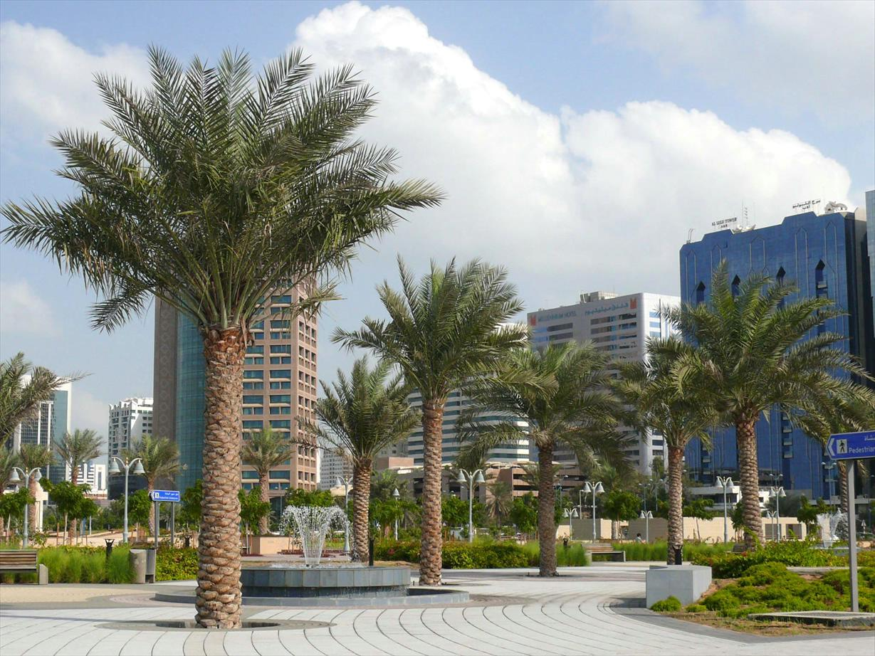
Image Credits: all Wikimedia Commons. Maps ©2017 Clairmont Press.

