Slide 1
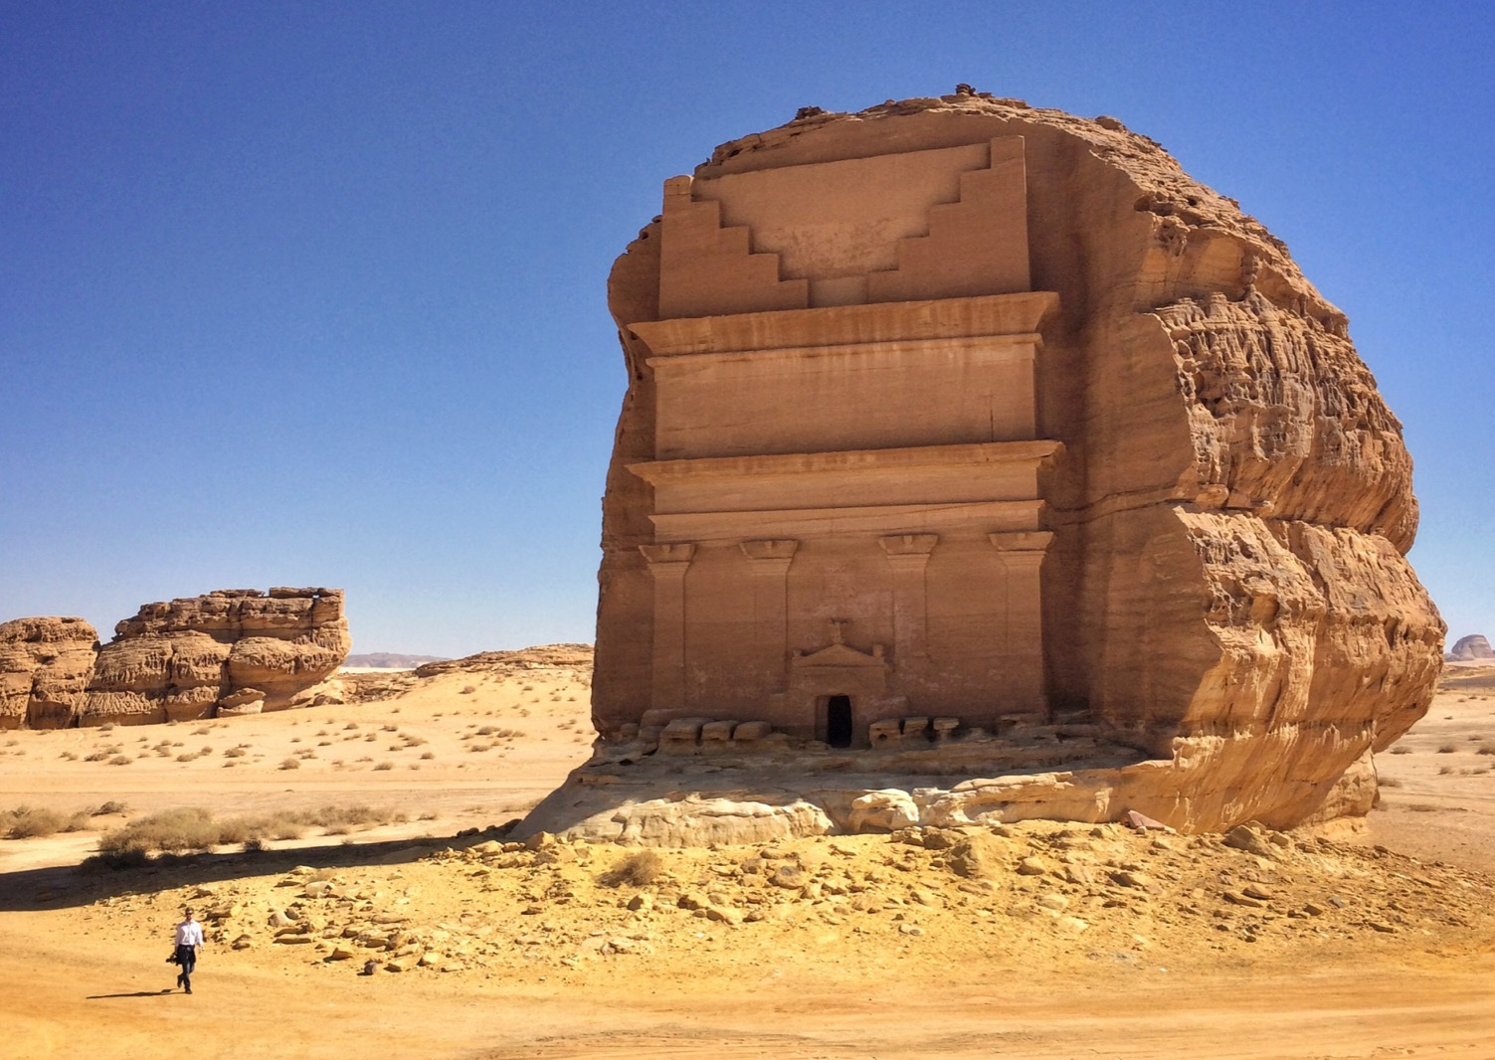
Chapter 5:
Kingdom of Saudi Arabia
STUDY PRESENTATION
© 2020 Clairmont Press

Slide 2
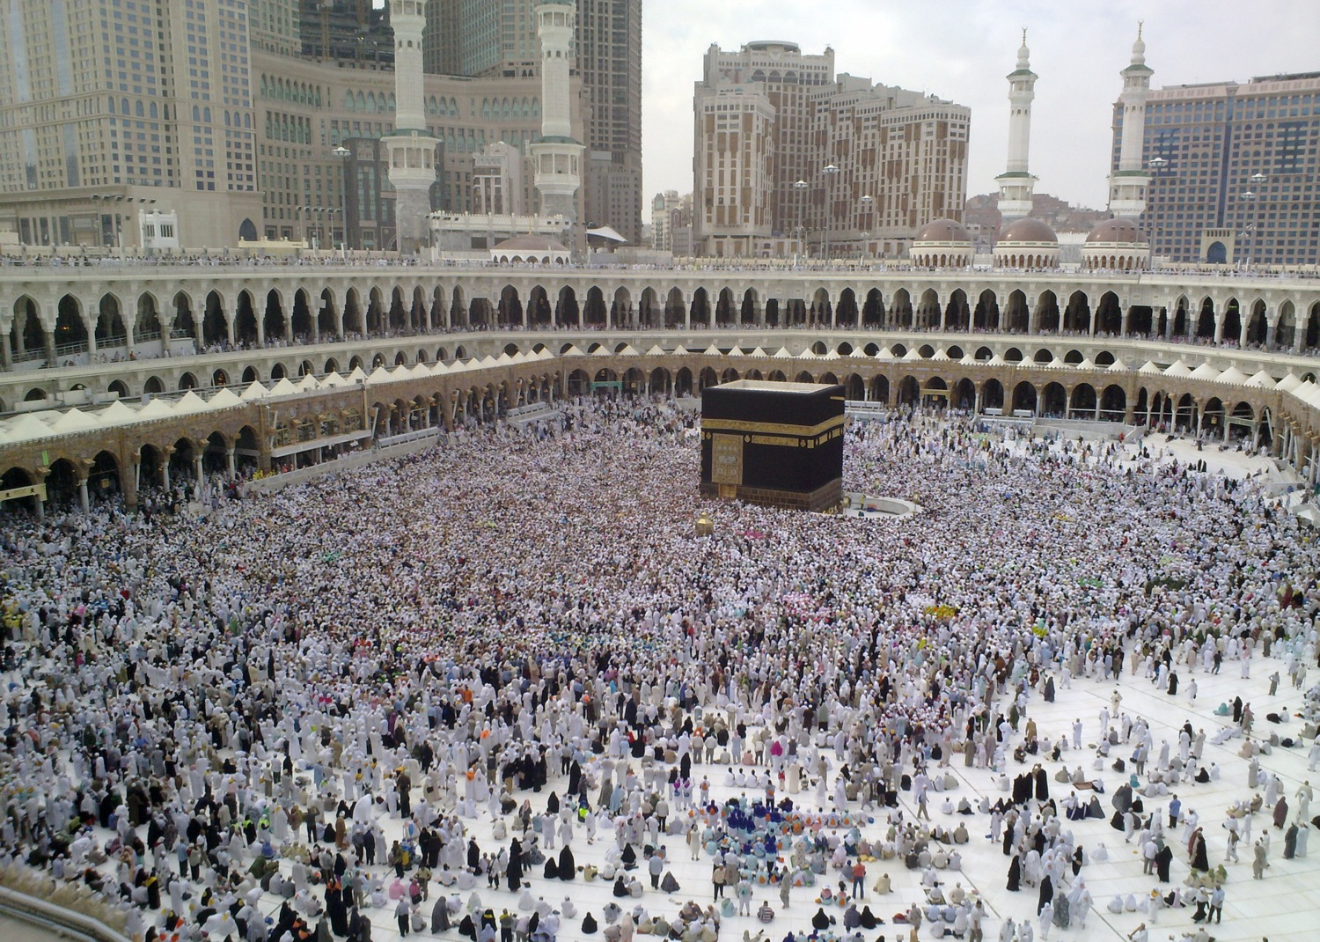
Section 1: The Geography of Saudi Arabia
Section 2: A Brief History of Saudi Arabia
Section 3: Government of Saudi Arabia
Section 4: Economy of Saudi Arabia
Section 5: U.S.-Saudi Relations

Slide 3
Section 1: The Geography of Saudi Arabia
Essential Question:
How do the waters that border Saudi Arabia affect the country?

Slide 4
Section 1: The Geography of Saudi Arabia
What terms do I need to know?
Empty Quarter
wadi
oasis
desalination
desertification
Suez Canal

Slide 5
Location and Size of Saudi Arabia
Saudi Arabia is the largest country in Southwest Asia, covering four-fifths of the Arabian Peninsula.
Much of it is a vast, uninhabited desert, with the Red Sea and Persian Gulf bordering the country on the left and right.
It is also bordered by five other countries: Iraq, Jordan, and Kuwait to the north, with Yemen and Oman to the south.

Slide 6
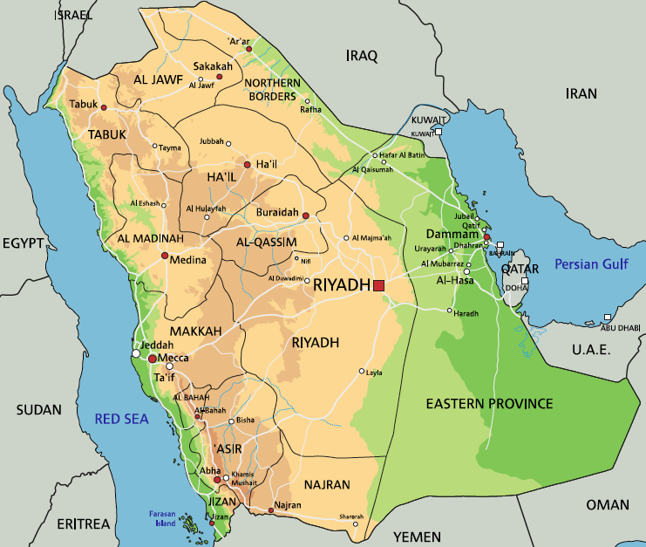
Location and Size of Saudi Arabia

Slide 7
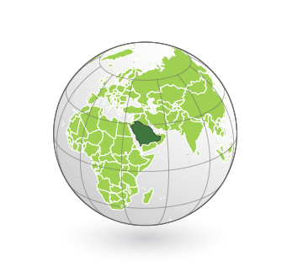
Location and Size of Saudi Arabia

Slide 8
Physical Geography of Saudi Arabia
The deserts of Saudi Arabia only receive about an inch of rain each year.
Over half of Saudi Arabia is covered by deserts, including the world’s largest all-sand desert, the Rub’ al-Khali, which means Empty Quarter.
There is a narrow coastal plain along the Red Sea, which is one of the largest agricultural areas in the country.
Just inland from this plain is a mountain range whose highest peak is Jabal Sawda. It is nearly 10,000 feet above sea level.
There are no permanent rivers in Saudi Arabia, but other forms of water can be found throughout the country.
A wadi is a riverbed that is dry when there has not been rain, but becomes a river when it rains a lot.
An oasis is a natural spring that can create a pond or small lake in the middle of a desert.

Slide 9
Climate of Saudi Arabia
It is no surprise that most of the climate of Saudi Arabia is arid, or hot and dry.
Along the southern Red Sea coastline is a small area with a milder climate that is humid and better for agriculture.
Occasional heavy rains can flood the area.
The inland temperatures can reach 130°F in the summer and drop to the 70s°F during the winter months.
Coastal locations are known for high humidity in the summer, but most of the country has low humidity.

Slide 10
Natural Resources of Saudi Arabia
Oil, or petroleum, is the most important resource in the country.
Saudi Arabia has the world’s largest oil reserves and is one of the largest producers of oil in the world.
Other resources include iron ore, gold, limestone, gypsum, copper, and sand.

Slide 11
Environmental Issues in Saudi Arabia
A major environmental issue for this country is the scarcity of fresh water.
The people of Saudi Arabia have heavily invested in desalination, or the process of removing salt and other minerals from salt water so it can be used for farming and drinking.
While this seems like the perfect solution, it can also lead to the death of sea life by increasing salt levels in the water nearby.
It’s also very expensive, requiring a lot of energy.
Desertification, or the expansion of deserts, also threatens the land that can be used for agriculture.
Oil spills along the eastern coast, where oil reserves are located, can cause massive environmental damage to plants and animals.

Slide 12
Impact of Location
More than four-fifths of all Saudis live in cities, or urban areas, like Riyadh, Mecca, Medina, and Jeddah.
Areas along the Red Sea and Persian Gulf also have higher population densities.
The long coastlines allow for trade by sea, with four major ports along the coasts.
It is located close to the Suez Canal, which links the Red Sea to the Mediterranean Sea, making trade with Europe easier.
The deserts act as a major barrier to trade, meaning trade by sea is their best trade route.

Slide 13
People of Saudi Arabia
Roughly 90% of Saudi citizens are Arab, and Arabic is the official language of the country.
Islam is the official religion of Saudi Arabia. It began here and has a large impact on daily life and on the government of the country.
Most citizens follow Sunni Islam, while about 15% follow Shia Islam.
There are small communities that practice Christianity, Judaism, Hinduism, Buddhism, and Sikhism, but openly practicing any religion besides Sunni Islam is illegal.
Schools, businesses, and government offices follow Islam’s holidays and daily prayer schedules.
Women’s roles are restricted, with husbands or a male relative having to give them permission to do anything.
Only recently have they been allowed to vote.

Slide 14
The Hajj
The hajj, one of the Five Pillars of Islam, is a pilgrimage to Mecca, the holiest city in Islam.
Muslims should make this pilgrimage once in their life, if they are able.
The hajj must be completed during the Islamic month Dhu al-Hijja.
There are many parts to the hajj:
Once pilgrims are about 6 miles from Mecca, they must wear white to show their time of purity
When they enter the city, they walk to the Grand Mosque where the stone cube of the Ka’bah sits, the most sacred place in Islam.
Pilgrims must circle the Ka’bah 7 times, where they either kiss or touch the Ka’bah and pray.

Slide 15
The Hajj (cont.)
There are many parts to the hajj (cont.):
They must also travel to other nearby holy places, like Muzdalifah, Mina, and others.
While in Mina, pilgrims must throw stones at pillars that represent the devil.
Finally, pilgrims return to Mecca to complete one last circle around the Ka’bah.
The government of Saudi Arabia is responsible for maintaining the holy places as well as keep peace.
Stampedes of pilgrims have led to many deaths in the past, which can increase foreign tensions.
Return to Main Menu

Slide 16
Section 2: A Brief History of Saudi Arabia
Essential Question:
What is the importance of Islam to Saudi history?

Slide 17
Section 2: A Brief History of Saudi Arabia
What terms do I need to know?
Arab Spring
terrorism

Slide 18
Early History
Saudi Arabia’s history goes back thousands of years.
One of the most important events in its history was the creation of Islam. Two of Islam’s holiest cities, Mecca and Medina, are located there.
The Prophet Muhammad was born in Mecca around the year 570, and millions of Muslims travel there each year as part of the hajj.
This land has largely been controlled by Islamic Kingdoms, like the Ottoman Empire.
The center, because of its harsh climate, was not part of these empires and was instead the home to nomads, like the Bedouins.

Slide 19
Unification and Creation of Saudi Arabia
Modern-day Saudi Arabia did not exist until the 20th century, when in 1932, Abd-al-Aziz bin Abd al-Rahman Al Saud* created Saudi Arabia.
This marked the end of a 30 year fight to unite the Arabian Peninsula.
Since then, the Al Saud family has ruled the country.
The kings have worked to create a stable and thriving economy in the country, along with maintaining its position as a regional power.
These kings have used the country’s oil as a major source of income for the country, using some of these funds to directly invest in schools and hospitals for citizens.
During the Persian Gulf War, Saudi Arabia sided with Kuwait and allowed United Nations soldiers to use their country as a base in their efforts against Iraq.

Slide 20
Saudi Arabia in the 21st Century
King Abdullah, who ruled from 2005 to 2015, modernized the country through social and economic programs and reforms.
These reforms included employment opportunities for women, increased foreign investment, and more.
Saudi Arabia fared well during the Arab Spring (the series of anti government protests, uprisings, and armed rebellions that spread across the Middle East in early 2011).
King Abdullah tried to settle some of the unrest by creating new benefits for Saudi citizens, like increased funds for affordable housing projects, providing for unemployed citizens, and allowing some elections.
King Salman became king in 2015 after the death of his half-brother King Abdullah.
Most of his reign has focused on tackling unrest and terrorism (the unlawful use of violence and intimidation, especially against civilians, in pursuit of political aims) throughout the region.
Saudi Arabia also created a coalition of 24 countries whose main goal is to eliminate terrorism.
Saudi Arabia, as of January 2016, executed 47 people tied to terrorism.

Slide 21
Camel Racing
The tradition of camel racing dates back to the 7th century, but a new love of the sport began in the 1970s.
While originally enjoyed by locals, it is now found in many Southwest Asian countries, as well as Kenya, Sudan, Egypt, India, and Australia.
Camel racing is very similar to horse racing, with one jockey riding one of the roughly 25 camels in the race.
Races can last between 2.5 and 6 miles, depending on the ages of the camels used.
Camels can reach up to 25 miles per hour during these races.
In Saudi Arabia, races are held every week in cooler months in the Riyadh Stadium, with the most important of these races being the King’s Camel Race.
Return to Main Menu

Slide 22
Section 3: Government of Saudi Arabia
Essential Question:
What power do citizens have in the government?

Slide 23
Section 3: Government of Saudi Arabia
What terms do I need to know?
absolute monarchy
Basic Law of Government
Sharia Law
Council of Ministers
Consultative Council
High Court

Slide 24
Structure of Government
The Kingdom of Saudi Arabia is an absolute monarchy, which means the king, always a member of the Al Saud family, controls the government.
In an absolute monarchy, citizens have no power or influence on the selection of the country’s leader, so the king rules until he dies, at which point the Saud family chooses a new male king.
There is no constitution to protect the rights or freedoms of citizens.
However, in 1992, the Basic Law of Government, a royal decree, outlined how the next king would be chosen and clearly stated that the country follows Sharia Law (laws based on Islam and the Quran).
Men and women do not have equal rights in Saudi Arabia, with women explicitly denied rights available to men.

Slide 25
Structure of Government (cont.)
The head of state and government in the country is the king.
The king has a cabinet called the Council of Ministers, who serve as advisors for four years and mainly include royal family members.
The Consultative Council is the legislative branch in Saudi Arabia.
There are 150 people who serve on the council for four years, are appointed by the king. As of 2013, the council now includes 30 women.
The judicial branch contains the High Court, which has judges selected by the king.
The laws of the court are based on Islam.

Slide 26
Laws for Women
Restrictions on what women can do occur in all parts of Saudi life, and are enforced by religious police.
Some laws include not being able to leave the country without permission from a male relative, no swimming in the same pools as men, and the requirement to wear an abaya and headscarf when out in public.
Women are allowed to drive, but they are heavily discouraged.
In 2016, four women were allowed to compete in the Olympics representing Saudi Arabia, but they cannot play or practice their sports in their home country.

Slide 27
Citizen Participation
Citizens twenty-one years and older can vote in municipal elections every four years, with 284 municipal councils in Saudi Arabia.
Citizens elect two-thirds of the members while the king elects the other third.
In 2015, women were allowed to run for office and vote for the first time, with 21 women being elected.

Slide 28
Challenges Facing the Government
One of the biggest challenges facing the country is the economy.
With alternative energy sources to natural gas and oil becoming more reliable and available, the world’s reliance on oil has diminished.
This means the Saudi government needs to diversify its economy in order to keep up.
Other challenges are: the decreasing amount of fresh water, the price of oil, and a growing population.
The government promoted foreign investment in the kingdom and continues to pursue economic reforms.
Return to Main Menu

Slide 29
Section 4: Economy of Saudi Arabia
Essential question:
How is Saudi Arabia trying to diversify its economy?

Slide 30
Section 4: Economy of Saudi Arabia
What terms do I need to know?
diverse economy
petrochemicals
riyal

Slide 31
Type of Economy
Saudi Arabia leans toward a market economy and relies on oil for most of its income.
Oil brings in 80% of Saudi Arabia’s revenue and makes up 45% of its GDP.
The king and his advisors decide how to use oil profits, but much of the nation’s wealth has been invested in technologies to produce goods like manufactured aluminum, milk and baby formula, and candy.
The government is also allowing more privately owned companies to exist.

Slide 32
Type of Economy (cont.)
Saudi Arabia is trying to shift to a diverse economy, which focuses on the production of different goods rather than just one, like oil.
It is shifting its focus towards telecommunications and power generation.
It is also expanding the production of petrochemicals, or chemicals made from petroleum or natural gas.
Unemployment rates in the country are rising, with an extremely high number of foreign workers in the country.
While the government is trying to hire more Saudi citizens, many youths lack the education and skill needed for jobs in Saudi Arabia.

Slide 33
Trade
Trade is very important to Saudi Arabia because it is based on oil and its leading exports are petroleum and petroleum products.
The country mainly exports to China, Japan, the United States, India, and South Korea.
Its main imports include machinery, equipment, food, chemicals, motor vehicles, and textiles.
These imports mainly come from the countries of China, the United Kingdom, the United States, Germany, South Korea, India, and Japan.

Slide 34
Currency and Trade Barriers
The currency of Saudi Arabia is the Saudi riyal, or SR.
In 2017, one Saudi riyal was worth about $0.27.
Free trade is important to the country, but they have used trade barriers.
In 1973, OPEC had a large embargo on oil sales placed on countries that supported Israel during the Arab-Israeli War.
This embargo affected many large countries, including the United States.
The country also has bans on imports of pork into the country based on Sharia Law, as well as bans on used clothing or cars over five years old.

Slide 35
Natural Resources
Saudi Arabia has few natural resources, but oil is an abundant one.
Oil and natural gas production make up a majority of the country’s wealth.
Having such a large supply of oil has also allowed them to become quite influential in OPEC.
Saudi Arabia has used its oil wealth to modernize their agriculture and build modern cities, roads, schools, communications, and more.
What was once a “desert kingdom” has now become quite modern in less than 100 years.

Slide 36
Human Capital
The technology used in the oil industry requires well-trained and educated workers.
The country also has modern communication and transport systems, as well as large building projects.
The country’s money has been used to invest in human capital, creating 8 universities as well as over 24,000 schools.
Saudi Arabia’s literacy rate is about 95%, with male literacy rates at 97% and female rates at 91%.
The average citizen attends school for 16 years.

Slide 37
Capital Goods
Saudi Arabia has heavily invested in capital goods, most of which are used in the oil industry.
They include technology related to oil production, transportation, and communications.

Slide 38
Entrepreneurship
Currently, it is not easy to begin your own business in Saudi Arabia.
However, entrepreneurship is one way the government can diversify the country’s economy.
The government is currently promoting entrepreneurship, and it seems to be paying off.
Return to Main Menu

Slide 39
Section 5: U.S.-Saudi Relations
Essential question:
What are some ways the United States assists Saudi Arabia?

Slide 40
Reasons for Close Ties
US-Saudi relations began in 1940.
This relationship is important to the United States for a few reasons:
Saudi Arabia is a leading country in Southwest Asia for Arabs and Islam.
The country’s location is also important as the two nations combat terrorism and extremism.
Oil used to be a big reason for the United States’ relationship, but now the US produces a lot of oil itself.
The main focus of the US-Saudi relationship is maintaining peace and combating terrorism in the Southwestern Asia region.
Saudi Arabia has a lot of influence over this region, with the exception of Israel and Iran.
The ongoing Syrian Civil War and the rise of ISIS now means this relationship is even more crucial.

Slide 41
US Assistance to Saudi Arabia
The United States’ assistance to Saudi Arabia includes military training, equipment, and construction.
The United States has helped train Saudi forces to use new weapons, modernizing Saudi military forces.
The United States has sold military aircraft, weapons, and other military equipment to Saudi Arabia.

Slide 42
Bilateral Economic Relations
The United States and Saudi Arabia are trade partners.
The United States exports many goods to Saudi Arabia, and the US is one of Saudi Arabia’s largest trade partners.
The countries have signed trade agreements to maximize the benefits and successes for both sides.
Currently, trade rates are about even, with the United States importing roughly $17 billion in 2016 and Saudi Arabia importing $18 billion in the same year.
Georgian companies trade with Saudi Arabia.
Some of the goods Georgia trades include paper, paper products, wood pulp, poultry, carpets, and flooring.

Slide 43
Saudi Arabia’s Membership in International Organizations
Saudi Arabia is a member of many of the same international organizations as the United States.
These include the United Nations, International Monetary Fund, World Bank, and World Trade Organization.
Saudi Arabia is a member of other organizations the United States is not a part of: OPEC, the Arab League, Gulf Cooperation Council, and the Muslim World League.
Return to Main Menu

Slide 44
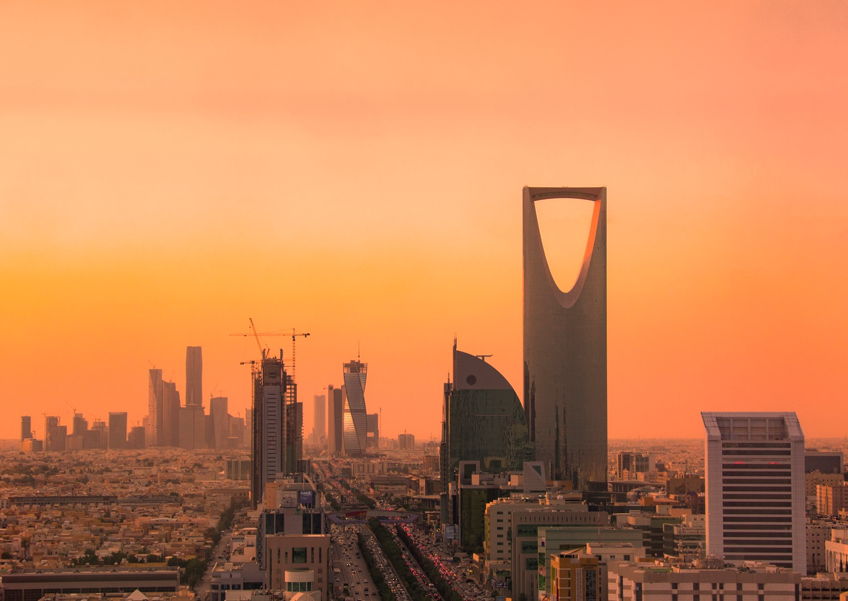
Image Credits: Wikimedia Commons. Maps ©2017 Clairmont Press.

