Slide 1
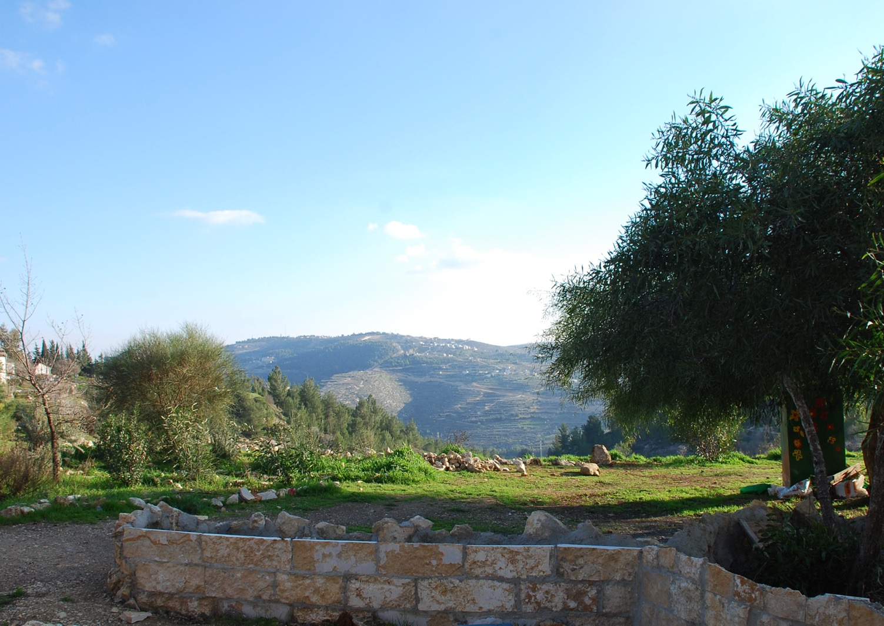
Chapter 6:
State of Israel
STUDY PRESENTATION
© 2020 Clairmont Press

Slide 2
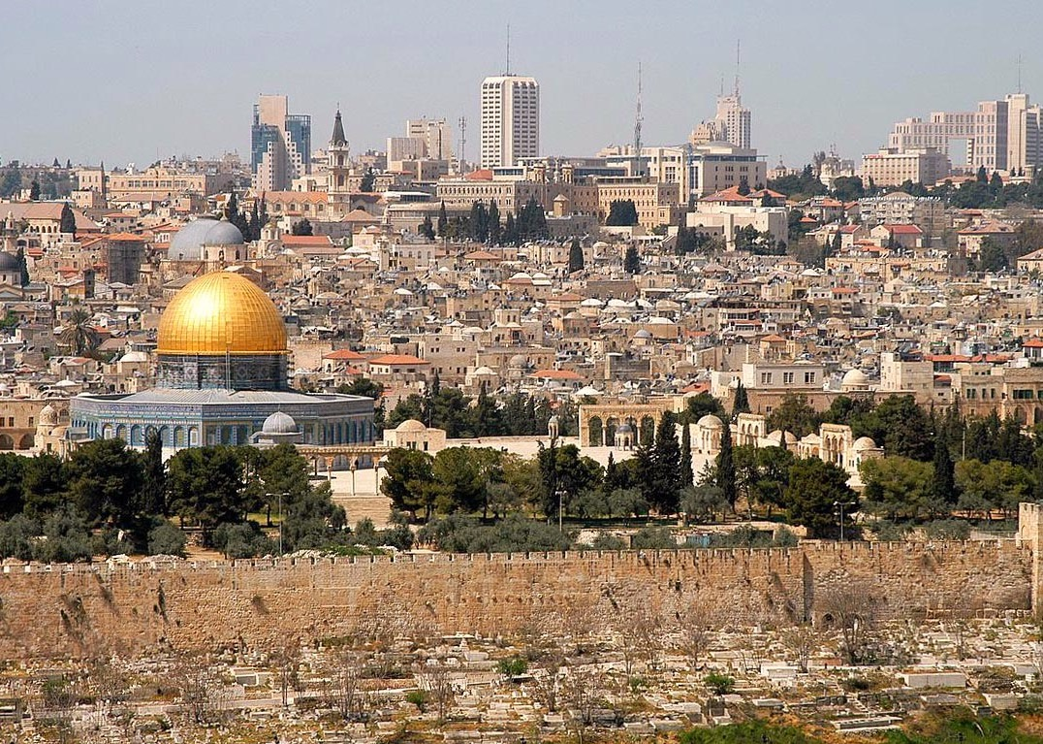
Section 1: The Geography of Israel
Section 2: A Brief History of Israel
Section 3: Government of Israel
Section 4: Economy of Israel
Section 5: U.S.-Israel Relations

Slide 3
Section 1: The Geography of Israel
Essential Question:
Why would water from the Jordan River be a source of conflict?

Slide 4
Section 1: The Geography of Israel
What terms do I need to know?
rift valley
Mediterranean climate

Slide 5
Location and Size of Israel
Israel is located in Southwest Asia and is found in both the northern and eastern hemispheres.
Israel is bordered by Lebanon, Syria, Jordan, and Egypt, with the Mediterranean Sea to the west.
The country is about 8,000 square miles in size, which is roughly the size of Georgia’s ten largest counties combined.

Slide 6
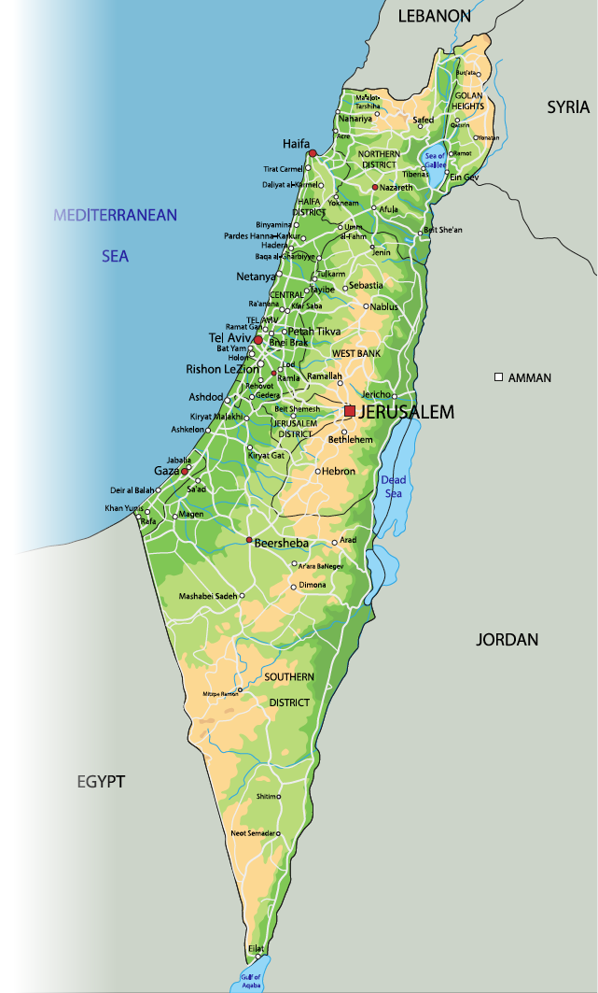
Location and Size of Israel

Slide 7
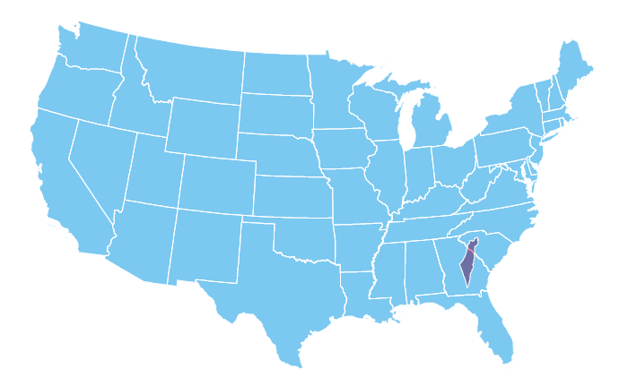
Location and Size of Israel

Slide 8
Physical Geography of Israel
Israel can be divided into four geographical regions:
The Mediterranean Coastal Plain is made of sandy beaches and fertile farmland. Over half of Israel’s population lives in this region. This area includes major cities, harbors for trade, a majority of industry, and a large part of agriculture and tourism.
The Central Hills region is made up of several small mountain ranges. These hills can reach heights of 4,000 feet above sea level, and their valleys are full of fertile land. This area focuses on agriculture, and the lowest freshwater lake, the Sea of Galilee, is located here.
Notes:
Replace Slide

Slide 9
Physical Geography of Israel (cont.)
Israel can be divided into four geographical regions:
The Negev Desert covers 60% of Israel. This area has a sparse population, focusing on agriculture and industrial jobs.
The Jordan Rift Valley is located in eastern Israel. Rift valleys occur when plates on the Earth’s surface move away from each other. The land is very fertile in the north, and the area focuses on agriculture, fishing, industry, and tourism.
The Jordan River flows through this region and is one of the major freshwater sources for Israel. It is shared with Syria and Jordan, which has caused conflicts in the past over how water should be used among the three countries.
Notes:
Replace Slide

Slide 10
The Dead Sea
The Dead Sea is a body of water so salty that no fish or aquatic plants can live in it.
The Dead Sea is also the lowest place on the surface of the Earth and the lowest body of water on Earth.
The sea lies between Israel, Jordan, and the West Bank.
The high level of salt in the water makes people more buoyant than normal, so tourists flock here to float on the water or to soak in the mineral baths.
The Jordan River is the main source of water for the Dead Sea.
Beginning in the 1960s, farmers began using water in the Jordan River for irrigation, which, over time, has dropped the water level in the Dead Sea.
To solve this problem, Israel and Jordan plan to make a canal from the Red Sea to the Dead Sea, but many are worried this would cause more problems.
Notes:
Replace Slide

Slide 11
Climate of Israel
The climate can vary from temperate to tropical.
There are only two main seasons: a cold, rainy period in winter and spring, and a hot, dry period in summer and fall.
The Mediterranean climate zone is the largest in the country, which means hot, dry summers and mild to cool, dry winters.
The southern and eastern part of the country have a desert climate.
This area can get up to 120°F in the summer and can receive less than two inches of rain a year.
Notes:
Replace Slide

Slide 12
Natural Resources of Israel
Israel has very few natural resources.
It has timber, potash, copper ore, natural gas, phosphate rock, magnesium bromide, clays, and sand.
Arable land, land that can be used for agriculture, is very valuable and makes up 24% of Israel’s area.
Natural gas discoveries have been found in the Mediterranean, but extracting these resources has had some delays.
Notes:
Replace Slide

Slide 13
Environmental Issues in Israel
Israel is working to be very environmentally friendly, mainly because it properly disposes of 85% of its solid waste.
However, major cities and industrial cities face pollution from industry and car emissions, which can create many health issues such as respiratory problems.
Water pollution also plagues the country, with chemically-polluted and bacteria-infested rivers.
Water-treatment facilities provide citizens with clean drinking water.
Excessive water usage for agriculture also has led to water shortages for citizens as well as shrinking water levels.
Notes:
Replace Slide

Slide 14
Impact of Location
Areas with higher population densities tend to be near arable land and have a Mediterranean climate.
This includes the Coastal Plain and Jordan Rift Valley.
Areas with fresh water also tend to have higher populations nearby.
Israel’s Mediterranean coastline makes trading much easier, with many deepwater ports built to increase the country’s ability to trade.
Notes:
Replace Slide

Slide 15
People of Israel
Israel’s population is a little over 8 million people, with over three-fourths being Jewish.
The remaining part is mostly Arabic.
The country has two official languages, Hebrew and Arabic, but English is commonly used because of tourism.
The largest religion practiced here is Judaism, with smaller numbers of Christians and Muslims also in the country.
Return to Main Menu
Notes:
Replace Slide

Slide 16
Section 2: A Brief History of Israel
Essential Question:
What were some problems associated with the creation of Israel in 1948?

Slide 17
Section 2: A Brief History of Israel
What terms do I need to know?
diaspora
Crusades
Zionists
Nazi Party
anti-Semitism
Holocaust
Six-Day War
Palestine Liberation Organization (PLO)

Slide 18
Early History of Israel
The history of Israel goes back thousands of years.
A crossroads of ancient trade routes, it was invaded and conquered by many groups, with the Hebrews, Romans, and European crusaders just naming a few.
Around 3,500 years ago, according to Jewish belief, God promised the land of modern-day Israel to the prophet Abraham.
The Hebrews, whose ancestors once lived in Israel, *left their slavery in Egypt to return to their homeland, winning back the land from other peoples and establishing Israel.
Eventually, outsiders forced the Israelites out into the world in an event called the diaspora.
The area came under Roman rule, and, during this time, Jesus, the founder of Christianity, was born.
Notes:
Replace Slide
Note: The fourth point needs to be reworded, left their slavery?

Slide 19
Early History of Israel (cont.)
Three hundred years after Jesus was executed by local officials, Christianity had spread to the point that Roman emperor Constantine converted to the religion.
The land of Israel became known as the Holy Land, and people from all over Europe and Asia wanted to travel to this area.
Around the year 640, Muslims took over the area, who believe the Prophet Muhammad rose to heaven in Jerusalem.
Despite the efforts of the Europeans and their Crusades, or attempts to retake the Holy Land, Israel remained a part of the Ottoman Empire until the end of World War I.
The Ottoman Empire was divided after it lost World War I.
The United Kingdom was given control of the area known as Palestine, making agreements with both Jews and Arabs that would lead to many problems.
Notes:
Replace Slide

Slide 20
Creation of Israel
Most of the people in Palestine before World War II were Palestinian Arabs, but since the late 1800s, large numbers of Jews had been immigrating to the area.
Some of these settlers, called Zionists, wanted to create a homeland for Jews in Palestine.
Conflicts broke out between these settlers and the Palestinian Arabs, with each side trying to hold onto the land.
During World War II, the Jewish people of Europe were the target of the Nazi Party, led by Adolf Hitler.
Anti-Semitism (or hatred of Jews) spread, and over 6 million European Jews were killed in Nazi concentration camps in an event known as the Holocaust.
After all the suffering the Jews endured, the new United Nations believed something should be done to ease their pain.
In 1948, the United Nations voted to create a Jewish homeland in part of Palestine.
The plan was to divide Palestine between the Arabs and Jews, with the Arabs retaining control of the Gaza Strip, West Bank, and Golan Heights.
Notes:
Replace Slide

Slide 21
Creation of Israel (cont.)
(Cont.) In 1948, the United Nations voted to create a Jewish homeland in part of Palestine.
In this deal, Jerusalem would be an international zone with neither group controlling it.
The Jews agreed and declared the creation of the State of Israel, but the Palestinian Arabs believed they were treated unfairly in the decision-making process and, along with other Arab countries, did not accept the new country.
War broke out in May 1948 between Israel and the Palestinians, with Arab countries supporting Palestine.
The Israelis not only won the war, but it also managed to claim much more land in the process.
In 1967, the Six-Day War broke out, where Israel managed to take even more land in the conflict.
In 1993, the Israeli government and the Palestine Liberation Organization (PLO) signed a peace treaty.
However, fighting still continues.
Return to Main Menu
Notes:
Replace Slide

Slide 22
Section 3: Government of Israel
Essential Question:
What type of government does Israel have?

Slide 23
Section 3: Government of Israel
What terms do I need to know?
Knesset
Law of Return
secular

Slide 24
Type of Government
The State of Israel is a parliamentary democracy, with its parliament called the Knesset.
The prime minister is the head of government, and there is a president of the state who serves only ceremonial roles and duties.
Israel does not have a written constitution.
Instead, the government is based on the Declaration of Establishment (1948), the Basic Laws, and the Law of Return.
Both the Basic Laws and Law of Return have been amended several times.
Most of Israel’s Jewish citizens see themselves as secular, meaning they do not feel the country’s laws should be based solely on religious beliefs.
However, many Orthodox Jews influence Israeli laws.
Notes:
Replace Slide

Slide 25
Branches of Government
The government is divided into three branches.
The executive branch includes the prime minister and cabinet, who are chosen by the winning political party.
The Knesset makes up the legislative branch, where members are directly elected by citizens every four years.
The judicial branch is the Supreme Court, where justices serve until 70 years old.
All citizens 18 and older can vote in elections for parliament members.
Return to Main Menu

Slide 26
Section 4: Economy of Israel
Essential question:
What is the core of Israel’s economy?

Slide 27
Section 4: Economy of Israel
What terms do I need to know?
pharmaceuticals
diversified economy
shekel

Slide 28
Type of Economy
Israel has a market economy, and its citizens enjoy a rather high standard of living.
The country has a strong justice system that protects businesses. Bribery and other corruption are illegal.
There are few barriers on trade other than tariffs on food imports.
Israel’s economy is heavily based on high-tech equipment, technology-based industries, diamond cutting, and pharmaceuticals.
Israel’s economy was unaffected during the Arab Spring of 2011.
Notes:
Replace Slide

Slide 29
Type of Economy (cont.)
High housing prices and income inequality are problems for Israel’s economy.
The technology sector only employs about 8% of the workers in the country, even though they generate a lot of income.
Service and manufacturing jobs are the most important sources of work for Israelis.
Unlike many countries in Southwest Asia, Israel has a diversified economy, or an economy that focuses on the production of many goods rather than just one.
Roughly 70% of the country’s GDP comes from things like tourism, housekeeping, medical treatments, and education.
Notes:
Replace Slide

Slide 30
Trade in Israel
Because the country lacks many resources, trade is very important.
Israel exports machinery and equipment, software, cut diamonds, and more.
It imports raw materials, military equipment, fuels, grains, and more.
Free trade agreements have greatly helped Israel’s economy.
The country uses very low tariffs.
The shekel is the currency other countries must use when trading with Israel.
Georgia businesses and Israeli businesses trade with one another. Governor Nathan Deal visited Israel in 2014 to promote trade and investment.
Notes:
Replace Slide

Slide 31
Natural Resources
While it does not have many natural resources, Israel does have a highly developed industrial economy that requires oil.
Oil prices greatly affect the country because of this.
Minerals and salts are collected and sold.
Israel’s technology depends on resources it does not have, which means it must purchase the fuel it needs or look for alternative sources.
Notes:
Replace Slide

Slide 32
Human Capital in Israel
Israel’s well-educated population has helped the economy remain strong.
Israelis have wide access to education. School attendance is required from age 5, and education is free until age 18.
The country has a literacy rate of 98%.
Many Israelis work in highly-skilled jobs that require a well-educated work force. For example: medical technologies, electronics, and mining.
Notes:
Replace Slide

Slide 33
Capital Goods in Israel
Israel has invested in capital goods, including technology and industrial production.
Israel is also heavily invested in defensive technologies.
Some major technologies developed here include solar windows that improve energy efficiency and generate power.
Innovation is valued in Israel for developing better technologies.
Notes:
Replace Slide

Slide 34
Entrepreneurship in Israel
Innovation in Israel is largely due to the high number of entrepreneurs.
The country has more than 3,000 high-tech companies, and it also has the highest rate of female entrepreneurs in the world.
As entrepreneurs open more businesses in the country, that creates higher paying jobs for the citizens.
Notes:
Replace Slide

Slide 35
A Kibbutz
A kibbutz is a community in Israel where the goal is collective ownership, equality, and democracy.
Money from paying jobs is combined, protected, and divided between each family based on its size.
The roots go back to the early 1900s, when a group of young Eastern Europeans moved to Palestine.
They created the first kibbutz, which quickly spread.
There are roughly 270 kibbutzim today, with over 130,000 people living in them.
Return to Main Menu
Notes:
Replace Slide

Slide 36
Section 5: U.S.-Israel Relations
Essential question:
How long have the United States and Israel been allies?

Slide 37
Section 5: U.S.-Israel Relations
What terms do I need to know?
Joint Economic Development Group

Slide 38
The Friendship of Israel and the United States
The relationship between these two countries began the moment Israel came into being.
Israel is the most reliable partner of the US in Southwest Asia.
The two share many of the same goals, such as maintaining a secure Jewish homeland in Israel, and spreading democratic values in the Middle East.
The United States is also dedicated to finding a solution for the Arab-Israeli conflict.
Notes:
Replace Slide

Slide 39
US Assistance to Israel
The United States provides over $3 billion in Foreign Military Financing to Israel.
Both countries participate in joint military exercises, military research, and weapons development, and both fight terrorism together.
It is estimated that the United States has provided $127 billion to Israel in financial assistance since its creation.
Notes:
Replace Slide

Slide 40
Bilateral Economic Relations
Israel’s largest trade partner is the United States.
In addition, both countries heavily invest in each other’s manufacturing sectors.
Since 1985, the United States and Israel have had a free trade agreement, allowing for expansion of trade and increased investment between the countries.
The two countries meet at the Joint Economic Development Group, which is a bilateral meeting to discuss economic conditions and reforms.
The countries also have scientific and cultural exchange partnerships.

Slide 41
Israel’s Membership in International Organizations
Israel is a member of many of the same international organizations as the United States.
These include the United Nations, International Monetary Fund, World Bank, and World Trade Organization.
Israel is also involved in European organizations.
Both the US and Israel belong to the Organization for Economic Cooperation and Development, which allows countries to receive economic investment to boost their economy.
Return to Main Menu

Slide 42
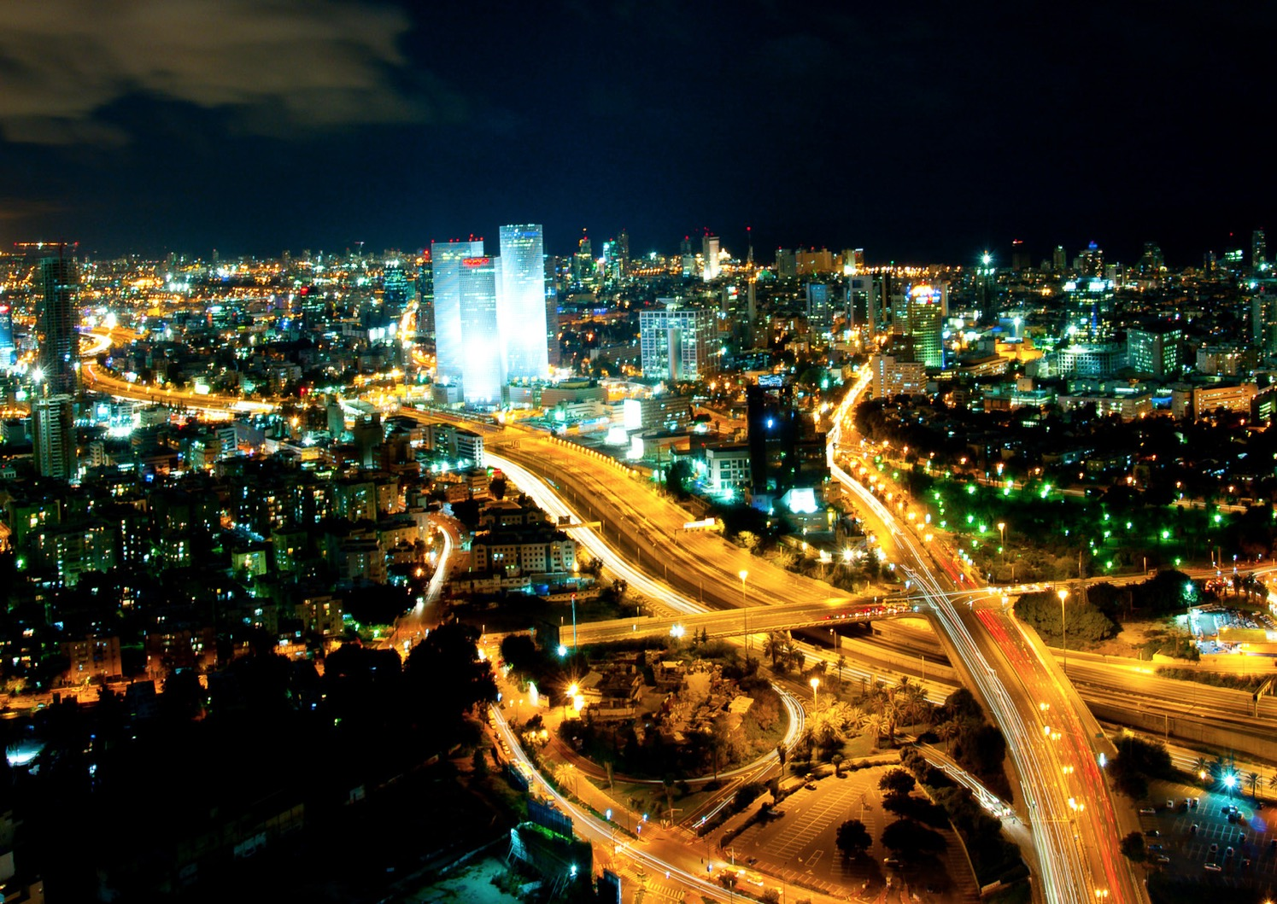
Image Credits: Wikimedia Commons. Maps ©2017 Clairmont Press.

