Slide 1
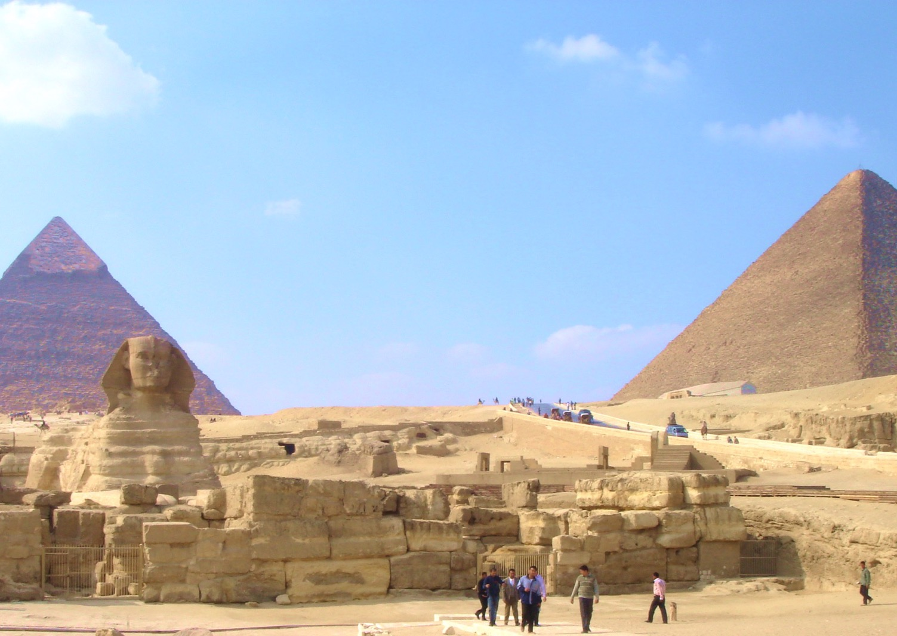
Chapter 8:
The Geography and History of Africa
STUDY PRESENTATION
© 2020 Clairmont Press

Slide 2
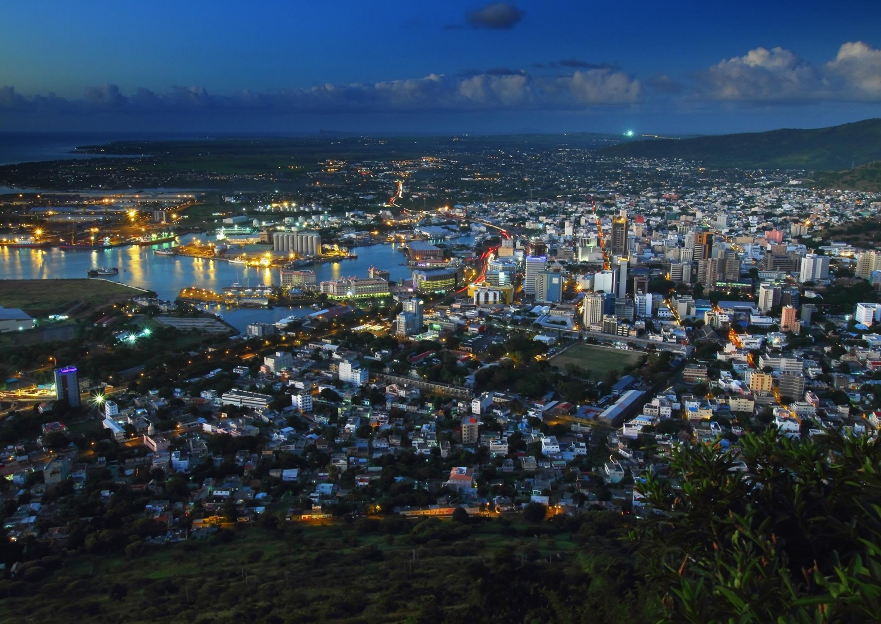
Section 1: The Geography of Africa
Section 2: The People of Africa
Section 3: An Overview of African History
Section 4: Government Instability in Africa

Slide 3
Section 1: The Geography of Africa
Essential Question:
What is the importance of the Sahara in Africa?

Slide 4
Section 1: The Geography of Africa
What terms do I need to know?
water wars
fertilizer
industrial waste
deforestation
desertification
oasis
ecosystem

Slide 5
Location and Size of Countries in Africa
Located in the northeastern part of Africa, Egypt is a large country located along the banks of the Red Sea and Mediterranean. The Nile River runs through Egypt.
South of Egypt is Sudan, which is larger than Egypt. It also contains the Nile River. Sudan is currently one of the most unstable countries in Africa, due to civil war and political instability.
Southeast of Sudan, you’ll find Kenya, which borders the Indian Ocean, has amazing animal parks and natural savanna grasslands, and the government is relatively stable.
Notes:
Replace Slide

Slide 6
Location and Size of Countries in Africa (cont.)
West of Kenya, you find the Democratic Republic of the Congo, which is the second largest country in Africa. It has a small coastline along the Atlantic Ocean, is rich in natural resources, and has a lush rainforest along the Congo River.
Northwest of the Democratic Republic of Congo is Nigeria, which is located on the West African coast. It contains nearly every kind of habitat found in Africa, has large oil reserves, and amounts of arable land.
At the southern tip of the continent, lies the country of South Africa. It has coasts on both the Atlantic and Indian Oceans, has an abundance of African animals and grasslands. South Africa has had to deal with the racist policy of apartheid for a long time.
Notes:
Replace Slide

Slide 7
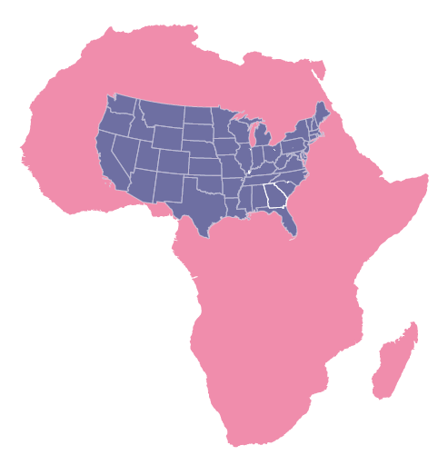
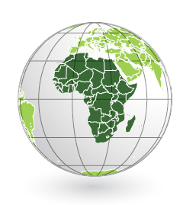
Location and Size of Countries in Africa

Slide 8
Physical Features of Africa
Africa has a few different regions, each with its own features:
The Sahara is covered with sand dunes reaching 600 feet, rolling rocky hills, and wide stretches of gravel. Traders have crossed the Sahara for thousands of years, with a mix of the traditional camel caravan and the modern transport vehicles used today.
South of the Sahara is the Sahel, a dry and semiarid region. Once acting as a transition between the Sahara and savannas, it is now turning into a desert from the lack of rainfall and the generations of people using the area for farming and cattle-raising.
Notes:
Replace Slide

Slide 9
Physical Features of Africa (cont.)
Africa has a few different regions, each with their own features:
Further south are the savannas, or grasslands and tropical habitats. This area runs along the equator in Africa. Many iconic African animals live here, and farming here is much easier than in the Sahel, though droughts can make it quite difficult.
Further south is the region of tropical rain forests. These rainforests are located in the center of Africa and along the Atlantic coast. It has a hot and humid climate with trees reaching hundreds of feet in height. Rapid population growth is a constant threat in this region, with the demand for wood as fuel climbing*.
Notes:
Replace Slide
Note: The second part of the last sentence doesn’t make sense. Demand for wood is understood but “fuel climbing” is confusing.

Slide 10
Rivers and Lakes
The longest river in the world is the Nile, with its origins as the Blue Nile and White Nile in Sudan.
These tributaries meet and form the Nile, which runs north to the Mediterranean.
The White Nile begins in Lake Victoria, the largest lake in Africa and a very important lake for the region.
The Congo River begins near Lake Tanganyika, flows through central Africa and the Congo Rain Forest, and to the coast of the Atlantic Ocean. It is an important source of fresh water for the region.
The Niger River begins in Guinea, flowing 2,600 miles through many countries, to its mouth in Nigeria.
Notes:
Replace Slide

Slide 11
Mountains and Valleys
The Atlas Mountains are found in the northwest part of the continent, stretching across the north, and separating the coastal region and rains* of the Mediterranean from the Sahara.
Mount Kilimanjaro, the tallest mountain in Africa, is in East Africa and is actually the combination of three volcanoes, two of which are extinct and the third is dormant.
The Great Rift Valley, located in East Africa, is formed from plate tectonics moving away from each other.
The valley runs about 4,000 miles from Syria through Africa to Mozambique, with a split in Africa: the Eastern and Western Rifts.
Notes:
Replace Slide
Note: * Last segment of the first sentence needs more clarification

Slide 12
Mount Kilimanjaro
Referred to as the “roof of Africa”, Kilimanjaro has a snow-covered peak despite being on the hottest latitude.
The mountain has had many names, but the origin of the name ‘Kilimanjaro’ is a mystery.
There are some mysteries and myths about this mountain:
Locals believe that the peak is the seat of God, which is why it is always white.
The mountain is supposed to be the home to small humans who live as hunters and gatherers.
Mount Kilimanjaro is one of the seven summits people attempt to climb around the world. An estimated two-thirds of these climbers are successful at reaching the top.
Notes:
Replace Slide

Slide 13
Environmental Issues of Africa
There are many environmental issues affecting the continent.
Many of these problems are not common in the United States or other developing countries, but they are devastating Africa.
Lack of clean water, poor soil quality, and expanding deserts are just a few of the issues.
The growing number of factories, causes increased pollution and more frequent droughts, which can lead to fertile places becoming deserts.
Notes:
Replace Slide

Slide 14
Water Pollution and Unequal Access to Water
Many countries in Africa struggle to have enough water for people to survive. They do not have access to the long rivers or nearby lakes.
Many guess that Africa will have to deal with water wars (conflicts over water) in the near future.
Even countries on a river may have limited amounts of water, due to other countries’ use of the water upstream.
Fresh water is also becoming polluted, due to: human waste contamination, fertilizers in runoff water from farms, and industrial wastes from factories dumping into the rivers.
Parasites are also a threat to fresh water sources, causing many diseases from drinking the water.
These problems are important, and the African countries are trying to solve them.
Notes:
Replace Slide

Slide 15
Poor Soil and Deforestation
Most historians believe the Sahel once had rich farmland.
However, centuries of poor farming practices and less rainfall have led to a damaged Sahel and growing desert.
Deforestation, or the destruction of trees and other vegetation, has also affected the soil, removing the very roots preventing the dirt from blowing away.
Rain forests are also hit with deforestation, due to logging, clearing of land for farming, and for fuel.
As a result of the poor soil, many face starvation and poverty.
Some attempt to find jobs in urban areas, but many of those are not able to find work.
In recent years, world organizations have tried to step in to help those affected by providing them with food and teaching them better farming techniques.
Notes:
Replace Slide

Slide 16
Desertification
Desertification occurs when a desert expands into areas that had been farmland previously.
When farmland is overused, the soil becomes powdery, eventually being blown away by Saharan winds and leaving a rocky terrain.
In the Sahel, desertification is largely caused by people, not the climate.
In East Africa, people have relied on farming and raising cattle. However, less grazing land, droughts, and expanding cities, have forced farmers to reuse their land over and over again, resulting in the soil wearing out.
People are trying to fight the spread of the desert by planting trees, and building windbreaks to keep out sand.
However, the desert continues to expand every year.
Notes:
Replace Slide

Slide 17
Living in the Sahara Desert
Very few people are able to live in the Sahara, which is considered one of the harshest environments.
There are few places where water is available, like in an oasis, or where a spring of fresh water comes from the ground.
While rare, they do tend to grow vegetation, and some people even choose to live there.
Today, most who live in the Sahara are nomads, moving from place to place in search of water.
They usually travel by camel and trade with other tribes of nomads.
Nomads have a hard time earning a living nowadays, so many are actually settling down in towns and cities to find stable work.
Notes:
Replace Slide

Slide 18
Living in the Sahel
While there is more rain in the Sahel than in the Sahara, the amount of rainfall can range from 6 to 20 inches a year.
This makes farming difficult, and vegetation is sparse and unevenly distributed in this region.
Desertification is a major problem in the Sahel.
Most people living here make their living by herding animals, and live in an area until the grasses and water run out.
Some people are subsistence farmers, meaning they grow just enough food for themselves and their families.
The main crops of this region are peanuts and millet, but unreliable rainfall can make farming difficult.
Notes:
Replace Slide

Slide 19
Living in the Savanna
Africa has the largest savanna, or grassland region, in the world, with heavy rains in the summer supporting the thick, green grass.
People in these areas usually farm, and their crops include wheat, oats, and sorghum.
These grasslands are an important ecosystem, which is a biological community of interacting organisms and their physical environment.
Lions, elephants, giraffes, and other familiar African animals live here.
The expansion of human populations into the Savanna is threatening the animal’s environment.
However, some countries have set up national parks and wildlife preserves to create a protected area for these animals to live.
Notes:
Replace Slide

Slide 20
Living in the Tropical Rain Forests
There are many different ecosystems in the tropical rain forest: the forest floor, the rivers and streams, and high up in the trees.
Each ecosystem has its own unique set of species.
The Europeans in the 1800s changed the lives of the people who lived in the forests, clearing land for plantations and harvesting resources of the forest.
The rain forests are still being destroyed today, through commercial logging and road building.
This deforestation has led to the extinction of both plant and animal species, as well as soil erosion and desertification.
Return to Main Menu
Notes:
Replace Slide

Slide 21
Section 2: The People of Africa
Essential Question:
What are the largest religious groups in Africa, and how did they get there?

Slide 22
Section 2: The People of Africa
What terms do I need to know?
religious group
ethnic group

Slide 23
Religious and Ethnic Groups
There are a few ways to divide people, two of which are by religion and ethnicity.
A religious group shares a belief system in a god or gods, with a specific set of rituals and literature.
Islam and Christianity are the the two largest religions in Africa. Islam was brought by Arabs hundreds of years ago. Europeans brought Christianity with them in the 1800s.
An ethnic group is a group of people who share cultural ideas and beliefs that have been a part of their community for generations, including history, language, religious beliefs, and more.
Africa has thousands of ethnic groups.
Notes:
Replace Slide

Slide 24
Arabs
Arabs arrived in North Africa in the 5th century when the first Muslim armies reached Egypt.
Arab armies, traders, and scholars spread across North Africa all the way to Morocco.
Wherever the Arabs went, they brought Islam and the Arabic language with them.
Arab traders eventually led caravans across the Sahara as part of the salt and gold trade.
Arabs also traveled south by sea and along the coast of East Africa.
These Arab traders married local women and began blending cultures and religions.
Arabs can be found today all over Africa, with a majority along the Mediterranean coast as well as the East African coast.
Notes:
Replace Slide

Slide 25
Bantu
Beginning over 2,000 years ago, the Bantu migrated in waves from the Sahel into central and southern parts of Africa.
The Bantu began as farmers and herdsmen, eventually learning to make tools out of iron.
They migrated south and east across Africa, following rivers and streams and meeting many different peoples.
These interactions taught the Bantu new skills which led to intermarriage between the groups.
Bantu people are both Islamic and Christian, and some are animists, believing there are nature spirits.
Over 60 million people speak a Bantu-based language and share some Bantu culture today.
Notes:
Replace Slide

Slide 26
Swahili
The Swahili ethnic group is found along the East African coast, beginning as a result of contact between Arab and Persian traders and marriage with Bantu cultures.
While Swahili is considered a Bantu language, it still includes many Arabic words or phrases, with the name ‘Swahili” being an Arabic word for “one who lives on the coast”.
Most Swahili live in cities, but many still fish and trade like their ancestors.
Most Swahili are Muslims, though it is not uncommon to also see them follow traditional beliefs as well.
Swahili see a close link between their religious beliefs and their practice of medicine and healing.
Return to Main Menu
Notes:
Replace Slide

Slide 27
Section 3: An Overview of African History
Essential Question:
What was the Scramble for Africa?

Slide 28
Section 3: An Overview of African History
What terms do I need to know?
trans-Atlantic slave trade
imperialism
Scramble for Africa
colonies
indirect rule
assimilation
civil war
dictatorship
Pan-African movement

Slide 29
The Trans-Atlantic Slave Trade
The first Europeans to land on the African coast were explorers trying to find a route to India and Asia.
The trans-Atlantic slave trade started when Europeans became interested in using Africa as a source of enslaved laborers to be sent to their colonies in the Americas.
This lasted from the 1500s until the middle of the 1800s, and between 12 and 15 million Africans were enslaved.
Europeans stayed close to the coast in the beginning, but competition for power and resources drove them deeper into Africa, creating more European colonies.
The advanced technology of the Europeans allowed them to easily defeat the natives.
Notes:
Replace Slide

Slide 30
The Age of Imperialism
In the 1800s, Europeans saw their number of colonies as a measure of power. Those colonies would provide raw materials and more markets for the ruling country.
Imperialism is the process through which a country controls another country.
Africa was sought after for a few reasons, mainly, protecting trade routes and collecting valuable resources.
Christianity was brought to Africa during this time.
This race for colonies in Africa is sometimes called the Scramble for Africa, and it almost led to war.
During the Berlin Conference of 1884, Europe divided Africa among themselves leaving out African leaders. This did not allow the African leaders any say with what was done with their land.
Notes:
Replace Slide

Slide 31
The Colonial Period
This period lasted from the 1800s to the mid-1900s.
European countries tried different ways of ruling the African colonies. For example, allowing large companies in the area to rule their work force or setting up colonial governments.
African colonies (areas under control of another country) were divided into districts and put under the power of European officials.
Indirect rule was another method of rule, used by the British, where they would appoint local chiefs to be their enforcers.
Africans were lured to these positions by promises of power, wealth, and influence, which did not last.
The French tried assimilation, which meant forcing the natives to give up their own culture and customs to adopt the French language and lifestyle as their own.
Europeans exploited and neglected the needs of the the African people until after World War II.
Notes:
Replace Slide

Slide 32
Independence in Africa
During the 1950’s, Africans began demanding change after realizing colonialism was only benefitting the Europeans.
After World War II, European countries were focused on rebuilding their own countries, taking their focus off of their African colonies.
Europeans began granting their African colonies independence, with 27 independent countries by 1960 and 47 by 1975.
When the Europeans first created their colonies, ethnic groups were not considered, so rival groups were occasionally put in the same colonies.
Colonial lines were followed when granting each country independence, so these rivalries continued.
Because of this, civil wars, or wars between citizens of the same country, and dictatorships, harsh rule by persons with total authority, became very common though Africa.
Notes:
Replace Slide

Slide 33
The Pan-African Movement
The Pan-African movement called for unity among African people as a reaction to the terrible experiences of colonial rule.
The goal was for people of African descent around the world to think of Africa as a homeland.
Many supporters hoped this movement would help Africans forget their differences and work to the benefit of each other and African countries’ economies.
Even though the peaceful unification of Africa never happened, this movement was responsible for independence movements across the continent and the formation of the African Union in 2002, which works to help people across Africa.

Slide 34
South Sudan
Until 2011, South Sudan was a part of Sudan.
Sudan was a British colony until it gained independence in 1956, and, shortly after, conflict between the north and south began.
North Sudan is primarily Arab and practices Islam, and south Sudan is a mix of 60 different ethnic groups and practice traditional religions and Christianity.
The country’s second civil war broke out in 1983. This was because the government, in the north, wanted to impose Sharia Law throughout the country, which the south did not want.
Sudan suffered nearly 2 million deaths in their civil war.
In 2011, South Sudan became an independent country, ending civil war with Sudan and South Sudan.
However, the different ethnic groups now have large conflicts and civil war.
Return to Main Menu
Notes:
Replace Slide

Slide 35
Section 4: Government Instability in Africa
Essential Question:
What are the reasons that led to unstable governments in Africa after independence?

Slide 36
Section 4: Government Instability in Africa
What terms do I need to know?
instability
HIV/AIDS
famine

Slide 37
The Legacy of Colonialism
Because of colonialism and the rapid European withdrawal from the continent, Africa has many unstable governments.
Civil wars broke out between ethnic groups. Dictators, supported by their militaries, seized power.
Government instability has led to many problems with African countries: poor education opportunities, lack of food and medicine, and the inability to combat disease and famine.
Instability means a tendency toward unpredictable or erratic behavior.
Notes:
Replace Slide

Slide 38
Access to Education in Africa
In relatively peaceful independent countries, education opportunities are better.
In Kenya, the government has made school improvements a priority.
The better educated a population is, the more they can contribute to an economy.
In some countries, civil war has led to educational neglect.
These conditions have made it unsafe for children to attend school. School buildings could be in ruins, and schools have little access to learning materials.
Another education issue is gender, with boys more likely to attend school than girls.
In rural areas, the traditional role of girls is to stay home and learn to cook and clean.
Government programs are working to close this education gap.
Notes:
Replace Slide

Slide 39
Jimmy Carter and the End of the Guinea Worm
Up until the 1980s, the Guinea worm was found in 21 countries throughout Africa and Asia and infected over 3 million people.
Today, it is only found in 4 countries: South Sudan, Ethiopia, Mali, and Chad.
The Guinea worm is a parasite that lives in water, and people swallow the worm larvae when they drink untreated water.
The females develop in the stomach for a year, then try to exit the body through the foot or leg, creating a burning sensation.
This burning causes people to put their feet in water, which lets the worm release more larvae. The removal of this worm can be difficult.
Jimmy Carter and the Carter Center have worked to eradicate the worm since 1986.
While there is no cure for the worm, it can be avoided by drinking clean water and by preventing the infected person from putting their legs and feet in water.
Notes:
Replace Slide

Slide 40
Combating HIV/AIDS in Africa
Control and treatment of diseases is another area where unstable governments cause problems.
HIV/AIDS (Human Immunodeficiency Virus/Acquired Immune Deficiency Syndrome) has the highest infection rates in the world in Sub-Saharan Africa.
There are an estimated 26 million people living in Africa with AIDS.
Poor health care systems, poverty, and lack of government organizations all contribute to the rising number of cases.
People are also not usually informed about how to prevent the disease.
While there are now drugs that can slow the progress of the disease, they are very expensive, which means the people who need them can’t afford them.
Countries with more stable governments tackle the AIDS issue more effectively than countries with unstable governments.
Notes:
Replace Slide

Slide 41
Combating Famine in Africa
Famine occurs when there is a food shortage and people aren't able to get enough food to eat.
People can starve to death because of famine.
The leading causes of famine in Africa are: climate change, political conflict, low prices for African goods on the world market, and disorganized or corrupt governments.
Bad land policies which try to favor native farmers often end up reducing the amount of food grown when compared to European farmers.
Civil wars can disrupt agriculture and trade, limiting the amount of food being brought into the country.
Return to Main Menu
Notes:
Replace Slide

Slide 42
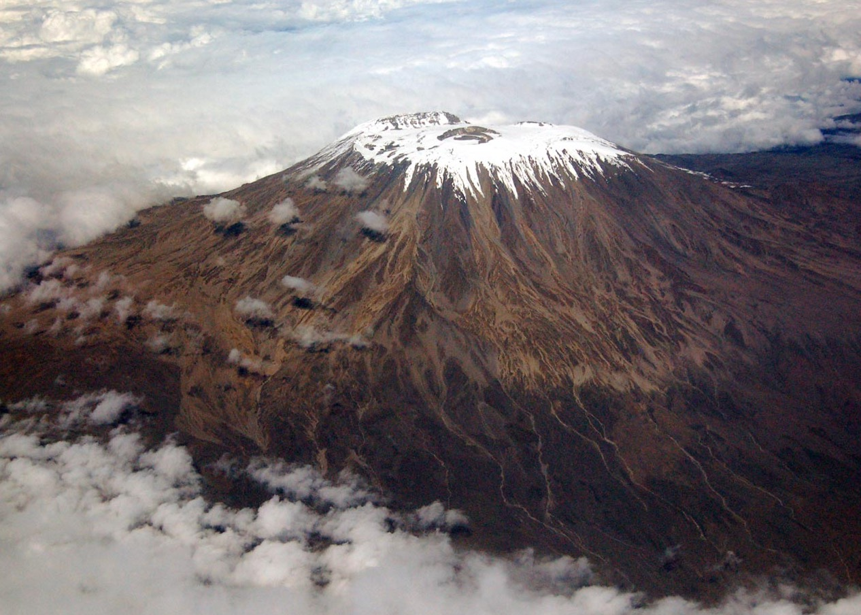
Image Credits: all Wikimedia Commons. Maps ©2017 Clairmont Press.

