Slide 1
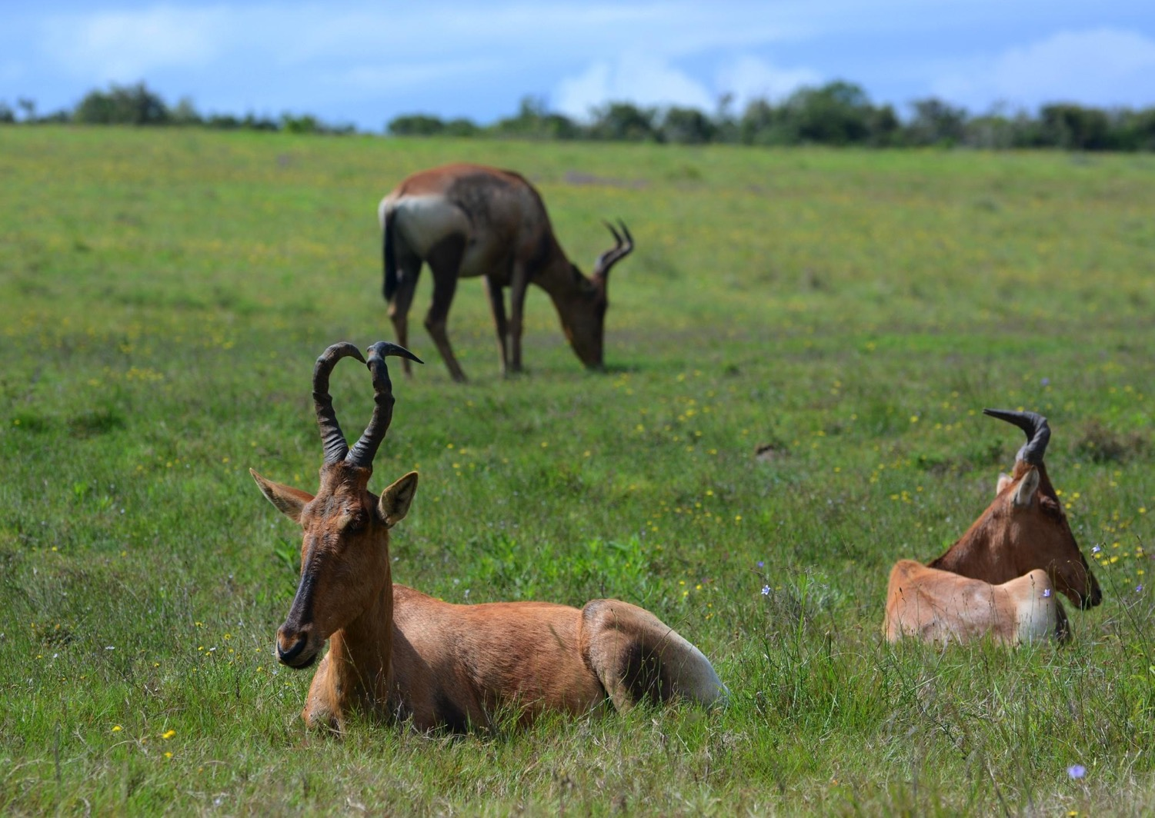
Chapter 9:
Republic of South Africa
STUDY PRESENTATION
© 2020 Clairmont Press

Slide 2
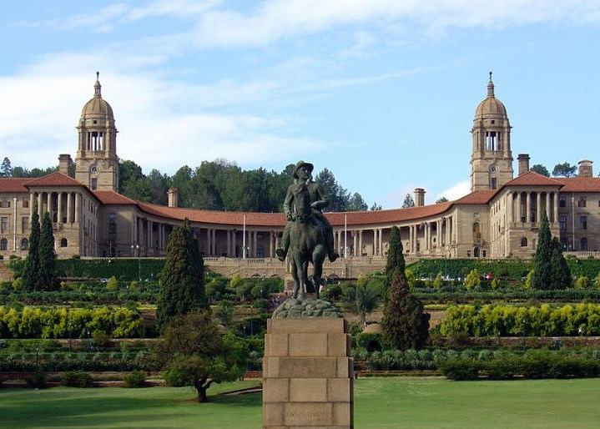
Section 1: The Geography of South Africa
Section 2: A Brief History of South Africa
Section 3: Government of South Africa
Section 4: Economy of South Africa
Section 5: U.S.-South Africa Relations

Slide 3
Section 1: The Geography of South Africa
Essential Question:
What is the Great Escarpment?

Slide 4
Section 1: The Geography of South Africa
What terms do I need to know?
veld
escarpment
acid rain

Slide 5
Location and Size of South Africa
South Africa is located at the southern tip of Africa, having over 1,864 miles of coastline.
Located in the southern and eastern hemispheres, South Africa is bordered by Botswana, Mozambique, Namibia, Swaziland, and Zimbabwe.
The kingdom of Lesotho is located inside the country.
The country has grasslands, mountains, beaches, and more, as well as open lands that farmers farm called velds.

Slide 6
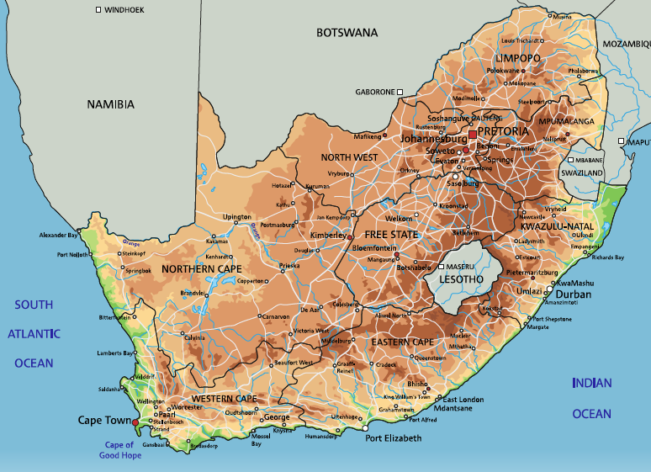
Location and Size of South Africa

Slide 7
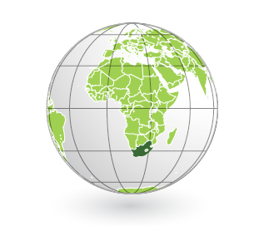
Location and Size of South Africa

Slide 8
Physical Geography of South Africa
None of South African river mouths along the coast are good for harbors or ports.
The Orange River is the country’s longest river.
None of the country’s rivers are navigable for transportation and trade.
The Great Escarpment is one of the most important physical features in South Africa.
An escarpment is a long, steep slope that usually separates lands at different heights.
The Great Escarpment separates an interior plateau from a coastal plain.
The Kalahari Desert is located in the northwest corner of the country.
Ironically, it receives too much rain to be considered a true desert, and the Okavango River runs through it.
Notes:
Replace Slide

Slide 9
Climate of South Africa
The climate is mainly temperate, or mild.
The climate is greatly affected by the ocean currents and altitude.
Because of the elevation of the large plateau covering most of South Africa, the temperature is cooler.
The coastal plain is subtropical because of the warm ocean currents.
Notes:
Replace Slide

Slide 10
Natural Resources of South Africa
South Africa has valuable natural resources.
Along with fertile land, it has large deposits of diamonds, gold, and platinum. It also has chromium, coal, iron ore, uranium, natural gas, and much more.
These resources have helped South Africa’s economy grow.
Notes:
Replace Slide

Slide 11
Where People Live in South Africa
The majority of people live in the eastern part of the country, where climate and geography are more favorable. The Kalahari Desert is in the northwest, and is sparsely populated.
Over half the population lives in urban areas, with over 8 million living in the Greater Johannesburg Metropolitan Area.
For a long time Apartheid limited where black South Africans could live. The effects of it are still present, though it ended in 1994.
Notes:
Replace slide

Slide 12
Environmental Issues in South Africa
The lack of rivers and lakes is hard on the population, so the people must practice water conservation to meet their needs.
A result of the growing population and urbanization is acid rain, or rain with an increased acidity caused by pollution and environmental factors.
Acid rain can kill forests as well as fish and other plant life.
Desertification and soil erosion are also issues South Africa faces.
Notes:
Replace Slide

Slide 13
South Africa’s People
South Africa is home to over 54 million people, having diverse religious beliefs, cultures, and languages.
The main ethnic groups are Nguni, the Sotho-Tswana, the Venda, and the Tsonga.
There are 11 official languages, and most people speak two or more languages.
English is the most commonly used language for government and commercial use.
80% of South Africans identify as Christian.
Return to Main Menu
Notes:
Replace Slide

Slide 14
Section 2: A Brief History of South Africa
Essential Question:
Which European countries colonized South Africa?

Slide 15
Section 2: A Brief History of South Africa
What terms do I need to know?
Dutch East India Company
African National Congress (ANC)
homeland
embargo
Truth and Reconciliation
African Union (AU)
Notes:
Replace Slide

Slide 16
Early History of South Africa
Thousands of years ago, people living in this area were hunter-gatherers.
Around 2,000 years ago, these people began herding animals and planting crops, which allowed development of larger settlements
About 1,800 years ago, the Bantu of the north moved into the area.
Most South Africans trace their history to these people.
Notes:
Replace Slide

Slide 17
Early Colonial Period
The Portuguese were the first Europeans to arrive in South Africa in the late 15th century.
They were looking for a sea route to India.
In the late 16th century, the Dutch and British, and other Europeans arrived.
In 1652, the Dutch East India Company, a trading company who protected Dutch interests in the Indian Ocean, set up a trading post in modern-day Cape Town.
In 1657, European settlers began creating permanent farms, and in the 1700s, European settlements began moving further inland, forcing natives off their land and into servitude.
Even after slavery was abolished in 1834, native Africans were still heavily discriminated against.
Notes:
Replace Slide

Slide 18
British Colonial Rule
The British took over the colony in the early 1800s, and Dutch descendants moved north into Zulu territory, causing conflict.
The Dutch set up two states in South Africa: Transvaal and Orange Free State.
These states merged with British South Africa in the early 1900s to form the Union of South Africa. Vast deposits of gold and diamonds had recently been discovered in this area.
The Union of South Africa was a constitutional monarchy, and the African natives were considered second-class citizens under this government.
They formed the African National Congress (ANC) to work towards equality.
In 1961, South Africa changed from a monarchy to a republic, but even with this change, racist policies continued to be enforced.
Notes:
Replace Slide

Slide 19
Robben Island
Robben Island was the most notorious prison for anti-apartheid protesters, and Nelson Mandela spent 18 of his 27 prison years there.
Located 6 miles north of Cape Town, the island is only 5 miles in area.
It became a Dutch prison island after many failed attempts at settlement, and it would eventually become a British penal colony.
It was a leper colony for a time as well as a colony for the insane.
From the mid-1960s to 1991, it became a maximum security prison, with most of the prisoners there for political offenses.
In 1991, all prisoners were released.
Today, Robben Island is a museum.
Notes:
Replace Slide

Slide 20
Apartheid
In 1948, the National Party came to power and instituted a strict policy of segregation called apartheid.
Blacks were allowed to own very little land, even though they made up over 70% of the population.
Black Africans were forcefully relocated to areas known as homelands. These people were assigned based on ethnic group. Black Africans were required to have passbooks to leave their area to go to work.
The white minority controlled the lives of the nonwhite minority, with segregation everywhere.
The African National Congress and Pan Africanist Congress worked for many years to end this, eventually convincing the international community to place an embargo on South Africa.
An embargo is a refusal from one country to trade with another country.
Eventually, the South African government was forced to begin making changes, repealing apartheid laws and releasing political prisoners.
In 1994, Nelson Mandela, leader of the African National Congress, was voted president when South Africa held its first multiracial elections.
Notes:
Replace Slide

Slide 21
Desmond Tutu
Desmond Tutu was an outspoken critic of apartheid.
After becoming a teacher and seeing the inequality between education for blacks and whites, he resigned. He then attended theological college, and became an ordained Anglican priest and later a Bishop.
Tutu was appointed general secretary of South Africa’s Council of Churches and became a spokesperson for the rights of blacks in the country.
He promoted nonviolent protest and economic punishment to push his message.
His work earned him the Nobel Peace Prize.
As apartheid ended, Tutu continued to work towards equality.
Though now retired, he works with a group of older world leaders to promote solutions for various problems with human rights, climate change, HIV/AIDS, and poverty.
Notes:
Replace Slide

Slide 22
Post-Apartheid South Africa
The government wrote a new constitution, set up a democracy, and restructured the country into 9 new provinces, with the intention of improving the lives of all South Africans and encouraging unity.
In 1999, the government established the Truth and Reconciliation Commission. It was tasked with correcting the wrongs and abuses that occurred in the apartheid era.
The government continues to assist families who were victims of the apartheid system.
South Africa became one of the leading countries in Africa in political, economic, and social matters. It helped establish the African Union in 2002 to promote unification in Africa and is an active member of the United Nations.
In 2004, the government issued a mandate to cut the amount of unemployment in half by 2014, and they plan to eliminate poverty and reduce inequality by 2030.
In 2010, South Africa hosted the FIFA World Cup, showcasing the country to the world.
Return to Main Menu
Notes:
Replace Slide

Slide 23
Section 3: Government of South Africa
Essential Question:
What are some challenges facing South Africa’s government?

Slide 24
Section 3: Government of South Africa
What terms do I need to know?
republic
head of government
head of state
Parliament of the Republic of South Africa
Constitutional Court

Slide 25
Type of Government
South Africa is a republic (a country with elected representatives) with a bicameral, or two house, parliament.
Citizens 18 or older are able to vote in elections for parliament.
The government is based on a constitution written in 1996 and it has been amended several times since.
South Africa has three capital cities, with one capital for each branch of government.
Notes:
Replace slide

Slide 26
Branches of Government
The executive branch of the government is made up of the president and cabinet.
The president is elected by a National Assembly for a 5-year term and can serve 2 terms in a row.
The president is both the head of government (person who deals with government business day-to-day) and the head of state (chief representative of the country).
The president appoints his cabinet to give him advice.
The legislative branch is called the Parliament of the Republic of South Africa.
Its two houses: the National Council of Provinces and the National Assembly.
The judicial branch of South Africa’s government is made of the Supreme Court of Appeals and the Constitutional Court.
The Constitutional Court has a chief justice, deputy chief justice, and nine judges, who are appointed by the president and enforce the constitution.
The Supreme Court of Appeals has a court president, deputy president, and 21 judges. They are the final authority on all legal matters excluding the constitution.
Notes:
Replace slide

Slide 27
Challenges Facing the Government
A major challenge is the slow growth of the country’s economy and unemployment.
The government is also dealing with the aftermath of apartheid, for example, inequality between races and housing shortages.
Corruption within the government has also begun to be a problem.
Return to Main Menu
Notes:
Replace slide

Slide 28
Section 4: Economy of South Africa
Essential question:
What are the reasons for high unemployment in South Africa?

Slide 29
Section 4: Economy of South Africa
What terms do I need to know?
National Development Plan
rand

Slide 30
Type of Economy
The economic system is a technologically advanced market economy with some government control over property-rights laws.
While the mining, services, manufacturing, and agriculture sectors of the economy are strong, the economy is still dealing with the effects of apartheid, and many still live in poverty.
The government faces the challenges of poverty, inequality, and high rates of unemployment.
Access to high-quality education is difficult for many, which can lead to high unemployment rates.
In 2012, the government created a National Development Plan in order to reduce and end poverty and inequality by 2030.
The government is working to build more power generators, but blackouts are still a common problem.
Notes:
replace slide

Slide 31
Trade in South Africa
South Africa exports about $94 billion per year. Their top exports are: gold, diamonds, machinery, and equipment.
South Africa imports about $81 billion per year. Their top imports are: petroleum products, chemicals, and food.
The currency of South Africa is the rand, and a US dollar can exchange for roughly 13 rand.
Georgia businesses trade with South African people and businesses. The top exports are motor vehicles, internal combustion piston engines, and insecticides.
Notes:
Replace slide

Slide 32
Natural Resources of South Africa
South Africa is the leading African nation in mining and the sale of gold. 40% of the world’s gold is found in South Africa.
96% of the world’s platinum reserves are found in the country.
Other important resources include: diamonds, coal, iron ore, nickel, manganese, phosphates, salt, uranium, and natural gas.
In other less stable countries, diamonds have been sold to provide money and weapons for wars and conflicts. South Africa is stable, however, and can get all the benefits from trade.
Notes:
Replace slide

Slide 33
Human Capital in South Africa
South Africa invests 6% of its GDP on education, has a diversified economy, and has one of the highest GDPs in Africa.
The literacy rate is about 94%, and most students attend school for 13 years.
The country’s electronics industry requires skilled and trained workers, and the mining industry needs workers who can used sophisticated technology.
However, the unemployment rate is still high due to the difficulties of accessing education and inequality from the aftereffects of apartheid.
Notes:
Replace Slide

Slide 34
Capital Goods in South Africa
South Africa needs specific equipment to mine gold, diamonds, and platinum from deep within the earth.
The country has invested in the equipment, technology, and training needed.
The same is true for the country’s iron and steel production and vehicle assembly plants.
Notes:
Replace Slide

Slide 35
Entrepreneurship in South Africa
Some people are working to become entrepreneurs in order to to avoid unemployment.
Unfortunately, it is not as easy as it sounds, since the biggest challenge facing them is funding.
To start a business, a business license must be purchased, which takes about 2 months.
Return to Main Menu
Notes:
Replace Slide

Slide 36
Section 5: U.S.-South Africa Relations
Essential question:
What is the focus of U.S.-South African relations today?
Notes:
Replace Slide

Slide 37
Section 5: U.S.-South Africa Relations
What terms do I need to know?
African Growth and Opportunity Act (AGOA)
BRICS

Slide 38
A Changing Relationship
The US and South Africa have had diplomatic relations since 1929, but relations were strained when apartheid took over.
The United States joined in the embargo against South Africa, but today, the US is one of South Africa’s major trading partners.
The two countries have recently worked together to focus on areas of health, security, trade, and political and economic development.
South Africa’s stability and success makes it a leading country on the continent, and the US would like to continue these positive relations.
Notes:
Replace Slide

Slide 39
U.S. Assistance to South Africa
South Africa faces the challenges of high unemployment, HIV/AIDS, crime, and corruption.
U.S. assistance to South Africa focuses on improving health care, increasing education standards, and its teacher training.
The U.S. also helps with improving agricultural practices and creating clean energy.
Notes:
*U.S. or US - can’t keep changing, confusing
Replace Slide

Slide 40
Bilateral Economic Relations
Because of the African Growth and Opportunity Act (AGOA), South Africa receives trade benefits with the U.S.
South Africa has also joined the Southern African Customs Union, whose goals are to encourage trade, reduce trade barriers, and promote investment with the U.S.
Some top traded items between both countries include machinery, medical equipment, diamonds, platinum, iron and steel, and vehicles.
Notes:
Replace Slide

Slide 41
South Africa’s Membership in International Organizations
South Africa belongs to many international organizations, with hopes that these memberships will benefit its people.
Some organizations focus on bringing peaceful endings to conflicts in Africa and encouraging economic and political development.
South Africa is a part of the United Nations, International Monetary Fund, World Bank, and World Trade Organization.
South Africa is a member of BRICS, which is made up of fast-developing countries in the world. These countries are: Brazil, Russia, India, China, and South Africa.
Return to Main Menu
Notes:
Replace Slide

Slide 42
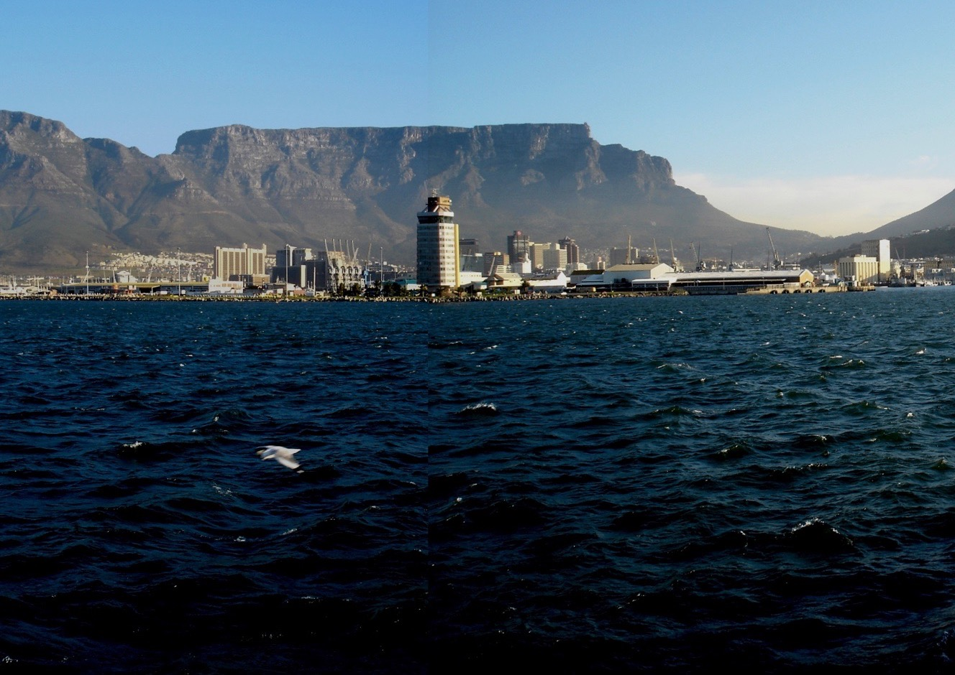
Image Credits: Wikimedia Commons. Maps ©2017 Clairmont Press.

