Slide 1
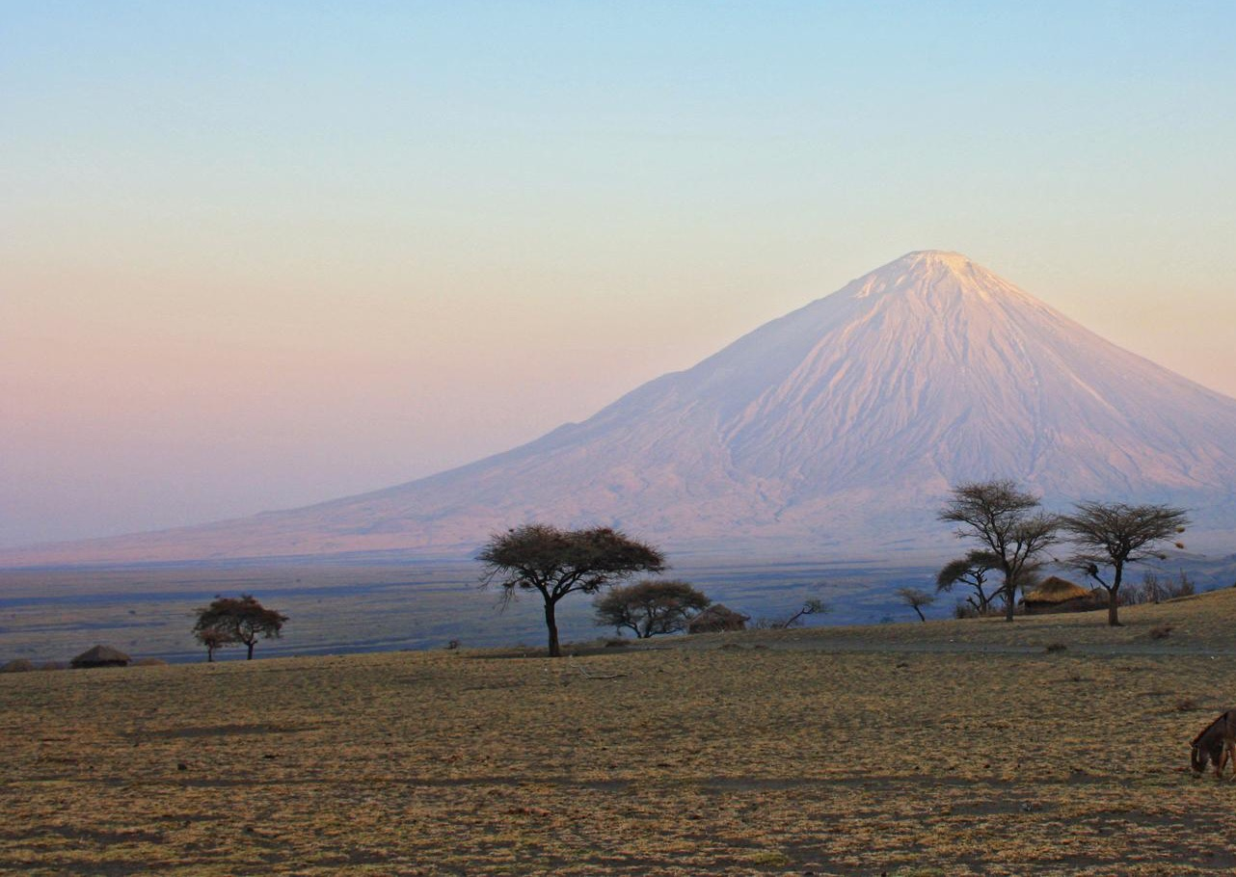
Chapter 10:
Republic of Kenya
STUDY PRESENTATION
© 2020 Clairmont Press

Slide 2
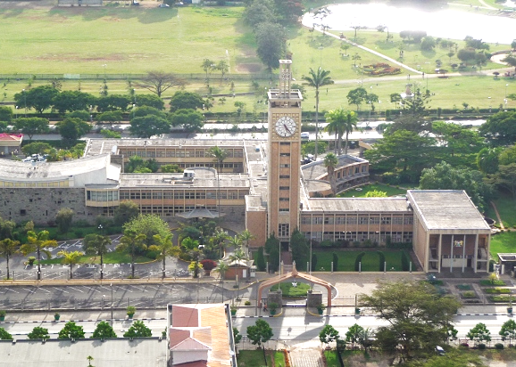
Section 1: The Geography of Kenya
Section 2: A Brief History of Kenya
Section 3: Government of Kenya
Section 4: Economy of Kenya
Section 5: U.S.- Kenya Relations
Notes:
Replace Slide

Slide 3
Section 1: The Geography of Kenya
Essential Question:
How does Kenya’s geographic location impact trade?

Slide 4
Section 1: The Geography of Kenya
What terms do I need to know?
tectonic plate
savanna
poaching
desertification
urbanization

Slide 5
Location and Size of Kenya
Kenya is located on the east coast of Africa.
Covering about 225,000 square miles, Kenya is the 23rd-largest country in Africa.
Kenya is bordered by South Sudan, Uganda, the shores of Lake Victoria, Tanzania, Ethiopia, Somalia, and the Indian Ocean.
Notes:
Replace Slide

Slide 6
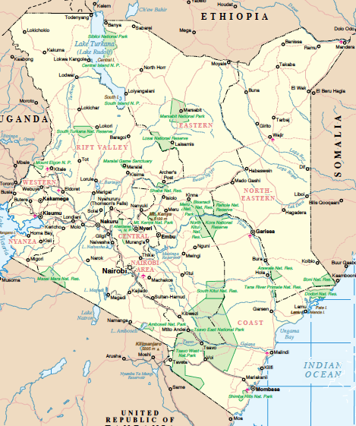
Location and Size of Kenya

Slide 7
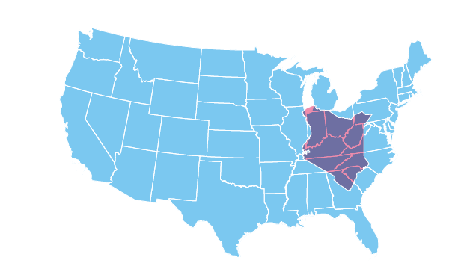
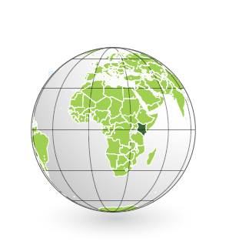
Location and Size of Kenya

Slide 8
Physical Geography of Kenya
The terrain in Kenya ranges from mountains, to desert, to fertile farmland, and then to sandy beaches.
Deserts make up 20 percent of Kenya’s total land area.
Kenya’s highlands are excellent for farming because of its soil quality and adequate rainfall.
The terrain surprisingly includes an isolated tropical rain forest.
Kenya shares access to Lake Victoria with Uganda and Tanzania.
Lake Victoria is the second-largest freshwater lake by surface area in the world.
Because it is a major source of water in the region, the area around the lake is densely populated. It is now facing the challenges of pollution and overfishing.
Kenya also has coral reefs, they are the third-most popular reefs in the world.
Notes:
Replace Slide

Slide 9
Physical Geography of Kenya (cont.)
Kenya is named after Mount Kenya, the second-tallest mountain in Africa, with an altitude of 17,058 feet above sea level.
The peak is always capped with snow, despite its location on the Equator.
The mountain, surrounded by highlands, is the location of one of Africa’s most successful agricultural region.
The Great Rift Valley runs 3,728 miles from Mozambique to Jordan in Southwest Asia.
Forming from two tectonic plates (separate areas of the Earth’s crust) moving away from each other, the valley almost divides the country in half.
This has created seven lakes, as well as volcanoes, in the country.
Savannas (grassy plains with few trees) are home to Kenya’s famous wildlife: lions, buffaloes, elephants, and more.
Kenya’s most famous savanna is the Serengeti Plain.
Kenya has 16 national parks, national reserves, and game reserves.
Notes:
Replace Slide

Slide 10
Climate of Kenya
Kenya has a number of different climates.
The northwestern part of Kenya has a very hot and dry climate.
To the east, there is a temperate area in the highlands, good for growing crops.
The coast has a tropical climate, influenced by currents from the ocean.
The dry seasons are from December to March and June to September. The rainy seasons are from March to May and September to December.
Notes:
Replace Slide

Slide 11
Natural Resources of Kenya
Kenya’s most valuable resource is its fertile farmland in the highlands.
Kenya’s economy relies on agriculture.
Kenya’s main exports are tea, coffee, and cut flowers.
Water, another natural resource, is used for hydroelectricity.
Some other natural resources are limestone, soda ash, salt, gemstones, zinc, and gypsum.
Notes:
Replace Slide

Slide 12
Environmental Issues in Kenya
Kenya faces several environmental problems.
Water pollution is the main problem in the country. Some contributing factors are: urban and industrial waste, and the pesticides and fertilizers used on farms.
Droughts are also a problem for Kenya.
Kenyans have worked to protect their wildlife, but poaching, or taking wildlife by illegal methods, is still a problem.
Deforestation is a common problem in Kenya, causing soil erosion and desertification (expanding of deserts).
Deforestation was the result of needing more agricultural space, and for timber and charcoal production.
The country began a restoration project whose goal is to replant 20 million trees.
Notes:
Replace Slide

Slide 13
Distribution of People in Kenya
Most Kenyans are scattered across the rural areas of the country.
Because their work is agriculture-based, their living decisions are influenced by rain and soil quality.
A number of people have moved to urban areas over the past 50 years through a process called urbanization.
This is because people believe there are higher wages and more job opportunities in cities.
Areas with the highest population density are around Lake Victoria, Nairobi (the capital of Kenya), and the port city Mombasa.
Lake Victoria provides drinking water, a place to fish, and trade opportunities.
Notes:
Replace Slide

Slide 14
Professor Wangari Maathai
Wangari Maathai is one of the most famous Kenyans in history. She has devoted her life to working for democracy, human rights, and the wildlife in Kenya.
She became the first woman in East and Central Africa to earn a doctorate, and was part of several important organizations.
In 1976, Maathai introduced the idea of replanting trees, and thus, the Green Belt Movement began. This movement has assisted women to plant over 20 million trees.
The movement also focuses on environment conservation and improving women’s lives.
The Green Belt Movement gained recognition in 1986 and has influenced many other countries, like Uganda, Lesotho, and Ethiopia.
Maathai was awarded the Nobel Peace Prize in 2004 for her work in environmental conservation.
She has also won many other awards and honors. She has served in the Kenyan parliament for a number of years.
Notes:
Replace Slide

Slide 15
People of Kenya
Kenya’s population is over 46 million people. Their culture shows a blending of traditions from the different ethnic groups native to the Kenyan region.
Over 80% of Kenyans practice Christianity, with the remaining practicing Islam and traditional religions.
Urban centers and rural villages are close together, with busy Nairobi only a few hours from traditional herding villages.
Notes:
Replace Slide

Slide 16
Maasai People
One of the most well-known ethnic groups in Kenya and Tanzania is the Maasai, a semi nomadic people living along the Great Rift Valley.
They mainly herd cattle, goats, and sheep, and live very traditional lives.
The Maasai gained worldwide attention after the September 11th terror attacks in 2001.
They gave the United States 14 cows, which are considered sacred.
The United States was unsure what to do with the cows, but they accepted the gift.
In the end, the Maasai people kept and cared for the “American cows”, and in return for the gift, the US has funded projects to help the Maasai.
Return to Main Menu
Notes:
Replace Slide

Slide 17
Section 2: A Brief History of Kenya
Essential Question:
What first interested Europeans in Kenya?

Slide 18
Section 2: A Brief History of Kenya
What terms do I need to know?
Berlin Conference
nationalism
Mau Mau movement
Pan-African movement

Slide 19
Kenya in Ancient Times
Villages and towns have existed in this area for at least 4,000 years. These coastal settlements grew largely due to trade on the Indian Ocean with Arabs.
The Bantu also arrived in Kenya around the same time.
The Swahili language developed from a mix of Bantu and Arabic languages.
Notes:
Replace Slide

Slide 20
Colonial History of Kenya
Europeans were interested in Kenya as a place to resupply their trading ships.
The Portuguese came to Kenya in 1498 and established the port of Mombasa as their resupply stop.
Kenya came under the control of the Imam of Oman in the 1600s, and remained under Islamic control until the British arrived 200 years later.
In 1885, the leading European powers met at the Berlin Conference to discuss African colonization. They felt that dividing the continent would help to avoid war.
The British received this area during the Berlin Conference, and they immediately began colonizing the area.
By 1895, it became an official colony and prevented Asians and Africans from participating in government.
The British brought over thousands of Indians as railroad construction workers, adding to the diversity.
The indigenous people were unhappy with British rule, and nationalism, or love for one’s country, was on the rise.
In 1952, the Mau Mau movement began, pushing for Kenyan independence.
Notes:
Replace Slide

Slide 21
Pan-African Movement
Another major factor influencing the independence movement, was the rise of the Pan-African movement.
This was the result of terrible experiences from colonial rule and the desire for people of African descent to work together and think of Africa as a homeland.
The goal of this movement was to work towards the betterment of all and end European rule in Africa.

Slide 22
Kenya’s Independence
Kenya gained its independence on December 12, 1963.
Since there was only one political party, the Kenyan African National Union (KANU), it was essentially ruled by that same party until the 1990s.
It amended its constitution in 1982, making it officially a one-party country.
Even though many countries of the world pressured the KANU into allowing other political parties, it is still the most powerful one.
One of the new political parties was the National Rainbow Coalition. This was a group of different parties that opposed the KANU.
In 2002, the NARC candidate became Kenya’s 3rd president, and during his time in office, more political parties emerged.
Kenya plays an important role in East Africa as one of the most stable countries in that region.
Return to Main Menu
Notes:
Replace Slide

Slide 23
Section 3: Government of Kenya
Essential Question:
What participation does a citizen have in the government?

Slide 24
Section 3: Government of Kenya
What terms do I need to know?
presidential democracy
Parliament of Kenya
Supreme Court

Slide 25
Type of Government
The Republic of Kenya is a presidential democracy, in which all citizens 18 and older can vote for the president and legislature.
The government of Kenya was based on a constitution written in 1963 and has been amended many times.
In 2013, the position of prime minister was abolished, leaving the president to now serve as both the head of government and head of state.
The legislative branch includes the Parliament of Kenya. This branch contains the Senate and National Assembly, with members of each serving 5-year terms.
The judicial branch is made up of the Supreme Court, which has a chief justice, deputy chief justice, and five judges.
These judges are approved by the Judicial Service Commission and then are appointed by the president.
Notes:
Replace Slide

Slide 26
Challenges Facing the Government
The rise of terrorism is a constant threat, with the Somalia-based group al-Shabaab launching terror attacks in Kenya recently.
Another challenge is the effort to improve the lacking infrastructure in Kenya, which can hurt its economic growth.
This includes clean, reliable water and improved transportation outlets such as roads and airports.
Kenya must also deal with corruption in their very government, as well as poverty and unemployment throughout the country.
Return to Main Menu
Notes:
Replace Slide

Slide 27
Section 4: Economy of Kenya
Essential question:
What are the goals of Kenya’s trade policies?

Slide 28
Section 4: Economy of Kenya
What terms do I need to know?
shilling
East African Community (EAC)

Slide 29
Type of Economy
Kenya has one of the most developed economies in Africa, as well as the largest in East Africa.
Kenya has a mixed economy, and has an even mix of government and private control of the economy.
Things like modernized roads, railroads, and airports have all helped promote economic growth.
The government is committed to promoting economic growth, but government corruption makes this more challenging.
Agriculture forms 25% of the country’s GDP, and about 80% of the population works in this field.
Notes:
Replace Slide

Slide 30
Trade in Kenya
Kenya’s seaports act as an entrance for goods to the rest of East Africa and Central Africa.
It currently has a trade deficit, exporting roughly $5 billion but importing $16 billion.
The country’s current trade policy focuses on economic growth through increased exports.
Kenya has very little tariffs or quotas on imports except on agricultural products.
Kenya’s currency is the Kenyan shilling.
Kenya is a part of the East African Community (EAC).
EAC countries cannot place trade barriers on goods traded with each other.
However, there is a tariff placed on goods imported from other countries.
Notes:
Replace Slide

Slide 31
Natural Resources and the Economy of Kenya
Kenya’s most valuable natural resource is the fertile soil of the highlands.
A major threat to the land is soil erosion and poverty, so the government is trying to combat these things.
Those who don’t have access to the land, turn to cutting down trees to support their family. This allows soil erosion and deforestation to occur.
Kenya also produces a large amount of hydroelectricity.
Additional natural resources include: limestone, soda ash, salt, gemstones, and other mineral-based resources.
Notes:
Replace Slide

Slide 32
Human Capital in Kenya
About 81% of males are literate, and about 75% of females are literate.
This reflects the traditional view that girls only need to be prepared for marriage.
As the literacy rates and education levels continue to rise in cities, so will the standard of living.
Currently, Kenya spends about 5.5% of its GDP on education.
In addition, the government spends about 6% of its GDP on health expenditures.
Increasing health care spending would reduce high levels of disease in the country.
Notes:
Replace Slide

Slide 33
Capital Goods in Kenya
There is not much investment in capital goods.
Kenya is moving to add diversity to its economy.
At the moment, it has to import capital goods such as machinery and transportation equipment.
However, as it grows its own industry, Kenya will be able to produce its own capital goods.
Notes:
Replace Slide

Slide 34
Entrepreneurship in Kenya
Kenya has a growing number of entrepreneurs which has started the growth of a middle class.
The rising level of entrepreneurship is helping the economy grow.
The cost of getting a business license alone, is about twice the annual income of the average citizen.
Return to Main Menu
Notes:
Replace Slide

Slide 35
Section 5: U.S.- Kenya Relations
Essential question:
Why does Kenya receive a large amount of U.S. assistance?
Notes:
Replace Slide

Slide 36
Section 5: U.S.- Kenya Relations
What terms do I need to know?
African Growth and Opportunity Act (AGOA)
Notes:
Replace Slide

Slide 37
A Diplomatic Relationship
Kenya’s independence in 1963 marked the beginning of its diplomatic relations with the US.
In 2015, President Barack Obama became the first US president to visit Kenya.
Kenya is dealing with many problems: economic, health, environmental, and political.
The US is pushing Kenya to weed out the corruption in its government. It is providing security training to civilian and military forces, after the country was hit by terrorist attacks.
Notes:
Replace Slide

Slide 38
US Assistance to Kenya
The US has given Kenya a lot of financial assistance because Kenya is one of the leading countries in East Africa.
The main goals of the US are to: strengthen the democracy, encourage economic growth and trade, advance peace and security, and promote development and opportunity.
The US is also committed to helping Kenya with its environment as well as increasing education and healthcare opportunities.
Notes:
Replace Slide

Slide 39
Bilateral Economic Relations between the United States and Kenya
In 2000, the United States enacted the African Growth and Opportunity Act (AGOA), which increased market access to the United States for qualifying countries in Sub-Saharan Africa.
Kenya is one of these countries that has special trade benefits.
The US invests in commerce, light manufacturing, and tourism within Kenya.
The US also has trade agreements with the East African Community and the Common Market for Eastern and Southern Africa. Kenya is a part each group.
Notes:
Replace Slide

Slide 40
Kenya’s Membership in International Organizations
Kenya is a member of several international organizations:
The United Nations, the International Monetary Fund, the World Bank, the World Trade Organization, the British Commonwealth of Nations, and the Organization of African Unity.
Kenya is a part of these organizations in order to improve the lives of its citizens.
Being a part of these groups can provide them relief or assistance, when they need it, as well as trade benefits.
Return to Main Menu
Notes:
Replace Slide

Slide 41
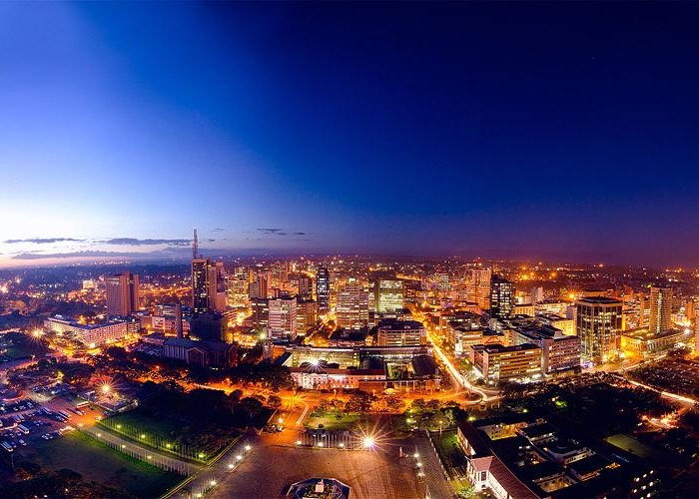
Image Credits: Wikimedia Commons. Maps ©2017 Clairmont Press.

