Slide 1
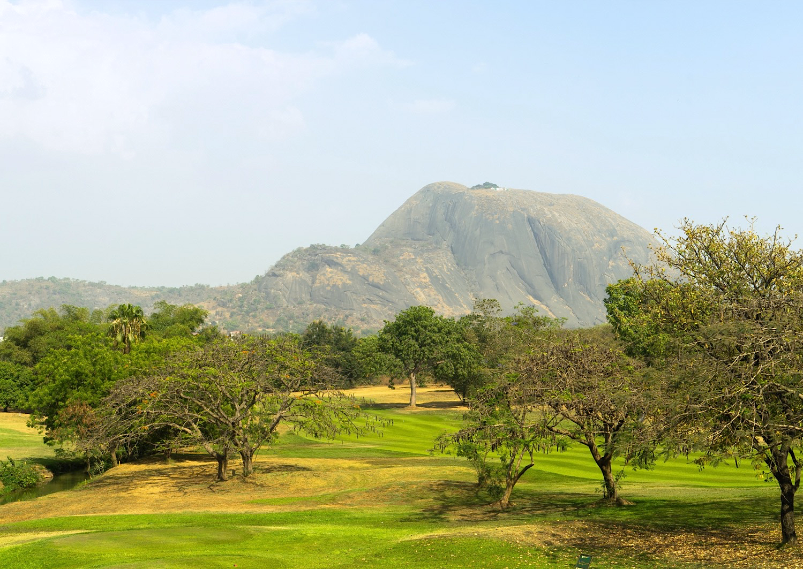
Chapter 11:
Federal Republic of Nigeria
STUDY PRESENTATION
© 2020 Clairmont Press

Slide 2
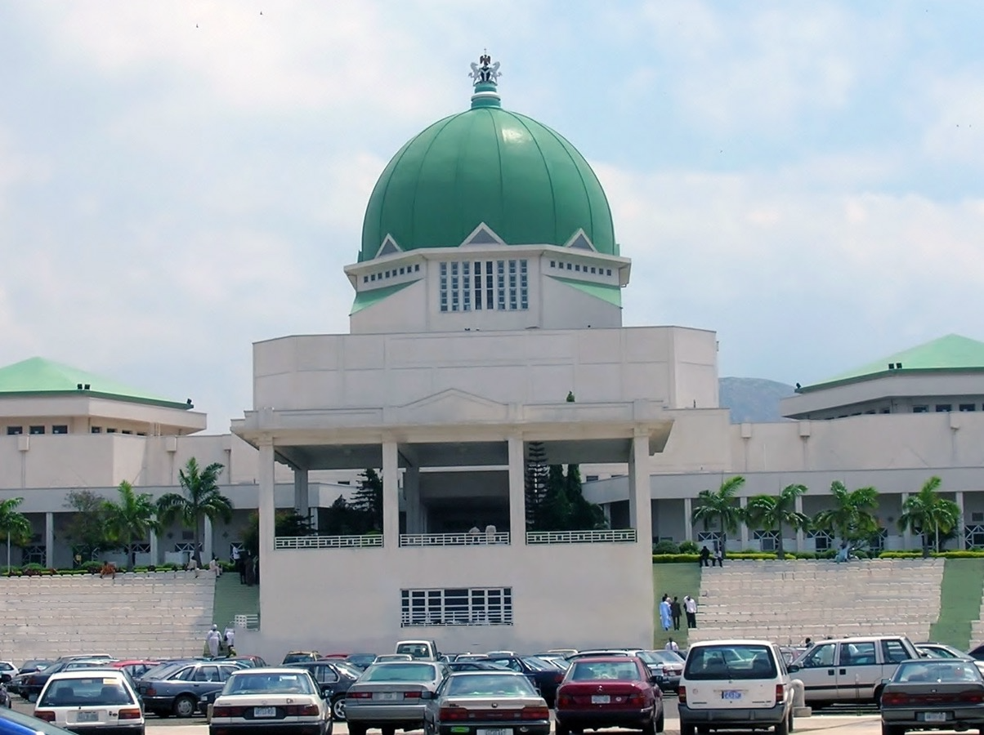
Section 1: The Geography of Nigeria
Section 2: A Brief History of Nigeria
Section 3: Government of Nigeria
Section 4: Economy of Nigeria
Section 5: U.S.-Nigeria Relations

Slide 3
Section 1: The Geography of Nigeria
Essential Question:
What is the role of religion in Nigeria?

Slide 4
Section 1: The Geography of Nigeria
What terms do I need to know?
delta
navigable
tropical savanna climate
harmattan
diverse
Boko Haram

Slide 5
Location and Size of Nigeria
Nigeria is in the eastern and northern hemispheres and is located on Africa’s west coast.
Nigeria is bordered by Niger, Benin, Cameroon, Chad, and the Gulf of Guinea.
Nigeria’s land area is about 356,000 miles, which is roughly six times the size of Georgia.

Slide 6
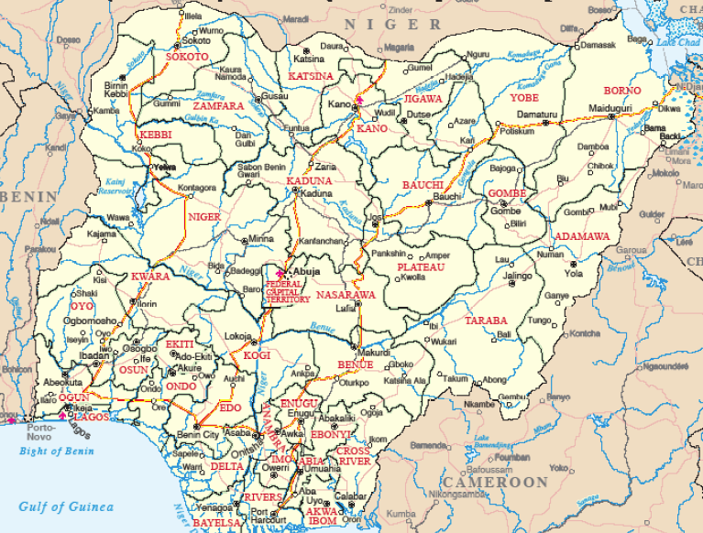
Location and Size of Nigeria

Slide 7
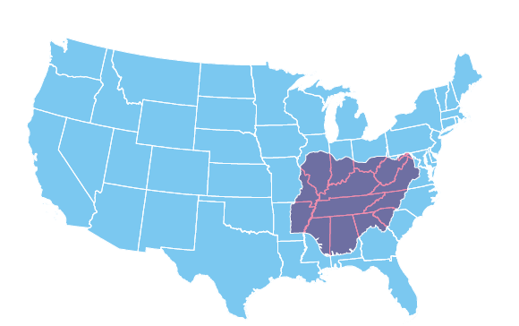
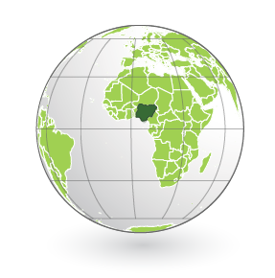
Location and Size of Nigeria

Slide 8
Physical Geography of Nigeria
The Niger River is the source of the country’s name and is the largest river in West Africa.
The river begins in Guinea and flows through Guinea, Mali, Niger, Benin, and Nigeria to the Gulf of Guinea.
The river flows through rain forests and swamps and has a delta, which is where a river divides into smaller bodies of water as it meets with a larger body of water.
Most of the river is navigable, or ships can operate on it, which is great for trade and shipping.
While the coastline is rich in oil, government corruption and other problems have prevented the country from enjoying these benefits.
The country has low plains in the south with some dense forests, highlands and extinct volcanoes in the central part of the country, and the north has rolling plains with plateaus.

Slide 9
Climate of Nigeria
Nigeria is just north of the Equator, meaning temperatures are high, with the most common climate being the tropical savanna climate.
That means monthly average temperatures are above 64° F year round.
A dry winter season is followed by a rainy season in May.
Along the coast is hot and wet most of the year, with tropical rain forests in this area.
The climate is hotter and drier in the north, with few plants being able to grow.
During the winter, a dry wind called the harmattan blows from the northeast, carrying dust from the Sahara across the region.

Slide 10
Natural Resources of Nigeria
Nigeria has large deposits of petroleum and natural gas along with other natural resources.
Unfortunately, the money from selling the oil has not benefitted many, due to mismanagement and corruption.
Nigeria has other natural resources that the government has not invested in because of its investment in the oil trade.
Even though Nigeria has a large amount of arable land, it still has to import much of its food to meet the needs of the people.
Nigeria also has talc, gypsum, iron ore, lead, zinc, gold, coal, gemstones, rock salt, and kaolin.

Slide 11
Where People Live in Nigeria
About half the people in the country still live in rural areas, practicing traditions.
The coast is heavily populated because it is easier to trade and is the center of the oil industry.
Areas along the Niger River and its delta are also heavily populated.
Cities like Lagos and Abuja are both large urban centers.

Slide 12
Environmental Issues in Nigeria
Deforestation is a problem, causing soil erosion as well as destroying habitats for plants and animals and disrupting the water cycle.
Urbanization brings with it pollution problems.
Nigeria deals with oil spills quite a bit, which can contaminate the water, air, and land.
The government needs to balance earning money from oil with protecting the environment.

Slide 13
People of Israel
Nigeria is a very diverse, or varied, country, with the Hausa, Igbo, and Yoruba ethnic groups making up a 5th of the population.
Nigeria is also divided by religion, with half being Muslim, 40% being Christian, and the remaining 10% practicing indigenous beliefs.
Religious tensions are a constant problem, with the militant Muslim group Boko Haram trying to take over parts of the country.
Generally, religion is taken very seriously, and most people will make frequent references to their faith.
Return to Main Menu

Slide 14
Section 2: A Brief History of Nigeria
Essential Question:
What was the immediate aftermath of independence in Nigeria?

Slide 15
Section 2: A Brief History of Nigeria
What terms do I need to know?
merchant
missionary
Pan-African Movement
Independent State of Biafra
civil war
civilian rule

Slide 16
Early History
Throughout its history, Nigeria has had many different ruling systems and has come in frequent contact with foreign traders.
The first group of traders that came to Nigeria were merchants, or people involved in trade, from North Africa and the Arabian Peninsula.
These traders brought gold, ivory, iron, slaves, and gum, as well as the Quran and Islam.
Two of the four trans-Saharan trade routes went through Nigeria, which made it a crossroads of people, goods, and ideas from around the continent.
European traders arrived in the 15th century, looking for gold and slave labor.
For over 300 years, the human slave trade was conducted along Africa’s shores, with the center of the trade in Nigeria.

Slide 17
British Colonial History
The British stayed in Nigeria even after they abolished slavery in 1807.
They were interested in Nigeria’s cocoa, groundnuts, rubber, and palm oil, so they made permanent settlements in Nigeria.
The British used the Niger River to move inland.
Along with their takeover, they brought missionaries to promote Christianity in the country.
British influence and control over Nigeria grew over the 19th century.

Slide 18
Pan-African Movement
This movement began as a reaction to colonial rule in Africa.
The goal of the Pan-African Movement was for all people of African decent to work together to improve Africa and to think of Africa as a homeland.
Another goal was to end European colonial rule, and as it spread through Nigeria and the rest of Africa, many Nigerians began pushing for independence.

Slide 19
Independence
After World War II, Nigeria was granted more and more freedoms through a series of constitutions, finally gaining independence in 1960.
However, war broke out between the Muslim north and Christian south, leaving thousands dead or injured.
When the country tried to reorganize itself into twelve regions, the Igbo people in the east declared themselves to be the Independent State of Biafra, resulting in a 30-month civil war (war between citizens of the same country).
By the end, Biafra was again part of Nigeria, but military coups and violence occurred in the years following.
In 1999, a new constitution was adopted, and a civilian government was established.
Nigeria is currently experiencing its longest period of civilian rule (which means that the leaders have not been part of the military), despite some minor violence around elections.

Slide 20
Wole Soyinka
Akinwande Oluwole “Wole” Soyinka is one of the best-known political activists and writers in Nigeria.
Born in Nigeria and attending the University of Leeds in England, he returned to Nigeria and produced his first play.
He was very outspoken for his support of democratic rule in Nigeria, with many of his works focusing on his dislike and distrust of the rulers in Africa.
After his arrest for speaking out against the civil war, he wrote poetry during his prison time.
Soyinka was awarded the Nobel Peace Prize in 1986 for his literature, and in 1996, he was named the Robert W. Woodruff Professor of Arts at Emory University in Atlanta, Georgia.
Today, he is still a political activist for democracy in Nigeria.
Return to Main Menu

Slide 21
Section 3: Government of Nigeria
Essential Question:
How do citizens participate in the government?

Slide 22
Section 3: Government of Nigeria
What terms do I need to know?
republic
federal government
presidential democracy
Federal Executive Council
National Assembly
Supreme Court

Slide 23
Type of Government
The country is a republic, which means it has elected representatives.
Nigeria also has a federal government, which means power within the government is divided among the national, state, and local governments.
The constitution, written in 1999, established a civilian government and has been amended several time.

Slide 24
Branches of Government
The head of government and cabinet make up the executive branch.
Nigeria has an elected president, making it a presidential democracy.
The president serves as both the head of government and state.
The cabinet, called the Federal Executive Council, is appointed by the president.
The legislative branch, called the National Assembly, is made up of two houses, the Senate and the House of Representatives, and makes the laws for the country.
The judicial branch has a Supreme Court, with a chief justice and 15 justices, who are appointed by the president and confirmed by the Senate.
Sharia Law is used in some states in northern Nigeria, but not the rest of the country.
Nigerian laws are based on British law traditions.

Slide 25
Challenges Facing the Government
Government corruption and terrorism are common problems in the country.
The country also has had a long period of military dictators as rulers, so they are getting used to elected leaders.
The government is working to strengthen its democracy and diversify its economy.
The Nigerian government forces have a lack of understanding on how to respond to peaceful protests, killing close to 500 people in 2015.
Return to Main Menu

Slide 26
Section 4: Economy of Nigeria
Essential question:
What factors are driving Nigeria’s economic growth?

Slide 27
Section 4: Economy of Nigeria
What terms do I need to know?
Nollywood
diversified economy
infrastructure
naira

Slide 28
Type of Economy
Nigeria has the largest economy in Africa, with a GDP of $1 trillion.
Nigeria’s economy is mixed, leaning toward a market economy.
Because of their oil reserves, Nigeria is a member of OPEC, and their reserves have been a dominant source of income since the 1970s.
Nigeria’s economic growth has recently been driven by agriculture, telecommunications, and services, but it has not been enough to decline poverty levels.
Nigeria’s entertainment industry includes a growing film industry that has been nicknamed Nollywood.
The most important challenge is developing a diversified economy, or one that is broadened to focus on other resources and industries instead of just one.
Nigeria is branching into telecommunications, financial services, and cement.
Nigeria is trying to improve its infrastructure, which includes roads, railways, and communication systems.
This would not only benefit Nigerians, but also businesses trading goods.

Slide 29
Nollywood
The Nigerian film industry is the second-largest movie producer in the world behind India’s Bollywood, producing an average of 1,000 films a year.
While the industry is valued at $3 billion, the actual movie industry sees very little of that money as most of it goes to video pirates.
Nollywood began in 1992, with minimal resources, self-taught directors, and a lot of ideas.
Today, Nollywood is growing at a fast pace, and it is the country’s largest employer after agriculture.

Slide 30
Trade in Nigeria
Trade is very important to Nigeria.
The country’s major exports are petroleum and petroleum products, cocoa, and rubber, while its imports were machinery, chemicals, transport equipment, manufactured goods, food, and live animals.
The currency of Nigeria is the naira, which one US dollar can be exchanged for about 315 naira.
In 2013, Georgia’s exports to Nigeria totaled about $248 million, and its imports totaled more than $25 million.

Slide 31
Natural Resources in Nigeria
Nigeria has a wide variety of natural resources.
It has roughly 23 billion barrels of petroleum and 160 trillion cubic meters of natural gas.
It also has talc, gypsum, iron ore, lead, zinc, gold, coal, rock salt, gemstones, and kaolin.
The government does not focus too much on these resources, though.

Slide 32
Human Capital in Nigeria
Nigeria should have a strong economy thanks to its rich oil deposits, but years of corruption, civil war, and military rule have left it poor.
Investment in human capital is a way to make the economy grow.
The literacy rate is currently about 60%, with 70% for men and 50% for women.
This is because 30% of children have to help their families work and cannot attend school.

Slide 33
Capital Goods in Nigeria
Nigeria has heavily invested in capital goods for the oil industry.
However, focus on this part of the economy has left many Nigerians without proper food or housing.
Nigeria does not have a large manufacturing sector, with most of their non-oil related capital goods having to be imported.

Slide 34
Entrepreneurship in Nigeria
Currently, it is not easy to be an entrepreneur in Nigeria.
Nigeria’s government is working to help small businesses thrive.
It costs about four times the average annual income to get a business license.
Return to Main Menu

Slide 35
Section 5: U.S.-Nigeria Relations
Essential question:
What are some reasons the relationship between the two countries was strained?

Slide 36
Section 5: U.S.-Nigeria Relations
What terms do I need to know?
diplomatic relations
military coup
transparency
African Growth and Opportunity Act (AGOA)

Slide 37
US-Nigeria Relations
The US established diplomatic relations, or an arrangement where two nations have representatives in each other’s country, with Nigeria in 1960, following its independence from the United Kingdom.
From 1966-1999, Nigeria experienced many civil wars and military coups (an overthrow of the government by military forces).
Following the adoption of the new constitution in 1999, relations improved, along with cooperation on foreign policy goals like peacekeeping.
The two countries hold talks on key areas: good governance, transparency (obligation to share information with citizens), and integrity, energy and investment, regional security, and agriculture and food security.

Slide 38
US Assistance to Nigeria
The US wants to help improve economic stability, security, and sell-being for Nigerians by strengthening their democracy.
Nigeria is combatting corruption in their government, and improving transparency will help citizens trust the government again.
The US also wants to help with health, education, and agricultural production.

Slide 39
Bilateral Economic Relations
The US is Nigeria’s largest foreign investor in Nigeria, with most investments concentrated on petroleum, mining, and the trade sector.
Nigeria is eligible for preferential trade benefits under the African Growth and Opportunity Act (AGOA), which increases the market access to the US for qualifying countries in sub-Saharan Africa.
The US and Nigeria have signed a bilateral trade and investment framework agreement.

Slide 40
Nigeria’s Membership in International Organizations
Nigeria and the US belong to many of the same organizations, including the United Nations, International Monetary Fund, World Bank, and World Trade Organization.
Nigeria is also an observer to the Organization of American States.
Nigeria is a member of the Organization of Petroleum Exporting Countries (OPEC), who’s goal is to control the price of oil in the world by controlling the supply.
Return to Main Menu

Slide 41
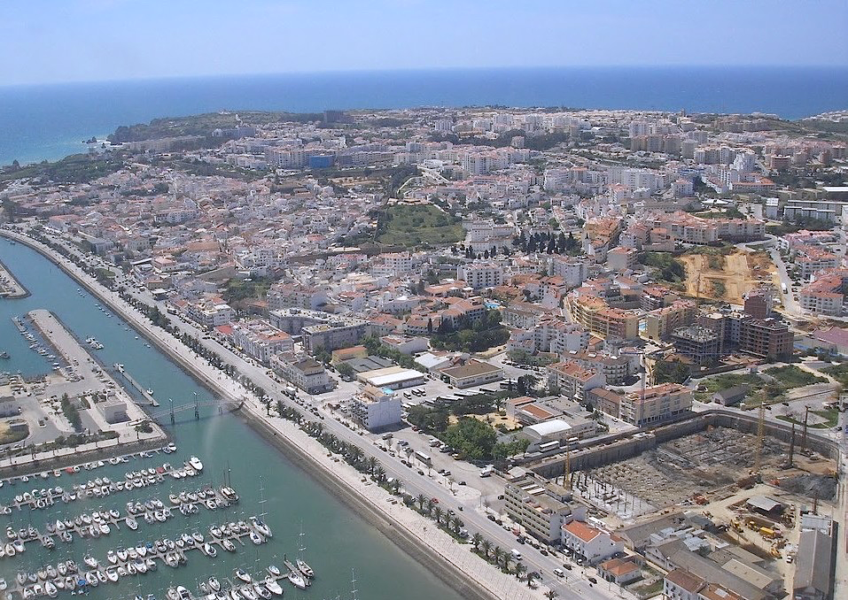
Image Credits: Wikimedia Commons. Maps ©2017 Clairmont Press.

