Slide 1
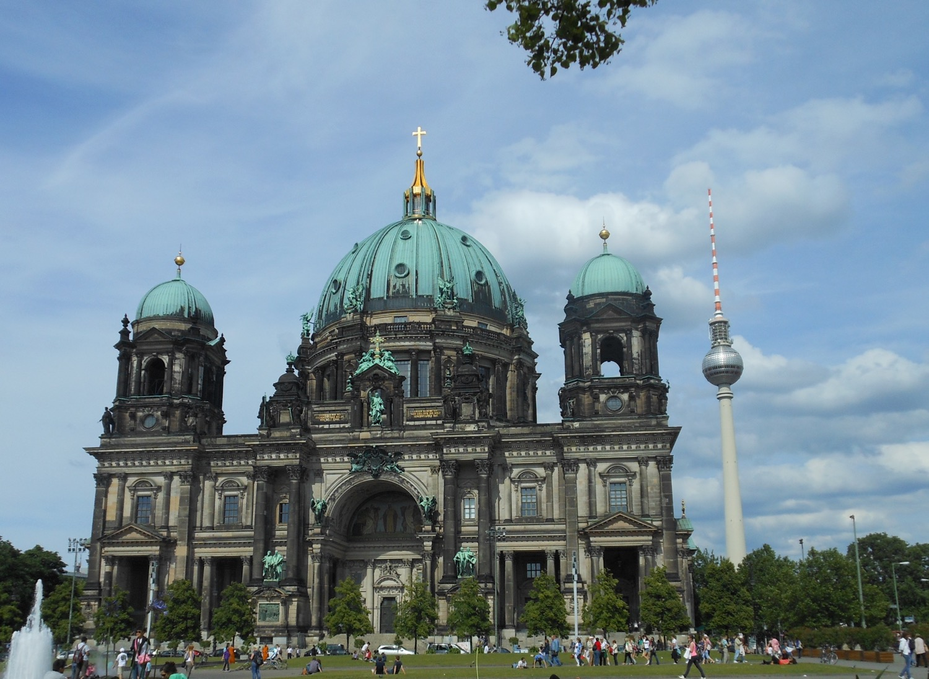
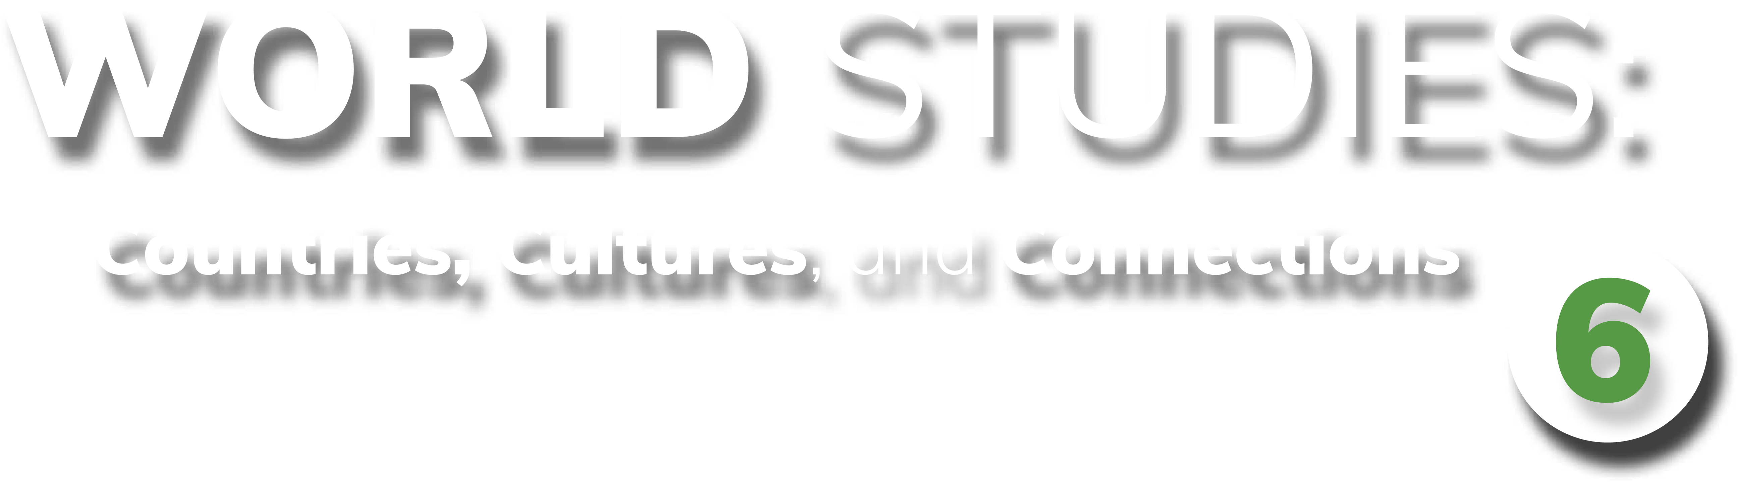
Chapter 6: Federal Republic of Germany
STUDY PRESENTATION
© 2025 Clairmont Press

Slide 2
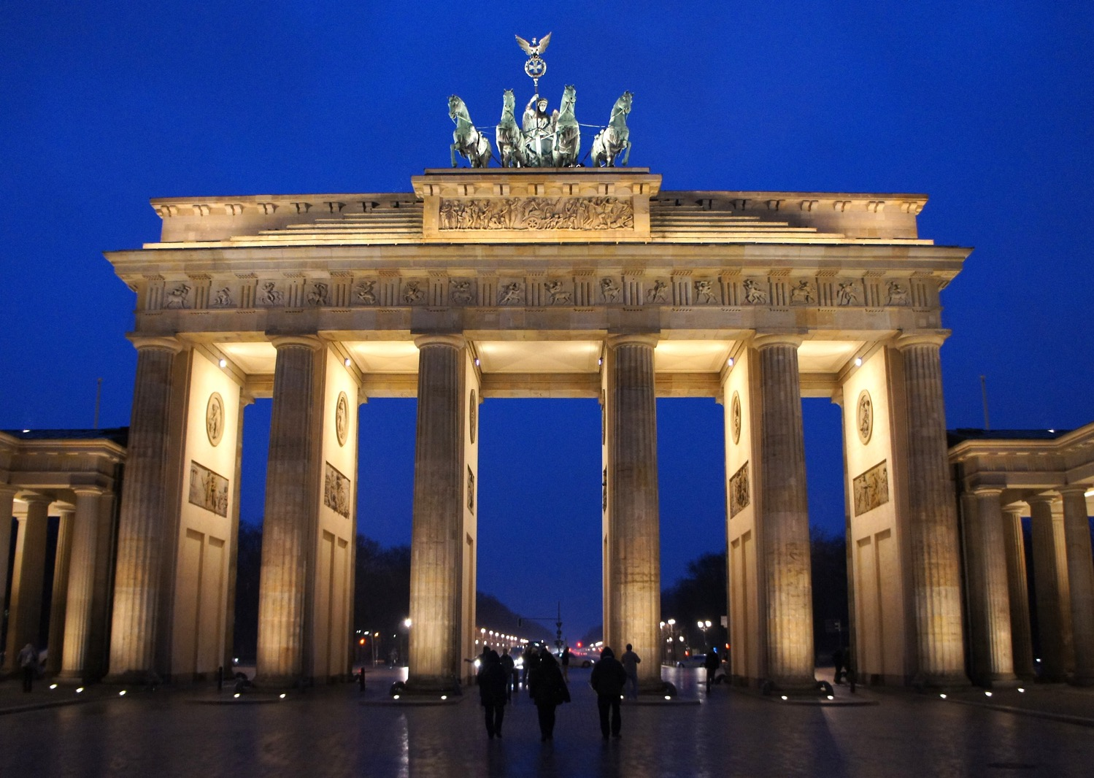
Section 1: The Geography of Germany
Section 2: A Brief History of Germany
Section 3: Government of Germany
Section 4: Economy of Germany
Section 5: US-German Relations

Slide 3
SECTION 1: THE GEOGRAPHY OF GERMANY
Essential Question:
How does Germany’s location and climate affect where Germans live?

Slide 4
SECTION 1: THE GEOGRAPHY OF GERMANY
What terms do I need to know?:
autobahn
acid rain

Slide 5
LOCATION AND SIZE OF GERMANY
Germany is located in the northern and central regions of Western Europe.
Germany shares a border with more countries than any other European country.
Germany’s location on the North and Baltic Seas allows it to have numerous ports, giving easy access to other countries and the Atlantic Ocean.
Germany is the 63rd-largest nation in the world based on its land area.

Slide 6
CLIMATE OF GERMANY
Most of Germany has a marine climate, as waters of the Gulf Stream bring warmth and moisture from the Gulf of Mexico across the Atlantic Ocean.
The warm waters keep the land warm in winter and cool in summer.
The climate of the Bavarian Alps changes based on altitude, with some areas of the mountains covered in snow all winter.
Eastern Germany is farther from the sea and therefore has longer, colder winters and hotter, drier summers.

Slide 7
DISTRIBUTION OF PEOPLE IN GERMANY
Germany is the most populated country in Europe with almost 84 million people.
Around 78% of Germans live in urban areas.
The most populated areas are in the northern and western parts of the country, along the Rhine River near Cologne and Frankfurt.
This area has the most manufacturing jobs and a large transportation system.
The former East German and Alps regions are the least populated areas.

Slide 8
NATURAL RESOURCES OF GERMANY
Germany’s natural resources include iron ore, coal, potash, uranium, nickel, natural gas, and copper.
Timber is an important renewable resource in Germany.
About 1/3 of Germany’s land is arable (able to be used for agriculture).
Germany’s natural resources have shaped the country’s development.
Coal helped build large industrial centers, which became large cities, mostly along the Rhine River.

Slide 9
PHYSICAL FEATURES OF GERMANY
Rivers and waterways are the lifelines of Europe, and Germany relies on the Rhine River for trade, travel, and transportation of goods.
The Rhine begins high in the Alps of Switzerland and flows through Germany to the North Sea.
The Main-Danube Canal connects Germany’s Rhine and Main Rivers to Europe’s second-longest river, the Danube.
Germany’s location in the center of Europe makes it an important crossroad for travel and trade, and the country’s excellent highway system (the autobahn) allows Germany to take full advantage of its location.

Slide 10
PHYSICAL FEATURES OF GERMANY, Pt. 2
The flat European Plain allows countries from Eastern and Western Europe to transport goods to and across Germany.
The European Plain has been used by travelers for centuries.
While the Alps to the south make transportation more difficult, Germany has constructed highways, bridges, and tunnels to navigate them.
Germany has 8 major ports along its coast, which handle many of the country’s imports and exports.
Construction on a tunnel under the Baltic Sea to Denmark began in 2020, which should provide quicker access to Denmark, Norway, and Sweden.

Slide 11
ENVIRONMENTAL ISSUES OF GERMANY
In recent decades, acid rain (rain with increased acidity caused by air pollution) has damaged Germany’s forests, rivers, and historic sites.
Acid rain damages buildings and statues, and it also pollutes rivers, killing the wildlife.
Acid rain comes from smoke from factories and power plants, but Germany depends on manufacturing industries.
Germany has begun to make changes to decrease the acid rain problem, like switching to wind-powered and solar- powered technologies.
Germany had several nuclear power plants to produce its energy, but it now produces over 50% of its electricity through renewable energy sources.
Return to Main Menu

Slide 12
SECTION 2: A BRIEF HISTORY OF GERMANY
Essential Question:
How did Germany’s economic conditions after World War I contribute to Hitler’s rise to power?

Slide 13
SECTION 2: A BRIEF HISTORY OF GERMANY
What terms do I need to know?:
alliances
Treaty of Versailles
reparations
Nazi Party
Holocaust
Cold War
Berlin Wall
North Atlantic Treaty Organization (NATO)
Warsaw Pact

Slide 14
EUROPEAN RIVALRIES
European countries, especially Spain, France and Great Britain, were constant rivals for power and wealth into the 1800s.
France was the most powerful country on the European continent and wanted to prevent the unification of the several German-speaking kingdoms into a single country which could compete for France’s power.
France went to war in 1870 against Prussia and the German-speaking territories and lost, resulting in the unification of Germany under Emperor (Kaiser) Wilhelm I.
Many countries began to establish colonies to help increase their power and wealth using raw materials from less-developed areas of the world, like Africa and parts of Asia.

Slide 15
WORLD WAR I
The constant competition among European countries led them to create alliances (agreements to protect each other in case of attack).
The June 1914 assassination of Austria-Hungary’s Archduke Franz Ferdinand by Serbians ignited the conflict.
Austria invaded Serbia (ally of Russia) with Germany’s support. Germany declared war on Russia and France and sent troops through Belgium to France, causing Great Britain to declare war on Germany in defense of Belgium.
More countries joined, including the US in 1917. Germany and the Central Powers surrendered in 1918.

Slide 16
WORLD WAR I, Pt. 2
After WWI, Germany had lost lands and people, and much of the country was destroyed.
Along with rebuilding, the Treaty of Versailles required Germany to pay reparations to the Allies, leaving Germany with almost nothing to rebuild with.
The German people blamed the government, and the Great Depression further worsened desperate conditions.

Slide 17
THE RISE OF THE NAZI PARTY
Adolf Hitler and the Nazi Party claimed they could fix the problems in Germany, blaming the Treaty of Versailles and the Jews for controlling the banks and money.
After Hitler became Germany’s leader in 1933, he quickly gained total control of the government as a dictator.
Hitler rebuilt Germany’s military strength, opened factories, created jobs, and improved the German economy, but the German people lost many civil rights.
The Nazis made plans to go to war, beginning to send troops into former German territories in 1936.
France and Great Britain declared war on Germany in 1939 when Germany invaded Poland, beginning World War II.
Hitler’s plan included systematically killing every Jew under German rule, now known as the Holocaust.

Slide 18
WORLD WAR II
World War II was the bloodiest conflict in human history, resulting in more than 60 million deaths.
Germany surrendered in 1945 after 6 years of war.
Germany had undergone intense bombing during the war, leaving much of the country destroyed, and more than than 7 million German citizens had died during the war.
The British, French, American, and Soviet allies divided Germany and Berlin into 4 zones, each under the control of an Allied country.
The Allies goal was to rebuild Germany so that the events that followed World War I would not repeat themselves.

Slide 19
THE COLD WAR
The Cold War was a period of distrust between the Soviet Union and its former allies, especially the US.
After WWII, Soviet dictator Joseph Stalin created a “bloc” of Eastern European countries that were under Soviet control, creating the “Iron Curtain”.
In 1948, the Western Allies wanted to reunite Germany, but Stalin refused, declaring the Soviet section of the country East Germany, even dividing Berlin (which was in East Germany) into East and West.
Communist leaders build the Berlin Wall in 1961 to separate the communist part of the city from the free section.
To prevent the Cold War from turning nuclear, Western Europe and the US formed the North Atlantic Treaty Organization (NATO) in 1949, which the Eastern European countries counteracted by creating the Warsaw Pact.

Slide 20
REUNIFICATION OF GERMANY
The Soviet Union’s economy was unstable by 1985 after putting down revolts and keeping up with the arms race.
Soviet leader Mikhail Gorbachev reduced government control of businesses and increased personal freedoms, which led to improved relations with the US.
With increasing demands of freedom, the Berlin Wall was torn down in 1989, and East and West Germany reunified in 1990, officially ending the Cold War.
By the end of 1991, the Soviet Union split into 12 independent republics, with Russia as the largest.
Return to Main Menu

Slide 21
SECTION 3: GOVERNMENT OF GERMANY
Essential Question:
What are the rights of citizens in Germany’s welfare state?

Slide 22
SECTION 3: GOVERNMENT OF GERMANY
What terms do I need to know?:
Länder
Bundestag
Bundesrat
president
chancellor
welfare state

Slide 23
STRUCTURE OF GOVERNMENT
Germany has a federal government system where the states (Länder) share power with the national government.
Germany has a parliamentary system divided into two houses:
The more powerful lower house, the Bundestag, contains 600 members elected by citizens. The Bundestag chooses the chancellor.
The upper house, the Bundesrat, has 69 members appointed by the states.
The president is the head of state and has limited powers. The chancellor is the head of government, takes care of the day-to-day business of government, and is head of the military.

Slide 24
CITIZEN PARTICIPATION
German citizens have freedom of religion and expression, are equal before the law, and are free to vote from the age of 18.
Germany’s citizens have the same basic freedoms as citizens of the United States or the United Kingdom.
Germany’s constitution (the Basic Law) makes Germany a welfare state (the government guarantees certain benefits to those who are unemployed, poor, disabled, elderly, or sick).
German citizens also elect representatives to the European Parliament, the representative body of the European Union.
Return to Main Menu

Slide 25
SECTION 4: ECONOMY OF GERMANY
Essential Question:
What evidence is there of strong trading partnerships between Germany and other countries?

Slide 26
SECTION 4: ECONOMY OF GERMANY
What terms do I need to know?:
deficit
surplus
euro

Slide 27
ECONOMIC SYSTEM TODAY
Germany has a strong market economy that has remained strong even when other countries have experienced recessions.
Germany is ranked in the top 20 freest economies in the world.
Germany’s economy is 3rd-largest in the world in terms of GDP and is the largest economy in Europe.
Stimulus efforts in 2008 and 2009 increased Germany’s total budget deficit (shortfall), but slower spending and high tax revenues let Germany reach a budget surplus (extra) in 2012.
Recent years have varied between surplus and deficit.

Slide 28
TRADE
Germany is a global power in the manufacturing of steel, iron, coal, machinery, tools, electronics, and automobiles.
German exports add up to more than $2 trillion annually.
Because Germany produces so many manufactured goods, they must import oil, gas, small machinery, food, and agricultural items that the people of Germany need.
Germany’s imports from the Netherlands, China, Poland, Belgium, and Italy alone add up to more than $1.9 trillion.

Slide 29
STANDARD OF LIVING
Germany has a high standard of living, and most adults in Germany work outside of the home.
More than 95% of Germans work in manufacturing and service industries.
These jobs require secondary education or continuing education after high school to stay informed of new technologies.
Germans tend to save more and borrow less than Americans.
An average German saves about 10% of income and has little or no debt.

Slide 30
CURRENCY
Since the end of World War I, Germany has experienced many changes and difficulties in its economy and currency.
By the time of the reunification of Germany, the German mark was a very strong, stable, and safe currency.
Germany continued to use the mark until the introduction of the euro in 1999, the currency of the European Union.
Currently, 19 countries use the euro as their currency.
Return to Main Menu

Slide 31
SECTION 5: US-GERMAN RELATIONS
Essential Question:
What evidence exists that the United States and Germany have developed strong trade relations?

Slide 32
SECTION 5: US-GERMAN RELATIONS
What terms do I need to know?:
Transatlantic Economic Council (TEC)

Slide 33
WORKING TOGETHER FOR SECURITY
Since the end of WWII, Germany has helped the US in their common goal of preserving peace in Europe.
US policy toward Germany is to maintain a close relationship as friends, trading partners, and allies.
As NATO allies, the US and Germany work together to maintain peace and freedom.
Germany was a major part of the UN forces in Afghanistan in the 2000s and has remained a strong ally in fighting global terrorism since the September 11, 2001 attacks.

Slide 34
BILATERAL ECONOMIC RELATIONS
The US and Germany share a commitment to an open and expanding world economy.
In 2007, Germany pushed for the creation of the Transatlantic Economic Council (TEC), increasing cooperation between the US and the European Union to promote economic growth.
The United States is one of Germany’s leading export markets.
The combined goods traded between the two countries show Germany as the United States’ 5th-largest trading partner.

Slide 35
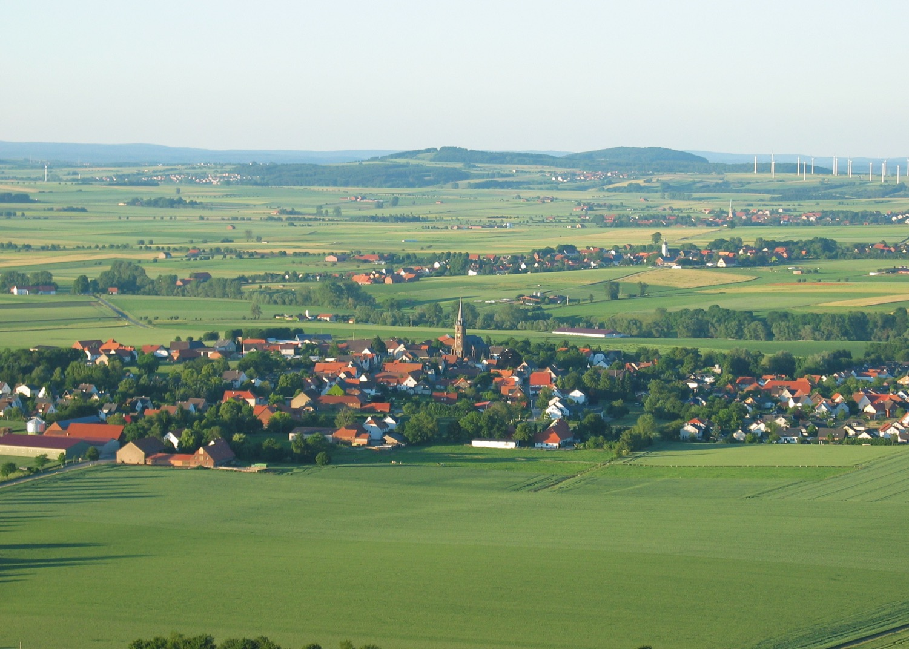
Image Credits: all Wikimedia Commons. Maps ©2025 Clairmont Press.
Return to Main Menu

