Slide 1

Chapter 2: Government and Civics
STUDY PRESENTATION
© 2025 Clairmont Press

Slide 2
Section 4: Two Types of Democracies

Slide 3
SECTION 4: TWO TYPES OF DEMOCRACIES
Essential Question:
What are the two types of democracy?

Slide 4
SECTION 4: TWO TYPES OF DEMOCRACIES
What terms do I need to know?:
parliamentary democracy
head of state
constitutional monarchy
presidential democracy

Slide 5
FORMS OF DEMOCRACY
A democratic government is one in which citizens vote on laws and make decisions in the government.
There are two major forms of democratic governments: parliamentary and presidential.
Each form of government is designed to represent and protect the people of its country.

Slide 6
PARLIAMENTARY DEMOCRACY
In a parliamentary democracy, the citizens vote for representatives from a few political parties to form a parliament.
Parliament’s purpose is to make and carry out the laws of the country.
The party with the majority of members after voting gets to choose the head of government, who holds power for the term allowed.
There is typically also a head of state, which is typically a leader who has very little power.
Australia’s constitutional monarchy has a sovereign as head of state, whose powers are limited by the constitution.

Slide 7
PARLIAMENTARY DEMOCRACY
In a presidential democracy, citizens elect the president as head of government separately from the legislature.
The legislative and executive branches are separate and can stop the other branches’ powers if needed.
The legislature cannot dismiss the president, and the president cannot dismiss the legislature.

Slide 8
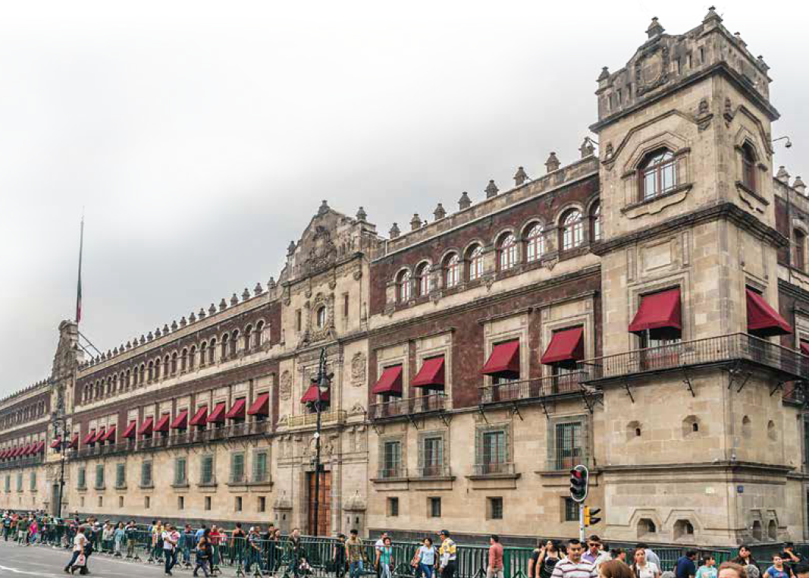
Image Credits: all Wikimedia Commons. Maps ©2025 Clairmont Press.
Return to Main Menu

