Slide 1
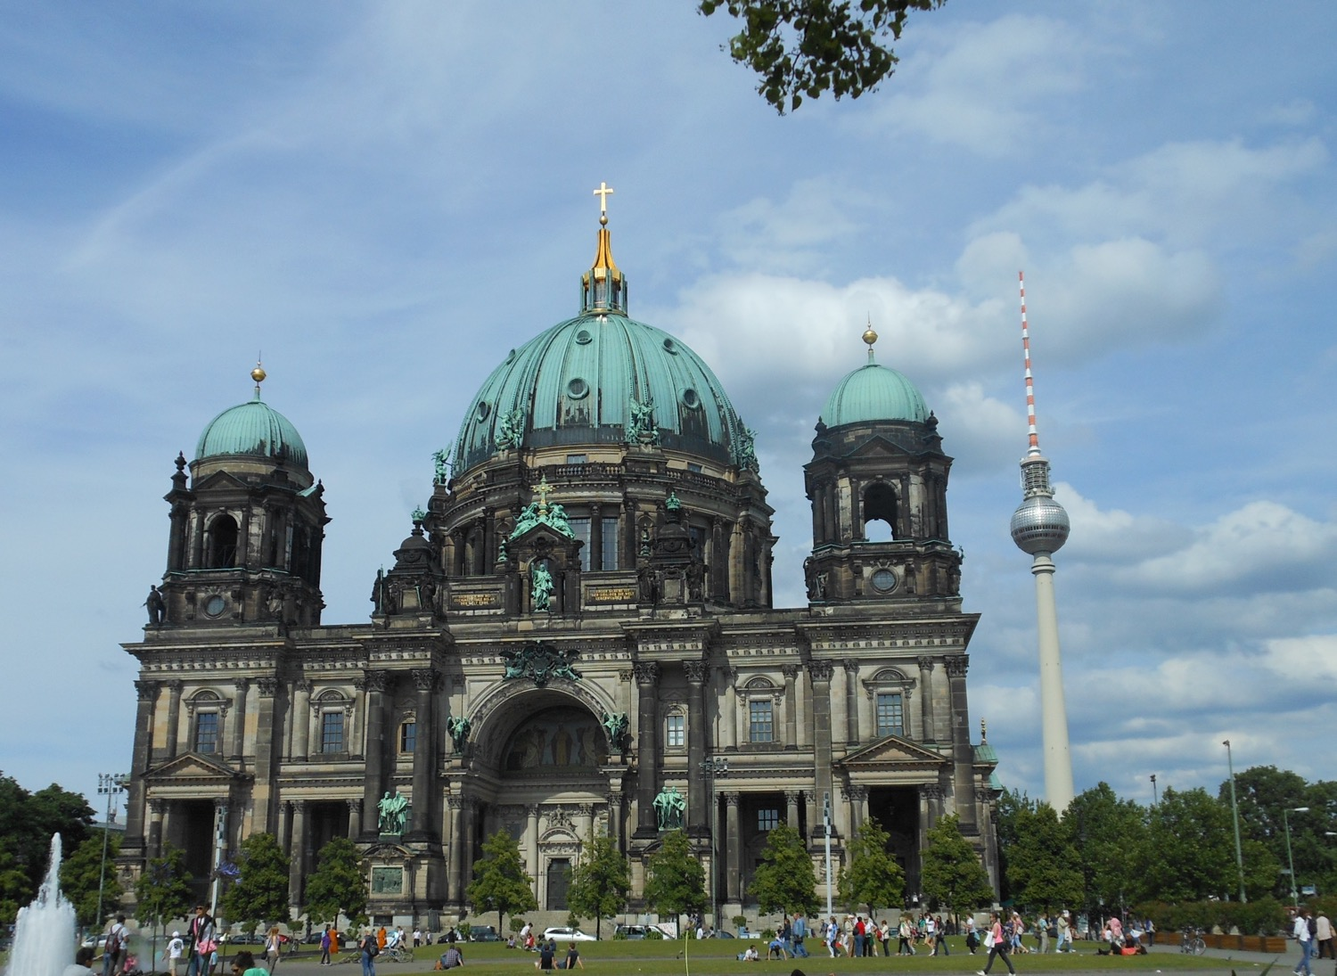
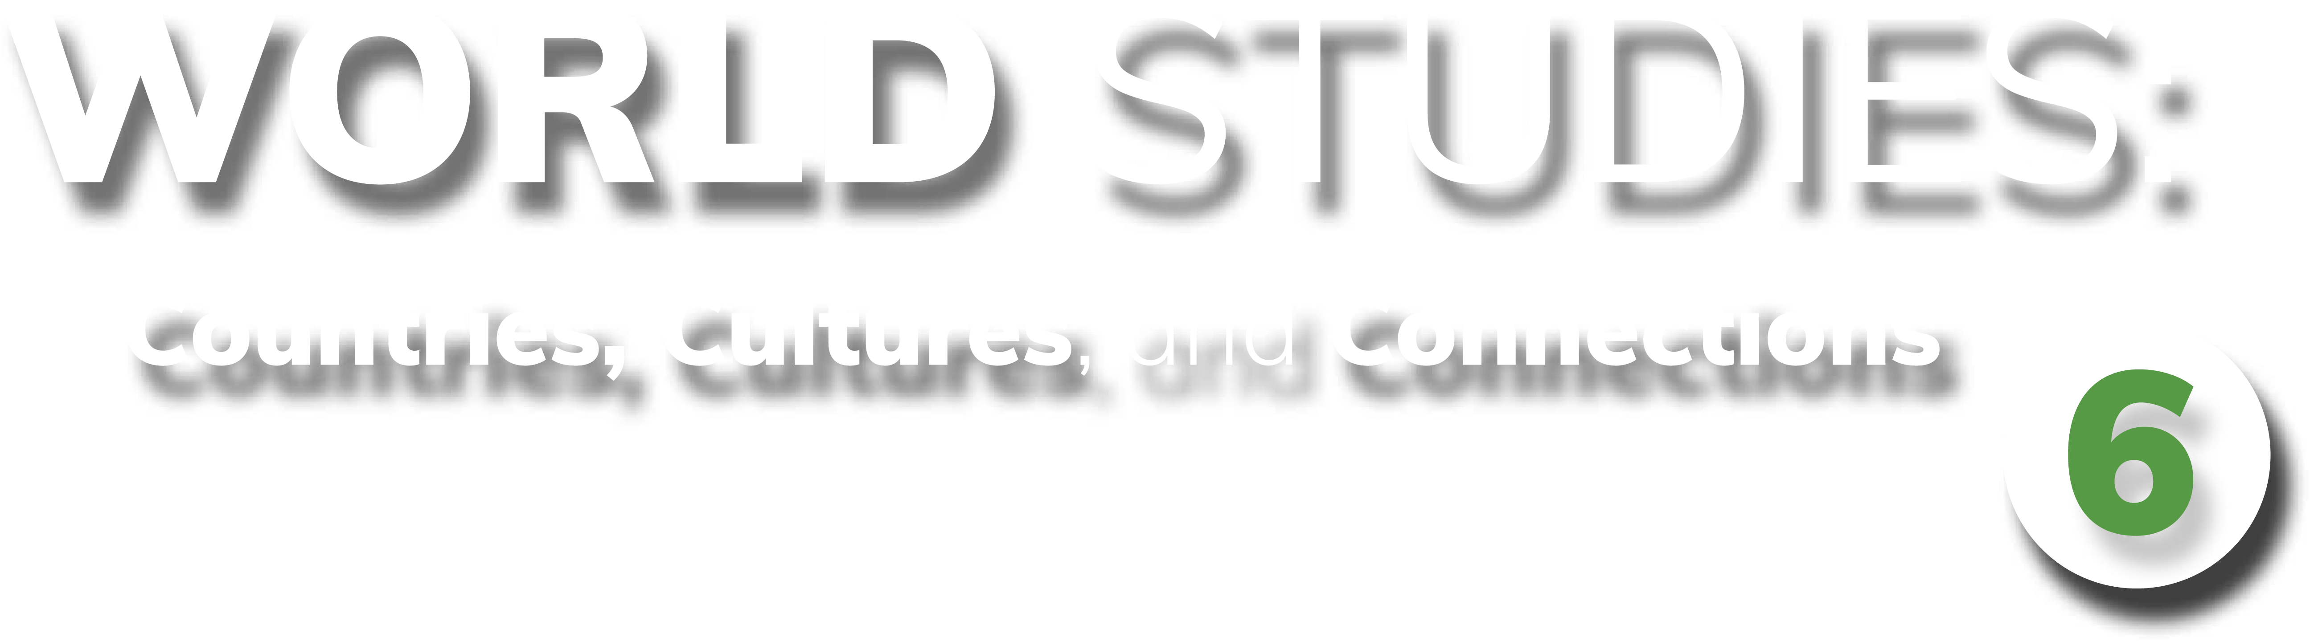
Chapter 6: Federal Republic of Germany
STUDY PRESENTATION
© 2025 Clairmont Press

Slide 2
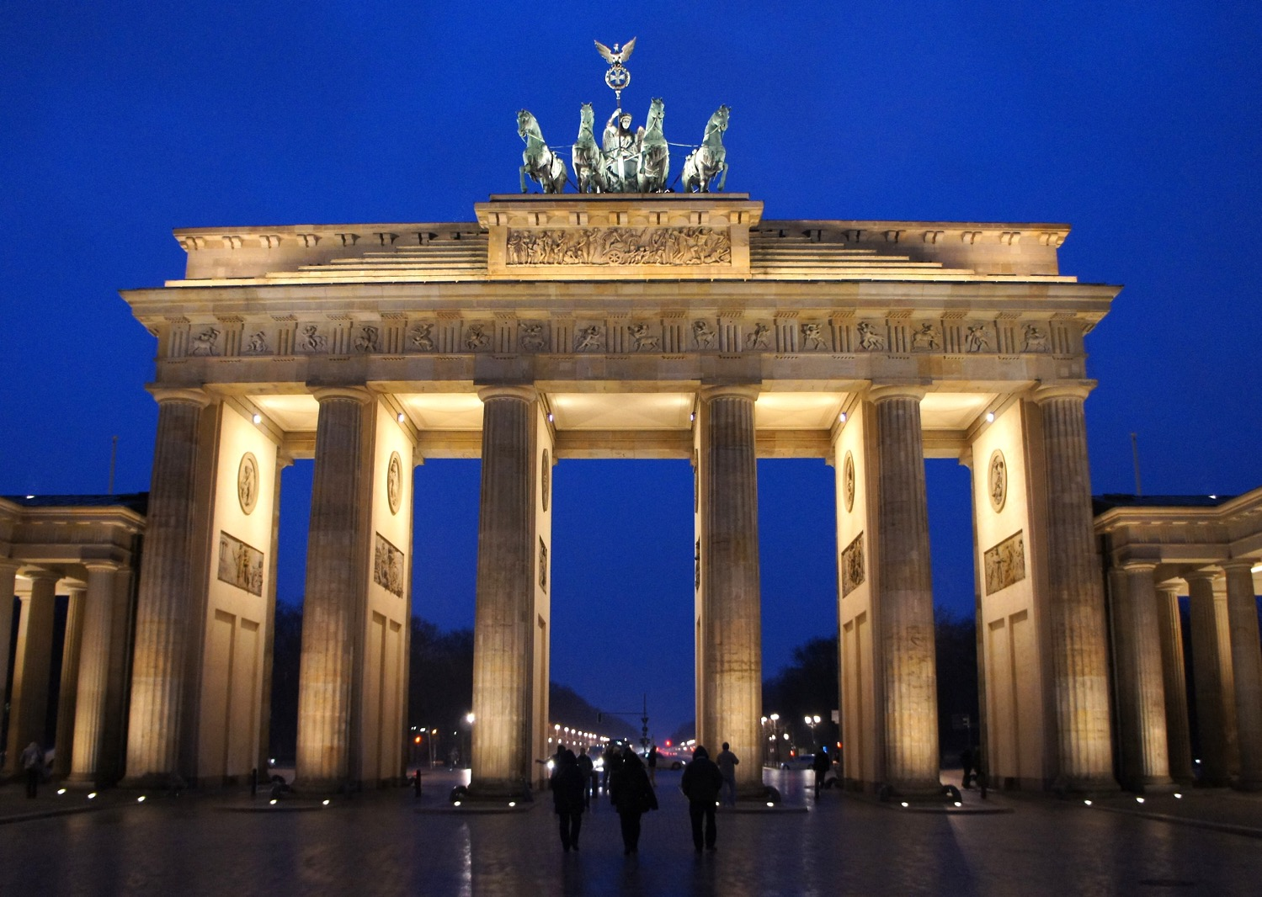
Section 1: The Geography of Germany

Slide 3
SECTION 1: THE GEOGRAPHY
OF GERMANY
  Essential Question:
    How does Germany’s location and climate affect where Germans live?

Slide 4
SECTION 1: THE GEOGRAPHY
OF GERMANY
  What terms do I need to know?:
  autobahn
  acid rain

Slide 5
LOCATION AND SIZE OF GERMANY
Germany is located in the northern and central regions of Western Europe.
Germany shares a border with more countries than any other European country.
Germany’s location on the North and Baltic Seas allows it to have numerous ports, giving easy access to other countries and the Atlantic Ocean.
Germany is the 63rd-largest nation in the world based on its land area.

Slide 6
CLIMATE OF GERMANY
Most of Germany has a marine climate, as waters of the Gulf Stream bring warmth and moisture from the Gulf of Mexico across the Atlantic Ocean.
    The warm waters keep the land warm in winter and cool in summer.
The climate of the Bavarian Alps changes based on altitude, with some areas of the mountains covered in snow all winter.
Eastern Germany is farther from the sea and therefore has longer, colder winters and hotter, drier summers.

Slide 7
DISTRIBUTION OF PEOPLE
IN GERMANY
Germany is the most populated country in Europe with almost 84 million people.
Around 78% of Germans live in urban areas.
The most populated areas are in the northern and western parts of the country, along the Rhine River near Cologne and Frankfurt.
    This area has the most manufacturing jobs and a large transportation system.
The former East German and Alps regions are the least populated areas.

Slide 8
NATURAL RESOURCES OF GERMANY
Germany’s natural resources include iron ore, coal, potash, uranium, nickel, natural gas, and copper.
Timber is an important renewable resource in Germany.
About 1/3 of Germany’s land is arable (able to be used for agriculture).
Germany’s natural resources have shaped the country’s development.
    Coal helped build large industrial centers, which became large cities, mostly along the Rhine River.

Slide 9
PHYSICAL FEATURES OF GERMANY
Rivers and waterways are the lifelines of Europe, and Germany relies on the Rhine River for trade, travel, and transportation of goods.
    The Rhine begins high in the Alps of Switzerland and flows through Germany to the North Sea.
The Main-Danube Canal connects Germany’s Rhine and Main Rivers to Europe’s second-longest river, the Danube.
Germany’s location in the center of Europe makes it an important crossroad for travel and trade, and the country’s excellent highway system (the autobahn) allows Germany to take full advantage of its location.

Slide 10
PHYSICAL FEATURES OF
GERMANY, Pt. 2
The flat European Plain allows countries from Eastern and Western Europe to transport goods to and across Germany.
    The European Plain has been used by travelers for centuries.
While the Alps to the south make transportation more difficult, Germany has constructed highways, bridges, and tunnels to navigate them.
Germany has 8 major ports along its coast, which handle many of the country’s imports and exports.
    Construction on a tunnel under the Baltic Sea to Denmark began in 2020, which should provide quicker access to Denmark, Norway, and Sweden.

Slide 11
ENVIRONMENTAL ISSUES
OF GERMANY
In recent decades, acid rain (rain with increased acidity caused by air pollution) has damaged Germany’s forests, rivers, and historic sites.
Acid rain damages buildings and statues, and it also pollutes rivers, killing the wildlife.
Acid rain comes from smoke from factories and power plants, but Germany depends on manufacturing industries.
Germany has begun to make changes to decrease the acid rain problem, like switching to wind-powered and solar- powered technologies.
Germany had several nuclear power plants to produce its energy, but it now produces over 50% of its electricity through renewable energy sources.

Slide 12
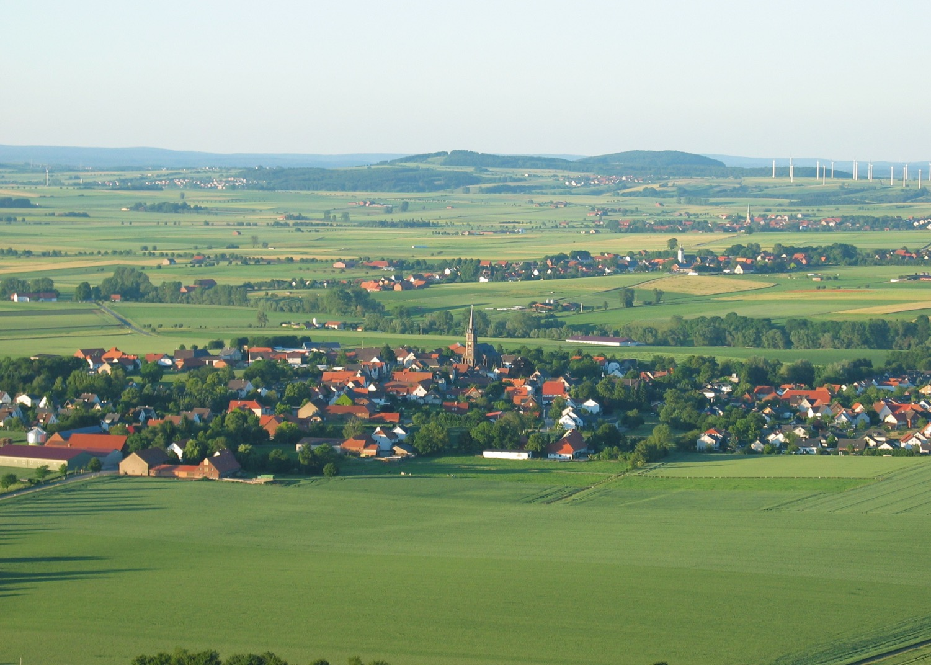
Image Credits: all Wikimedia Commons. Maps ©2025 Clairmont Press.
Return to Main Menu

