Slide 1
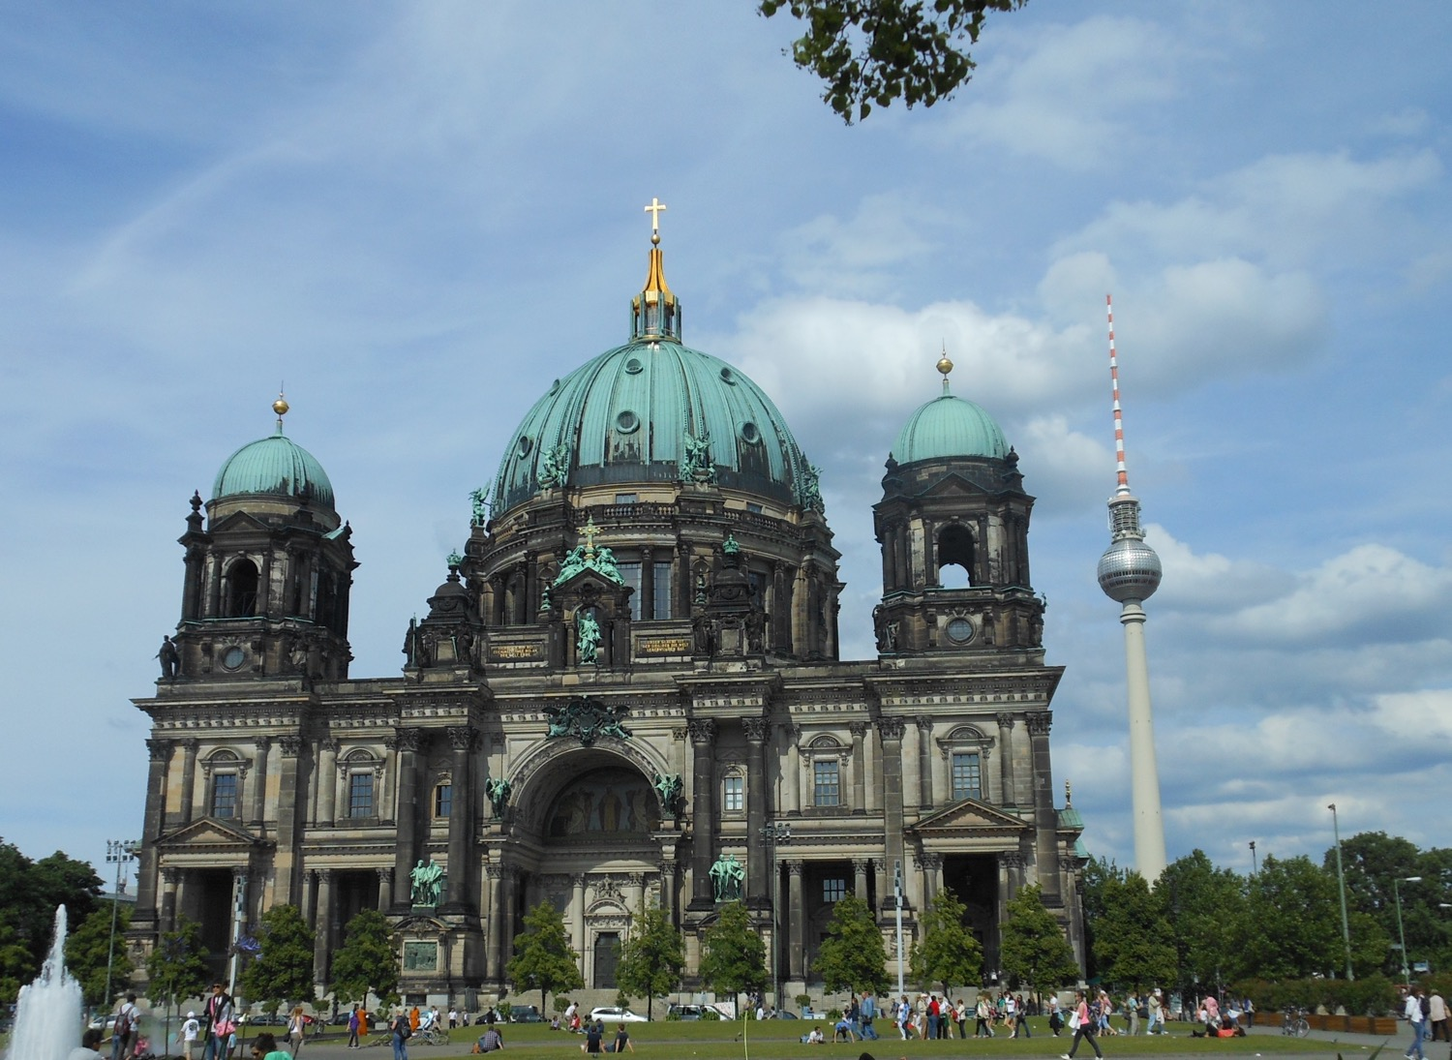

Chapter 6: Federal Republic of Germany
STUDY PRESENTATION
© 2025 Clairmont Press

Slide 2
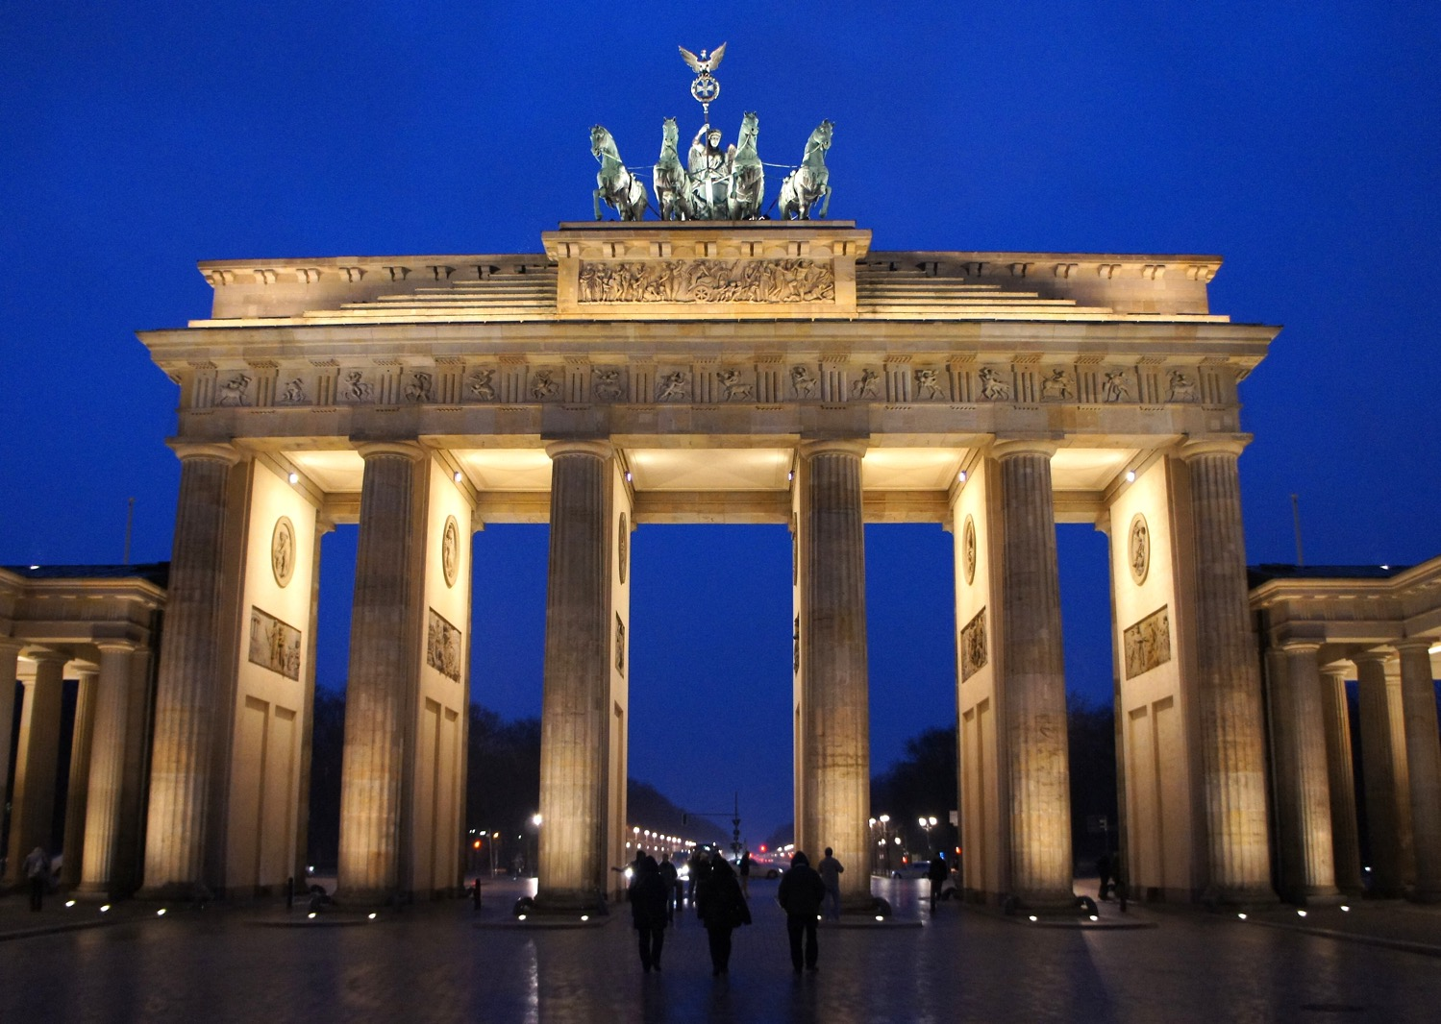
Section 2: A Brief History of Germany

Slide 3
SECTION 2: A BRIEF HISTORY OF GERMANY
Essential Question:
How did Germany’s economic conditions after World War I contribute to Hitler’s rise to power?

Slide 4
SECTION 2: A BRIEF HISTORY OF GERMANY
What terms do I need to know?:
alliances
Treaty of Versailles
reparations
Nazi Party
Holocaust
Cold War
Berlin Wall
North Atlantic Treaty Organization (NATO)
Warsaw Pact

Slide 5
EUROPEAN RIVALRIES
European countries, especially Spain, France and Great Britain, were constant rivals for power and wealth into the 1800s.
France was the most powerful country on the European continent and wanted to prevent the unification of the several German-speaking kingdoms into a single country which could compete for France’s power.
France went to war in 1870 against Prussia and the German-speaking territories and lost, resulting in the unification of Germany under Emperor (Kaiser) Wilhelm I.
Many countries began to establish colonies to help increase their power and wealth using raw materials from less-developed areas of the world, like Africa and parts of Asia.

Slide 6
WORLD WAR I
The constant competition among European countries led them to create alliances (agreements to protect each other in case of attack).
The June 1914 assassination of Austria-Hungary’s Archduke Franz Ferdinand by Serbians ignited the conflict.
Austria invaded Serbia (ally of Russia) with Germany’s support. Germany declared war on Russia and France and sent troops through Belgium to France, causing Great Britain to declare war on Germany in defense of Belgium.
More countries joined, including the US in 1917. Germany and the Central Powers surrendered in 1918.

Slide 7
WORLD WAR I, Pt. 2
After WWI, Germany had lost lands and people, and much of the country was destroyed.
Along with rebuilding, the Treaty of Versailles required Germany to pay reparations to the Allies, leaving Germany with almost nothing to rebuild with.
The German people blamed the government, and the Great Depression further worsened desperate conditions.

Slide 8
THE RISE OF THE NAZI PARTY
Adolf Hitler and the Nazi Party claimed they could fix the problems in Germany, blaming the Treaty of Versailles and the Jews for controlling the banks and money.
After Hitler became Germany’s leader in 1933, he quickly gained total control of the government as a dictator.
Hitler rebuilt Germany’s military strength, opened factories, created jobs, and improved the German economy, but the German people lost many civil rights.
The Nazis made plans to go to war, beginning to send troops into former German territories in 1936.
France and Great Britain declared war on Germany in 1939 when Germany invaded Poland, beginning World War II.
Hitler’s plan included systematically killing every Jew under German rule, now known as the Holocaust.

Slide 9
WORLD WAR II
World War II was the bloodiest conflict in human history, resulting in more than 60 million deaths.
Germany surrendered in 1945 after 6 years of war.
Germany had undergone intense bombing during the war, leaving much of the country destroyed, and more than than 7 million German citizens had died during the war.
The British, French, American, and Soviet allies divided Germany and Berlin into 4 zones, each under the control of an Allied country.
The Allies goal was to rebuild Germany so that the events that followed World War I would not repeat themselves.

Slide 10
THE COLD WAR
The Cold War was a period of distrust between the Soviet Union and its former allies, especially the US.
After WWII, Soviet dictator Joseph Stalin created a “bloc” of Eastern European countries that were under Soviet control, creating the “Iron Curtain”.
In 1948, the Western Allies wanted to reunite Germany, but Stalin refused, declaring the Soviet section of the country East Germany, even dividing Berlin (which was in East Germany) into East and West.
Communist leaders build the Berlin Wall in 1961 to separate the communist part of the city from the free section.
To prevent the Cold War from turning nuclear, Western Europe and the US formed the North Atlantic Treaty Organization (NATO) in 1949, which the Eastern European countries counteracted by creating the Warsaw Pact.

Slide 11
REUNIFICATION OF GERMANY
The Soviet Union’s economy was unstable by 1985 after putting down revolts and keeping up with the arms race.
Soviet leader Mikhail Gorbachev reduced government control of businesses and increased personal freedoms, which led to improved relations with the US.
With increasing demands of freedom, the Berlin Wall was torn down in 1989, and East and West Germany reunified in 1990, officially ending the Cold War.
By the end of 1991, the Soviet Union split into 12 independent republics, with Russia as the largest.

Slide 12
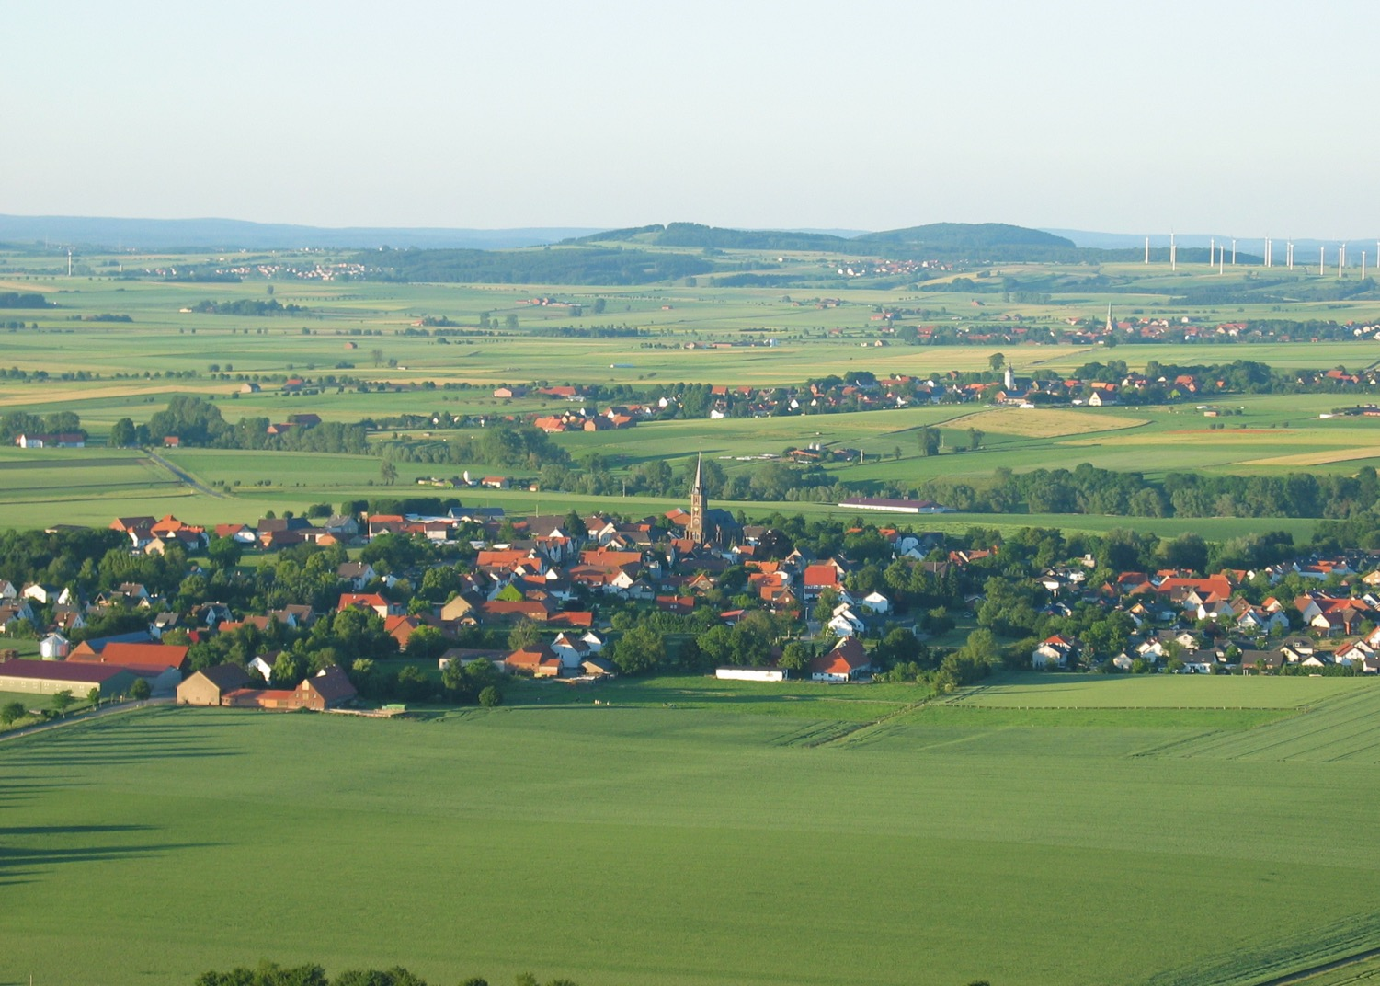
Image Credits: all Wikimedia Commons. Maps ©2025 Clairmont Press.
Return to Main Menu

