Slide 1
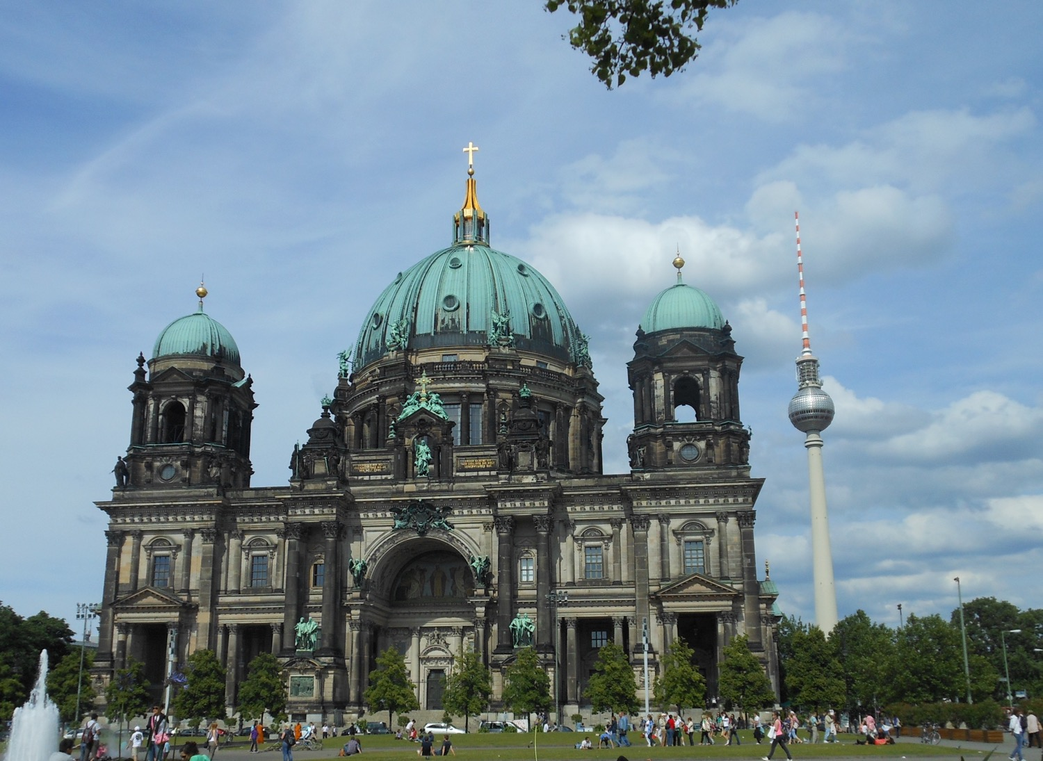

Chapter 6: Federal Republic of Germany
STUDY PRESENTATION
© 2025 Clairmont Press

Slide 2
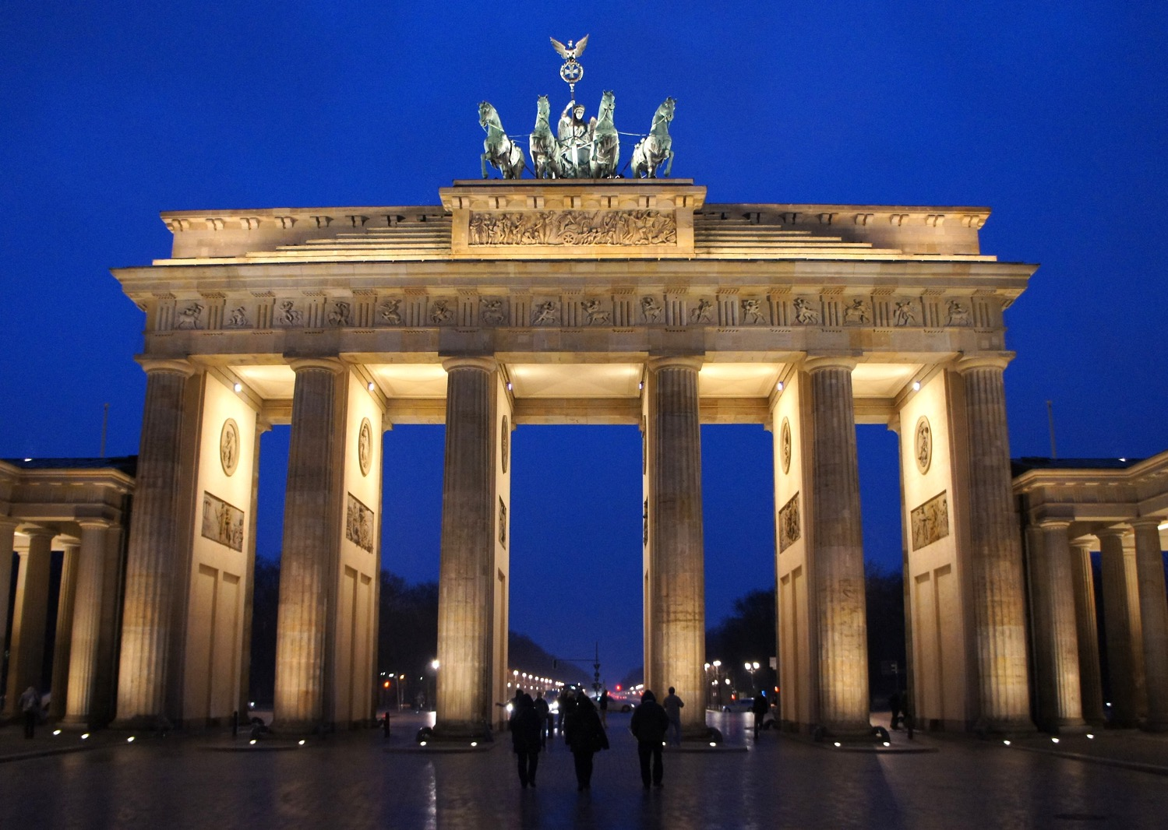
Section 3: Government of Germany

Slide 3
SECTION 3: GOVERNMENT OF GERMANY
Essential Question:
What are the rights of citizens in Germany’s welfare state?

Slide 4
SECTION 3: GOVERNMENT OF GERMANY
What terms do I need to know?:
Länder
Bundestag
Bundesrat
president
chancellor
welfare state

Slide 5
STRUCTURE OF GOVERNMENT
Germany has a federal government system where the states (Länder) share power with the national government.
Germany has a parliamentary system divided into two houses:
The more powerful lower house, the Bundestag, contains 600 members elected by citizens. The Bundestag chooses the chancellor.
The upper house, the Bundesrat, has 69 members appointed by the states.
The president is the head of state and has limited powers. The chancellor is the head of government, takes care of the day-to-day business of government, and is head of the military.

Slide 6
CITIZEN PARTICIPATION
German citizens have freedom of religion and expression, are equal before the law, and are free to vote from the age of 18.
Germany’s citizens have the same basic freedoms as citizens of the United States or the United Kingdom.
Germany’s constitution (the Basic Law) makes Germany a welfare state (the government guarantees certain benefits to those who are unemployed, poor, disabled, elderly, or sick).
German citizens also elect representatives to the European Parliament, the representative body of the European Union.

Slide 7
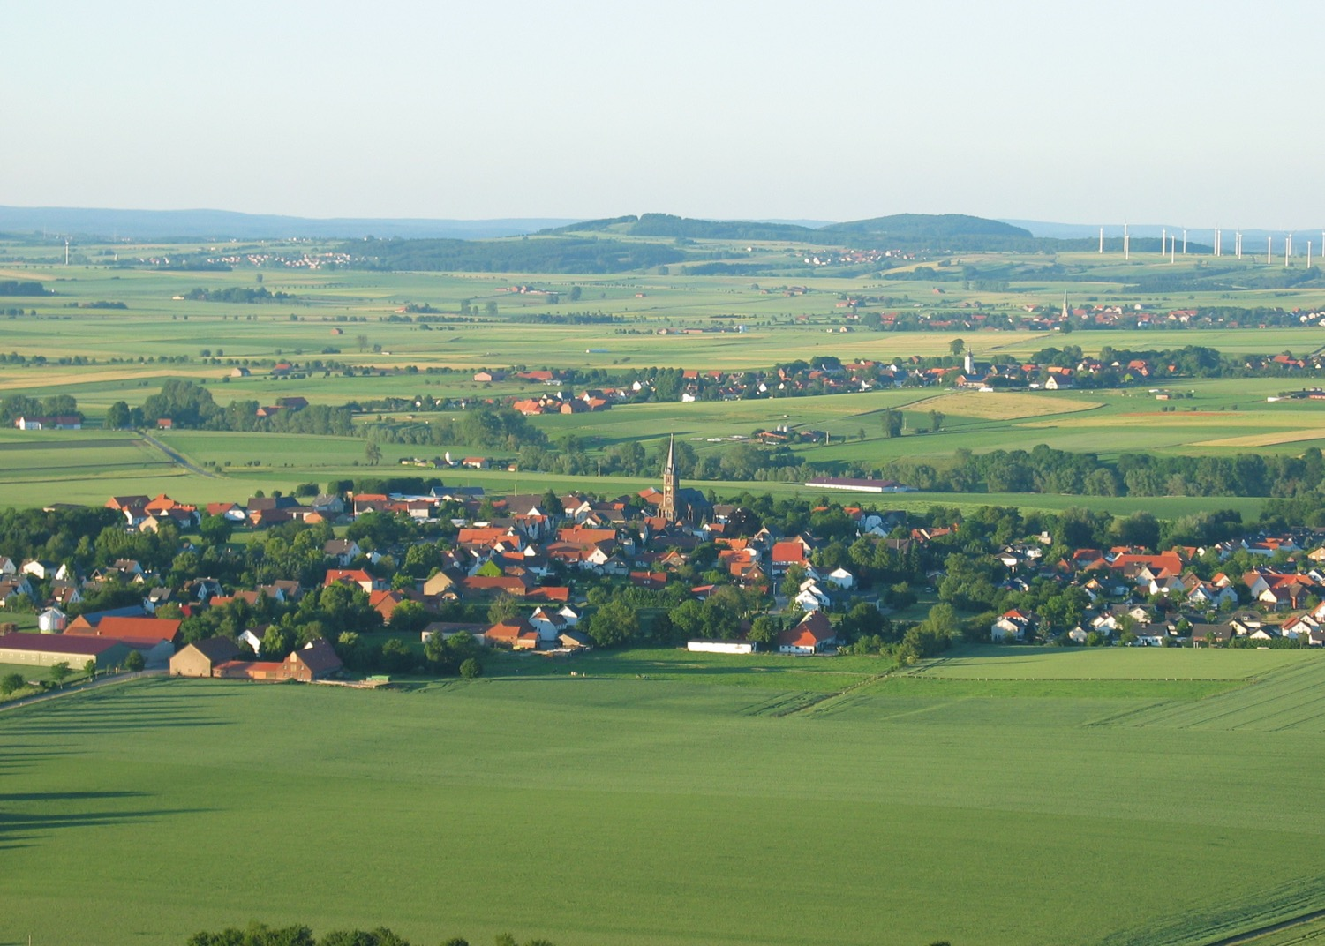
Image Credits: all Wikimedia Commons. Maps ©2025 Clairmont Press.
Return to Main Menu

